Slide 1
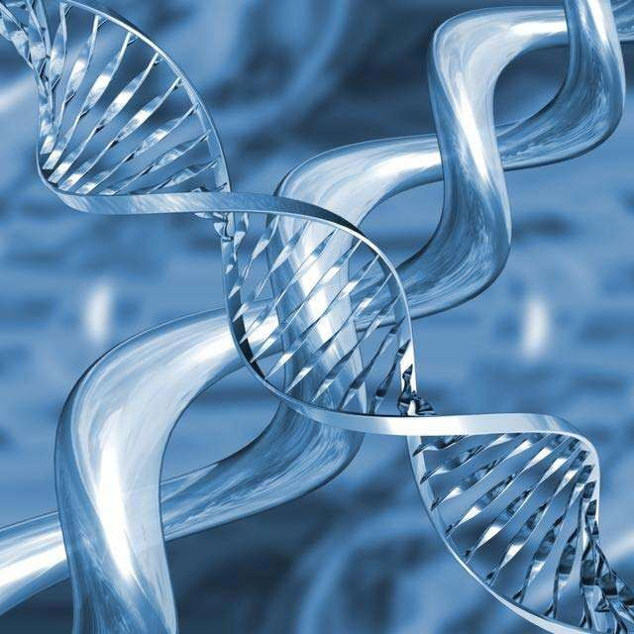



GENE EXPRESSION & REGULATION

Slide 2
INTRODUCTION
DNA, the chemical vehicle heredity, is composed of
functional units, namely genes.
The term genome refers to the total genetic information contained in a cell.
The bacteria E.coli contains about 4,400 genes present on a single chromosome.
The genome of humans is more complex, with 23 pairs of (diploid) chromosome containing 6 billion (6 X 10⁹ ) base pairs of DNA, with an estimated 30,000 – 40,000 genes.

Slide 3
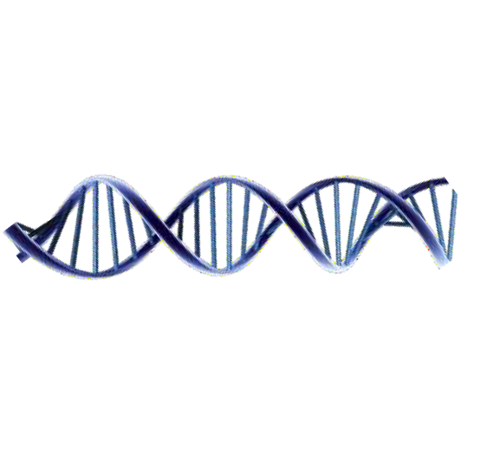

Expression of gene means
synthesis of the product
encoded by the gene
A large number of genes are present in DNA
Most of them encode proteins; some encode tRNA and rRNA.
Proteins encoded by different genes are not required all the time
A gene should be expressed only when the protein encoded by it is required.
This is possible only if gene expression is regulated

Slide 4
GENE EXPRESSION & REGULATION
Organisms adapt to environmental changes by altering gene expression.
The regulation of gene expression of genes is necessary for the:
growth
development
differentiation &
very existence of the organism.

Slide 5

Gene expression can be regulated at the level of:
Transcription
Post-transcriptional Modification
RNA degradation
Translation
Post Translational modifications

Slide 6
Types of Gene Expression:
Mainly 2 types of gene expression & regulation:-
Positive regulation &
Negative regulation.

Slide 7
a. Positive regulation:-
When the expression of genetic information is quantitatively increased by the presence of specific regulatory element, it is called as positive regulation.
The element or molecule mediating positive regulation is called positive regulator.

Slide 8
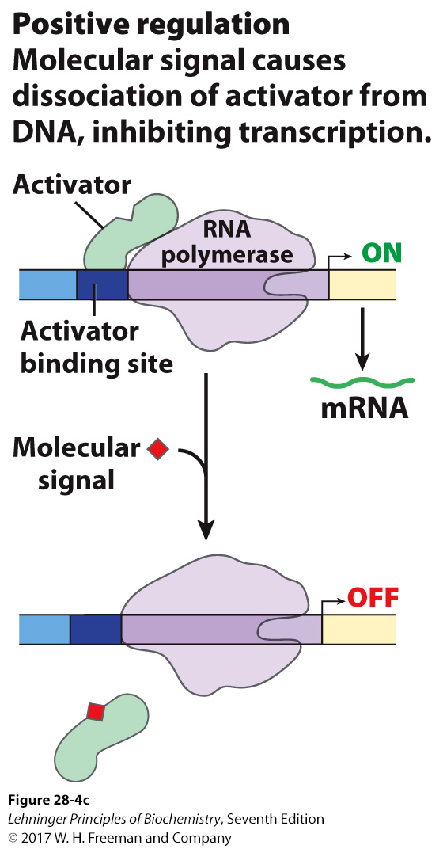
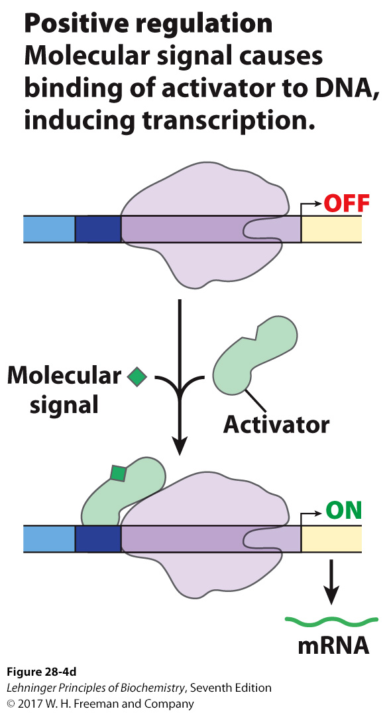
Positive Regulation
Positive regulation involves activators.
Enhance activity of RNA polymerase
Activator-binding sites are near promoters that weakly bind RNA Pol or do not bind at all.
It may remain bound until a molecule signals dissociation.
Alternatively, the activator may only bind when signaled.

Slide 9
b. Negative regulation:-
When the expression of genetic information is quantitatively decreased by the presence of specific regulatory element, it is called as negative regulation.

Slide 10
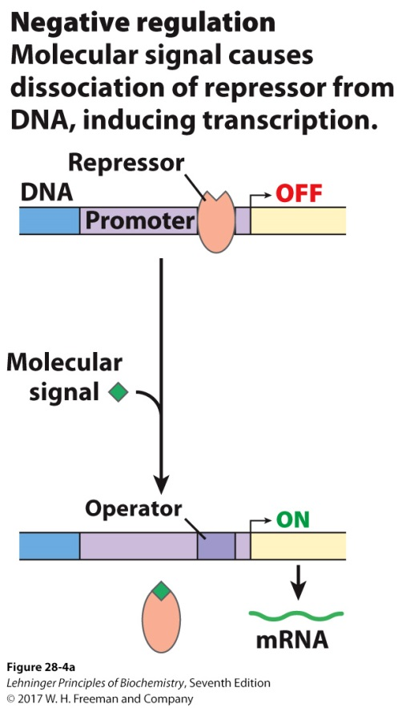
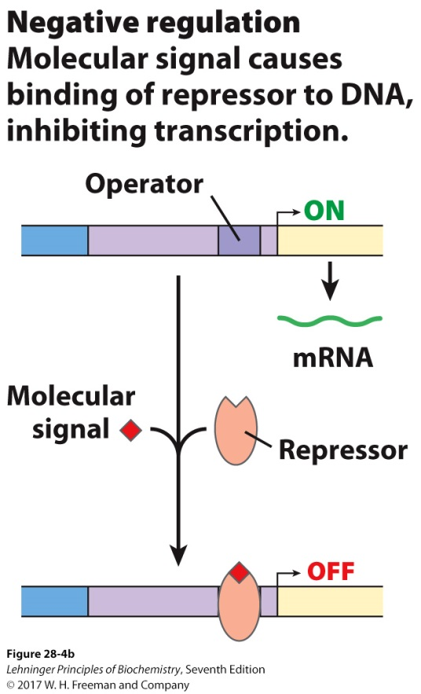
Negative Regulation
Negative regulation involves repressors.
Example: Repressor binds to DNA and shuts down transcription
Alternative: Signal causes repressor to dissociate from DNA; transcription induced
Despite opposite effects on transcription, both are negative regulation

Slide 11
Type of genes: based on the functions
Two types-
Inducible genes &
Constitutive genes.

Slide 12
1. Inducible genes:-
The expression of the inducible gene increased in response to an inducer.
Inducers are small molecules.
Some proteins produced by E.coli, e.g. β- galactosidase are said to be inducible because they are only produced in significant amounts when a specific inducer “Lactose” is present.
Tryptophan pyrrolase of liver is induced by tryptophan
Dihydrofolate reductase enzyme in cancer patients with methotrexate.

Slide 13
2. Constitutive genes:
The constitutive genes are expressed at more or less constant rate in almost all the cells and they are not subjected to regulation.
Also known as “House keeping Genes”
The products of these genes are required all the time in cells.
E.g. Enzymes of citric acid cycle.
Enzymes of glycolysis

Slide 14
Gene Expression in Prokaryotes
The process of alteration of gene expression has been studied in details in prokaryotes.
It generally involves the interaction of specific binding proteins with various regions of DNA in the immediate vicinity of the transcription site and this produces either a positive or negative effect on transcription

Slide 15
The z, y and a genes are structural (protein encoding) genes
These genes are present in a cluster
These are preceded by:
An operator (o) site A promoter (p) site A regulatory (i) gene

Slide 16
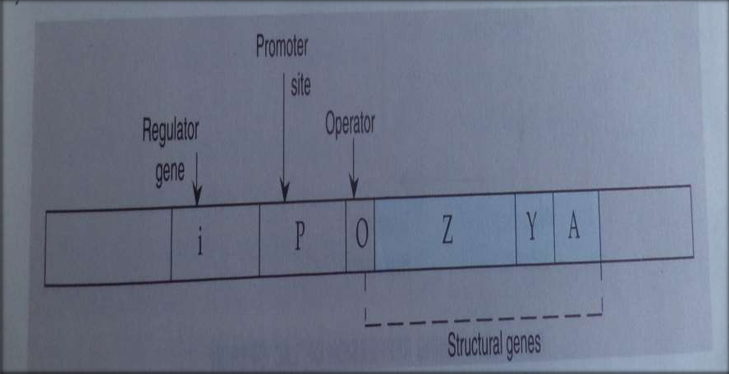
Control
sites
Regulatory gene
Structural genes
i | p | o | z | y | a
This cluster is called the lac operon

Slide 17
Gene Expression in Eukaryotes
In eukaryotes, studies are not extensive and not well understood.
Gene expression in the eukaryotes, cannot be the same as that in the prokaryotes because of
Genome of the eukaryotes is much larger than that of the prokaryotes.
Human genome consists of 23 pairs of diploid chromosomes containing 10⁹ base pairs of DNA with an estimated one lac genes approximately.
There is a great deal of redundancy in the DNA of eukaryotes.

Slide 18
:The regulatory strategies in eukaryotes include
Gene amplification
Gene re-arrangement Regulation of transcription Alternative splicing
RNA editing
Post Translational Modifications

Slide 19
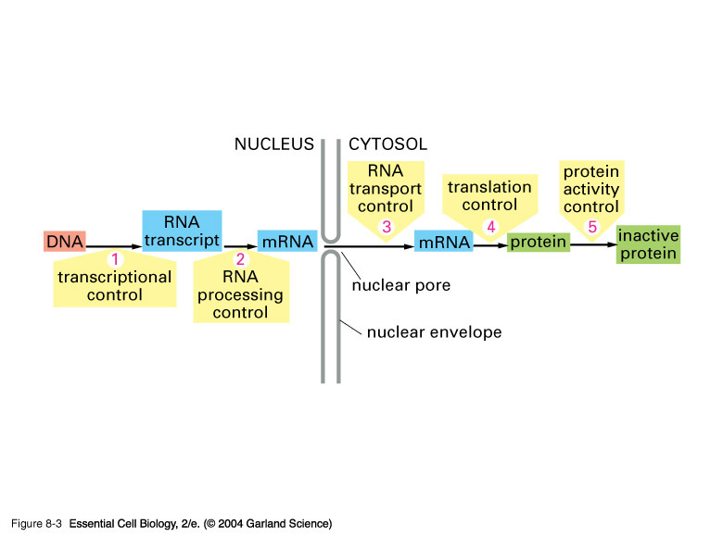
Control of Gene Expression

