Slide 1
Nitro: A Fast, Scalable In-Memory Storage Engine for NoSQL Global Secondary Index
Sarath Lakshman
Sriram Melkote
John Liang
Ravi Mayuram
VLDB 2016

Slide 2
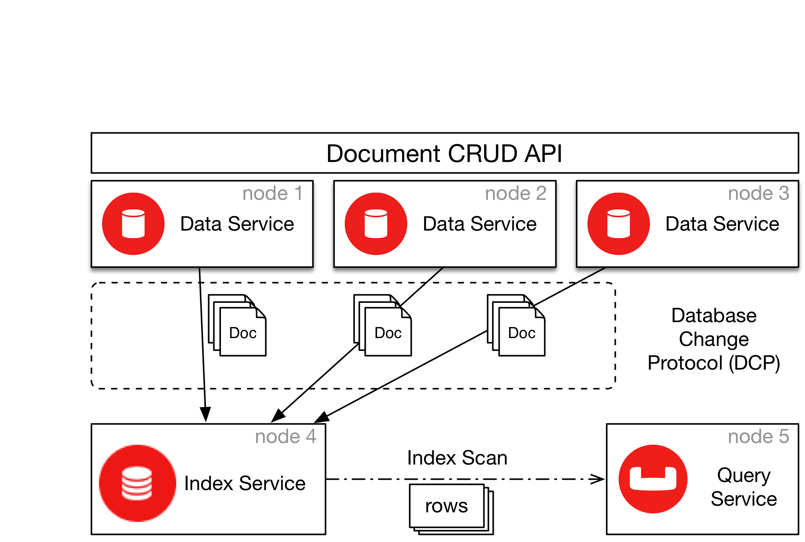
Background
Couchbase is a scalable NoSQL distributed document database
Global Secondary Indexes (GSI) are updated asynchronously and scaled independently from main document storage
Single index write performance matters as it has to keep up with the rate of document mutations

Slide 3
Design considerations
Multiple Writers for high performance
Utilize the inherent parallelism in the Database Change Protocol (DCP)
Scalable single index write performance by using available CPU cores
Lock-free data structures for high concurrency
Writers and readers never block
Maximize utilization of multicore CPUs
Fast snapshots
Minimize latency for index queries/ reduce staleness of the index
Create read snapshots at the rate of 100/second
Leverage optimizations for memory resident data structures

Slide 4
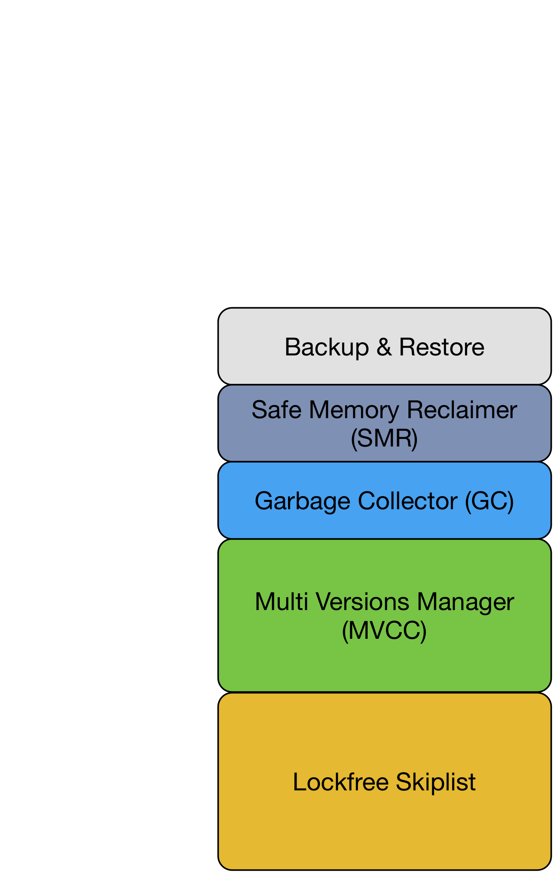
Nitro Architecture
Create backups from snapshots and recover nitro after restart/crash
Free items when GCed and not in reference
Remove items from skiplist which belongs to the unused snapshots
Create point-in-time immutable snapshots for index scans
Avoid phantoms and provide scan stability
Manage index snapshot versions in use
Implements Insert, Delete, Lookup, Range Iteration
Concurrent partitioned visitors
Concurrent bottom-up skiplist build

Slide 5
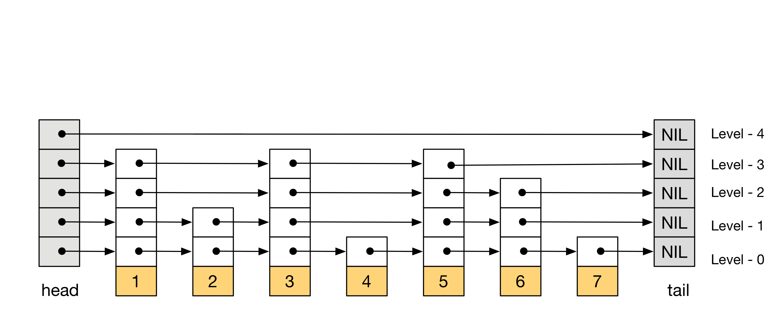
Skiplist
Probabilistic balanced ordered search data structure
Search is similar to binary search over linked-lists (O(logn))
Item granular operations unlike B+Tree (page oriented)
Lock-free skiplist is implemented by making use of compare-and-swap, atomic-add-fetch (See paper for details)

Slide 6
Multi versions management
bornSn=1
deadSn=0
bornSn=1
deadSn=0
bornSn=1
deadSn=0
Lifetime (bornSn, deadSn)
V=10
V=20
V=30
Create Snapshot (Sn=1)
bornSn=1
deadSn=0
bornSn=2
deadSn=0
bornSn=1
deadSn=0
bornSn=1
deadSn=0
bornSn=2
deadSn=0
V=10
V=15
V=20
V=30
V=32
Create Snapshot (Sn=2)

Slide 7
Multi versions management
bornSn=1
deadSn=0
bornSn=2
deadSn=0
bornSn=1
deadSn=3
bornSn=1
deadSn=0
bornSn=2
deadSn=3
bornSn=3
deadSn=0
V=10
V=15
V=20
V=30
V=32
V=32
Create Snapshot (Sn=3)

Slide 8
Multi versions management
bornSn=1
deadSn=0
bornSn=2
deadSn=0
bornSn=1
deadSn=3
bornSn=1
deadSn=0
bornSn=2
deadSn=3
bornSn=3
deadSn=0
V=10
V=15
V=20
V=30
V=32
V=32
Visibility: Iterator (Sn=1)

Slide 9
Multi versions management
bornSn=1
deadSn=0
bornSn=2
deadSn=0
bornSn=1
deadSn=3
bornSn=1
deadSn=0
bornSn=2
deadSn=3
bornSn=3
deadSn=0
V=10
V=15
V=20
V=30
V=32
V=32
Visibility: Iterator (Sn=2)

Slide 10
Multi versions management
bornSn=1
deadSn=0
bornSn=2
deadSn=0
bornSn=1
deadSn=3
bornSn=1
deadSn=0
bornSn=2
deadSn=3
bornSn=3
deadSn=0
V=10
V=15
V=20
V=30
V=32
V=32
Visibility: Iterator (Sn=3)

Slide 11
Garbage Collection
bornSn=1
deadSn=2
bornSn=2
deadSn=0
bornSn=1
deadSn=0
bornSn=1
deadSn=2
bornSn=2
deadSn=3
bornSn=3
deadSn=0
bornSn=4
deadSn=0
bornSn=1
deadSn=0
bornSn=3
deadSn=0
bornSn=3
deadSn=4
V=1
V=8
V=9
V=10
V=1
V=2
V=3
V=4
V=5
V=6
V=7
GC
Sn=1
Sn=2
Sn=3
Sn=4
rfcnt=0
rfcnt=1
rfcnt=0
rfcnt=2
Garbage Collection Snapshot List
SMR

Slide 12
Safe Memory Reclamation
Early and alive accessors can potentially hold references to GCed items
Freeing GCed items/nodes can cause dangling references
The memory reclaimer has to make sure that no accessor is holding reference to GCed items
This problem does not occur with garbage collected languages
A lock-free SMR algorithm is described in the paper

Slide 13
Nitro Backup
non-intrusive
backup
GC
Backup worker-1
Backup worker-2
Backup worker-3
File-3
Delta files
File-1
File-2

Slide 14
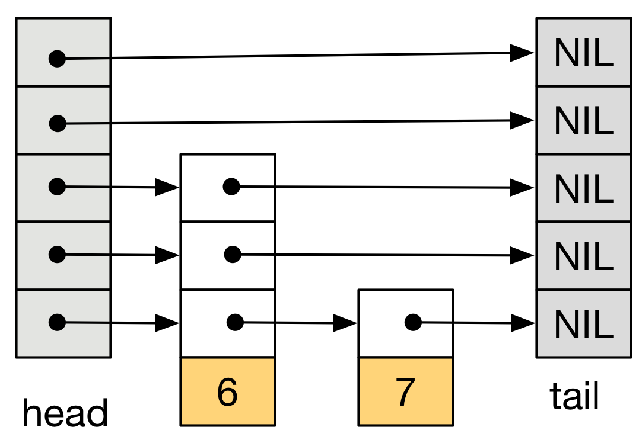
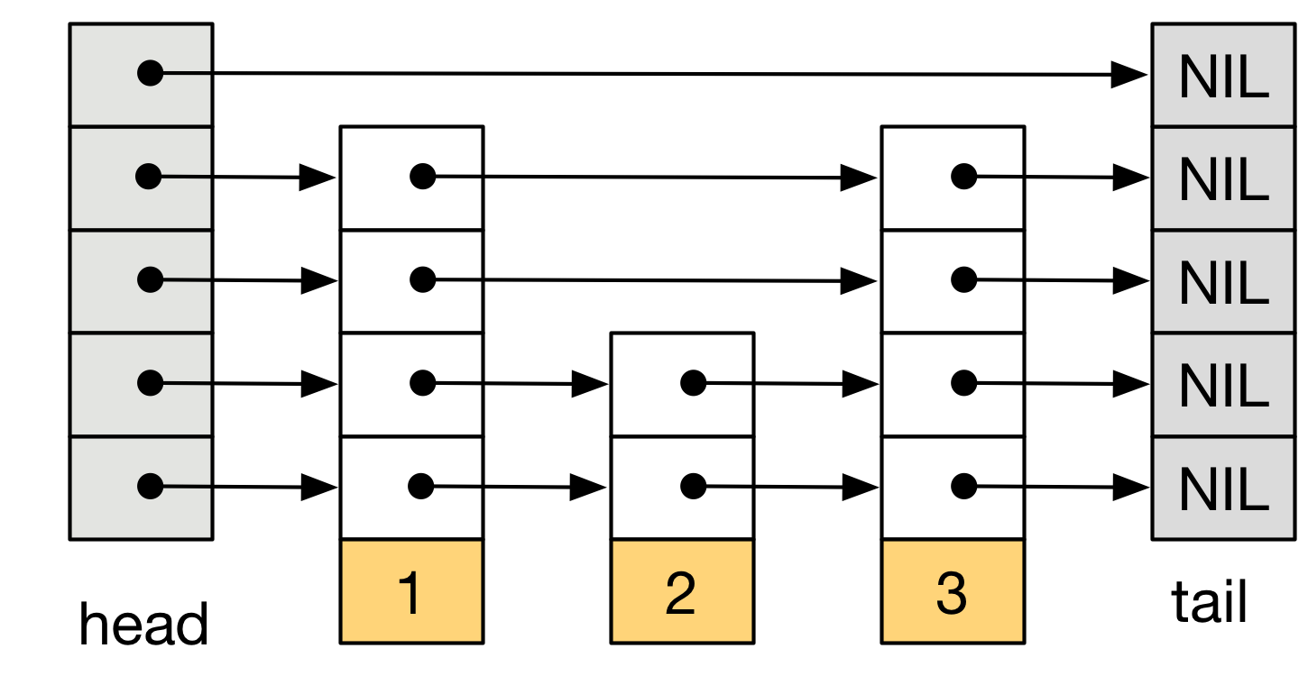
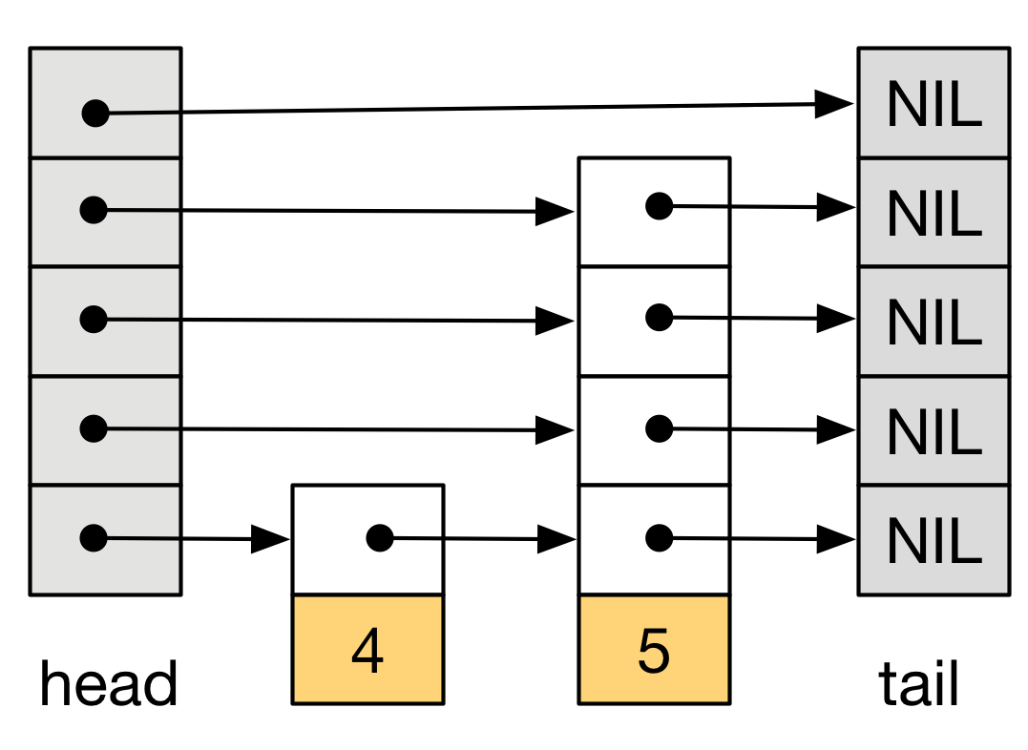
Nitro Recovery
File-1
Concurrent bottom-up skiplist build
Avoids unnecessary CAS conflicts
during concurrent insert
Snapshot number starts from Sn=1
Once build is complete, additional
items are inserted by replaying inserts from
delta files concurrently
File-2
File-3

Slide 15
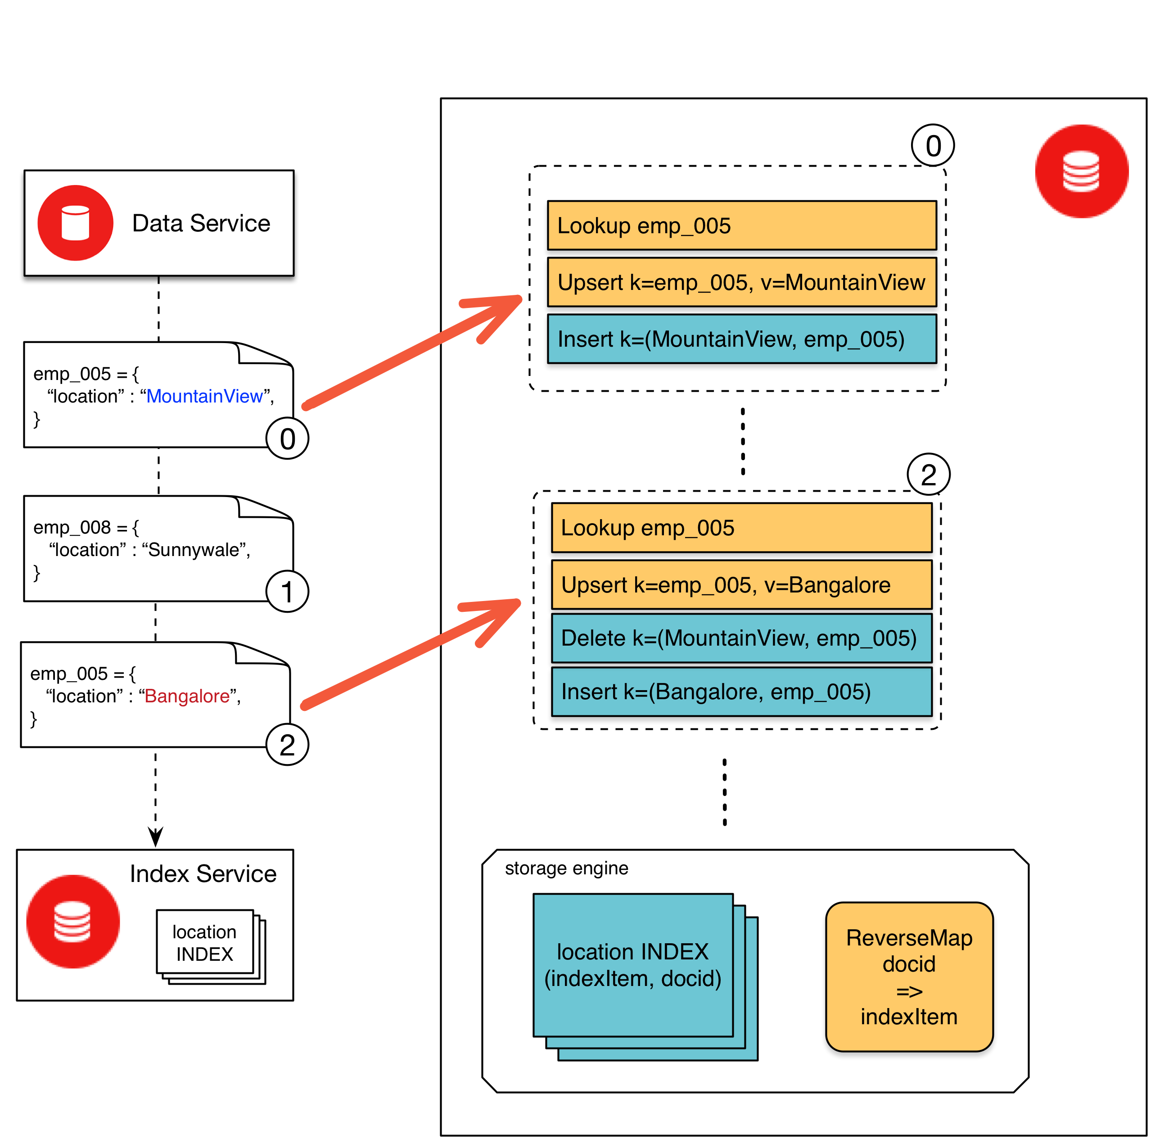
Couchbase Global Secondary Indexes (GSI)
The storage engine needs to maintain two storage structures:
Reverse map
Index
Reverse map is used to lookup and remove previous index entry for the docid during the update
Index store maintains ordered index entries used by index scans

Slide 16
Nitro Integration – Couchbase Memory Optimized Indexes
Scalable write performance using multiple writers
Simple hash table used for reverse map instead of Nitro (Avoid concurrency overheads)
Periodic backup persists only (indexItem, docid)
The reverse map can be reconstructed on the fly during recovery
End-to-end Indexing latency ~20ms
hash(docid) % n
writer-1
writer-2
writer-n
HT
HT
..
HT
Nitro INDEX
Index Scan

Slide 17
Storage Optimization for reverse map
DocID | Indexed Item
emp_005 | MountainView
emp_008 | Sunnywale
CRC32 Hash | Node Pointers
hash1
hash2
HT
Direct pointers from hash table to index entry
Storage needed for index maintenance reduced ~50%
Index item delete cost reduced from O(logn) to O(1)
Optimized multi-entry indexing from single document
Index Entry
MountainView:emp_005
Sunnywale:emp_008
Nitro INDEX

Slide 18
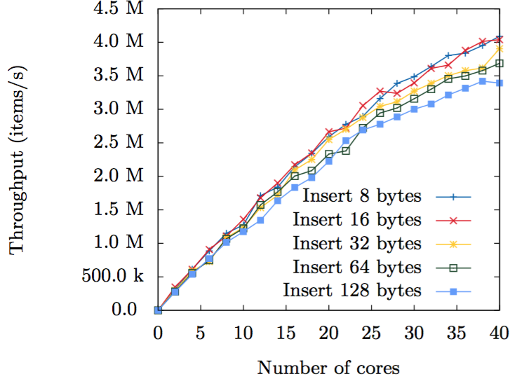
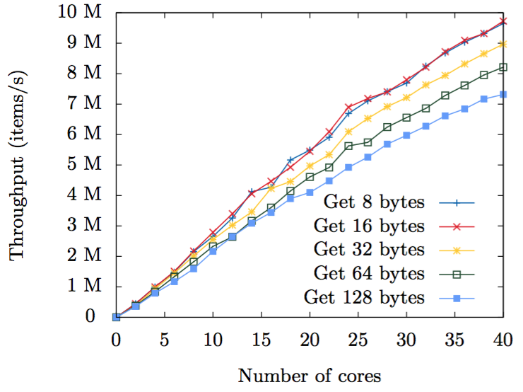
Nitro Performance
Insert benchmark
Lookup benchmark

Slide 19
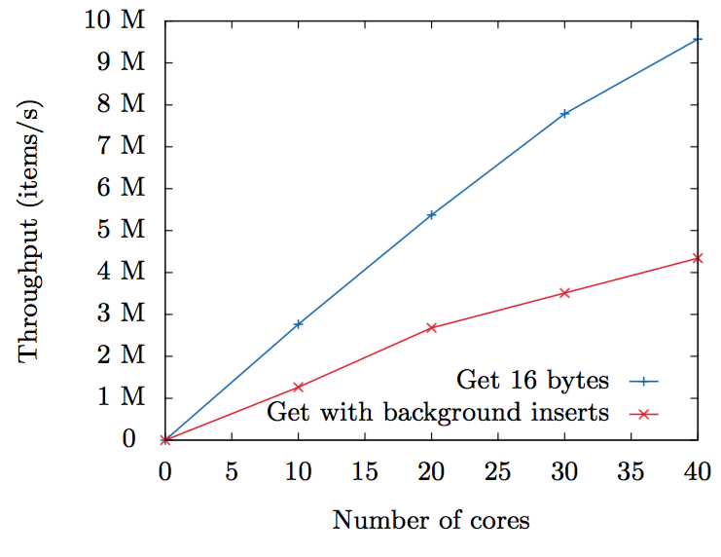
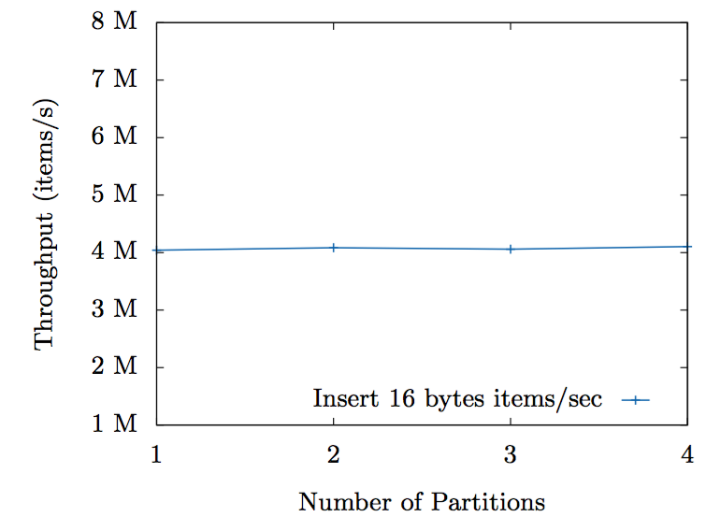
Nitro Performance
Get with background Inserts
Throughput scalability with partitions

Slide 20
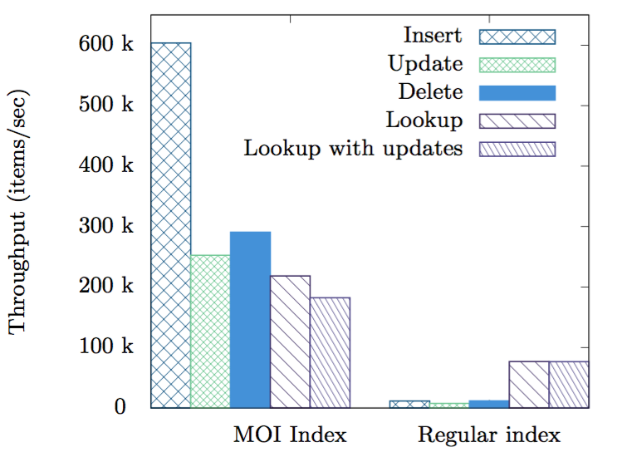
End-to-End GSI Performance
Operation | MOI Index | Regular Index
Insert | 1,658,031 | 88,102
Update | 822,680 | 70,802
Delete | 1,578,316 | 80,578
GSI index server throughput (items/sec)
Single Index benchmark

Slide 21
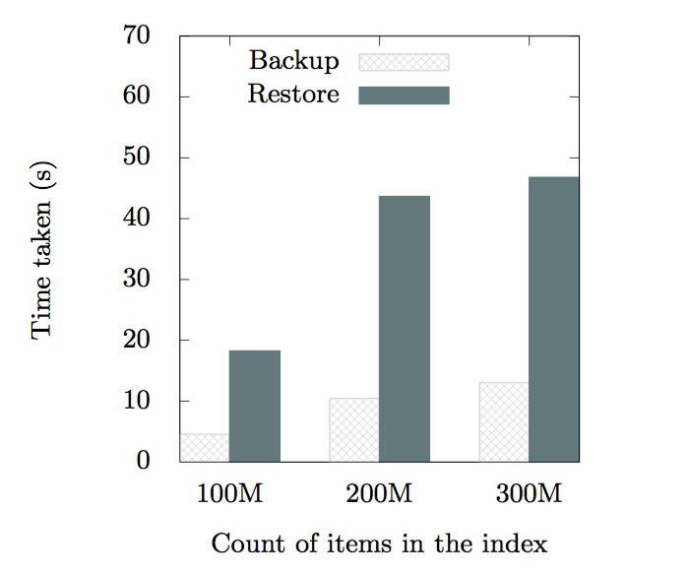
Backup and Recovery time

Slide 22
Q&A

