Slide 1
SpindleUtil Manual
By T47, Dec 2014

Slide 2
Contents
Introduction…………………………………………………..3
Image Processing…………………………………………...9
Input Arguments…………………………………………….…11
Interactive Interface: Define Spindle from Image………….19
Output Plots……………………………………………………28
Data Processing…………………………………………....33
Ratio Calculation………………………………………………34
Pick Spindles and Plot………………………………………..39
MATLAB Data Structure……………………………………...46
Function Usages…………………………………………...54

Slide 3
Introduction
SpindleUtil is a set of MATLAB scripts to facilitate the process of spindle line-scan quantitation. It is aimed to improve the productivity by replacing the “traditional” way of manually draw lines in MetaMorph and process data by hand using Excel.
SpindleUtil makes it much easier in rotating the image to position poles vertically. It also introduces box-scan, as well as the line-scan as a comparison.
SpindleUtil automates the quantitation, data visualization, comparison, and data management, making it all done in MATLAB.

Slide 4
Introduction
In this manual, we will demonstrate the basic setup and process. Using a test dataset, the interface and output files will be illustrated.
For future expansions, the steps after the FITC/TexRd ratio plot needs to be developed and tested.
All scripts are named with “spindle_” prefix, making it easier to identify in MATLAB
You should “Set Path” first to include those scripts (Add with subdirectories).

Slide 5



Without SpindleUtil
Before SpindleUtil became available, the image quantitation is done with MetaMorph and Excel. Lines are drawn in MetaMorph, suffering problems with inconsistent spindle boundaries. Data was exported to a huge Excel sheet, making plots and comparisons are thus hard and cumbersome.
Line-scan Plots
Quantitation Comparison

Slide 6
With SpindleUtil
SpindleUtil aims to take over the whole process using MATLAB, eliminating the complicated and time-consuming data transfer.
SpindleUtil takes advantage of an interactive interface for spindle rotation and boundary setup, which is faster than in MetaMorph or ImageJ.
SpindleUtil quantitates the intensity from the original TIFF, and overlays them to each other using normalized inter-pole distance. This is much faster than Excel.
SpindleUtil automatically saves all figures, log, and workspace data to an “analysis” folder in an organized way.

Slide 7
Box-scan Quantitation
One advantage of using SpindleUtil is its box-scan quantitation, especially when comes to deformed spindle geometry, e.g. splayed poles.
Line-scan quantitation only takes account for the center line (pole-pole line) and 2 side-lines. This is representative in regular spindles, but may be inaccurate and losing information.
Box-scan draws as many lines as possible in the spindle (including the 3 lines in line-scan), and thus averaging the whole spindle. This is useful in e.g. splayed pole case where the pole is not focused.

Slide 8
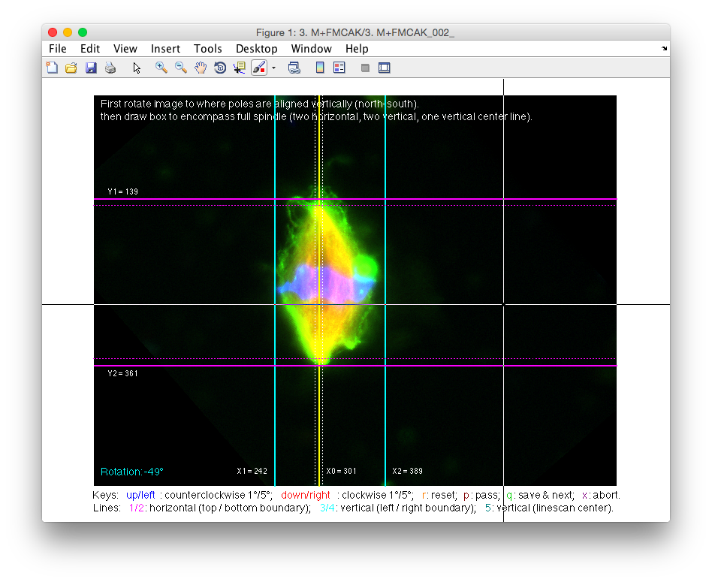
Box-scan Quantitation
Line-scan
(3 lines)
Box-scan
(every line)

Slide 9
Section 1: Image Processing
In this section, we will go over the pipeline of image processing, which is from raw TIFF files to quantitated traces saved in MATLAB session.
Related scripts are in folder:
Scripts/SpindleQuantify/ImageProcess
However, you will be using a master function spindle_mat_analysis, instead of any individual functions in the above folder.

Slide 10
spindle_mat_analysis
This is an all-in-one function to perform the analysis pipeline.
Usage:
spindle_mat_analysis (dir_name,
CEN_LINE_OFFSET, POLE_PORTION, y_lim,
NUM_BIN)
dir_name is required, all others are optional.
Example:
spindle_mat_analysis(“3. M+F2MCAK”);

Slide 11
spindle_mat_analysis
Arguments:
dir_name: (type string), the name of the folder containing all the TIFF images.
CEN_LINE_OFFSET: (type int), the distance between side-lines and the center line used in line-scan. If not specified, default of 5 will be used.
POLE_PORTION: (type double), the portion along the pole-pole axis considered as pole region. If not specified, default of 1/24 will be used.
y_lim: (type double), the y axis upper limit in the ratio plots. If not specified, default of 2.0 will be used.
NUM_BIN: (type int), the number of bins used to group ratio data points. If not specified, default of 100 will be used, meaning one ratio data point for every 1%.

Slide 12
More about the arguments
dir_name:
First, make sure your “current working directory” is correct (see left panel in MATLAB window). Go to the parent directory of your image-file folder (so that the target folder is a child of the current working directory).
Second, use the target directory name as dir_name. For example, “3. M+F2MCAK” (exactly as is, including whitespaces).

Slide 13
More about the arguments
dir_name:
All TIFF files should meet the format of “Prefix_XXX_fluroChannel.TIF”:
Prefix should be exactly same as the parent folder name (i.e. dir_name).
ID number is 3-digit, (filled with 0s). It needs to be neither continuous (of files in the same folder), nor starting with 001.
Fluorophore Channel should be one of the following: “w1DAPI”, “w2FITC”, “w3Texas Red”. This is same as default by microscope image output.
Extension is “TIF”, not “TIFF”.
Valid image name example:
“3. M+F2MCAK_001_w2FITC.TIF”.
“nd” and “_thumb” files in the folder will be ignored.

Slide 14
More about the arguments
dir_name:
The script is expecting that for each spindle (set), 3 images of each channel are present. Thus, the number of total legit TIF images should be multiples of 3.
Possible error messages:
ERROR: directory not found.
ERROR: TIFF images set (of 3) incomplete.
14 non-thumb TIF files present.
ERROR: TIF and directory name mismatch.
3. M+F2MCAK/5. M+715AA_001_w1DAPI.TIF

Slide 15
More about the arguments
CEN_LINE_OFFSET:
This defines the distance between the 3 lines used in line-scan. In line-scan, one center line is drawn, and two side-lines (one on each side) CEN_LINE_OFFSET pixels away are automatically drawn.
Default is 5 (pixels), as inherited from older MetaMorph approaches.

Slide 16
More about the arguments
POLE_PORTION:
This defines the portion of spindle considered as “pole region”. Default is 1/24, which means the inter-pole distance will be divided to 24 sections, where the 1st and 24th section are considered “north” and “south” pole, while the 2nd-to-23rd sections are “body”.
This number is useful when comparing a distribution of “pole” (where MTs are enriched) to rest of spindle. Currently, no calculation in the output files is dependent on this argument. But it can be used in marking the boundary on plots.
Use 1/24, not 24.

Slide 17
More about the arguments
y_lim:
This defines the upper limit of y-axis in all ratio plots. Default is 2.0, which means ratio of 0-to-2.0 will be shown. Ratios higher than 2.0 will appear “cut-off” on the plot. You may specifiy a lower number, e.g. 1.5, if max ratio of the trace is low.
NUM_BIN:
This defines the number of bins used in grouping/normalizing the ratio trace across different spindle length. See “calculate the ratio” page.

Slide 18
spindle_mat_analysis
A successful launch will show the following message in MATLAB console:
Load files from directory: 3. M+FMCAK
Load 15 non-thumb TIF images from directory.
Group into 5 spindles {DAPI, FITC, TexRd}.
Instructions:
First rotate image to where poles are aligned vertically (north-south),
then draw box to encompass full spindle
(two horizontal, two vertical, one vertical center line).
Controls:
Keys: up/left: counterclockwise 1°/5°; down/right: clockwise 1°/5°;
r: reset; p: pass; q: save & next;
x: abort (premature terminate, data lost).
Lines: 1/2: horizontal (top / bottom boundary);
3/4: vertical (left / right boundary);
5: vertical (linescan center).

Slide 19
Define spindle from image
For each spindle set (of 3 images representing each channel), we will select a region that defines the spindle. This is done using an interactive interface.
A window will pop out (see next page), with a cross-cursor and key descriptions.
We will first rotate the image, then draw 5 lines to define the spindle.

Slide 20
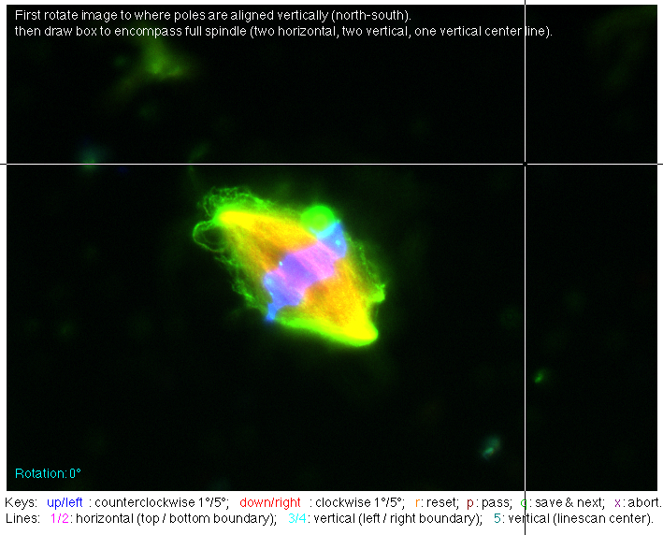

Interactive interface

Slide 21
Rotate the spindle
This is to make the line drawing easier. The goal is to rotate the image so that the spindle is oriented/aligned north-to-south (vertical).
To do so, use the following control keys:
Up: rotate counterclockwise by 1 degree;
Down: rotate clockwise by 1 degree;
Left: rotate counterclockwise by 5 degree;
Right: rotate clockwise by 5 degree.
Use left/right first to rotate the image, then refine by up/down. You can check the orientation by overlaying the cursor, which has vertical cross-line.
The current rotation angle is shown in bottom-left corner (cyan).

Slide 22
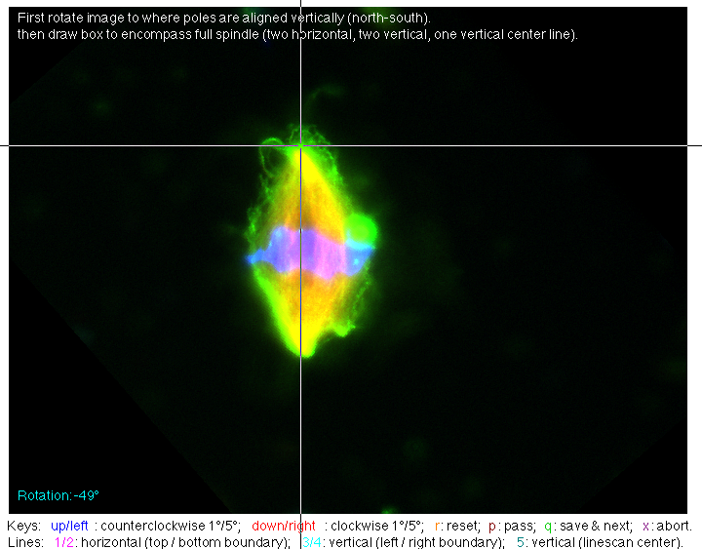
Interactive interface

Slide 23
Draw 2 horizontal lines
These first 2 lines are horizontal and defines the north and south boundary. They are shown in magenta. It should be drawn exactly at the outer tip of the pole (names y1 and y2).
The POLE_PORTION defined pole region will be automatically shown by dashed lines inside the 2 horizontal lines you drawn.

Slide 24
Draw 3 vertical lines
These next 2 lines are vertical and defines the left and right boundary. They are shown in cyan. It should be drawn exactly at the widest point of the spindle (named x1 and x2).
The last vertical line mimics the line-scan, where it should be through both poles. So it’s not necessarily at the center. It is shown in yellow (named x0), and the CEN_LINE_OFFSET defined two side-lines are shown in dashed lines.

Slide 25
Interactive interface

Slide 26
Interactive interface
At this point, the line drawing is complete. Hit “q” to save and quit, which leads you to the next spindle.
Other keys:
r: reset, restores the original image and erases all lines;
p: pass, the current spindle is considered bad (quality), thus it will be excluded from the following analysis (does not count in ratio calculation); Any rotation or lines drawn will be ignored.
x: abort: quit the spindle_mat_analysis function without saving any data (all will be lost).

Slide 27
Interactive interface
Note:
The “close window” button is disabled to avoid mistaken clicks. Neither does “command+w” works.
The MATLAB console window may gain focus when you click keys too fast. Use “command+`” to switch back to it.
You can’t go back to a spindle once “q” or “p”. So think twice before passing/finishing a spindle.
You can use 1/2, 3/4, and 5/6 key pairs to
adjust the display of R, G, B channels. This only
alters the display (contrast), not affecting the data
in the image to be quantified. Use t to reset color
display (not reset rotation or lines).

Slide 28
Spindle output
Once you’ve done the definition for all spindles in the folder, an output file (.eps) will be saved for each spindle. See example next page.
The output file includes the image of the spindle (rotated), the 5 lines drawn on top of the image, parameters used, and the quantitated traces. Although printing out the output is costly (color printing, black background), it is a good record.

Slide 29
Spindle output
Outputs are saved to “Prefix_analysis/summary” with same name as spindle, e.g. “3. M+F2MCAK_analysis/summary/3. M+F2MCAK_002.eps” (not same folder as TIF data).
Additionally, a snapshot output file (“Prefix_analysis/summary.eps” ) is present for an overview of all “good” spindle shapes.

Slide 30
Output file

Slide 31
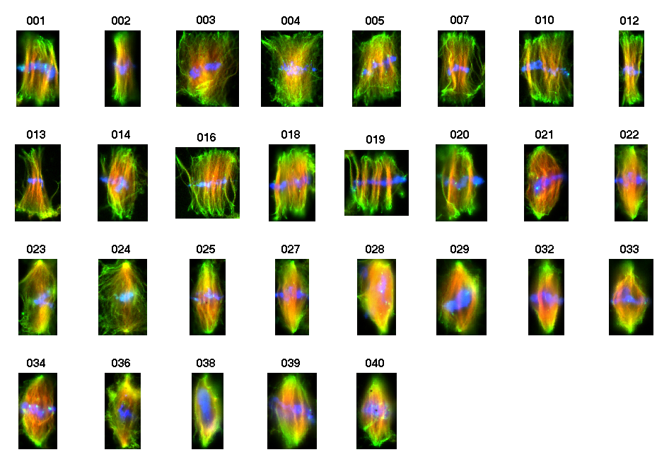
Output file

Slide 32
Spindle output
First 2 plots are the fluorescence intensity from pole-to-pole, averaged by box-scan and line-scan, respectively.
X-axis is the pole length in pixels; Y-axis is the averaged fluorescence. Again, box-scan averaged all columns while line-scan only samples 3 columns.
The 3rd plot is the FITC/TexRd ratio (assuming that FITC channel is protein of interest and Texas Red is labeled MTs). Ratio at each pixel position is calculated by dividing the FITC intensity by TexRd. X-axis is normalized to 0%-to-100% and the POLE_PORTION line is drawn for reference.

Slide 33
Section 2: Data Processing
In this section, we will go over the pipeline of data processing, which is from quantitated traces to normalized FITC/TexRd ratio.
Related scripts are in folder:
Scripts/SpindleQuantify/DataProcess
However, you will still be using a master function spindle_mat_analysis, instead of any individual functions in the above folder (continuously from section 1).

Slide 34
Calculating the ratio
As described in the previous section, FITC/TexRd ratio of each spindle is calculated by simple division.
However, the ratio of each spindle cannot be averaged directly since the length of each spindle (pole-to-pole distance in pixels) are different, thus the number of points in the (0%-to-100%) range is different.
To solve the problem, we group the data points in the ratio trace to 100 bins first, then average the binned ratio trace across spindles.
This is done by spindle_mat_average_ratio function, with a default NUM_BIN = 100.

Slide 35
Calculating the ratio
Briefly, the grouping into bins is simple:
Divide 0%-100% into 100 bins (1% each);
Find the data points in the original ratio in each bin;
Assign ratio of each (1%) bin by averaging the ratio data points fall in the bin.
Usually, the pole-to-pole distance in pixels is larger than 100. So each 1% bin will have at least one ratio data points.
In the end, an average of ratio of all spindles is calculated and plotted (as well as standard deviation).

Slide 36
Calculating the ratio
An example output is in next page.
For box-scan and line-scan, the averaged ratio (across spindles) is colored in black and overlaid to all individual ratio traces.
The averaged ratio is plotted against each other (box-scan vs. line-scan) with error bars.
Overall, the box-scan and line-scan agrees in trends, while box-scan has smaller errors.

Slide 37
Ratio

Slide 38
Calculating the ratio
Notes:
The averaged ratio is across all “good” spindles in the folder, not discriminating “regular vs. splayed”. For such selection, see “pick spindles to plot” page.
Ratio plot is saved as “Prefix_analysis/ratio.eps”.
Screen log is saved as “Prefix_analysis/log.txt”.
MATLAB data is saved as “Prefix_analysis/save.mat”. (see “MATLAB data structure” page)

Slide 39
Pick spindles to plot
You may need to pick a subset of spindles in a folder and calculate statistics of the subset, instead of the mixture of all “good” spindles.
To do so, you will use an all-in-one function:
Usage:
obj_select = spindle_mat_pick (spd_data,
str_title, file_name, y_lim,
NUM_BIN)
spd_data is required, all others are optional.
Example:
obj_splayed = spindle_mat_pick (spd_data, “splayed”);

Slide 40
spindle_mat_pick
Arguments:
spd_data: (type spd_data struct), the spd_data variable from save.mat.
str_title: (type string), the title of the plot, e.g. “MCAK-715AA splayed”. If not specified, default of folder name will be used.
file_name: (type string), the saved .eps file name. If not specified, default of “ratio_pick” will be used.
y_lim: (type double), the y axis upper limit in the ratio plots. If not specified, default of 2.0 will be used.
NUM_BIN: (type int), the number of bins used to group ratio data points. If not specified, default of 100 will be used, meaning one ratio data point for every 1%.

Slide 41
More about the arguments
spd_data:
First, load the save.mat from any “prefix_analysis” folder. This loads the previously saved data into MATLAB session. The spd_data variable in save.mat is the data structure holding all spindle information and quantitated data.
str_title and file_name:
These allows you to specify the figure title and saved figure name for easier comparison when printed out.
y_lim and NUM_BIN:
Same as before.

Slide 42
More about the arguments
obj_select
This is the return variable that holds the data. It is a struct with following fields:
list_chosen: all spidnle IDs used in the average ratio calculation;
ratio_box_mean: averaged ratio of box-scan;
ratio_box_std: standard deviation of box-scan ratio;
ratio_box_mean: averaged ratio of box-scan;
ratio_box_std: standard deviation of box-scan ratio;
Use a variable name that is identifiable, e.g. “obj_splayed”.
See “MATLAB data structure” page.

Slide 43
spindle_mat_pick
First, you will be asked to type in the selection:
Type in spindle IDs (MATLAB expression, e.g. [1:10,12].
Only spindles not marked as is_bad will be selected.
Input:
Use MATLAB expression for ranges, e.g. [1:10], or [1:10, 12], or [1:10, 12:15], etc. Do not forget the square brackets.
The function will automatically go through spd_data, and get all good (not “is_bad”) spindles in your range, and put together a new list_select for averaging and plotting.

Slide 44
spindle_mat_pick
The result figure is similar to the calculated ratio figure, but only with the spindles you just picked.
It is saved as the name you input (or “ratio_pick.eps” if left blank), at the same folder as current working directory.
The number of picked spindles is shown in the title of 3rd panel (“ n = “);

Slide 45
Ratio pick plot

Slide 46
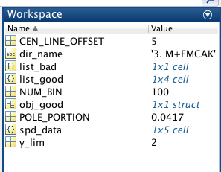
MATLAB data structure
There are several variables in save.mat:
Input arguments of CEN_LINE_OFFSET, POLE_PORTION, y_lim, NUM_BIN and dir_name are saved.

Slide 47
MATLAB data structure
spd_data is the main variable holding all data. It is a 1xn cell, where n is the total number of spindles (good and bad together) originally in the folder.
For each entry of spd_data (e.g. spd_data{2}), it is a struct as below:

Slide 48
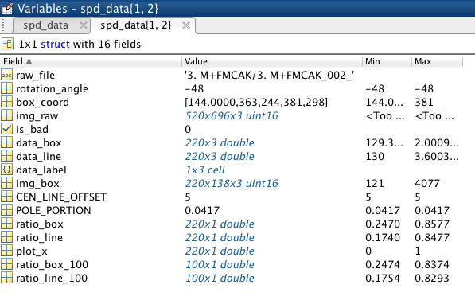
MATLAB data structure

Slide 49
spd_data entry
raw_file: (type string) the prefix of the spindle image file names.
rotation_angle: (type int) the final rotation angle (in degrees).
box_coord: (type array double) the coordinates of 5 drawn lines after image rotated, i.e. [y1, y2, x1, x2, x0].
img_raw: (type matrix uint16) the raw TIFF image, height-by-width-by-3, 3 as in (R,G,B) channels. This serves as a backup of the TIFF files.
img_box (type matrix uinit16) the cropped TIFF image, only showing the spindle, i.e. [y1:y2, x1:x2, :] of img_raw.

Slide 50
spd_data entry
CEN_LINE_OFFSET: (type int) the input argument.
POLE_PORTION: (type double) the input argument.
data_label: (type cell string) the label of color channels, i.e. {‘TexRd’, ‘FITC’, ’DAPI’} as in (R,G,B).
is_bad: (type boolean) the flag for whether this spindle is considered bad quality.
If it were “passed” in interactive interface, is_bad = True (1), and no quantitation data (img_box, rotation_angle, box_coord, data_box, data_line, ratio_box, ratio_line, ratio_box_100, ratio_line_100, plot_x) is available (all empty).

Slide 51
spd_data entry
data_box and data_line: (type matrix double) the averaged/projected fluorescence intensity from pole to pole in 3 channels, using box-scan and line-scan respectively; same column order as data_label.
ratio_box and ratio_line: (type array double) the FITC/TexRd ratio from corresponding projected data, i.e. data_box(:,2)./data_box(:,1).
plot_x: (type array double) the 0-to-100% normalized x-axis positions, used for plotting ratio_box and ratio_line on 0-100% scale.
ratio_box_100 and ratio_line_100: (type array double) ratios of ratio_box_100 and ratio_line_100 grouped into NUM_BIN bins.

Slide 52
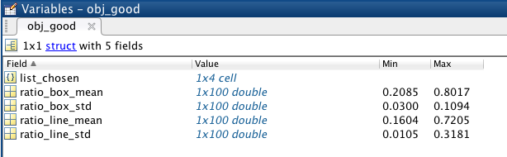
obj_good
obj_ variables are objects that hold data for the result of ratio averaging of a selected set of spidles.
obj_good is saved after image analysis automatically. As the name suggests, it is the result of all “good” spindles.
obj_select is returned by spidnle_mat_pick to reflect the subset the user picked.

Slide 53
obj_good
list_chosen: (type cell string) the list of all chosen spindle IDs of this object. For each individual entry, the 3-digit ID is saved as string, i,e. ‘001’, not (int) 001.
ratio_box_mean and ratio_line_mean: (type array double) the averaged ratio trace across all spindles in list_chosen, using box-scan or line-scan, respectively.
ratio_box_std and ratio_line_std: (type array double) the standard deviation of the averaged ratio trace across all spindles in list_chosen, using box-scan or line-scan, respectively.
Note: ratio_box_mean,ratio_line_mean, ratio_box_std and ratio_line_std are all of length NUM_BIN.

Slide 54
Function Description
Image processing:
spd_data = spindle_read_folder(dir_name, CEN_LINE_OFFSET, POLE_PORTION);
Scan through and checks all TIF files in a input folder, generate and match a list of TIF files, call spindle_box_select for each spindle.
im_input = spindle_read_TIFF(file_id, file_id2, file_id3);
Load 3 TIF files into MATLAB and save as matrix.

Slide 55
Function Description
Image processing:
spd_data = spindle_box_select(file_id, CEN_LINE_OFFSET, POLE_PORTION);
Calls spidnle_read_TIFF to load image, calls spindle_draw_box to interactively define spindle, calls spindle_quantitate to project data traces, and builds each spd_data entry.
[y1, y2, x1, x2, x0, rot_angle, is_pass] = spindle_draw_box(im_input, rot_angle, file_id, CEN_LINE_OFFSET, POLE_PORTION);
Interactive interface for rotation and line drawing.

Slide 56
Function Description
Image processing:
[data_box, data_line] = spindle_quantitate(im_input, rot_angle, coord_xy, CEN_LINE_OFFSET);
Quantitates and projects box-scan and line-scan to get 1D fluorescence intensity.
spindle_mat_display(spd_data, list_good);
Print snapshot of all “good” spindles in one-page.

Slide 57
Function Description
Data processing:
spindle_mat_analysis(dir_name, CEN_LINE_OFFSET, POLE_PORTION, y_lim, NUM_BIN);
Calls spindle_read_folder to process all images in folder, calls spidnle_mat_summary to print out summary for each spindle, calls spindle_mat_calc_ratio to group ratio traces into bins, calls spindle_mat_plot_ratio to plot average ratio, and saves log and workspace file.
idx = spindle_mat_find_ID(spd_data, spindle_ID);
Finds index of target spindle ID in spd_data.

Slide 58
Function Description
Data processing:
spindle_mat_summary(spd_data_sub);
Print out one-page summary for a specific spd_data entry, including raw image, lines, intensity plots, and ratio.
spd_data = spindle_mat_calc_ratio(spd_data, list_good);
Calculates FITC/TexRd ratio for all “good” entries in spd_data.
[spd_data, ratio_box_mean, ratio_box_std, ratio_line_mean, ratio_line_std] = spindle_mat_average_ratio(spd_data, list_good, NUM_BIN)

Slide 59
Function Description
Data processing:
Groups ratio trace data points into NUM_BIN of bins.
[spd_data, ratio_box_mean, ratio_box_std, ratio_line_mean, ratio_line_std] = spindle_mat_plot_ratio(spd_data, list_plot, y_lim, NUM_BIN, str_title, file_name, dir_name);
Plots a selected list of spindles for averaged ratio.
obj_chosen = spindle_mat_pick(spd_data, str_title, file_name, y_lim, NUM_BIN)
Let user choose a subset of spindles and calls spindle_mat_plot_ratio.

Slide 60
Function Description
For historical reasons, data processing scripts has prefix “_mat_”. This is due to a previous version processing data output from MetaMorph, with a set of scripts with prefix “_excel_”. Those are no longer in use.

