Slide 1
Project1
By Tyler Westbrook

Slide 2
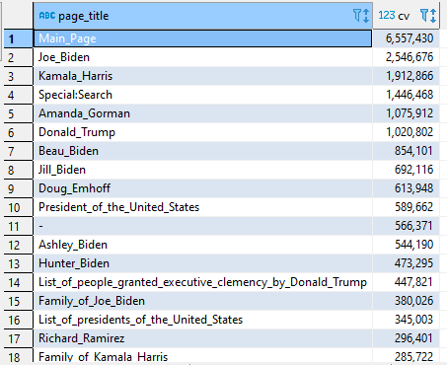
Question 1 Most Popular Page Jan 20, 2021
Analysis
Retrieved all page views data for Jan 20
Summed the total views for each article
Selected on pages with a domain code of en
Assumed
All bots filtered

Slide 3
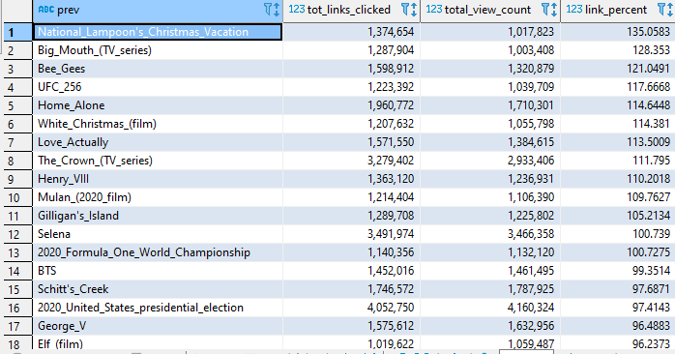
Question 2 Page with highest fraction of links clicked
Analysis
Took page views data for 1st,10th,20th,and 30th of December and averaged them
Took clickstream data from last month and extracted on the referral pairs from links
Divided amount of link Pairs by total views * 31 to get the fraction of links clicked
Counted sites with views > 1000000
Assumptions and Problems
Clickstream data most likely counts a pair even if already clicked before
All bot traffic not filtered
Pageviews is not accurate

Slide 4
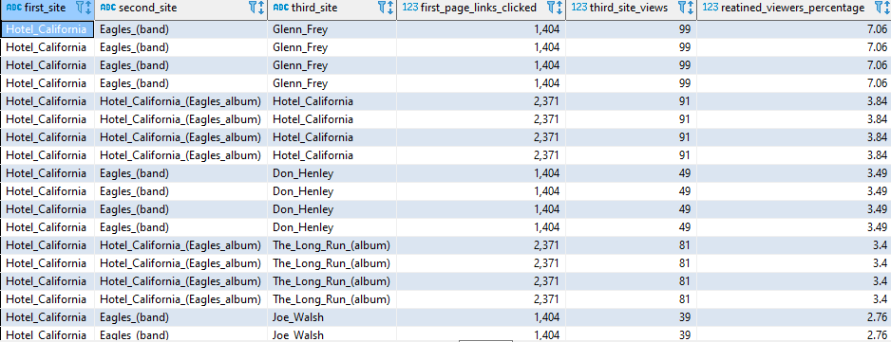
Question 3 Fraction of Viewers Still Clicking Links Starting With Hotel California
Analysis
Used the fraction from the last question to get the number of views for each page in the series
Only retrieved data up till the third page
Limited to initial views greater than a 1000
Assumptions and Issues
Using data from previous question that may not be completely accurate
Again, some traffic might be bots

Slide 5
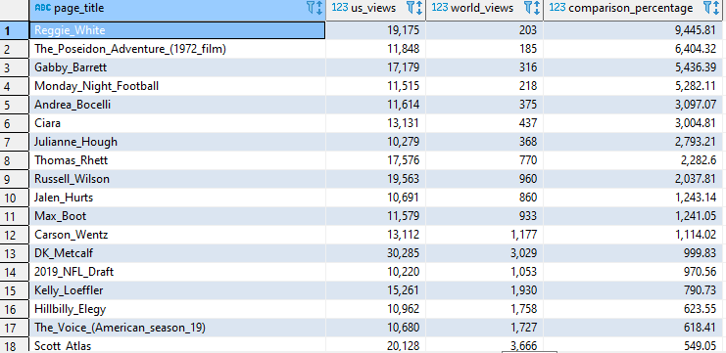
Question 4 What Page is More Popular in America vs WW
Analysis
Took pageviews data from between 1-3 UTC Dec 1st for American views due to most being off work by that time
Used times between 8-10 UTC for the rest of the world due to a lot of Americans most likely being asleep
Assumptions and Issues
Only used 3 hours worth of data for each
Traffic still most likely is all from America for the us views and vice versa for the world views

Slide 6
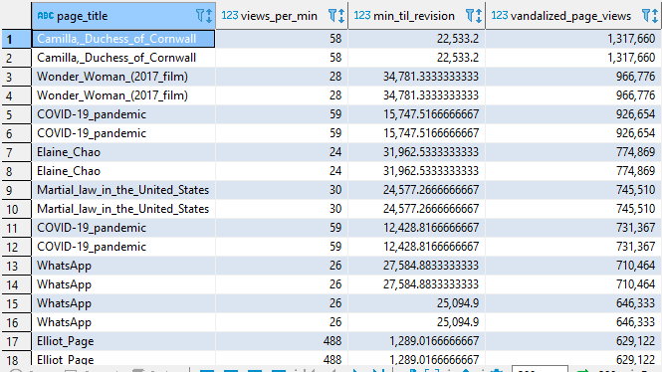

Question 5 How Many Users See a Vandalized Web Page
Analysis
Used revision history data and avg page view data for December calculated earlier
Counted a vandalized page as one that was reverted and was a major edit
Divided avg views in a day to avg views a min
Used the seconds till a revert and converted to min
Multiplied the two together to get the number of vandalized page views
Avg the number of views
Assumption and Issues
Just because a page was reverted does not necessarily mean it was vandalized
Page view data not completely representitive

Slide 7
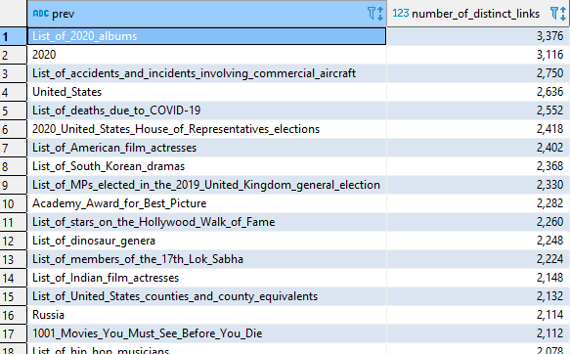
Question 6 Page With the Most Individual Links Clicked
Analysis
Used December clickstream data and extracted all link pairs
Counted number of times a page was the first in a link pair
Assumptions
Possible some links could have been clicked by bots affecting pairs with a low amount of occurences

Slide 8
Github
https://github.com/t4co97/Revature.git

