Slide 1

October 2017
Accelebrate
Webinar
Getting Started with Machine Learning using Python and Visual Studio Code!
Presenter: Eric Greene (eric@t4d.io)

Slide 2
October 2017
The Accelebrate Difference
In-person private training for your group
In-person with some remotes
Synchronous online
Private
Public
Online courses (and courses with some online remotes) are easily recordable in most cases

Slide 3
October 2017
The Accelebrate Difference
Instructors who are experts
Real-world experience
Flexible and eager to customize your training
We always request a pre-class call and/or survey
Rapidly responsive before, during, and after class
Drama-free logistics - instructor and materials arrive on-time

Slide 4
October 2017
Machine Learning-related Courses
Comprehensive Data Science with Python
Python Programming for Scientists
Scientific Python for Experienced Developers
Python Programming for Data Analysis
MOC 20774 - Perform Cloud Data Science with Azure Machine Learning
And many more…

Slide 5
October 2017
Webinar Agenda
What is Machine Learning?
Anaconda and Visual Studio Code
Anaconda Tools
Integrating Visual Studio Code with Anaconda
Example Machine Learning Experiment with Python and Visual Studio Code
Questions

Slide 6
October 2017
Getting Started
Machine Learning is a field of computer science that gives computers the ability to learn without being explicitly programmed¹
Machine learning focuses on the ability of machine to move beyond strictly static code to having the ability to learn from data, and make new predictions based upon that data
All programs have code and data
With static programs the code drives the result
With machine learning programs the data (model) drives the result
1. https://en.wikipedia.org/wiki/Machine_learning

Slide 7
October 2017
Getting Started
Real Life Example
Static Program
A person eats (code) food (input) for energy (result)
Input -> Code -> Result
Machine Learning Program
A person learns (code creates a data model) they get more energy from certain foods and less energy (training) from other foods; therefore, given a food (input) the amount of energy produced (result) can be predicted
Step 1: Input -> Code -> Data Model
Step 2: Input -> Data Model -> Predictive Result

Slide 8
October 2017
Getting Started
Creating the Data Model
Many techniques: decision trees, neural networks, support vector machines, clustering, etc…
Mathematically intensive
Number crunching is performed by code
Developer needs to know which mathematical techniques to apply
Subject matter knowledge is critical

Slide 9
October 2017
Getting Started
Python – a general purpose scripting language which is highly popular in the machine learning community
Within the Python eco-system there are numerous packages designed to support machine learning and data science in general
numpy
scikit-learn
pandas
And many more…

Slide 10
October 2017
Getting Started
Why Python?
This is a fair question
Python is a good language but many other languages work as well if not better than Python in general, so why Python?
Python is relatively easy to learn
Numerous scientific packages exist for it
Great for running short programs

Slide 11
October 2017
Anaconda Distribution
Anaconda is a special distribution of Python targeted towards the machine learning and larger data science community
Anaconda comes with numerous packages and tooling pre-installed
Tooling such as Jupyter Notebooks and Spyder are provided
Packages such as numpy and matplotlib are pre-installed
Conda package and environment manager

Slide 12
October 2017
Anaconda Distribution
Spyder
"Scientific Python Development Environment"
Provides advanced editing, interactive testing, debugging, and introspection layers
Providers a numeric computing environment including IPython, NumPy, SciPy and matplotlib
Link: https://github.com/spyder-ide/spyder

Slide 13
October 2017
Anaconda Distribution
Jupyter Notebook
"open-source web application that allows you to create and share documents that contain live code, equations, visualizations and narrative text"
Supports 40 languages including Python and R
Notebooks can be shared via email, DropBox, GitHub, etc…
Produce rich, interactive output such as HTML, images, etc…
Link: http://jupyter.org/

Slide 14
October 2017
Anaconda Distribution
Conda Package and Environment Manager
PIP – Python Package Index
Default Package Manager Distributed with Python
PIP installs packages globally only
Conda and PIP ships with Anaconda
Conda manages packages
Conda manages environments, packages per environment not globally

Slide 15
October 2017
Visual Studio Code
Very popular, cross-platform text editor built on the Electron framework
Used for building application in many languages including Python
Has a rich extension system which expands the functionality of the Visual Studio Code to do Python and Machine Learning programming
https://code.visualstudio.com/

Slide 16
October 2017
Visual Studio Code
Useful Extensions
Python (ms-python.python) – Microsoft's Extension for Python Language support within VS Code
Jupyter (donjayamanne.jupyter) – Runs Juptyer Notebook Cells within Visual Studio Code
Shell launcher (Tyriar.shell-launcher) – Runs Multiple Shells configured for different kinds of environments

Slide 17
October 2017
Scikit Learn
Scientific Python Package for Machine Learning
Supports many kinds of machine learning techniques: classification, regression, clustering, dimensionality reduction
Also, provides tools to help with machine learning: model selection and preprocessing

Slide 18
October 2017
Scikit Learn
For the machine learning demonstration in the webinar, we are going to do an expanded form of the digits classification example
The classification example uses a machine learning technique known as a Support Vector Machine
Support Vector Machine can be used in a number of ways, one of them being classification
The goal will be classify an image of a digit as an actual digit

Slide 19
October 2017
Scikit Learn
Why a Support Vector Machine?
Effective in high dimensional spaces
Effective when the number of dimensions is higher than the number of samples
Uses a subset of training points in the decision function
Different kernel functions can be used for the decision function

Slide 20
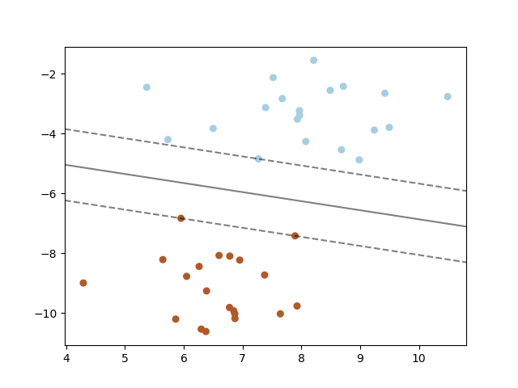
October 2017
Scikit Learn
Maximum margin separating hyperplane within a two-class separable dataset using a Support Vector Machine classifier with linear kernel
Source: http://scikit-learn.org/stable/auto_examples/svm/plot_separating_hyperplane.html

Slide 21
October 2017
Helpful Resources
Python: https://www.python.org/
Visual Studio Code: https://code.visualstudio.com/
Jupyter Notebooks: http://jupyter.org/
SciKit-Learn: http://scikit-learn.org/

Slide 22
October 2017
Coding Demos
Let's explore coding examples of these features:
Run Spyder and Jupyter Notebooks
Install and Configure Extensions for VS Code
Create Multiple Shells (in Windows only)
Import Existing Jupyter Notebook Into VS Code

Slide 23
October 2017
Coding Demos
Let's explore coding examples of these features:
Debug Python
Run Jupyter Cells in VS Code
Machine Learning Example

Slide 24
October 2017
Getting the Code
Code will be pushed to GitHub at the end of the webinar!
https://github.com/t4d-accelebrate-webinars/getting-started-ml-using-py-vscode
Contact Eric: eric@t4d.io
Contact Accelebrate: info@accelebrate.com

Slide 25
October 2017
Questions
?
?
?
Feel free to ask questions on Python, Anaconda, Visual Studio Code and Machine-Learning related technologies!

