Slide 1
LinkedList Reversal LLNode
Tanishq Padwal 664972389

Slide 2
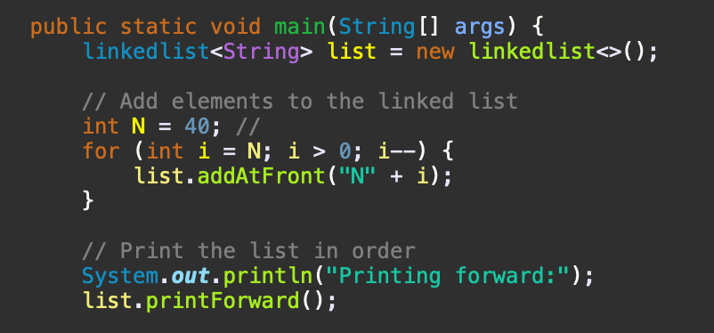
Creating an N numbers string list in a Linked List
We start by creating an instance of our linkedlist<String>, which sets up our singly linked list for storing string elements.
To populate the list, we use a for loop counting down from N to 1. This backward counting ensures that when we add elements at the list's front, they end up ordered from "N1" to "N40". Each insertion with the addAtFront method places a new string node at the list's start, effectively reversing their order.
Finally, we showcase the list using the printForward method. It walks through the list from start to end, displaying each string and its link to the next, ending with "null" to indicate the list's end.

Slide 3
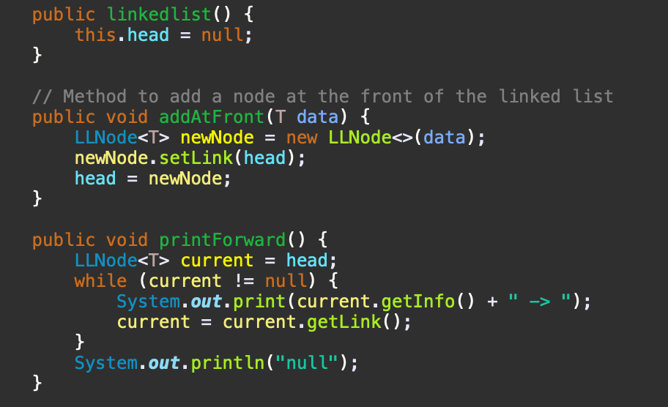
Using the LLnode class :
The LLNode class is essentially the backbone of our linked list, designed to hold any type of data and a link to the next node. It's pretty straightforward, with info for the data part and link to point to the next item in the list. This setup lets us easily add and link up nodes to build the list.

Slide 4
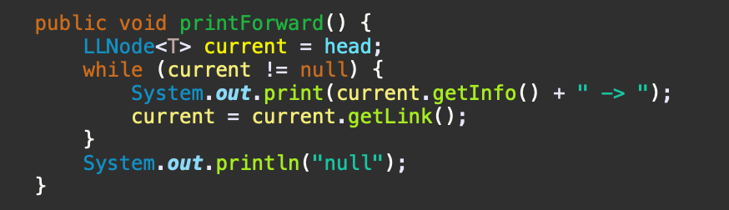
Storing Data and Printing List in Order
I created a program that initializes a singly linked list and populates it with string data. Each node, made with the LLNode class, contains data and a link to the next. To display the list, I used a method that iterates from the first node to the last, printing each node's data in the order they were added, demonstrating the list's orderly and accessible nature.

Slide 5
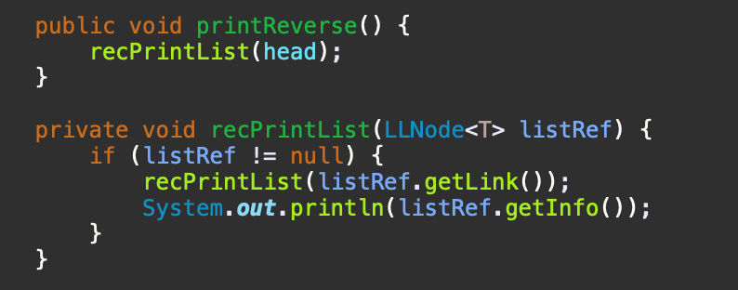
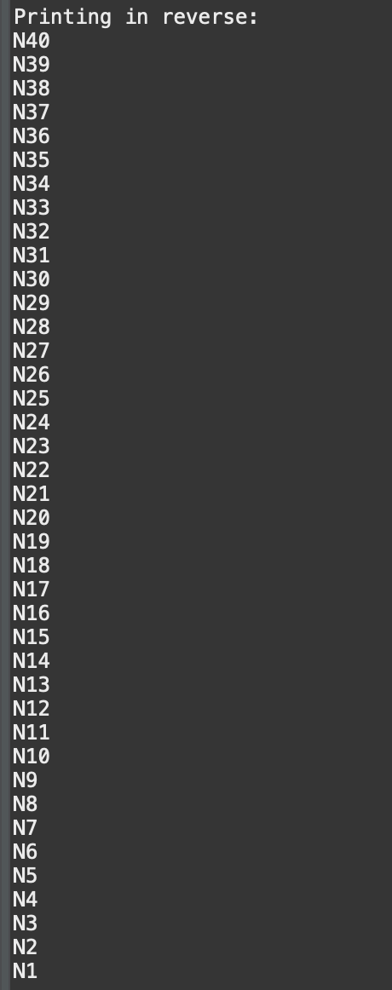
Printing the list in a Reverse Order
This method leverages the recursive nature of the list to navigate to the list's end before printing each node's data on the return journey.
This approach efficiently prints the list in reverse order by calling recPrintList with the head node. The recursion unwinds from the last node back to the first, printing each node's data in reverse order.

Slide 6
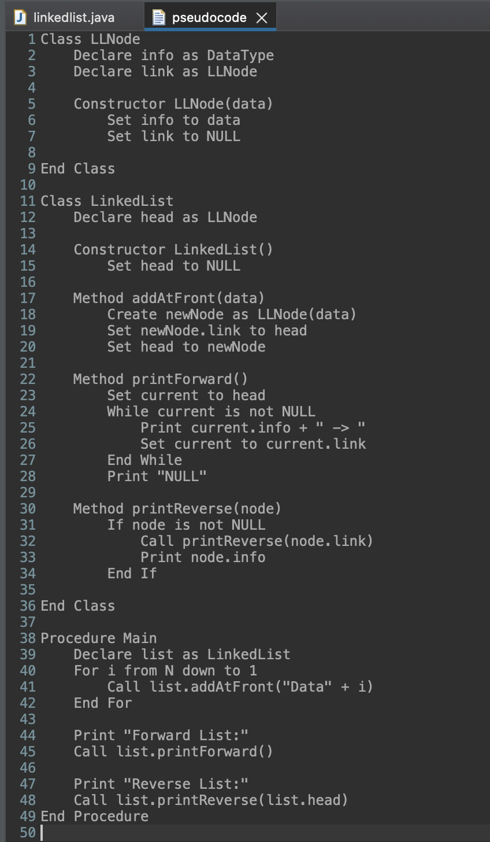
Pseudocode
Class LLNode: Defines the structure of each node in the linked list, including the data it holds (info) and a reference to the next node (link).
Class LinkedList: Manages operations on the list, including initialization (Constructor LinkedList), adding elements to the front (Method addAtFront), printing the list in forward order (Method printForward), and printing the list in reverse order (Method printReverse).
Procedure Main: Demonstrates creating a linked list, populating it with N elements in reverse order so they appear in ascending order when traversed from the head, and invoking both print methods to display the list's content in forward and reverse order.

Slide 7
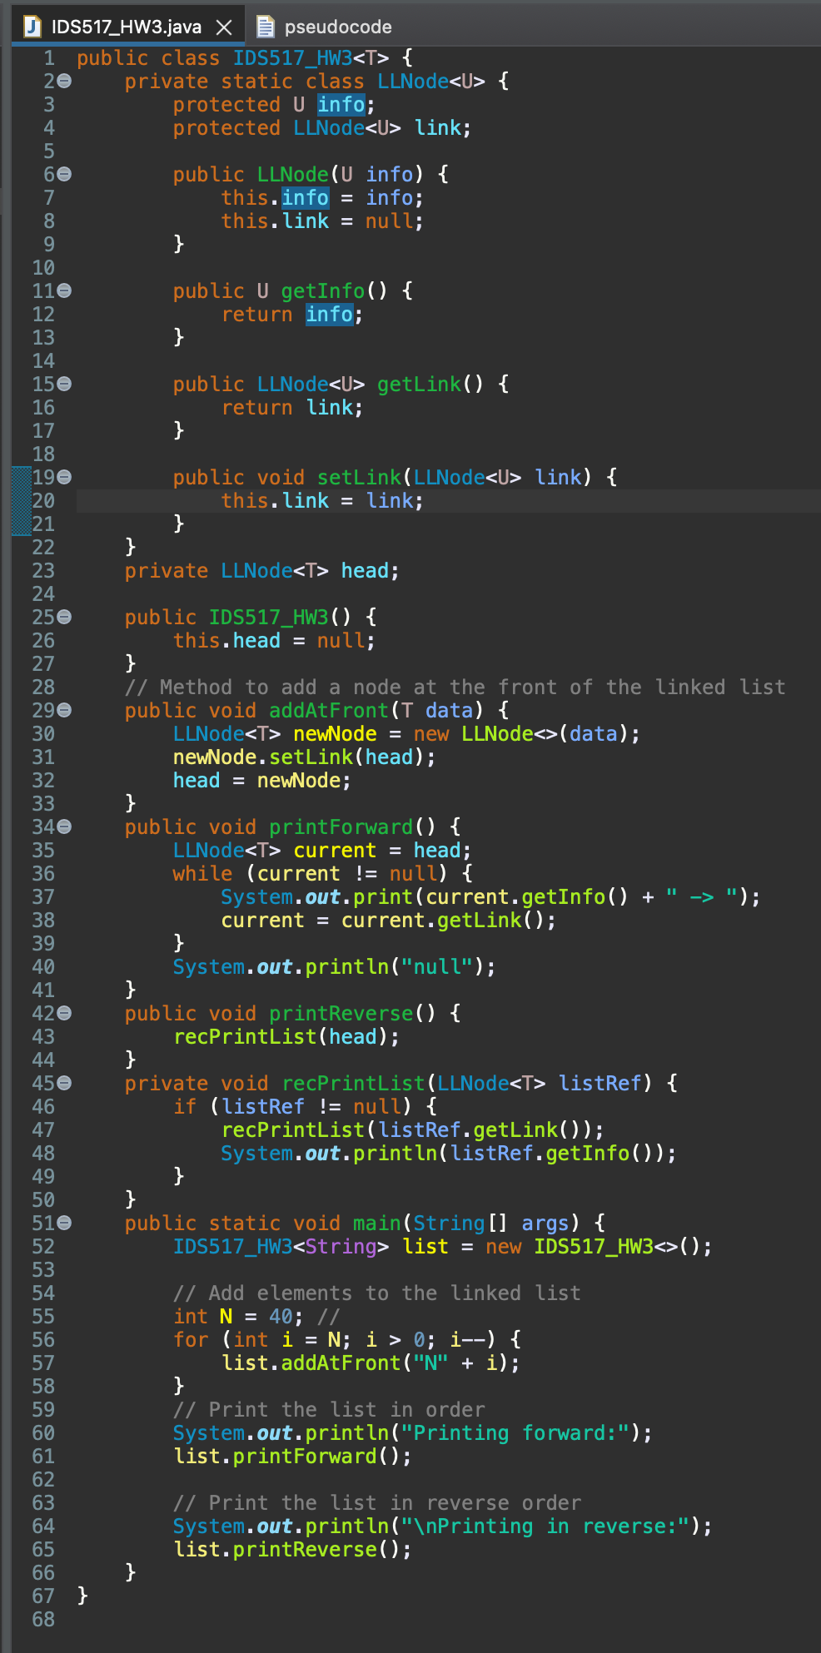
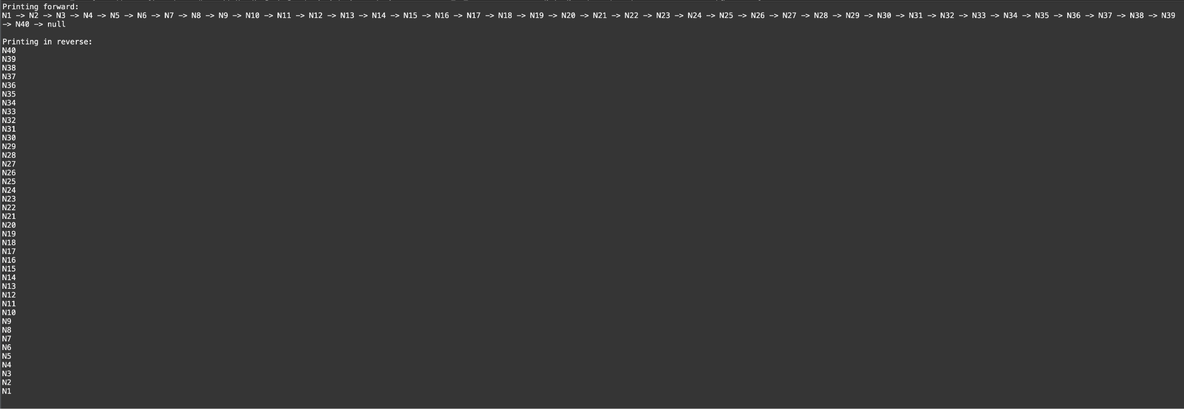
Code and Output :

Slide 8
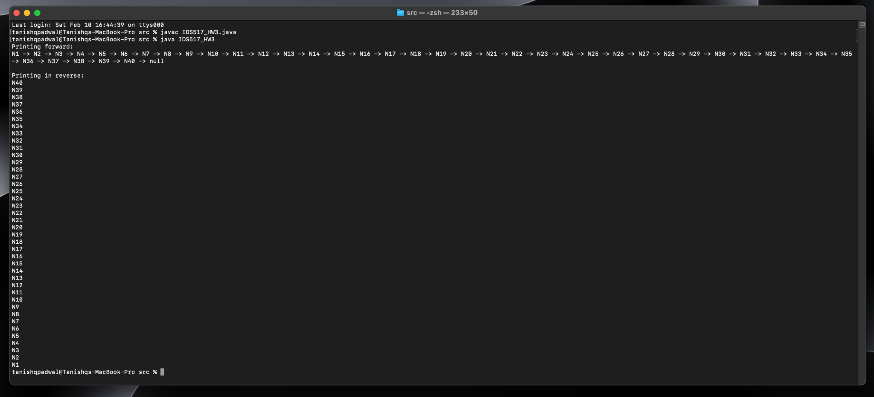
ByteCode File compilation

Slide 9
Understanding Singly Linked Lists
Singly Linked Lists Are Forward-Only: They lack backlinks to previous nodes, making backward traversal inherently require additional memory or structural modifications.
Recursion Implies Additional Memory Usage: Using recursion for reverse printing implicitly uses the call stack to store return addresses, which conflicts with the constraint against using additional structures.
In-Place Reversal Modifies the List: Reversing the list's links in place to then print it in reverse order modifies the original structure, which may not be desired.

Slide 10
Conclusion :
Given the constraints against using additional structures or modifying the original list, devising a method to reverse print a singly linked list presents a significant challenge. Traditional approaches either modify the list structure, use additional memory, or both. This highlights a fundamental limitation in singly linked list design for reverse operations, underscoring the importance of choosing the right data structure based on use case requirements.

