Slide 1
HiLo Game
IDS517
Tanishq Padwal
664972389

Slide 2
Project Scheduling & Timeline (January 24th to February 4th)
January 24: Planning & Analysis
Define game requirements and objectives.
Deliverable: Requirements game requirements document.
January 25: Environment Setup
Establish Java development setup.
Deliverable: Operational development environment.
January 26-27: Game Framework
Create basic game structure and user input handling.
Deliverable: Game framework.
Jan 28-February 1: Algorithm Development
Jan 28: Random Guess (With Duplicates)
Jan 29: Random Guess (No Duplicates)
Jan 30: Sequential Search
Jan 31-Feb 1: Binary Search
Deliverable: Implemented algorithms.
Feb 2: Integration & Testing
Combine algorithms, conduct thorough testing.
Deliverable: Fully functional game.
Feb 3: Performance Analysis
Evaluate and compare algorithm efficiency.
Deliverable: Analysis report.
Feb 4: Documentation & Finalization
Compile documentation, finalize project presentation.
Deliverable: Comprehensive project presentation.

Slide 3
Hi Lo Game: Requirements and Description
Project Overview
The Hi Lo game is a number-guessing game where the objective is to guess a target number within a specified range using various algorithms. The game will offer different modes and algorithms for the player to experiment with.
Game Description
Title: Hi Lo Game
Genre: Puzzle/Number Guessing
Platform: Java (Console-based)
Objectives
To create an engaging number guessing game.
To implement and compare different number guessing algorithms.
To provide both an auto-mode and a manual mode for number selection.

Slide 4
User Interface
Console-based text interface.
Initial menu for selecting auto-mode or manual mode.
In manual mode, prompt the user to input a target number.
Display the number of guesses each algorithm takes to find the target number.
Clear instructions and results are displayed on the console.
Game Modes
Auto-Mode: The game automatically generates a random target number between 1 and 1000.
Manual Mode: The user inputs a target number between 1 and 1000.
Algorithms
Random Guess (with duplicates): The algorithm randomly guesses numbers, allowing duplicate guesses.
Random Guess (without duplicates): The algorithm randomly guesses numbers, ensuring no duplicates.
Sequential Search: The algorithm sequentially searches from 1 to 1000 until it finds the target.
Binary Search: The algorithm uses a binary search strategy to find the target number.
Performance Metrics
Each algorithm will have a counter to track the number of guesses made.
The game will compare the performance of each algorithm based on the number of guesses.
Technical Requirements
Java Development Kit (JDK) for development and testing.
Standard Java libraries only (e.g., java.util).

Slide 5
Development Timeline
Start Date: January 24th
End Date: February 4th
Detailed timeline and task breakdown as per the project scheduling.
Testing and Validation
Each algorithm will be tested for accuracy and efficiency.
The game will be tested in both auto-mode and manual mode for functionality.
Documentation
Code documentation for maintainability and clarity.
Final presentation detailing the development process, algorithm comparison, and learnings.

Slide 6
Hi Lo Game Design Document
The Hi Lo game challenges players to guess a target number between 1 and 1000 using various algorithms. The game offers both an automatic mode, where the target number is randomly generated, and a manual mode, where the player chooses the target number.
Architectural Overview
The game is structured into several key components:
Main Control Unit: Manages game flow and user interactions.
Algorithm Module: Contains implementations of the four guessing algorithms.
User Interface: Console-based interface for player interactions.
Performance Analyzer: Tracks and compares the performance of algorithms.
Technical Considerations
Language: Java
Data Structures: Utilization of basic data structures like arrays and sets (for storing guessed numbers).
Error Handling: Implement error handling for user inputs.
Modularity: Code organized into methods and classes for readability and maintainability.

Slide 7
Component Design
Main Control Unit
Handles the initial user input to select the game mode.
Initiates the target number generation or user input process.
Coordinates the running of different algorithms.
Collects results from each algorithm and sends them to the Performance Analyzer.
Algorithm Module
This module includes four distinct algorithms:
Random Guess (with duplicates)
Generates random guesses, allowing duplicates.
Random Guess (without duplicates)
Generates random guesses, ensuring each guess is unique.
Sequential Search
Iteratively guesses each number from 1 to 1000.
Binary Search
Uses a divide-and-conquer approach to guess the number.
Each algorithm is implemented as a separate method with a standardized interface for ease of integration.
User Interface
Console-based, text-input/output interface.
Displays instructions, options for game modes, and results.
Handles input validation and error messages.
Performance Analyzer
Receives the number of guesses from each algorithm.
Compares and displays the efficiency of each algorithm in terms of the number of guesses.

Slide 8
Documentation
In-line comments for critical sections and methods.
Separate presentation for project explanation.
Testing Strategy
Each algorithm will be tested independently for correctness.
User Testing: Manual testing in different scenarios to ensure reliability.
Conclusion
This design document outlines the structure and components necessary for the Hi Lo game's development. It ensures that the game is built systematically, with a focus on maintainability, efficiency, and user experience.

Slide 9
Pseudocode
Program HiLoGame
Method Main
Initialize scanner and random generator
Display game instructions
Read game mode choice (auto or manual)
If manual, prompt and read target number
Else, generate random target number
Display target number
Call and display results from:
- randomGuessWithDuplicates(target)
- randomGuessWithoutDuplicates(target)
- sequentialSearch(target)
- binarySearch(target, 1, 1000)
End Method
Method randomGuessWithDuplicates(target)
Initialize count, generate random guesses until target is found
Return count
End Method
Method randomGuessWithoutDuplicates(target)
Initialize count, set for guesses, generate unique random guesses until target is found
Return count
End Method
Method sequentialSearch(target)
Initialize count, iterate from 1 to 1000 until target is found
Return count
End Method
Method binarySearch(target, low, high)
Initialize count, perform binary search until target is found
Return count
End Method
End Program

Slide 10
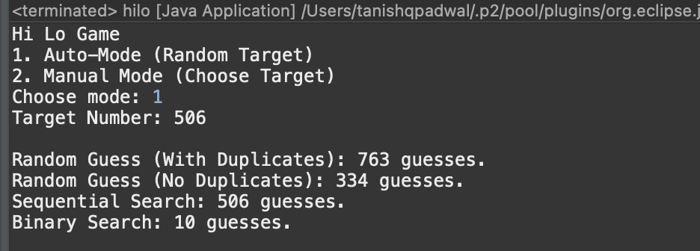
Game Screenshots :

Slide 11
Hi Lo game Analysis Report
This report presents an analysis of four algorithms used in the Hi Lo game, focusing on their performance in terms of the average number of guesses required to find a target number, along with a theoretical Big-O analysis for each.
The analysis underscores the importance of algorithm selection based on efficiency. Binary Search emerges as the most efficient algorithm for the Hi Lo game, demonstrating the practical benefits of logarithmic complexity. In contrast, Random Guessing, particularly with duplicates, proves to be the least efficient due to its unstructured approach and high variability. This report highlights how algorithm efficiency impacts performance in computational tasks.

Slide 12
Algorithms Performance
Random Guess with Duplicates
Average Number of Guesses: 935.0
Observations: High variability in guesses due to randomness and duplicate guesses. The high average indicates lower efficiency.
Big-O Analysis: Worst case is O(∞), as there's no upper limit to the number of guesses, especially with duplicates allowed.
Random Guess without Duplicates
Average Number of Guesses: 499.6
Observations: More efficient than guessing with duplicates due to elimination of repeat guesses. However, still not as efficient as more structured methods.
Big-O Analysis: O(n) - Every number is unique; the worst case would involve checking every number once.
Sequential Search
Average Number of Guesses: 464.5
Observations: Moderate efficiency; the approach is systematic but can be less efficient for larger target numbers.
Big-O Analysis: O(n) - In the worst case, might need to check each number sequentially.
Binary Search
Average Number of Guesses: 8.6
Observations: Highly efficient with far fewer average guesses. Its logarithmic nature greatly enhances its effectiveness.
Big-O Analysis: O(log n) - Divides the search range in half with each guess, significantly reducing the number of guesses.

