Slide 1
NYSTRÖM-OPTIMIZED KERNEL K-MEANS CLUSTERING
A COMPARISON OF CLUSTERING METHODS
LUKE FLECKER AND TANUSH KALLEM

Slide 2
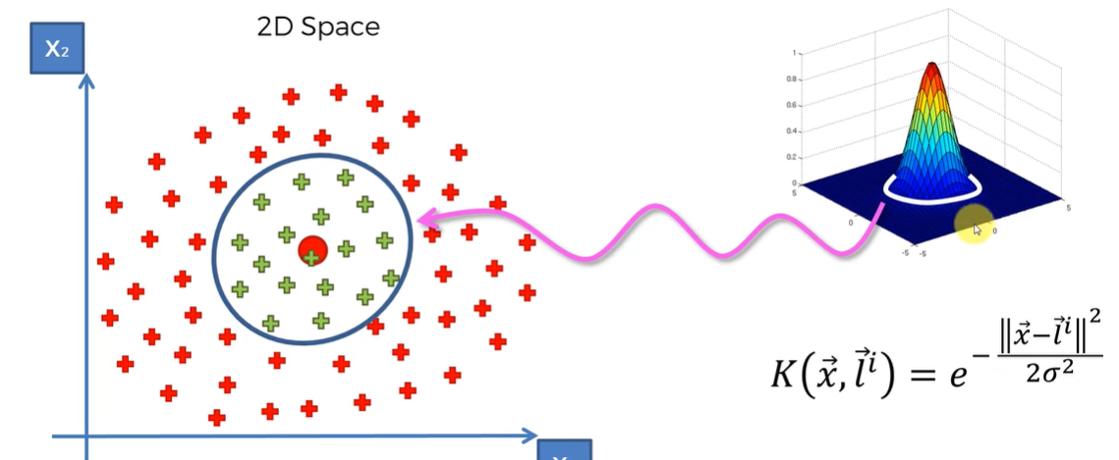
INTRODUCTION TO CLUSTERING
Clustering: Fundamental unsupervised machine learning task
Goal: Divide data into clusters based on similarity
K-means: Simple and efficient, but struggles with non-linear data
Kernel K-means: Uses RBF kernels for non-linear patterns
Computationally intensive for large datasets

Slide 3
THE NYSTRÖM APPROXIMATION
Problem: Full kernel matrix calculation is expensive
Solution: Nyström approximation
Approximates the kernel matrix by using a subset of data points
Reduces computational cost
Improves scalability of kernel methods for clustering non-linear data

Slide 4
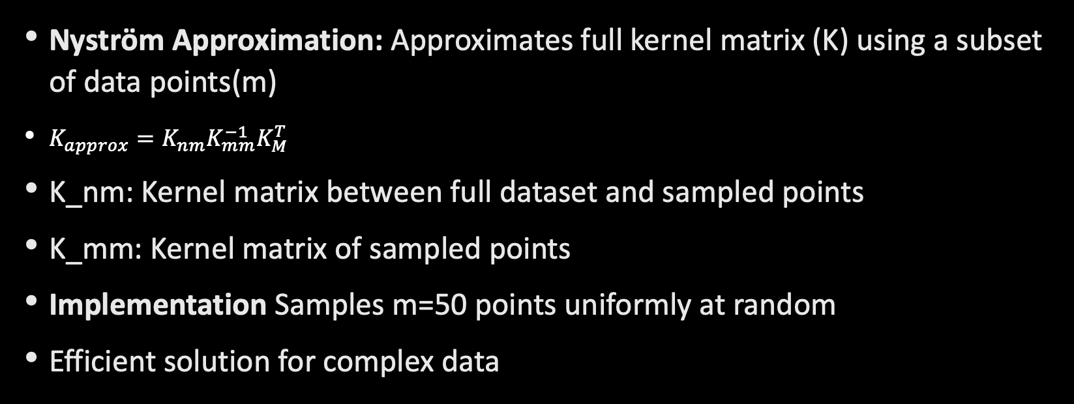
NYSTRÖM KERNEL K-MEANS METHOD

Slide 5
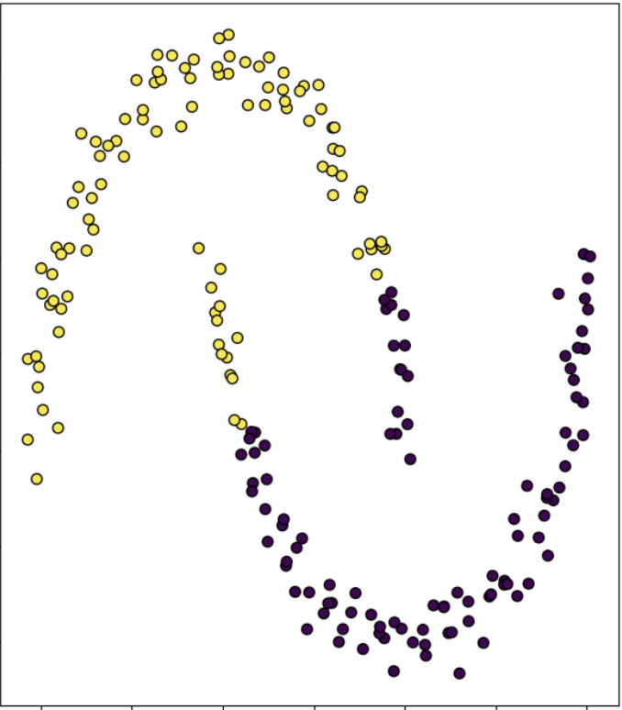
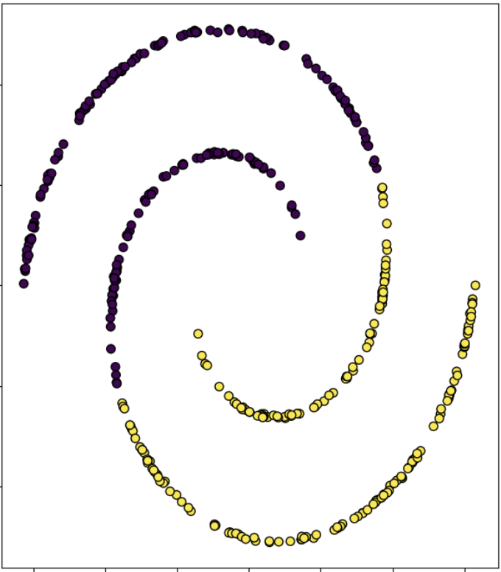
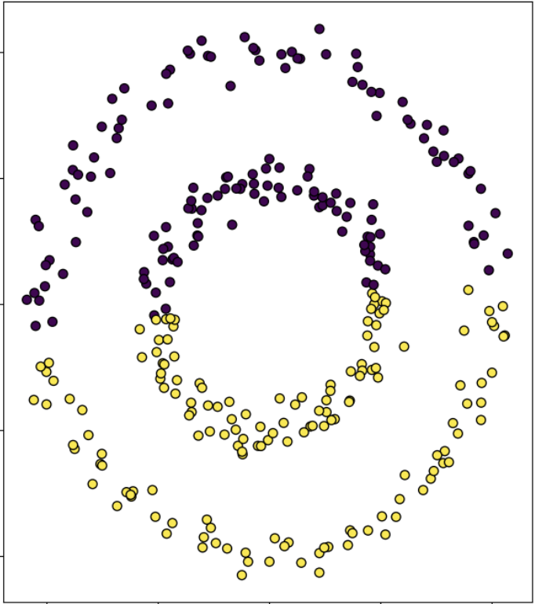
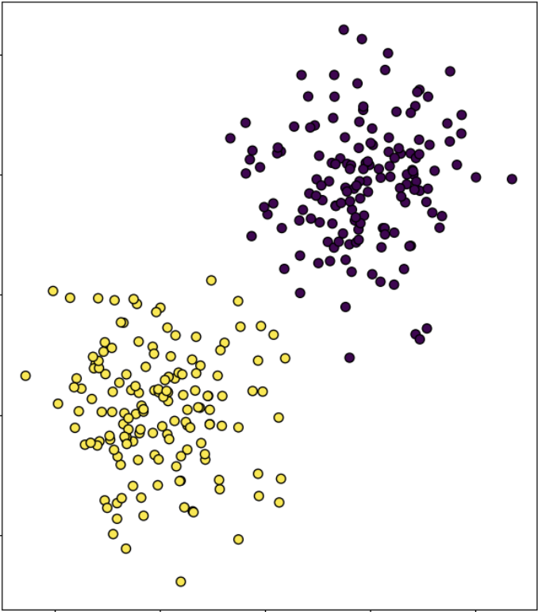
DATASETS
Moon: Interleaving crescent shapes
Non-linearly separable
Spiral: Spiral arrangement
Non-linearly separable
Circles: Concentric circles
Non-linearly separable
Blobs: Gaussian-distributed clusters

Slide 6

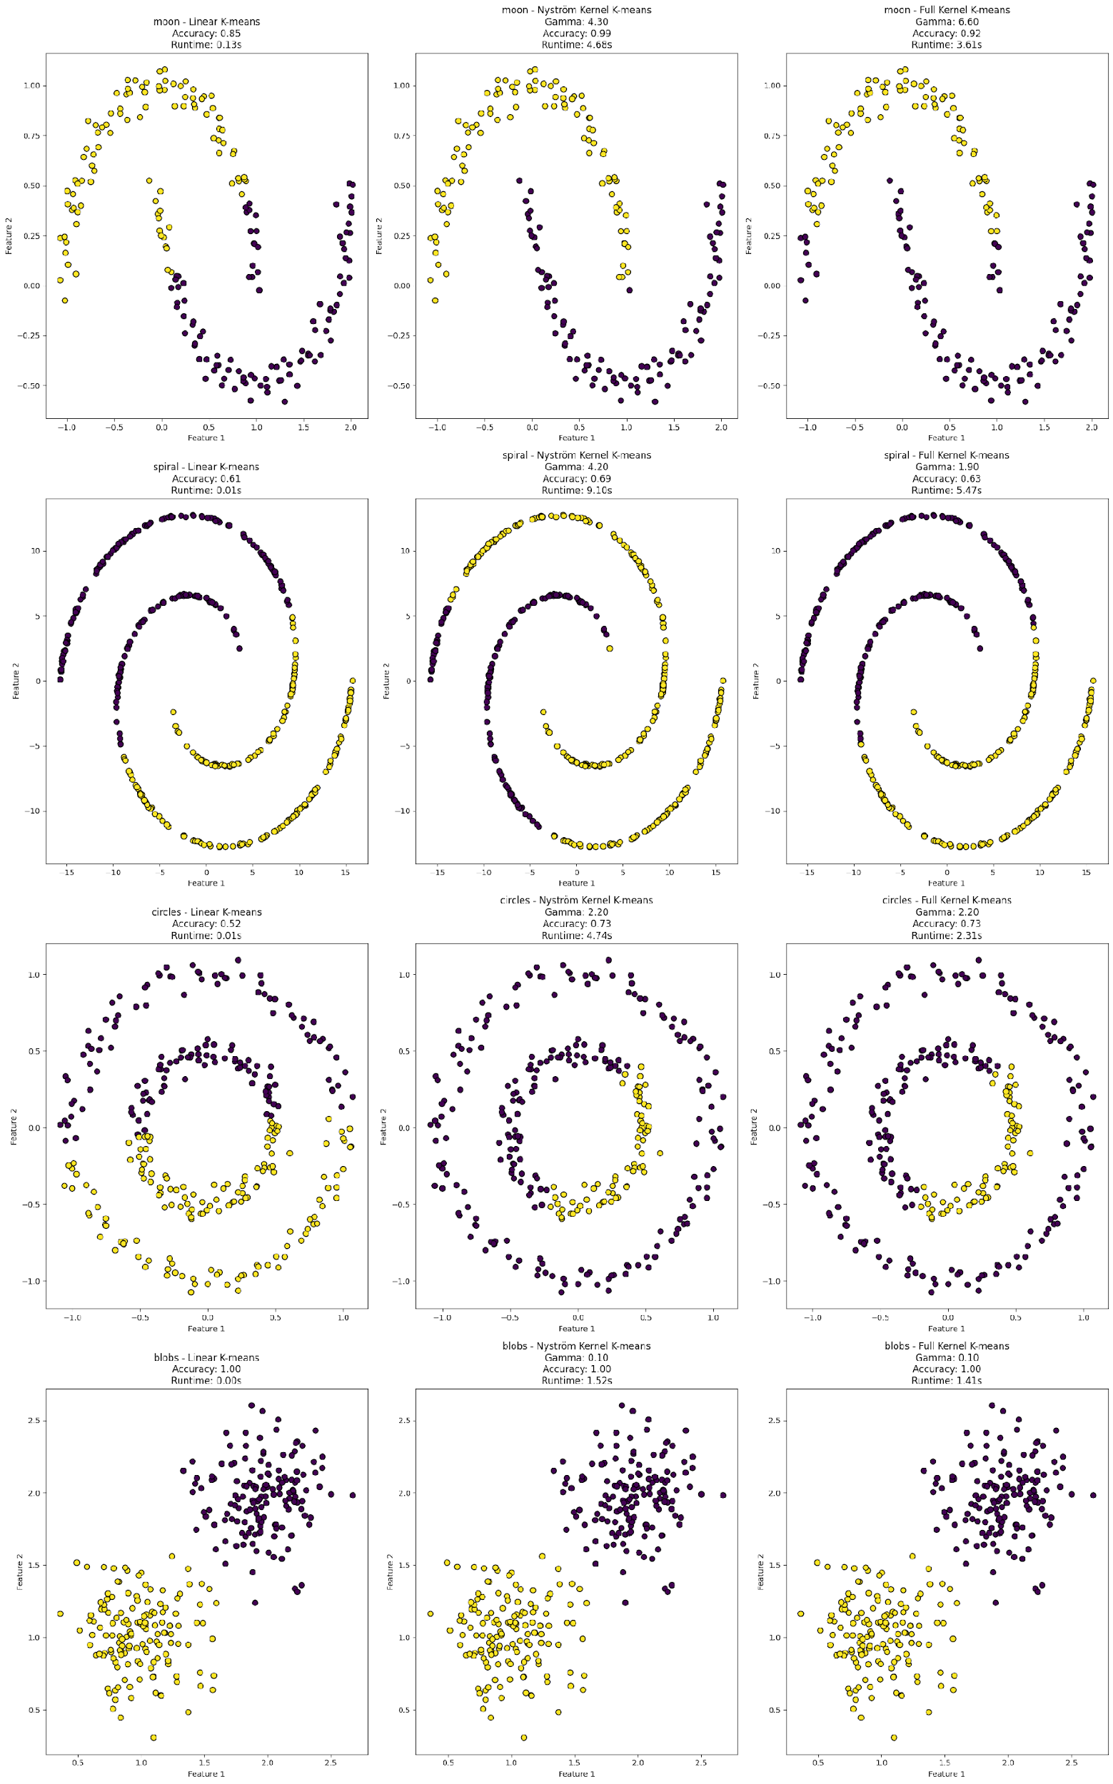

RESULTS

Slide 7
RESULTS
Dataset | Method | Accuracy | Runtime(s) | Optimal γ
Moon | Linear K-means | 0.85 | 0.13 | -
 | Nyström Kernel K-means | 0.99 | 4.68 | 4.3
 | Full Kernel K-means | 0.92 | 3.61 | 6.6
Spiral | Linear K-means | 0.61 | 0.01 | -
 | Nyström Kernel K-means | 0.69 | 9.10 | 4.2
 | Full Kernel K-means | 0.68 | 5.47 | 1.7
Circles | Linear K-means | 0.52 | 0.01 | -
 | Nyström Kernel K-means | 0.73 | 4.74 | 2.2
 | Full Kernel K-means | 1.00 | 2.31 | 2.2
Blobs | Linear K-means | 1.00 | 0.00 | -
 | Nyström Kernel K-means | 1.00 | 1.52 | 0.1
 | Full Kernel K-means | 1.00 | 1.41 | 0.1
Linear K-means:
Fast, but poor on non-linear data (Spiral, Circles)
Good on linearly separable data (Blobs)
Nyström Kernel K-means:
Enhanced accuracy for non-linear data
Best accuracy on Moon dataset
Runtime slower than expected
Full Kernel K-means
Consistently competitive accuracy
Runtime comparable to Nyström

Slide 8
CONCLUSION & FUTURE WORK
Nyström Kernel K-means: a good alternative for large datasets
Outperformed Full Kernel K-means on some datasets
Can be improved with a coarser gamma search
Try changing m
Explore a coarser search for the gamma parameter
Test on larger datasets
Test Nyström kernel k-means on real-world applications

