Slide 1
報告者：○○○ (標楷體) 中報日期：2013年11月13日
論文資訊
Daniele Panozzo, Philippe Block, and Olga Sorkine-Hornung. 2013. Designing unreinforced masonry models. ACM Trans. Graph. 32, 4, Article 91 (July 2013), 12 pages. DOI=10.1145/2461912.2461958 http://doi.acm.org/10.1145/2461912.2461958
Notes:
http://dl.acm.org/citation.cfm?id=2461912.2461958&coll=DL&dl=ACM&CFID=261429965&CFTOKEN=16514996

Slide 2
影片播放
影片請事先下載到硬碟

Slide 3
論文摘要(英中對照)
We present a complete design pipeline that allows non-expert users to design and analyze masonry structures without any structural knowledge.
中文…
We optimize the force layouts both geometrically and topologically, finding a self-supported structure that is as close as possible to a given target surface.
中文…

Slide 4
論文摘要(英中對照) continued
The generated structures are tessellated into hexagonal blocks with a pattern that prevents sliding failure.
中文…
The models can be used in physically plausible virtual environments or 3D printed and assembled without reinforcements.

Slide 5
圖片
無須把paper的圖貼到ppt
只需要回到paper從圖一瀏覽到最後一張圖

Slide 6
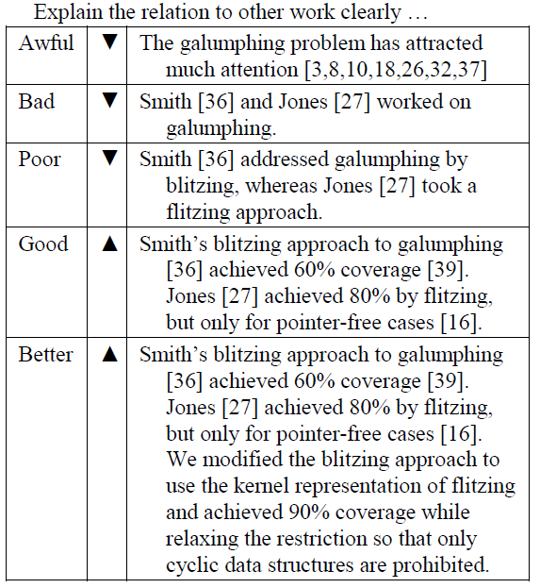
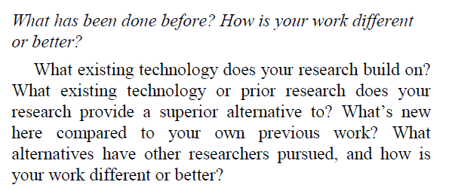
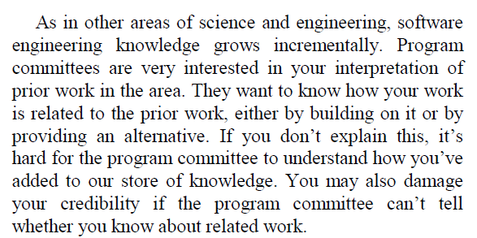
撰寫相關文獻討論

Slide 7
回答下列問題
What are motivations for this work? 該論文解決的問題
What is the proposed solution? 該論文解決的方法
What is the evaluation of the proposed solution?該論文作者如何評估其結果? (問卷, 量測時間數據, 實驗…)

Slide 8
回答下列問題
What alternative solutions exist? 有無其他解決方法?
What are the contributions? 該論文的貢獻為和?
What are future directions for this research? 未來研究方向可以為何?

