Slide 1
PRACTICAL ATTACHMENT PRESENTATION
Development of a Full-Stack Web Application
A corporate website for BCS Coffee Market Consulting
Tsion Tesfaye · Student ID 3725/16
Department of Information Systems · Faculty of Informatics · Hawassa University
Host: BCS Computer and Finance Solution — Web Development Section
Company Mentor: Bekure Yimam, Owner & Managing Director
Attachment Period: June 23 – August 22, 2026

Slide 2
Presentation Outline
1. Background of the hosting company
2. My attachment experience, section and workflow
3. Work tasks, procedures and performance
4. The developed system — features and architecture
5. Website screenshots (figures from the report)
6. Challenges encountered and measures taken
7. Benefits gained — technical, theoretical and professional
8. Conclusion and recommendations
Practical Attachment Report · BCS Computer and Finance Solution · June 23 – August 22, 2026
2

Slide 3
Background of the Hosting Company
BCS Computer and Finance Solution
Information technology and business consulting company and training institution located in Addis Ababa, Ethiopia.
Professional services in information technology, software development, computer training, and business and finance consulting.
Main service areas: professional training (programming, engineering, accounting and design packages), software and web development, graphics and multimedia, IT and financial/IFRS consulting, accounting and ERP systems, technical maintenance and sales of computers and accessories.
Also operates BCS Coffee Market Consulting — an affiliated coffee exporting and consulting firm, for which this website was developed.
Customers: students and trainees, small and medium-sized businesses, and organizations requiring IT, software or consulting services.
Practical Attachment Report · BCS Computer and Finance Solution · June 23 – August 22, 2026
3

Slide 4
BCS Coffee Market Consulting
BCS Coffee Market Consulting — Brief History
2009 — Founded in Addis Ababa as a local broker linking coffee producers and roasters.
2014 — Began exporting to the European, Asian and Middle Eastern markets.
2019 — Formed relationships with over 100 exporters and built a verified network across Ethiopia's primary coffee-growing regions.
2024 — Expanded operations into international coffee consulting, serving buyers across 40+ countries.
Owned and led by Bekure Yimam, Owner and Managing Director.
Consulting Services for International Buyers
Seven core consulting services guiding buyers through the export and sourcing process (company profile):
Coffee export consulting
Coffee certificate consulting and verification
Quality control and grading
Market research
Logistics coordination
Pricing negotiation
Support across sourcing requirements, certification and compliance, supplier vetting, market information, export logistics and origin-based transparent pricing.
Practical Attachment Report · BCS Computer and Finance Solution · June 23 – August 22, 2026
4

Slide 5
Organization and Workflow of the Company
Team Structure — Four Main Members
Bekure Yimam — Owner & Managing Director: general management, coffee consulting, corporate strategy, marketing, finance and IFRS consulting, export/import consulting, and relations with clients, suppliers and partners of the business.
Rose Ahmed — Coffee Documentation Officer: prepares documents and records for coffee samples and international shipments; supports export documentation.
Ferehiwot Dires — Finance Officer: payments, receipts and expenses, bookkeeping, accounting and budgeting; maintains financial records.
Zehara Bedru — Coffee Sample Processing & Office Support Officer: processes, filters, sorts and pre-screens coffee samples for cupping; performs secretarial and assigned office tasks.
Workflow of the Company
Begins with a client or international buyer providing requirements: volume, grade, origin, profile and certifications.
The right coffee sources are identified with A and B grading.
Table cupping quality control: tasting by grading, connoisseurship in cup, and aroma analysis.
Bekure Yimam provides market information, pricing and sourcing advice.
Relationship and deal management plus coffee export coordination support the buyer in getting the right Ethiopian coffee.
Practical Attachment Report · BCS Computer and Finance Solution · June 23 – August 22, 2026
5

Slide 6
How I Joined and the Section I Worked In
How I Got into the Company
Contacted BCS Computer and Finance Solution directly and asked whether I could complete my practical attachment there.
Introduced myself as an Information Systems student, explained my existing technical skills, and expressed my goal to enhance them and acquire new knowledge in web development.
After discussing my background and learning goals, the company accepted me for a training placement in the Web Development section.
The Owner and Managing Director agreed to act as my mentor and oversee the placement.
The Section I Worked In
Joined the technology and web development department of BCS Computer and Finance Solution.
Because of the small size of the organization, there was no formal IT department.
Main involvement: development of the web system for BCS Coffee Market Consulting.
Worked closely with my mentor, who supplied the business requirements, company services and activities, content direction and branding preferences for the website.
Practical Attachment Report · BCS Computer and Finance Solution · June 23 – August 22, 2026
6

Slide 7
Workflow of the Section — Six Phases
Phase 1 — Requirement Understanding
June 23–27, 2026
Familiarized with the company, its services, coffee production stages, origins and sector terms; discussed website contents, users and business requirements before programming.
Phase 2 — Project Setup & Initial Development
June 27 – July 7, 2026
Learned React, Vite, TypeScript and Tailwind CSS basics; initialized the project, defined its structure and set up routing, layout, navigation bar, footer and first pages.
Phase 3 — Main Page Development
July 7–16, 2026
Built Home, About, Services, Origins, From the Field, Our Team and Contact pages with reusable layout, footer and navigation — designed to be responsive on all screen sizes.
Phase 4 — Content Integration & Refinement
July 16–27, 2026
Revised pages with company information, services and contact details; adjusted layouts per client requirements; removed or changed content as requested.
Phase 5 — Feature Development & Improvements
July 27 – August 7, 2026
Added dark/light themes, a reusable contact form and the interactive Ethiopian coffee origins map; implemented SEO metadata, Open Graph tags, sitemap, accessibility and mobile navigation.
Phase 6 — Backend & Contact Form Integration
August 7–22, 2026
Built the backend so submitted messages are sent to the API and stored; continuous implement–test–fix and redesign cycles to meet the client's needs.
Practical Attachment Report · BCS Computer and Finance Solution · June 23 – August 22, 2026
7

Slide 8
Work Tasks Executed
Work Tasks I Executed (I)
Identifying the client's requirements and planning the project.
Learning about and applying new web development technologies (React, Vite, TypeScript, Tailwind CSS).
Developing the frontend application: pages, routing and reusable components.
Designing for responsiveness and styling for both dark and light themes.
Developing the interactive Ethiopian coffee origins map.
Work Tasks I Executed (II)
Implementing the contact form and integrating it with the backend.
Developing search engine optimisation (SEO) and accessibility enhancements.
Integrating website content and incorporating client feedback.
Testing, debugging and improving the application.
Applying Git version control throughout the development process.
Practical Attachment Report · BCS Computer and Finance Solution · June 23 – August 22, 2026
8

Slide 9
Procedures Used While Performing Tasks
Planning and Building
1. Analyze each requirement precisely — discuss with the mentor and gather information on the company, its services, clients, coffee products, contact details and branding choices.
2. Learn the key points of each new technology through documentation and practice before coding.
3. Plan the project structure, routing, reusable components, asset handling and styling.
4. Code incrementally — base layout, then navigation, then individual pages and reusable components — checking that major parts work correctly each time.
Integrating and Delivering
5. Integrate company information continuously; resolve ambiguous or incomplete information with the mentor before publishing it on the site.
6. Add features progressively: responsive navigation, themes, interactive map, contact form, SEO and UI improvements.
7. Test regularly — navigation, forms, responsive design, interactive features and screen sizes — then fix bugs and retest the affected features.
8. Review the implementation with the mentor and incorporate feedback on content, layout and styles.
9. Commit frequently with Git and GitHub to record progress and maintain versions.
10. Final review of usability, responsiveness, consistency and functionality; fix remaining issues and polish.
Practical Attachment Report · BCS Computer and Finance Solution · June 23 – August 22, 2026
9

Slide 10
Performance of Work Tasks
Successfully Implemented
The primary portions of the BCS Coffee Market Consulting website.
Page infrastructure, routing and reusable components.
Responsive design across screen sizes, with dark and light theme switching.
Contact form, SEO improvements and accessibility enhancements.
Flexible adaptation of content and layout to client feedback without disturbing the overall design.
How My Performance Developed
React, Vite and TypeScript were unfamiliar at first; competence was gained through self-education, practice, research and asking for help.
Biggest improvement: recognizing and troubleshooting technical issues independently — import statements, component rendering, Tailwind CSS effects and responsiveness errors.
Learned to analyze possible causes, research solutions, experiment with approaches and apply fixes.
Started knowing little about the technologies; finished by using them in a production system.
Overall improvement in technical, problem-solving, debugging and communication skills.
Practical Attachment Report · BCS Computer and Finance Solution · June 23 – August 22, 2026
10

Slide 11
Challenges Encountered
Technical Challenges
New technologies (React, TypeScript, React Router, Tailwind CSS): import and routing errors, configuration issues and difficulty applying utility classes.
UI refinement: layout, spacing, typography and styling changes often failed to produce the expected results, requiring repeated testing and adjustment.
Backend integration: connecting the contact form required understanding form data, asynchronous requests, loading states and error handling.
Multi-language support: text direction, alignment, spacing and layout considerations for each language.
Large video files: media weight created performance and deployment concerns.
Project-Related Challenges
Changing requirements — for example, the planned blog section was later removed based on project requirements.
Some planned content and company information was ambiguous or incomplete and needed clarification.
Working on a real client project required continuous communication and adaptation to feedback.
Balancing flexible changes against keeping the rest of the system unaffected — modifications had to be made without breaking other parts of the application.
Practical Attachment Report · BCS Computer and Finance Solution · June 23 – August 22, 2026
11

Slide 12
Measures Taken to Overcome Challenges
Technical Approach
Self-learning: official documentation, tutorials and sample code for React, TypeScript, React Router and Tailwind CSS.
Systematic debugging: analyze the error message, trace it to the exact code, make incremental changes and run the test after every change.
Applied newly learned concepts immediately in the project to consolidate knowledge.
Continuous testing across screen sizes, languages, themes and modes — checking responsiveness, alignment, spacing and text direction.
Media optimization: conscious selection of suitable image and video file sizes and formats.
Git version control with frequent commits to monitor changes, review old solutions and spot changes causing faults.
Guidance and Adaptation
Consulted the mentor whenever a problem could not be solved alone or requirements were unclear.
Discussed technical problems and content, style or design decisions, then implemented the agreed suggestions.
When requirements changed (e.g., removing the blog section), analyzed which parts of the application needed adjustment and adapted them.
Built a systematised problem approach: understand the problem, research solutions, test them, adapt to new requirements, and consult when necessary.
Result: problems that once blocked progress were resolved through a repeatable process — and the mentor confirmed the revised implementations met the requirements.
Practical Attachment Report · BCS Computer and Finance Solution · June 23 – August 22, 2026
12

Slide 13
The Developed System — Features
Public Website
Seven pages: Home, About, Services, Origins, From the Field, Our Team and Contact.
Dark and light themes based on user and system preferences.
Interactive Ethiopian coffee origins map with a region information panel.
Contact form that sends submissions to the backend API for storage.
Multi-language content: English, Amharic, French and Chinese.
From the Field video gallery, scrolling partner logos and cookie consent.
Responsive layout with mobile navigation across screen sizes.
Admin Panel and Quality Attributes
Secure admin login with JWT authentication and bcryptjs password hashing.
Dashboard with statistics and quick actions.
CRUD management of coffee commodities, contact submissions, site content and settings.
SEO: metadata, Open Graph tags, sitemap.xml and robots.txt.
Accessibility: semantic HTML, heading structure, image alt texts, labels and ARIA tags.
Backend logging and environment-based configuration (.env / .env.example).
Practical Attachment Report · BCS Computer and Finance Solution · June 23 – August 22, 2026
13

Slide 14
Architecture and Technology Stack
React SPA → Express REST API → Prisma ORM → SQLite
Layer | Technology | Purpose
Frontend | React, TypeScript, Vite | User interface and development
Styling | Tailwind CSS | Responsive visual design
Routing | React Router | Client-side navigation
Backend | Node.js, Express | REST API
Database | SQLite, Prisma ORM | Data storage and access
Authentication | JWT, bcryptjs | Secure admin authentication
Database models (Prisma schema): Admin · CoffeeCommodity · ContactSubmission · SiteContent · SiteSetting
CUID primary keys, required fields, unique constraints and default values; client and server architecture with public and admin API routes.
Practical Attachment Report · BCS Computer and Finance Solution · June 23 – August 22, 2026
14

Slide 15
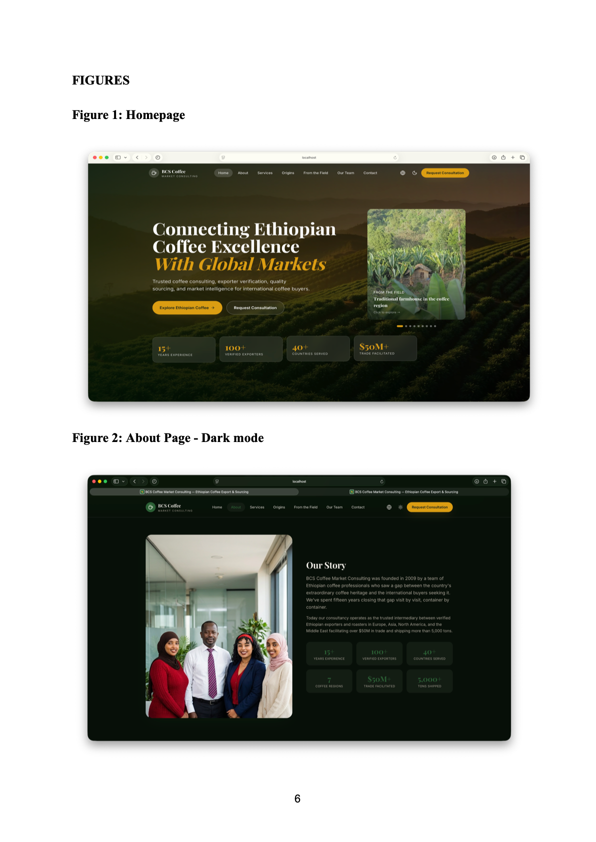
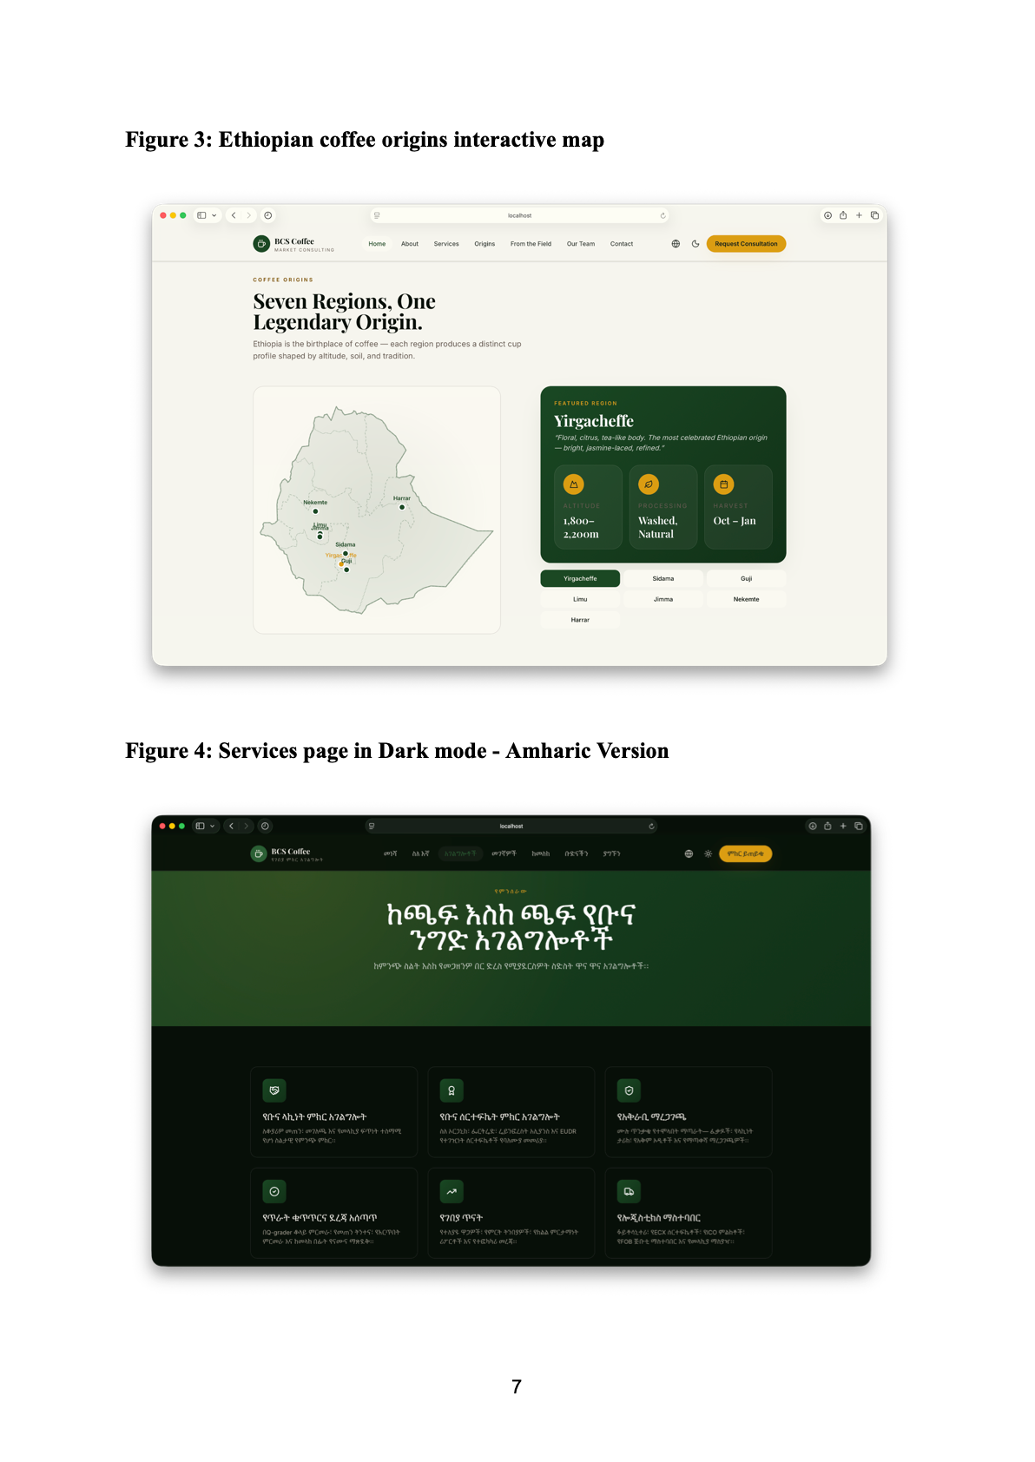
Website Screenshots — Figures 1–4
Figure 1: Homepage
Figure 2: About page — dark mode
Figure 3: Ethiopian coffee origins interactive map
Figure 4: Services page in dark mode — Amharic version
Practical Attachment Report · BCS Computer and Finance Solution · June 23 – August 22, 2026
15

Slide 16
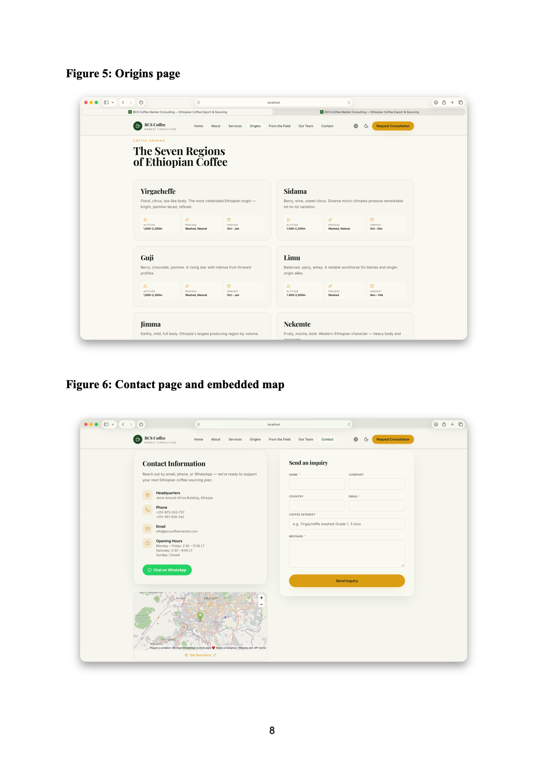
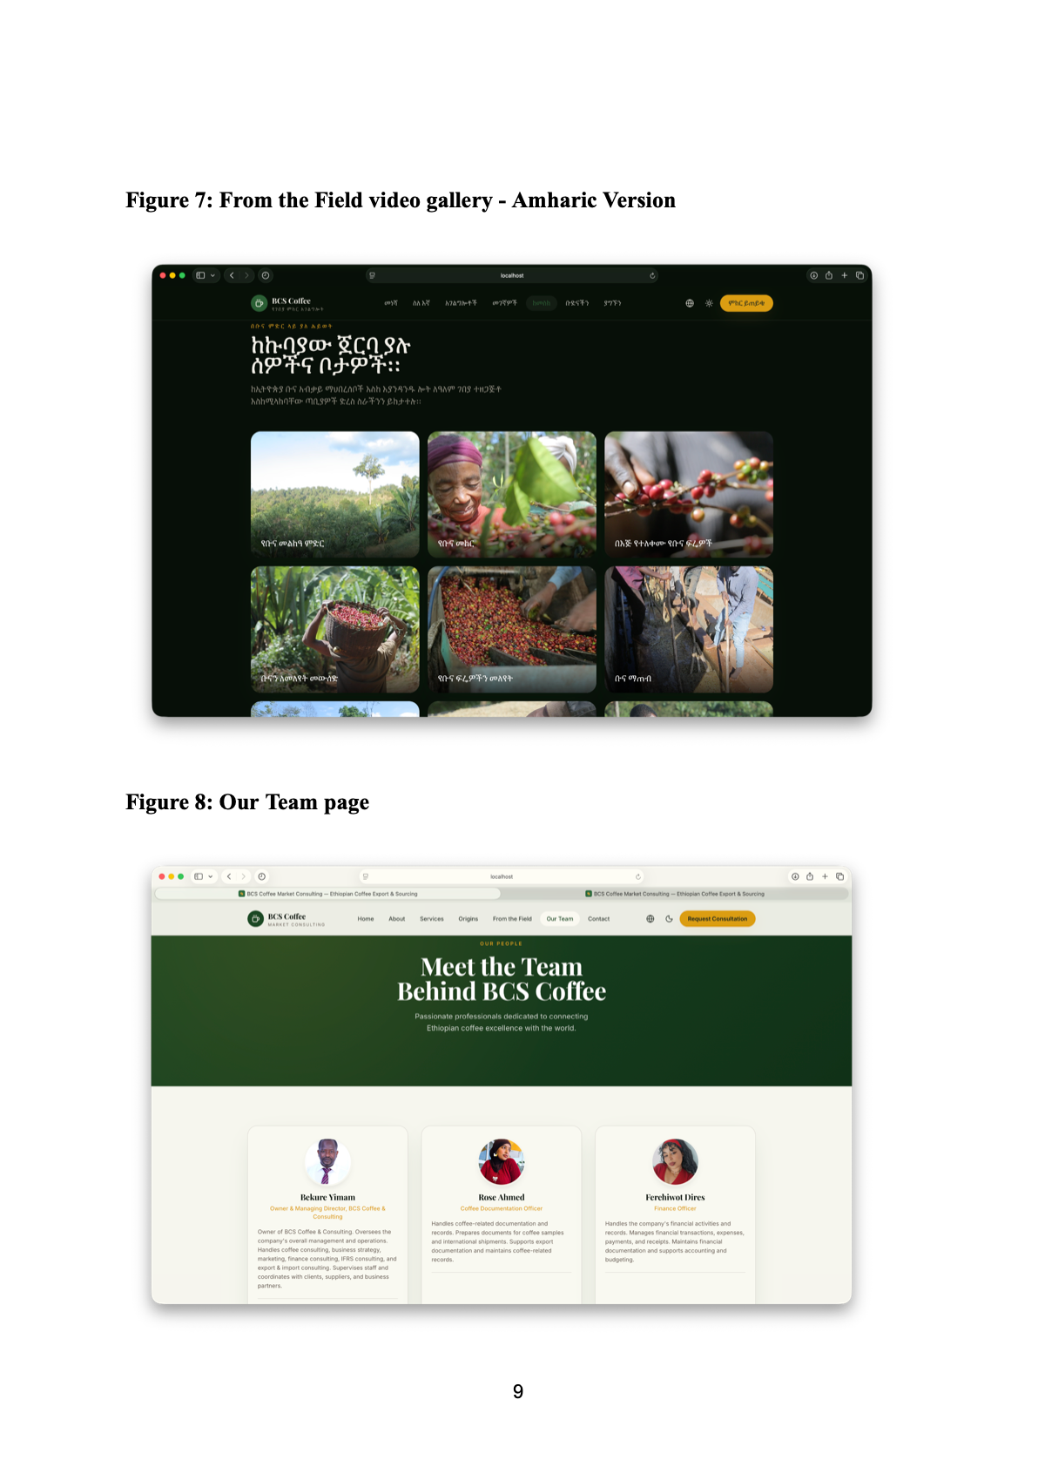
Website Screenshots — Figures 5–8
Figure 5: Origins page
Figure 6: Contact page and embedded map
Figure 7: From the Field video gallery — Amharic version
Figure 8: Our Team page
Practical Attachment Report · BCS Computer and Finance Solution · June 23 – August 22, 2026
16

Slide 17
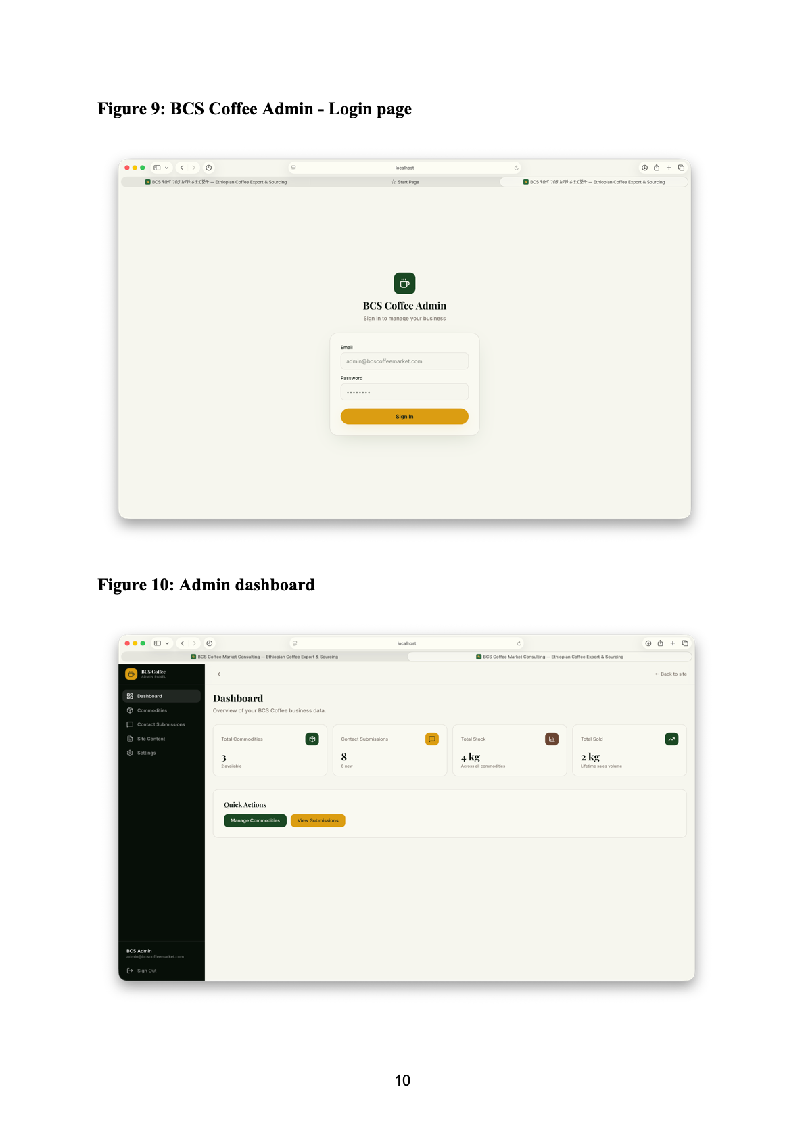
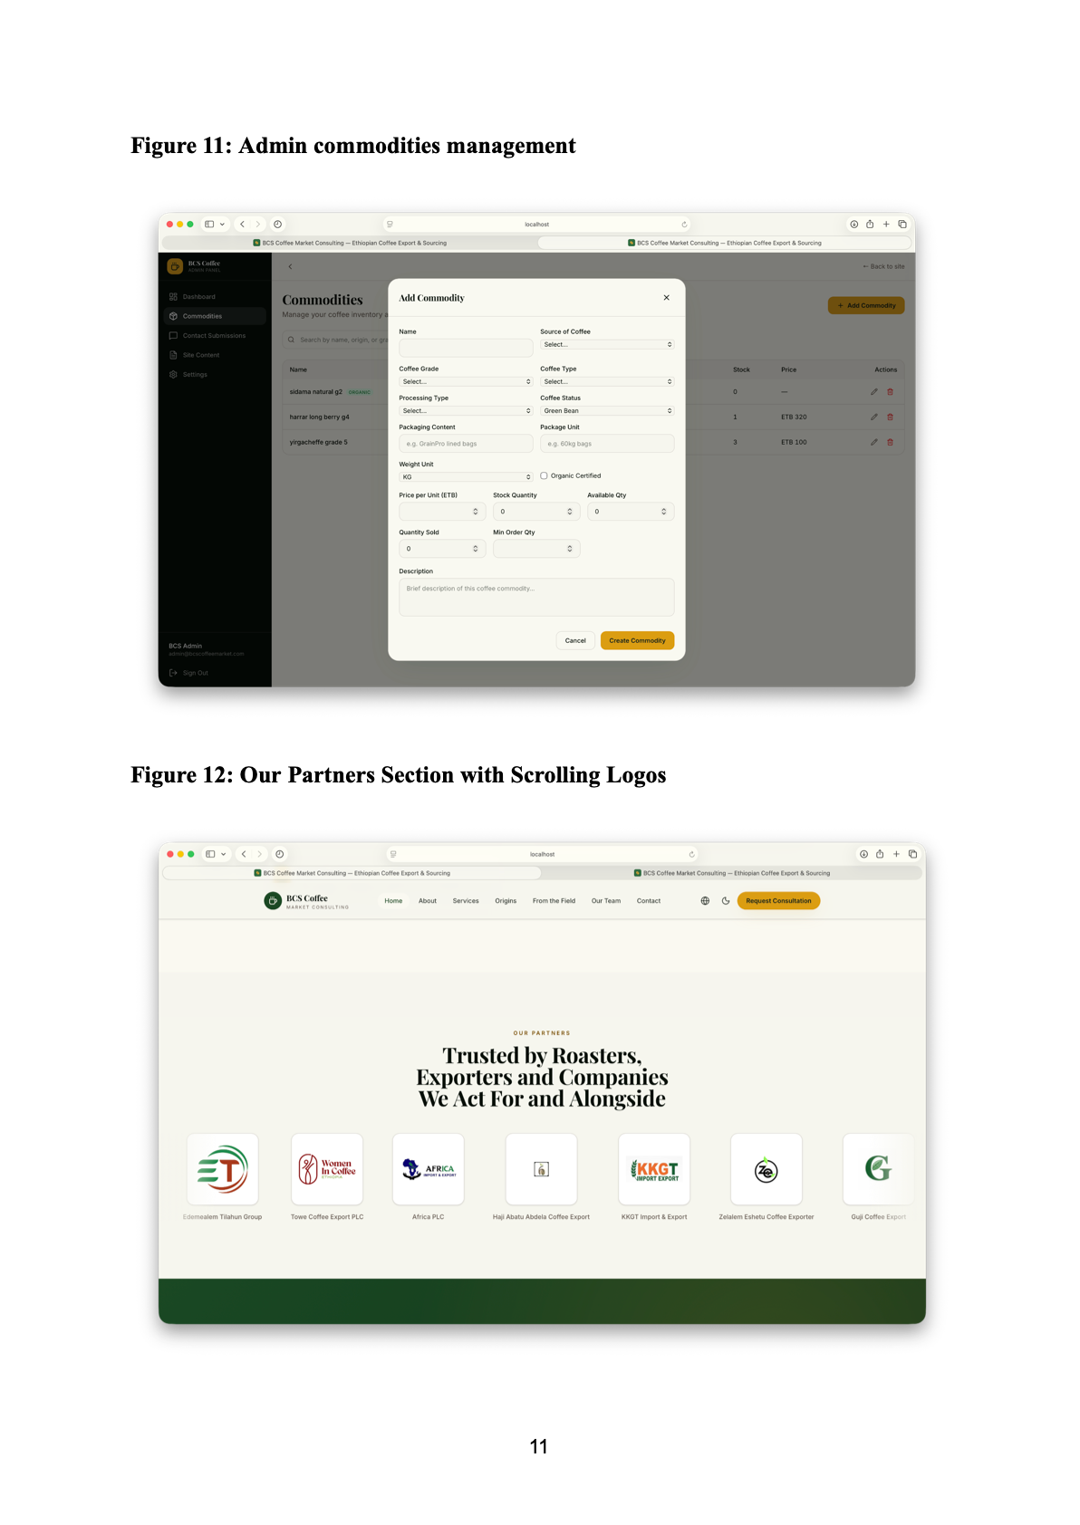
Admin Panel and Partners — Figures 9–12
Figure 9: BCS Coffee Admin — login page
Figure 10: Admin dashboard
Figure 11: Admin commodities management
Figure 12: Our Partners section with scrolling logos
Practical Attachment Report · BCS Computer and Finance Solution · June 23 – August 22, 2026
17

Slide 18
Benefits Gained — Practical Technical Skills
Frontend, Styling and UI
React: writing reusable components, organizing a front-end application, declaring component state, handling UI events and implementing client-side routing.
TypeScript: declaring interfaces and types, and using type checking — type safety catches errors during development and eases maintenance.
Responsive design with Tailwind CSS: responsive breakpoints, flexible layouts, and adapting navigation, grids, spacing and typography for mobile and desktop.
UI and theme development: visual consistency across pages and alignment of functionality with visual design for a consistent user experience.
Full-Stack, Tooling and Soft Skills
Full-stack understanding: how a frontend makes asynchronous requests to the backend and handles successful and unsuccessful responses.
Database and data handling: storing structured data in a relational database with models and retrieving it through backend services.
Git and GitHub: descriptive commits, change tracking, reviewing previous work and keeping a record of the development process.
Debugging and problem solving across routing, imports, styling, components and API calls.
Accessibility (semantic HTML, heading tags, alt texts, labels, ARIA) and SEO (page descriptions, Open Graph tags, sitemap).
Client communication: asking questions when requirements are unclear, listening to feedback and making corrections.
Practical Attachment Report · BCS Computer and Finance Solution · June 23 – August 22, 2026
18

Slide 19
Benefits Gained — Theoretical Knowledge
Software Development Concepts
Software Development Life Cycle (SDLC): experienced requirements collection, planning, interface and structure design, implementation, testing and continuous development as an iterative process.
Requirements analysis: eliciting, validating and turning business requirements into technical requirements.
Client-server architecture: the frontend lets visitors interact with the website while the backend provides services — understood through the contact form and its API.
Database concepts: representing users, coffee commodities, contact submissions and website content as entities with attributes, data types, constraints and CRUD operations.
Web, Security and Business Concepts
APIs: understanding GET and POST requests — sending a request from a page in the app to the API and receiving a reply.
Web application architecture: single-page applications and client-side routing with React Router (no full page reload), plus separation of concerns through reusable components.
Information security: input validation, safe handling of user information and configuration values — security addressed through the whole development process, not only at the end.
UI/UX principles: consistency in colors, fonts, space and navigation; loading states, validation messages, accessible navigation and dark mode.
Information systems in business: the website as a means for the company to communicate, market and demonstrate its coffee services — the IS professional translates business needs into technology.
Practical Attachment Report · BCS Computer and Finance Solution · June 23 – August 22, 2026
19

Slide 20
Communication, Teamwork and Leadership
Communication Skills
Frequent discussions with the mentor about the website and the company's expectations.
Learned to explain technical information understandably: features, design decisions, limitations and their potential impact.
Feedback skill: listen carefully, understand what changes are required and implement them.
Gathered required content (services, coffee information, team details, contacts) through discussion.
Active listening, asking relevant questions, progress updates and professional discourse.
Team Playing Skills
Most development was individual, with frequent contact with my mentor and other team members.
Collaborated on collecting and researching content: services, coffee information and team information.
Modified my implementation as new information and different opinions emerged — more flexible and open-minded.
Shared work, recognized and used feedback, and stayed flexible to changing requirements.
Learned that teamwork is also about sharing the work and checking the big picture, and taking responsibility for the deliverable.
Leadership Skills
Managed my own project and tasks autonomously — no formal team-lead role, but expected to take the lead on my tasks.
Initiative, planning, decision-making and responsibility: broke development into phases (learning, setup, pages, content, features, debugging).
Decision-making and problem-solving: diagnose the issue, research options, try different solutions and ask the mentor when needed.
Owned adaptation as project specifications evolved — editing or deleting content and features per requirements.
Developed accountability, independent decision-making and awareness of when it is appropriate to seek help.
Practical Attachment Report · BCS Computer and Finance Solution · June 23 – August 22, 2026
20

Slide 21
Work Ethics and Entrepreneurship
Understanding Work Ethics
Took full responsibility for my assigned work: checked code carefully, fixed problems I noticed and did my best to satisfy the mentor's requirements.
Code quality: meaningful names, well-structured elements, consistent code and use of TypeScript.
Responsibility and confidentiality: awareness of keeping sensitive information such as configuration values secure.
Git submissions created awareness of detailing changes, owning them and managing history.
Honesty and accountability: communicated challenges honestly, welcomed correction, asked for help when necessary and delivered on time.
Attention to accessibility, error handling, responsiveness, SEO and accuracy of information.
Developing Entrepreneurship Skills
Gained an understanding of working on a real business and how technology can solve its problems.
Learned that technological products are not only functional — they are value products for the business and its customers.
Assessed the business organization, its need for a professional website presence, and how the website could be an asset for the business.
Learned to think from a customer perspective and turn business concerns into technical proposals.
Produced minimal but professional information about coffee origins, grades, processing, packing and services.
Developed business need analysis, customer analysis, value creation via technology, and designing solutions with maintainability and extendability in mind.
Practical Attachment Report · BCS Computer and Finance Solution · June 23 – August 22, 2026
21

Slide 22
Conclusion
Conclusion
Completed a two-month practical attachment (June 23 – August 22, 2026) in the Web Development section of BCS Computer and Finance Solution.
Developed a corporate website for BCS Coffee Market Consulting covering the full cycle: requirement analysis, planning, interface design, front-end and back-end development, database development, testing and a deployment draft.
Used React, TypeScript, Vite, Tailwind CSS and React Router to build responsive pages and reusable components, with a Node.js/Express backend, Prisma ORM and SQLite.
Implemented key features: dark and light themes, the interactive Ethiopian coffee origins map, contact form integration, search engine optimization, accessibility and responsive design.
Connected academic concepts — requirements analysis, system design, user interface design, client-server communication, software testing and version control — to real software development practice.
Gained confidence in self-motivated continuous learning and in troubleshooting unfamiliar issues.
Practical Attachment Report · BCS Computer and Finance Solution · June 23 – August 22, 2026
22

Slide 23
Recommendations for the Company
Content, Performance and Data
Keep website content regularly updated: services, coffee details, team members, contact details and pictures.
Optimize media: compress images and videos and use correct file formats to improve page speed, especially for users with slow internet connections.
Migrate from SQLite to a scalable database such as PostgreSQL when traffic and administrative demands increase, to handle higher concurrent requests.
Introduce regular backups of website data — database and configuration files — to protect against data loss from errors or system failure.
Introduce automated testing for critical parts: contact form, input validation and API communication.
Operations and Digital Presence
Continuously monitor responses, loading speed, browser compatibility, content navigation and readability, image loading and keyboard navigation.
Focus on mobile users, since a majority of visitors tend to browse with mobile devices.
Provide periodic maintenance and deployment using version control, with quality checks — code standards, type errors, build pass/fail — before each release.
Strengthen the digital presence systematically: valuable coffee information, company news, career and industry content, and social links for the professionals.
Deliver fresh content to consumers and international key buyers to enhance the company's existence in the digital environment.
Practical Attachment Report · BCS Computer and Finance Solution · June 23 – August 22, 2026
23

Slide 24
References
1. BCS Computer and Finance Solution. (2026). Company information and practical attachment guidance.
2. BCS Coffee Market Consulting. (2026). Company information, coffee industry content, services, and business requirements provided during the website development project.
Additional project materials — folder structure, database schema, API summary, technology stack and configuration — are included in the appendices of the submitted report.
Practical Attachment Report · BCS Computer and Finance Solution · June 23 – August 22, 2026
24

Slide 25
Thank You
Questions & Discussion
Tsion Tesfaye · Student ID 3725/16 · Department of Information Systems
Practical Attachment at BCS Computer and Finance Solution · June 23 – August 22, 2026

