Slide 1
Sales forecasting of Jain's kirana store
Harsh Pratap Singh
22f3002166
1

Slide 2
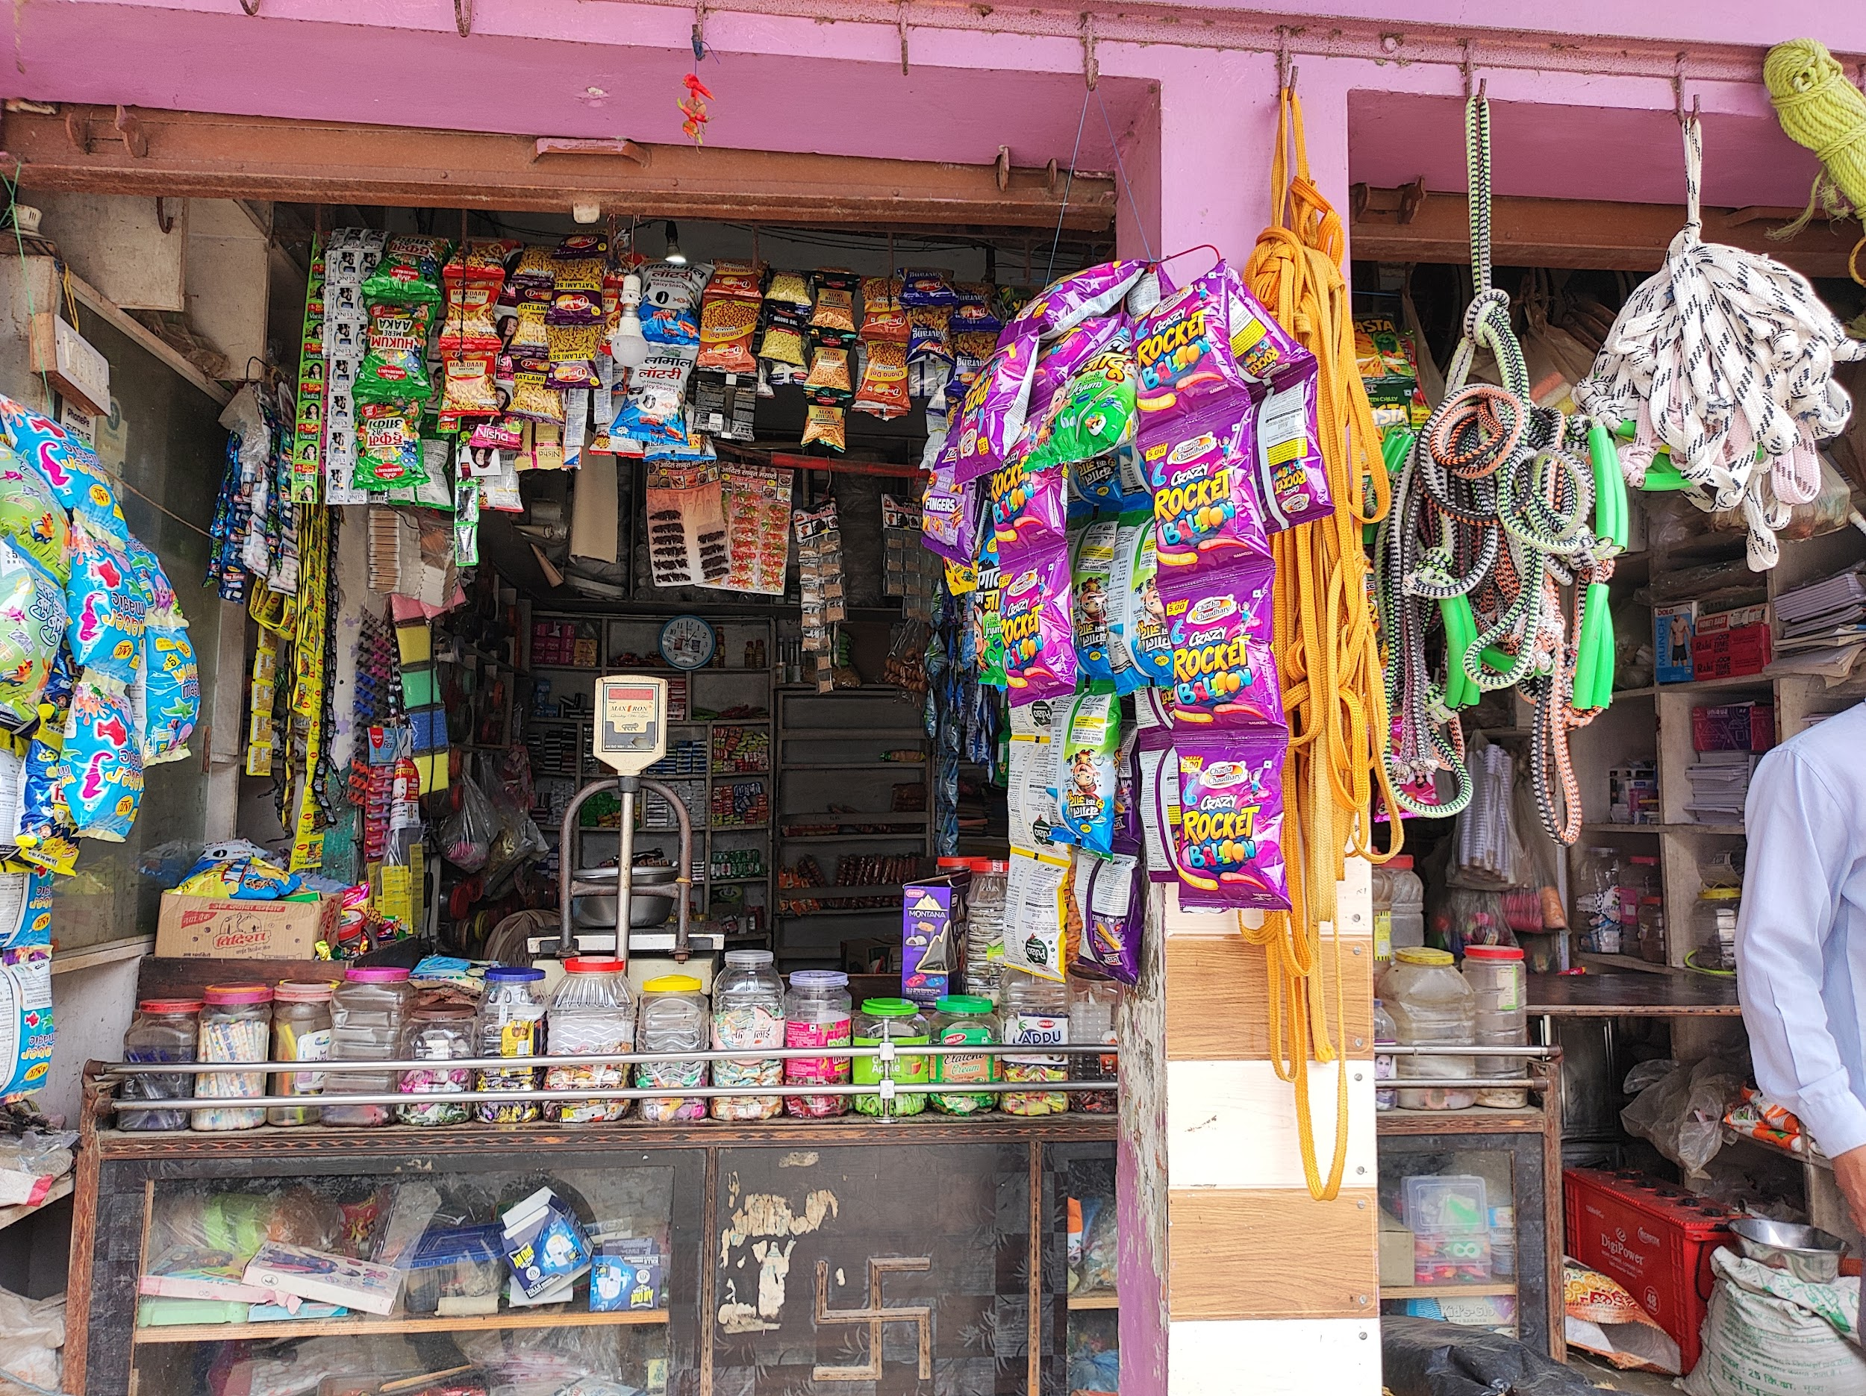
ABOUT THE BUISNESS
Jain's Kirana Store is a well-established grocery store in Village Daulari, Dist. - Moradabad.
It operates as a Business-to-Consumer (B2C) Grocery Store.
The Store provides high-quality products to the community.
Mr. Subham Jain is the Owner of this Store.
2

Slide 3
Understanding the Challenges
Problem 1
Problem 2
Problem 3
Excessive Inventory Costs:
High stock levels are increasing expenditure and tying up financial resources.
Low Profit Margins:
Many products are not generating sufficient profit, impacting overall profitability.
Poor Sales Performance for Some Items:
Certain products have weak turnover rates, leading to inefficiency in inventory management.
3

Slide 4
Data Overview:
To address these challenges, we collected weekly data over 12 weeks, from May 12th to August 4th.
Meta Data
Item name
Stock
Quantity purchased
Quantity sold
Cost per unit
Total cost
Selling price per unit
Total revenue
4

Slide 5
Trend analysis for Heat map
Findings
The Sales-to-Stock Ratio heat map shows strong performance for Rice, Sugar, and Tea, while Sev, Mustard, and Tobacco indicate slower sales and potential inventory inefficiencies.
Implications:
Maintain sufficient inventory for high-turnover items like Rice and Tea.
Reevaluate pricing and promotion strategies for low-turnover items.
Fig : 1 (Sales to stock ratio Heat map)
5

Slide 6
Trend analysis for Bar chart
Findings
The bar charts show Sugar and Tea lead in profit, while Honey, Jam, Nescafe Coffee, and Tobacco underperform, needing better pricing and inventory management.
Implications:
Focus on high-margin products like Sugar and Tea to maintain profitability.
Restructure pricing for low-margin products like Honey and Jam to increase profitability.
Fig : 2 (Revenue and profit contribution Bar chart)
6

Slide 7
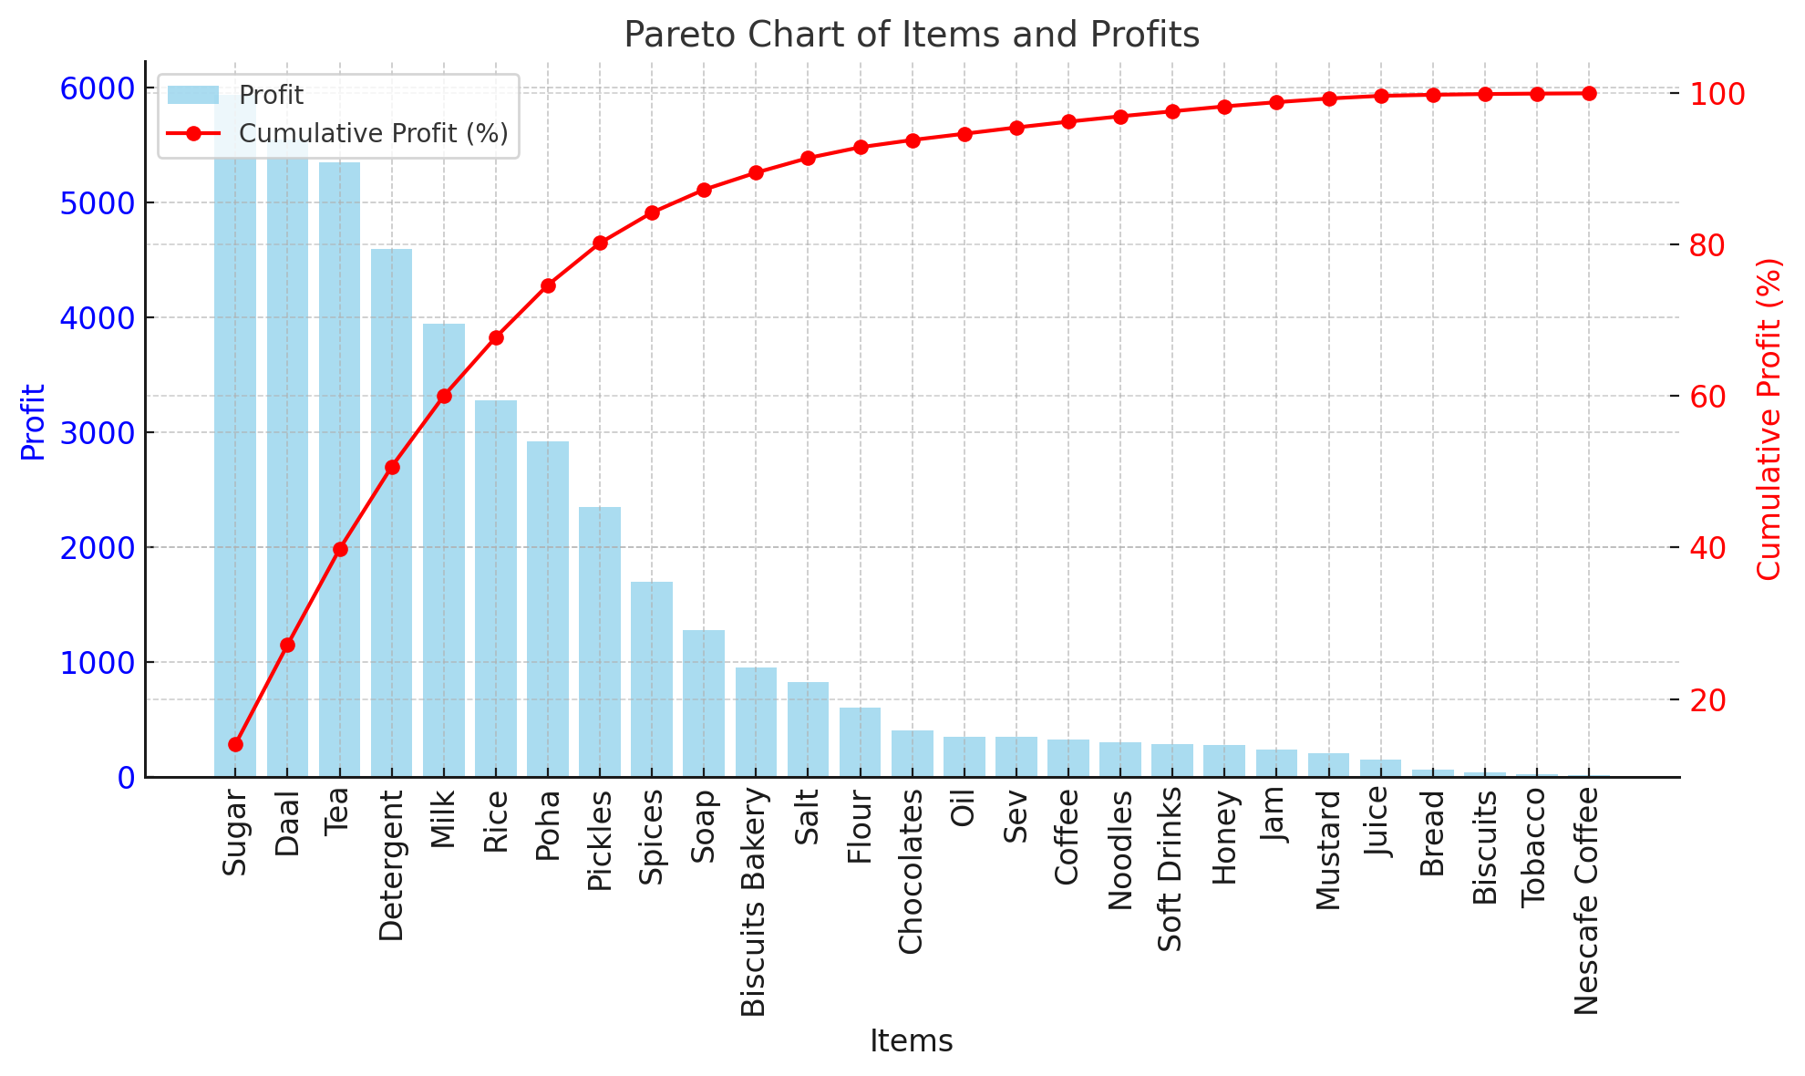
Trend analysis for Pareto chart
Findings
The Pareto chart shows most profits come from a few items like Daal, Sugar, and Tea, while many items add minimum value.
Implications:
Focus on promoting high-profit items (e.g., Daal, Sugar).
Cut inventory or renegotiate terms for low-profit items.
Add complementary products to boost revenue.
Fig : 3 (Profit Pareto chart)
7

Slide 8
Results and Findings
In a span of 12 weeks, The Store sold 8,408 items, generating a total revenue of ₹4,69,414. With an expenditure of ₹4,27,112, the store achieved a profit of ₹42,302.
Sugar and Milk excelled, with Sugar achieving ₹5,340 in profit and Milk achieving a strong 16.67% margin, contributing ₹4,950 in profit.
Low-volume products like Honey and Daal contribute significantly to revenue.
Items with low margins (Coffee, Chocolates, Tobacco) need pricing or cost adjustments.
8

Slide 9
Recommendations
Match stock levels to demand to reduce costs.
Focus on fast-selling products and manage slow-moving ones.
Optimize Inventory
Adjust prices for low-margin items.
Promote high-margin products like Milk and Tea.
Increase Profitability
Boost Sales
Bundle products to increase value.
Promote underperforming items strategically.
9

Slide 10
Thankyou
10

