Slide 1
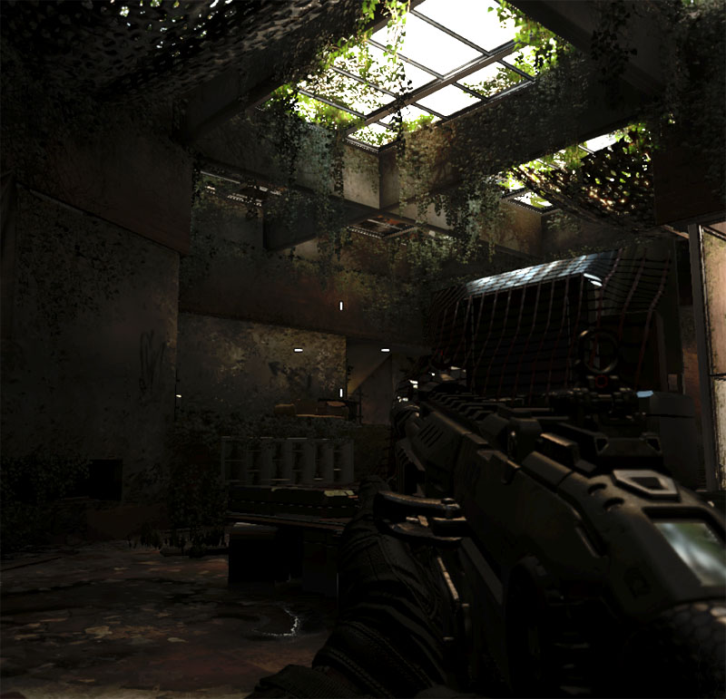
We Do The Render
So Can You!

Slide 2
WTF is PBR?
Physically Based Rendering
Used by Treyarch since Black Ops 1
Been used by the film industry since 2500 BCE
This might be a lie, or an exaggeration.
Provides a stable shading model to avoid unintended artifacts.

Slide 3
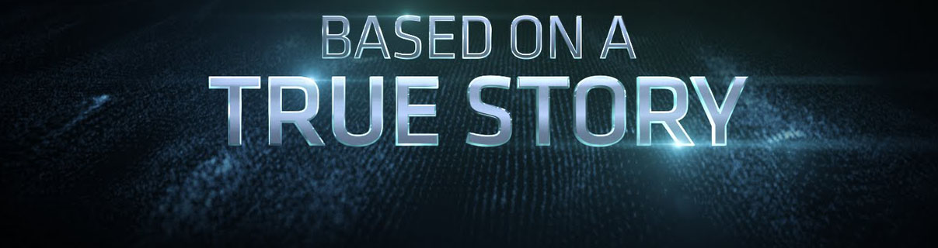
Core Ideas of PBR
The light that comes off of a surface cannot exceed the light that hits the surface.
All surfaces can be represented as a series of very small, v-shaped, mirrors.

Slide 4
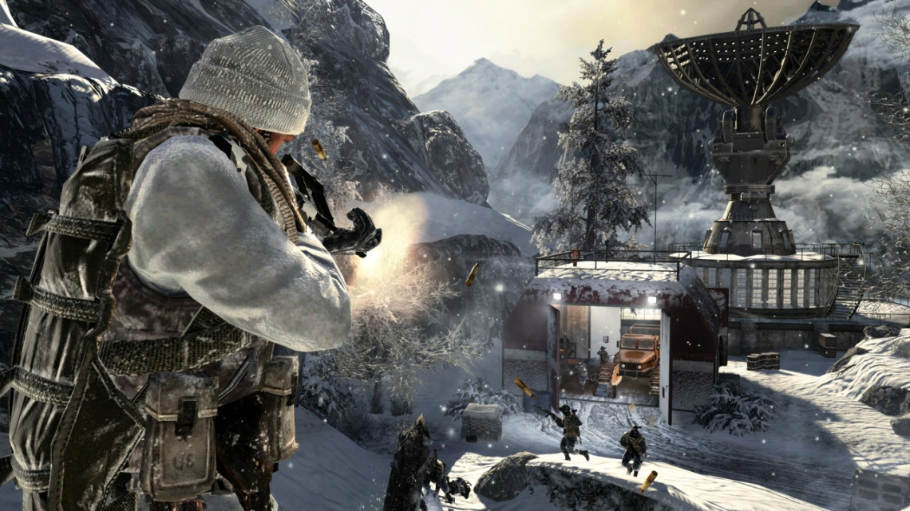
Black Ops 1 PBR
Partially HDR lighting, LDR effects.
Phong specular lighting.
Lambert diffuse lighting.
Maximum glossiness of 2^13.
Single, per object, 128x128 reflection probe for reflections.
GI lighting baked into light maps.
Some GI lighting in light grids, for dynamic objects.

Slide 5
Current PBR
Full HDR Lighting pipeline.
GGX specular lighting.
Oren-Nayar diffuse lighting.
Maximum glossiness of 2^17.
Global specular lighting in multiple, 256x256, blended reflection probes.
GI lighting from point cloud diffuse bake.
Vertex lighting/shadowing on particles.

Slide 6
Forward v. Deferred
Forward renders are the type that we are all used to: each pixel looks at all the lights that hit it and produces a final result.
Deferred renderers compile all the visible texture information, and then apply the lights to the whole screen in one pass.
You need both and we have both.

Slide 7
Forward v. Deferred (2)
The forward renderer is needed to represent transparency and odd-ball or complicated lighting models like anisotropic lighting.
The deferred renderer is a bit more efficient and allows us to do some nice tricks, like GBuffer decals.
The deferred renderer also supports alpha test (on-off alpha) geometry.

Slide 8
From Theory to Practice
Artists paint unlit surface features and properties into textures.
Specular colors have been determined from measured Indices of Refraction.
Diffuse colors have been measured using cross polarization photographic techniques and analysis of various color spaces.
ALL TEXTURES MUST BE AUTHORED IN 16bit!!!
Everyone must leave room for everyone else.
There should be minimal duplication of information.

Slide 9
Authoring Normal Maps
This is the most important map of the bunch. Highest resolution, most detail.
Bake from a high-poly. model with your package of choice.
We compute variance based on the roughness represented in the normal and modify gloss.
Detail normal maps should be used to represent anything smaller than 1/8th of an inch. Detail normal maps contribute to gloss variance as well.

Slide 10
Authoring Diffuse Textures
No values below 40, none above 238. This leaves room for lighting.
Exception: In the case of a pure metal, this map should be completely black.
Start with a flat color swatch to represent the unlit base color, or reflectance, of your surface.
Do not paint AO or highlights of any kind into the diffuse map.

Slide 11
Authoring Specular Textures
Most of the time you should be skipping this step.
In the case of a surface with bare metal showing, you can create a specular mask.
Start with a white texture and paint all the parts that are not pure metal black.
Touch up the areas around your metallic areas with grayscale values to simulate some dust coverage, or light pitting.

Slide 12
Authoring Gloss Textures
Start with a fully white texture, to represent the glossiest that your surface will be.
Set the gloss range in APE to the appropriate surface type.
If the presets in APE don’t work, you can select custom and dial in the high and low gloss thresholds to suit your full range map.
Paint the least glossy parts of this texture completely black.
There is a separate power point that goes into further detail on gloss maps.

Slide 13
Authoring AO Textures
Bake these with your favorite tool, just make sure they aren’t too dark.
There should not be AO across your entire surface, this will make your model get very dark in shadow and look flat.
AO only affects the indirect lighting: reflection and bounced diffuse. Otherwise, your model would look like it had creepy moustache growing all over it.

Slide 14
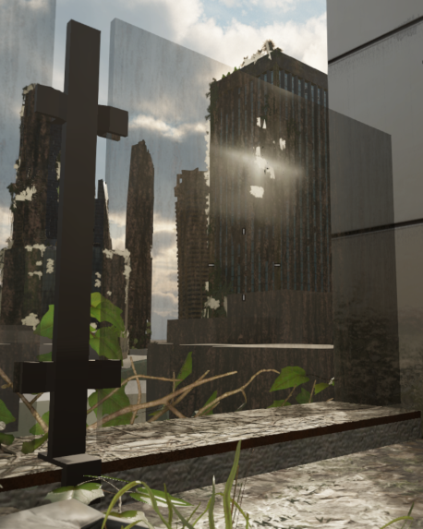
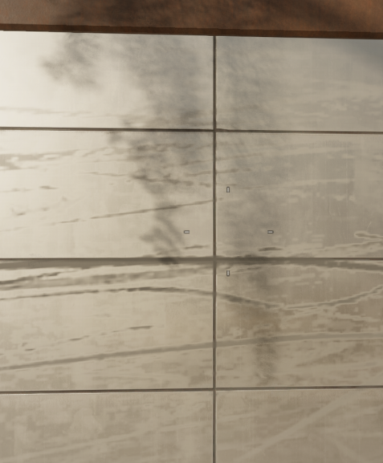
Transparency v. Decal
Transparency refers to freestanding objects that must blend with objects behind them: panes of glass and as little else as possible.
Decals are objects that are coplanar with another piece of opaque geometry and override all, or parts, of the underlying GBuffer.

Slide 15
Transparency v. Decal (2)
Transparency is the single fastest way to ruin our framerate because you open the door to having to light a pixel multiple times. Only use transparency when ABSOLUTELY necessary. Try alpha test first, it’s better than you remember.
Decals don’t have to just be grime they can be dents, polished patches, water on a surface, etc.
Decals need to have their Decal Layer set to an appropriate default value based on what they represent.

Slide 16
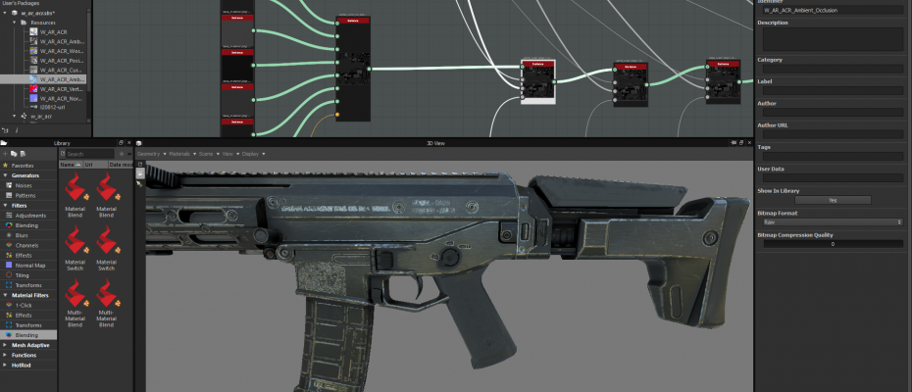
Substance Designer
Allows a set of textures for a material to be tied together. One graph can spit out diffuse, specular, normal, gloss, etc. at the same time and at appropriate resolutions.
Does a good job of baking information from a mesh.
Building the base materials with Substance graphs allows batch updates if necessary.
Opens the door for in-engine texture blending (at the cost of memory) if we get the engineering support and the impetus.

