Slide 1
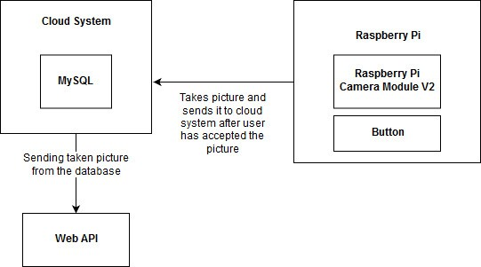
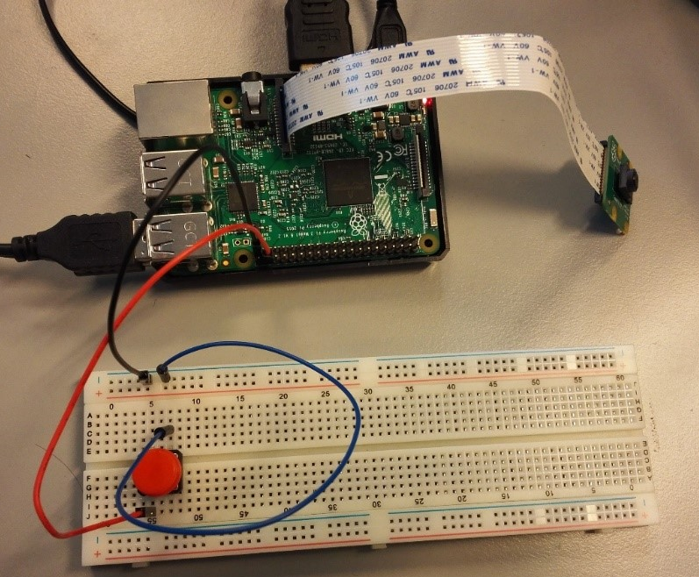
PhotoBooth
Patanen Kaisa, Harja Niina, Ryynänen Lotta, Sirviö Kalle, TVT17SPO
School of Engineering, Information Technology, Software Engineering
Introduction
Photobooth is a project that combines the use of RaspBerry Pi microprosessor and android app to provide picture storing system for the user.
The user is able to view taken picture from Android Application.
The project is aimed to provide camera solution for the user, so that the picture can be saved on the cloud.
Objectives
The objective of the project would be a service able to show photobooths taken picture on android application. User would insert on android application pictures number to see the wanted picture.
FIGURE 1. Connecting camera and button to Raspberry Pi.
Methods
Raspberry Pi’s program and android phones program works as user interface, and the database is hosted with MySQL. The Raspberry Pi’s program is constructed using python and the android phone’s program is constructed using Java. Wampserver is used to crreate a backend server to get information from database.
The Camera module is connected to Raspberry Pi, which is used to take a picture. When the picture is taken by clicking the button, it is shown to user. When user clicks save button, it will result Raspberry Pi sending the image to MySQL database for the use.
Results
Raspberry Pi takes pictures successfully and shows them to user. Saving the picture to database as blob works and this can be verified by checking the database with phpMyAdmin website. Getting the image with android app is not working properly, because functions to get image are returning empty strings. With little more time the app can be working since the problem is quite small.
FIGURE 2. System diagram of the product.
Conclusions
In conclusion the project fulfils the requirements that were set at the start of the project.
Assembling parts together and writing a functioning program for Raspberry Pi went smoothly, but creating a android application proved to be harder than expected.
References
https://www.mysql.com/
https://www.raspberrypi.org/
https://thonny.org/
Project
ECTS credits: 3
Date of publication: 2019, 27th of February
Instructor Heikkilä Pertti
Notes:
This project is a part of IoT-programming course. Assingment was to make a project with Raspberry Pi, using Python 3. We were provided some equipment to go with Raspberry Pi, and we decided to use camera module. Our projects aim was to provide camera solution, so that it can be saved in a cloud or uses Web API.
Objectives
Objective was to create a camera solution, when the picture is taken, it can be viewed from a webserver.
Criteria for this project, was to implement Python 3 application on Raspberry Pi, which uses database on the cloud for storing data, or it uses some Web API with the data of an Raspberry Pi application. In this project, Web API was chosen to be the platform where users views taken pictures.
Methods
As hardware equipment in this project are used Raspberry Pi 3, Raspberry Pi Camera Module V2, some wires, breadboard and a button. The programs run in Raspberry Pi and on the MySQL cloud system were developed using Visual Studio and Thonny development tools.
Results
When button is pressed, camera captures a picture. After that, user can either save it, or take a new one. If user saves the picture, it is saved to a database. User is informed which webpage picture is available.
References
Assingment criteria from course basics of IoT-programming

