Slide 1

Exploratory Data Analysis

Slide 2
Introduction
This report presents an analysis of employee data collected from Aspiring Minds from the Aspiring Mind Employment Outcome 2015(AMEO).
The dataset includes information on employees' ID, salary, date of joining (DOJ), date of leaving (DOL), designation, job city, gender, date of birth (DOB), educational qualifications, and performance metrics.

Slide 3
Overview of Employee Data The dataset consists of the following columns:
ID: Unique identifier for each employee
Salary: Employee's current salary
DOJ: Date of joining the company
DOL: Date of leaving the company (if applicable)
Designation: Employee's job title or designation
JobCity: City where the employee's job is located
Gender: Employee's gender
DOB: Employee's date of birth
Educational Qualifications:
10percentage: Percentage obtained in 10th grade
10board: Board of education for 10th grade
12graduation: Year of graduation from 12th grade
12percentage: Percentage obtained in 12th grade
12board: Board of education for 12th grade
CollegeID: Unique identifier for the college attended
CollegeTier: Tier of the college attended
Degree: Highest degree obtained
Specialization: Area of specialization in the degree
CollegeGPA: Grade point average in college
CollegeCityID: Unique identifier for the city where the college is located
CollegeCityTier: Tier of the city where the college is located
CollegeState: State where the college is located
GraduationYear: Year of graduation from college

Slide 4
Performance Metrics:
English: Score in English assessment
Logical: Score in logical reasoning assessment
Quant: Score in quantitative aptitude assessment
Domain: Overall domain knowledge score
ComputerProgramming: Score in computer programming assessment
ElectronicsAndSemicon: Score in electronics and semiconductor assessment
ComputerScience: Score in computer science assessment
MechanicalEngg: Score in mechanical engineering assessment
ElectricalEngg: Score in electrical engineering assessment
TelecomEngg: Score in telecom engineering assessment
CivilEngg: Score in civil engineering assessment
Personality Traits:
Conscientiousness
Agreeableness
Extraversion
Neuroticism
Openness to Experience

Slide 5
Analysis and Insights
Salary Distribution: The distribution of salaries across different
designations and cities.
Employee Tenure: Analysis of the average tenure of employees in the
company.
Educational Background: Understanding the educational qualifications
and performance metrics of employees.
Personality Traits: Exploring the distribution of personality traits among
employees and their impact on job performance.

Slide 6
observations
The data set consists of 3998 rows and 38 columns
There are 27 numerical columns and 11 categorical columns
In our analysis, we have utilized a diverse array of plots to extract valuable insights and findings from the data
Histograms and Density Plots Used to visualize the distribution of numerical variables such as Salary, 10percentage, 12percentage, etc. This helps in understanding the central tendency and spread of the data
Box plots for visualizing the distribution of numerical variables to identify any differences or outliers.

Slide 7
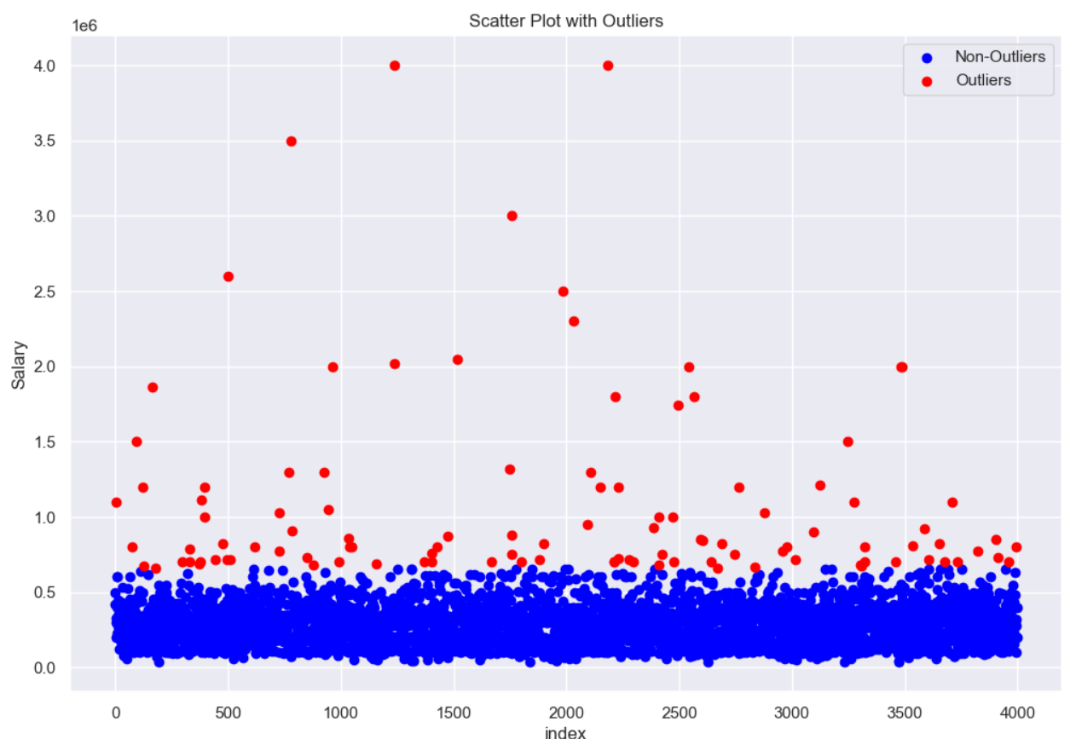
In the data the average salary of a employee is 307699.8 where minimum and maximum salaries are 35000, 4000000.
By observing the frequency distribution or density plot on the salaries column we observed the data is right skewed indicating presence of outliers.
Box plot and scatter plot are used to visualize the outliers in the column
There are 109 outliers in the Salary column

Slide 8
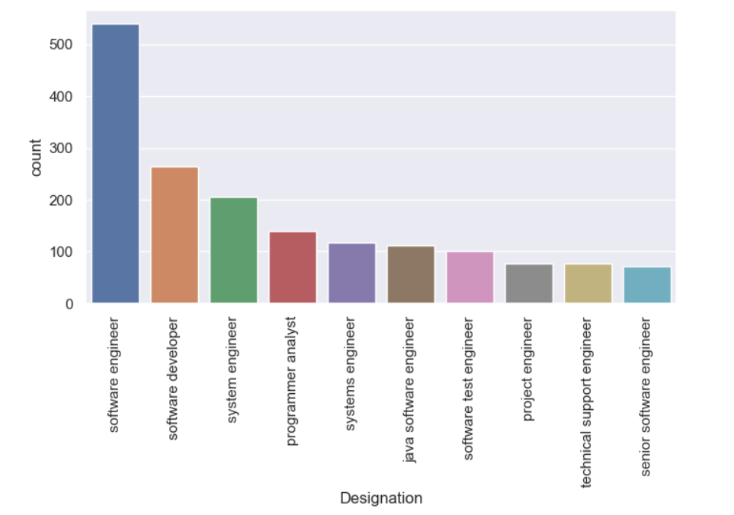
There are total 3041 males and 957 females.
Top 10 Designations of Employees in the data frame are.

Slide 9
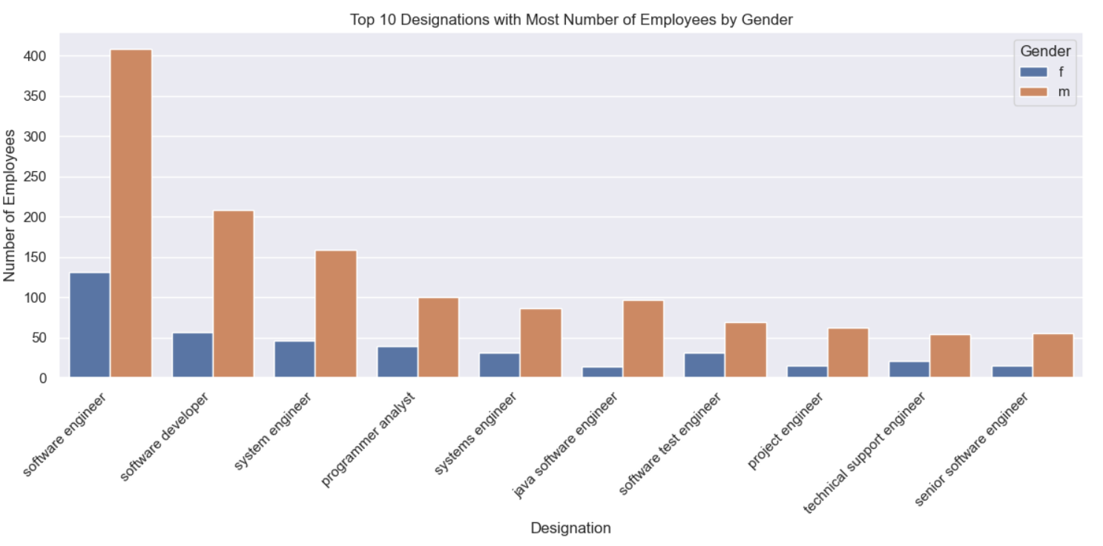

Slide 10
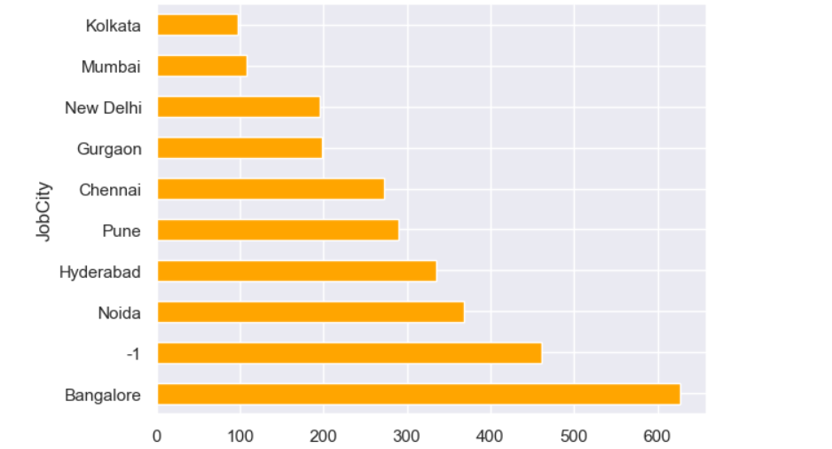
Top 10 cities where most of the employees are working are the
represented in this visual.

Slide 11
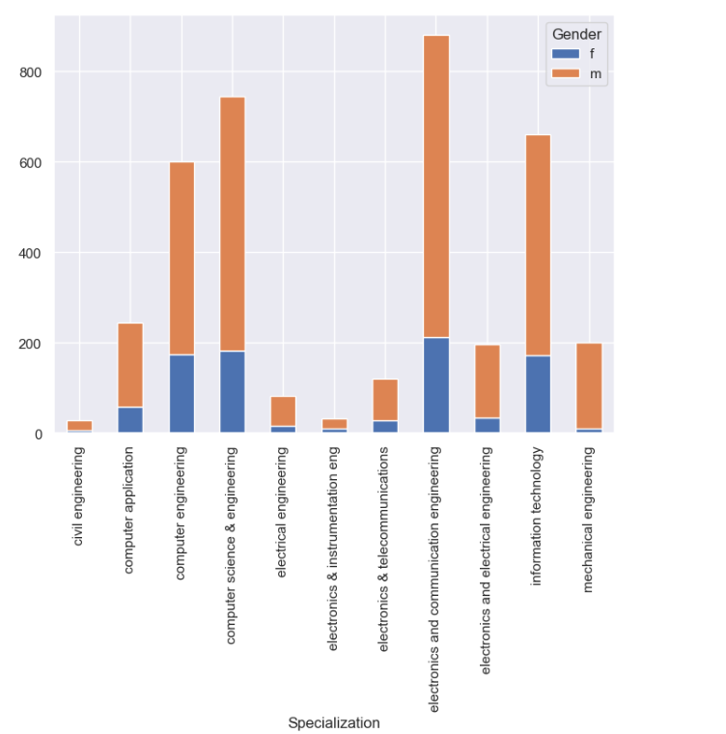
Total there are 46 different specializations over 94.7% people belong 10 specializations and 5 % people are belong other 36 specializations.
Every specializations in top 10 consists of mostly males.

Slide 12
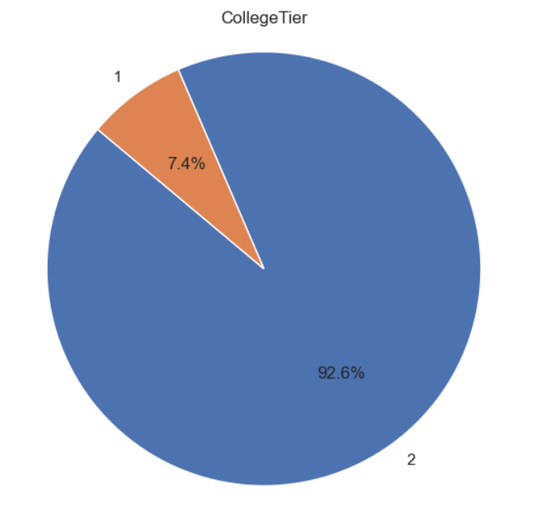
Out of total 3998 employees, 7.4% of employees belongs from Tier 1 college and
92.6% employees are from Tier 2 college

Slide 13
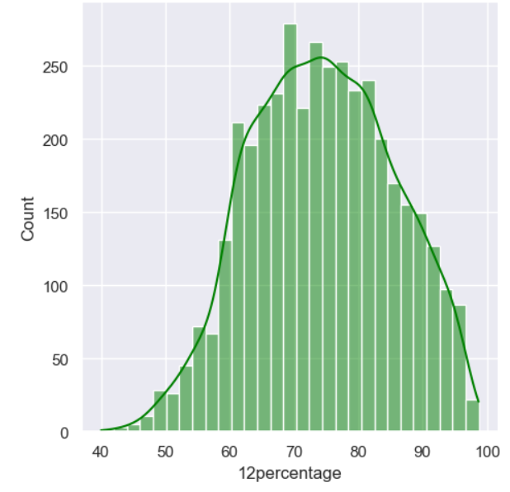
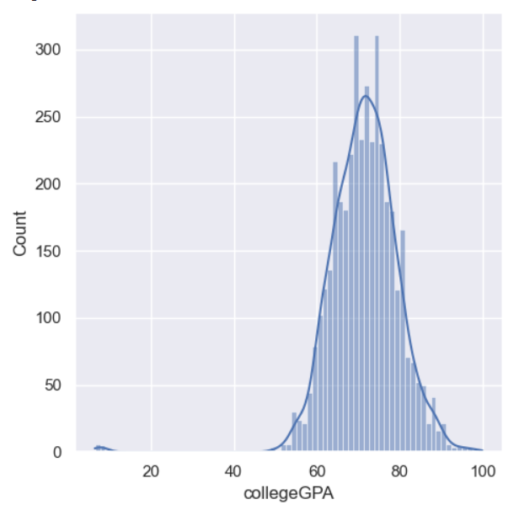
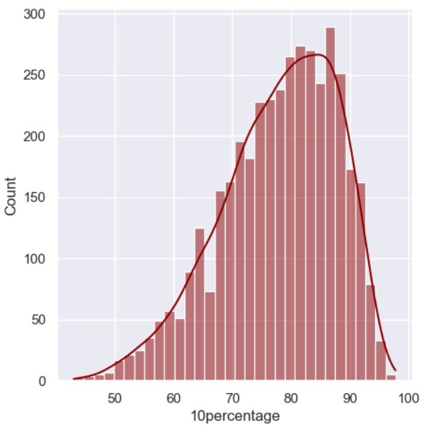
These are few frequency distribution plots to understand the spread of data

Slide 14
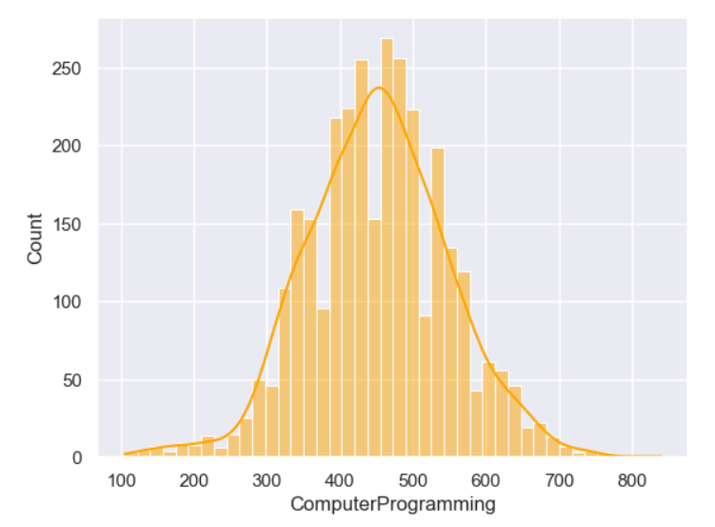
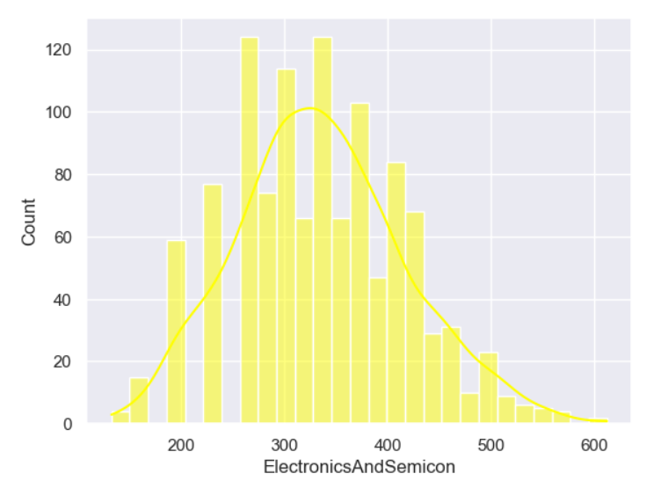
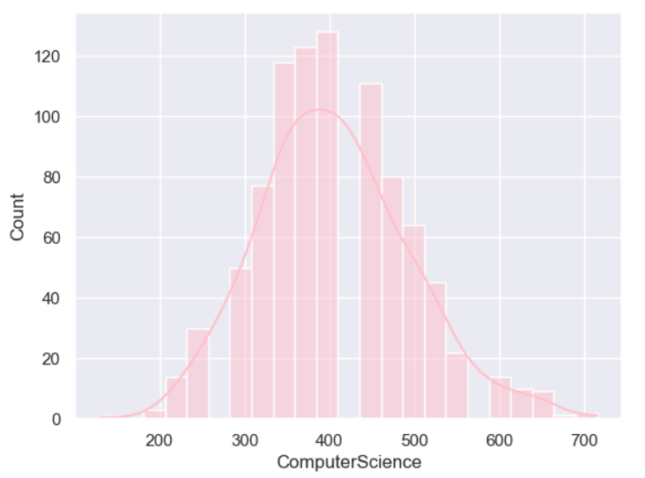
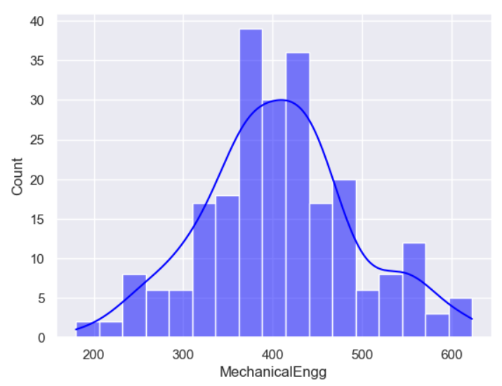
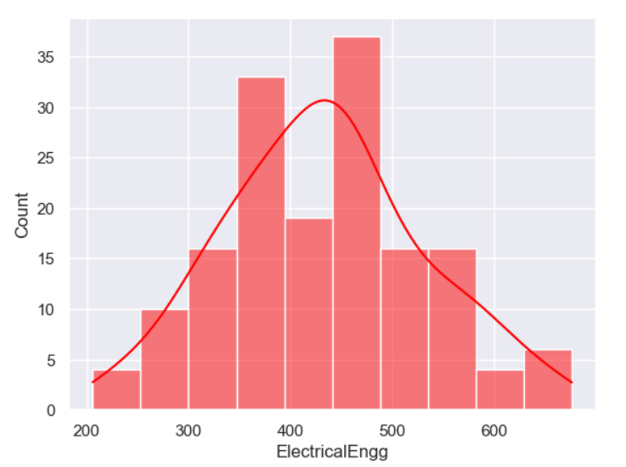
Subject wise marks distribution plots

Slide 15
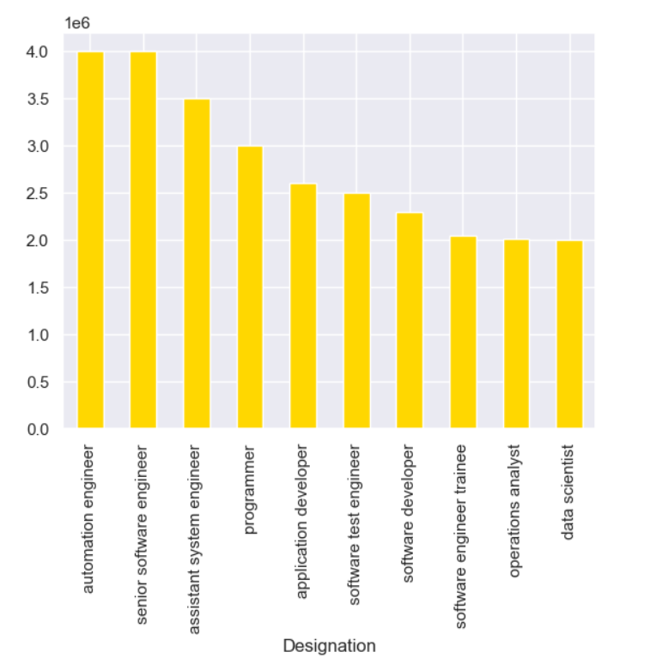
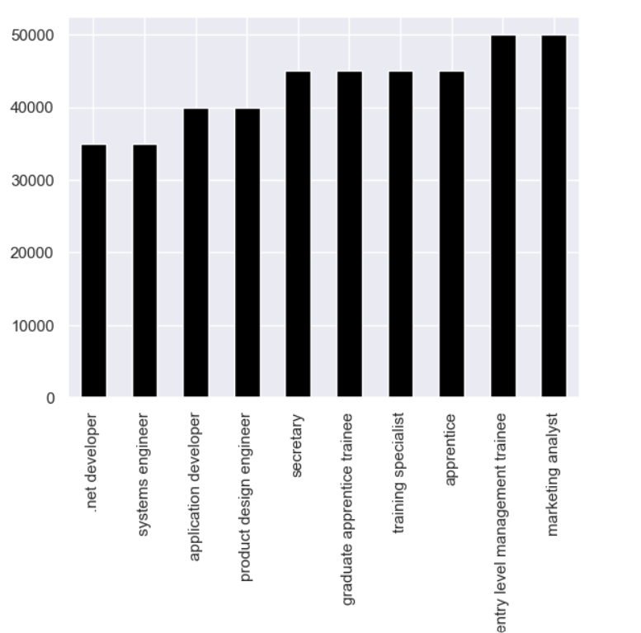
The Designations with the minimum and maximum salaries over the date frame are

Slide 16
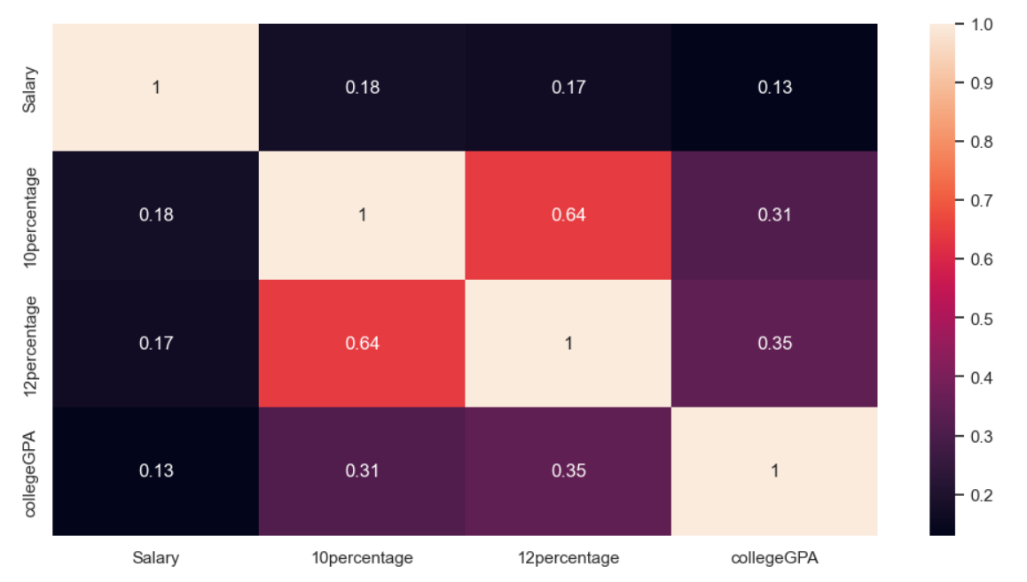
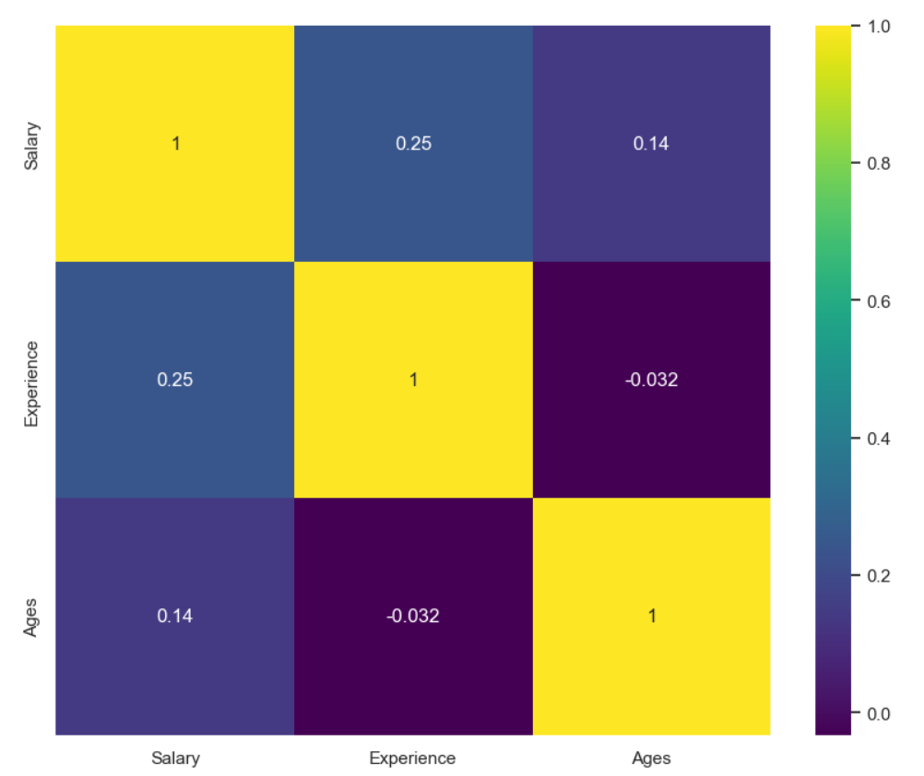
These are few co relation heatmaps to understand the relationship between the numerical columns of data frame

Slide 17

THANK YOU

