Slide 1
ML Fundamentals
Intro to TensorFlow

Slide 2
Overview

Slide 3
Syllabus
Overview
Machine Learning fundamentals: Features, Models, Generalization, Loss, Training…
Logistic Regression, Classification
TensorFlow Programming
Feature Engineering
Neural Networks and Deep Learning
Applications: Images, Text, NLPs
Important Neural Network Architectures
Production Machine Learning Systems
Projects – Build an ML Application

Slide 4
2. ML Fundamentals

Slide 5
What is a ML system?
ML systems learn
how to combine inputs to produce useful predictions on never-before-seen data

Slide 6

A linear regression example
$y= \sum_{1}^{n}{x_{i}∗w_{i}+b}$

Slide 7

Terminologies: labels, features
Label – the thing we are predicting: y
The y variable in the linear regression example
Features – input variables that describe our data: $x_{i}$
$\{x_{1}, x_{2},…, x_{n}\}$variables in linear regression

Slide 8
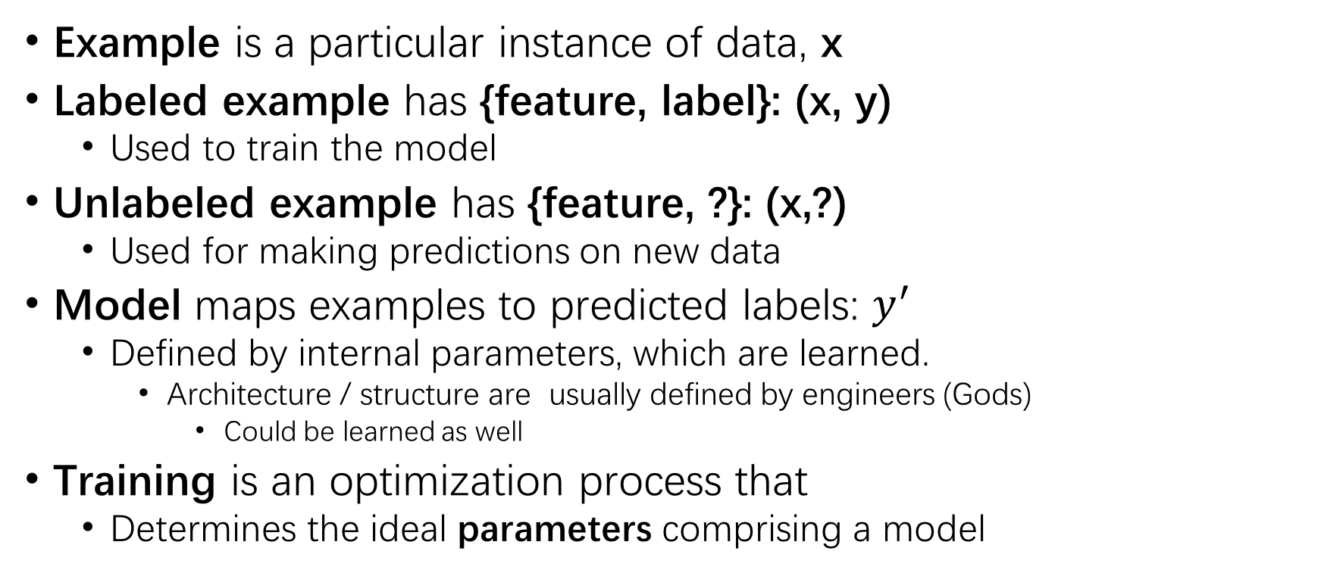
Examples and Models
Example is a particular instance of data, x
Labeled example has {feature, label}: (x, y)
Used to train the model
Unlabeled example has {feature, ?}: (x,?)
Used for making predictions on new data
Model maps examples to predicted labels: $y^{′}$
Defined by internal parameters, which are learned.
Architecture / structure are usually defined by engineers (Gods)
Could be learned as well
Training is an optimization process that
Determines the ideal parameters comprising a model

Slide 9
Regression vs. Classification
Regression: predict continuous values
House price in California
Probability { a user clicks on this ad }
Classification: predict discrete values
An email spam or not?
An image of dog, cat, or gopher?

Slide 10
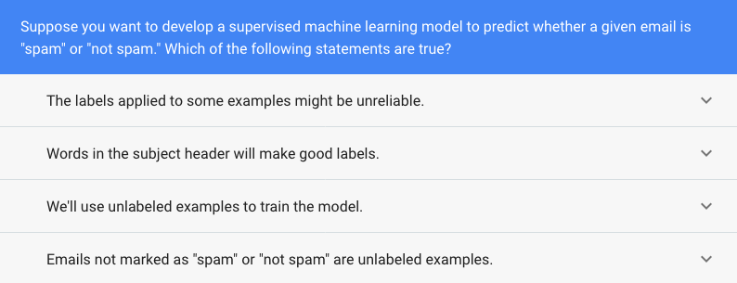
Quiz

Slide 11
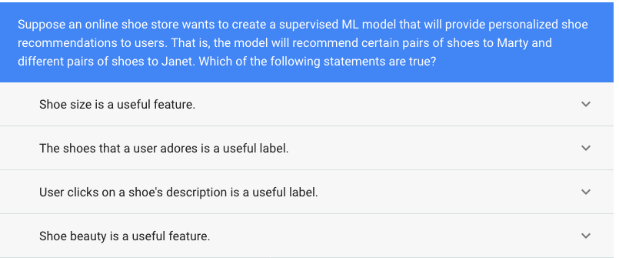

Slide 12
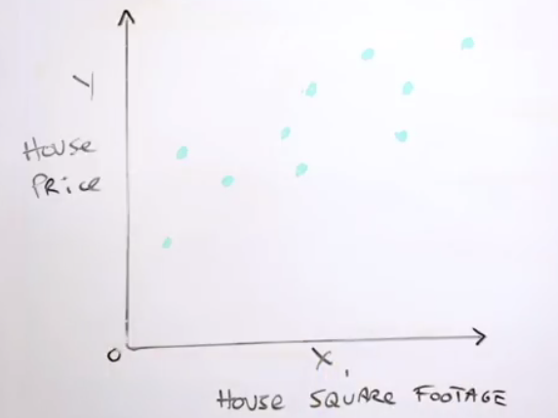
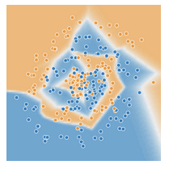
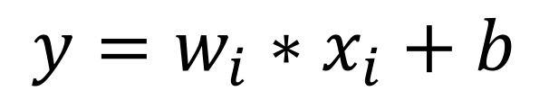
Simple linear relations – learn from data
Lots of complex ways to learn from data
We start with something simple (linear) and familiar
$$y=w_{i}∗x_{i}+b$$

Slide 13

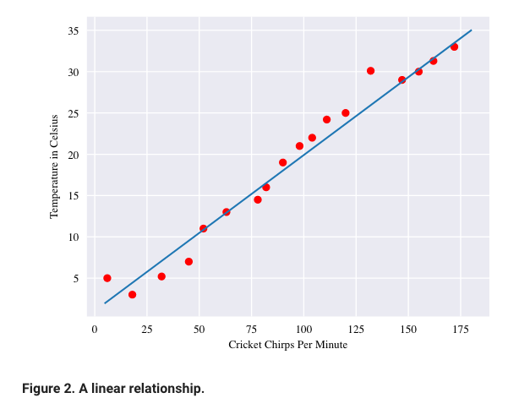
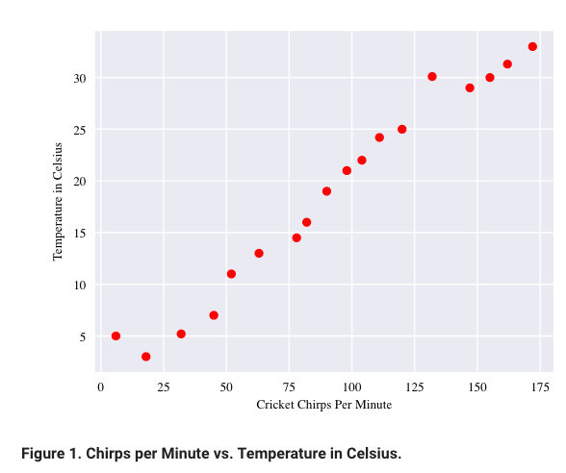
Linear relationship

Slide 14
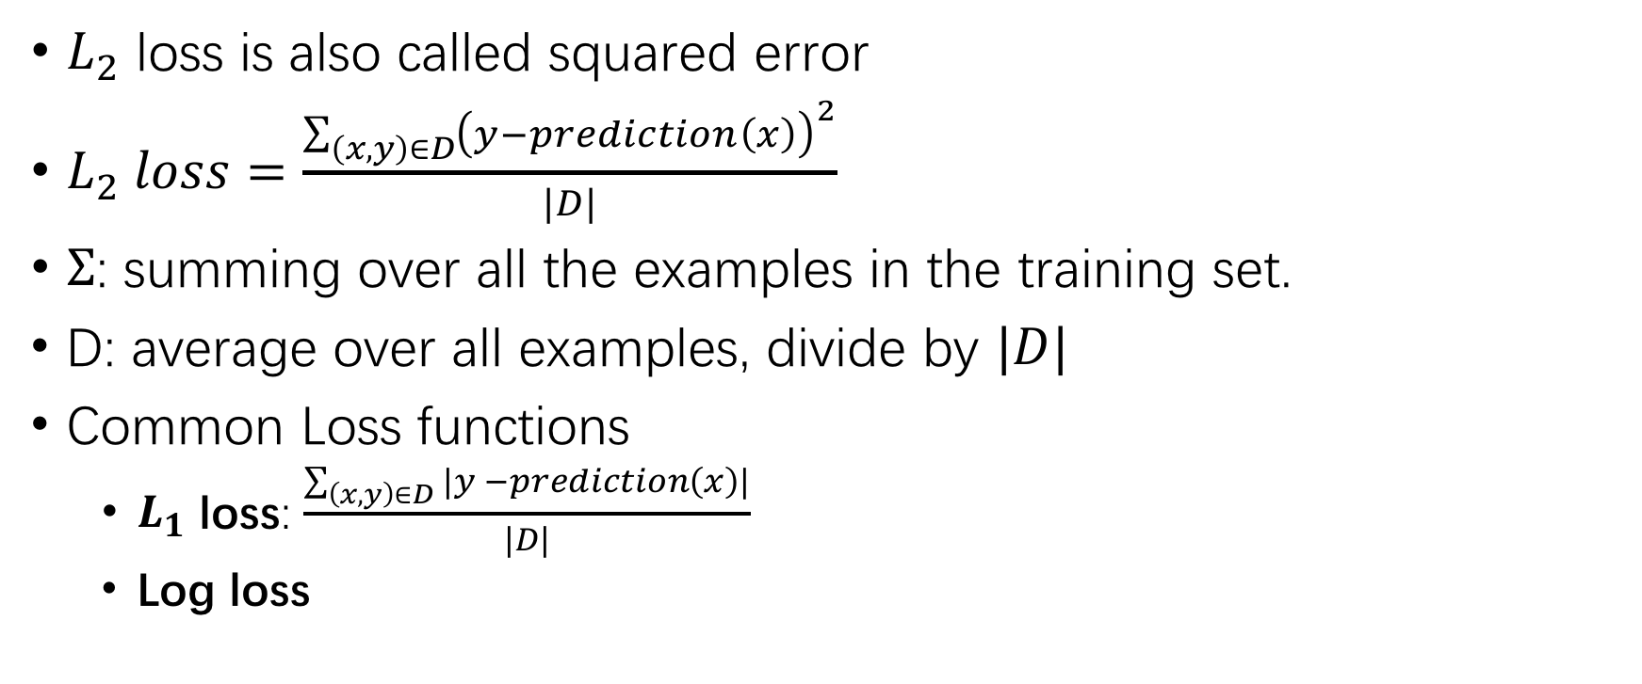
Loss (functions)
$L_{2}$ loss is also called squared error
$L_{2} loss=\frac{\sum_{\left(x,y\right)∈D}{{\left(y−prediction\left(x\right)\right)}^{2}}}{|D|}$
$Σ$: summing over all the examples in the training set.
D: average over all examples, divide by $|D|$
Common Loss functions
$L_{1}$ loss: $\frac{\sum_{\left(x,y\right)∈D}{|y −prediction\left(x\right)|}}{|D|}$
Log loss

Slide 15
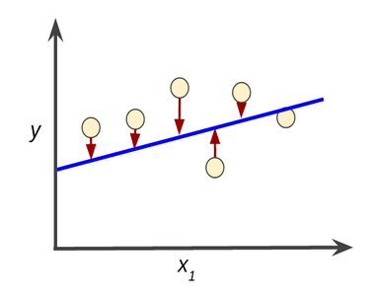
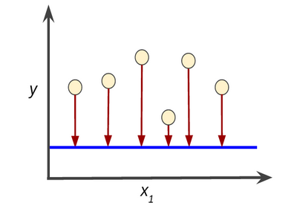
Loss / Training
Loss: penalty for a prediction.
training
Training: learning good values for the weights and bias from labeled examples.
* Reduce loss

Slide 16
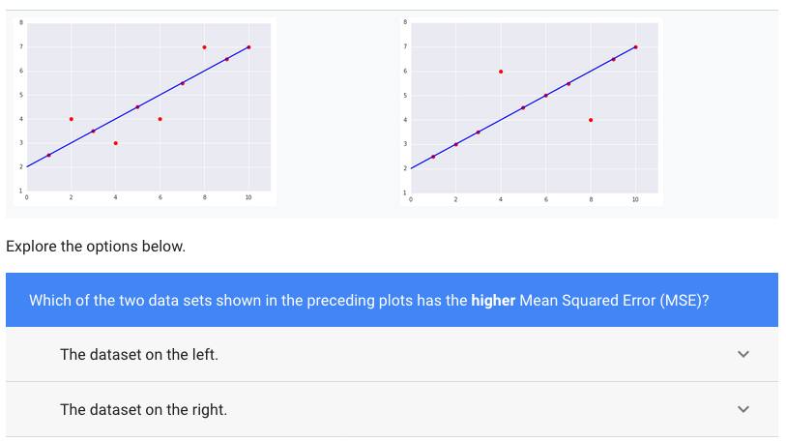

Slide 17
Reducing Loss

Slide 18
3. Logistic Regression, classification

Slide 19
4. TensorFlow Programming

Slide 20
5. Feature Engineering

Slide 21
6. Neural Networks and Deep Learning

Slide 22
7. Applications: Images, Text, NLPs

Slide 23
8. Important Neural Network Architectures

Slide 24
9. Production ML Systems

Slide 25
10. Projects – Build an ML Application

Slide 26
Additional…

