Slide 4
Notes:
The Serializable is a tagging interface in the java.io package that indicate that a class contains get, set and is methods that another class can use to read and write an object’s instance variable to and from a persistence data source.
The zero argument constructor use 3 statements to set all 3 instance variables equals to empty string.

Slide 6
Notes:
the three rules for defining a JavaBean.
The Serializable is a tagging interface in the java.io package that indicate that a class contains get, set and is methods that another class can use to read and write an object’s instance variable to and from a persistence data source.

Slide 7
Notes:
Whenever you use EL, you begin by coding a dollar sign followed by an opening brace and a closing brace. The, you code the expression within the brace.

Slide 11
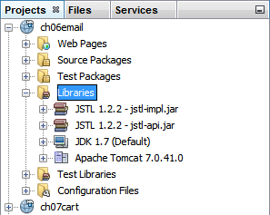

Slide 19
Notes:
JSP directive
JSP scriptlet
JSP expression

Slide 29
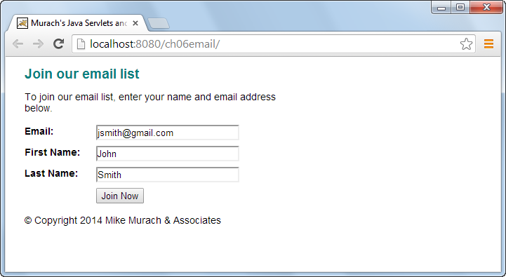

Slide 30
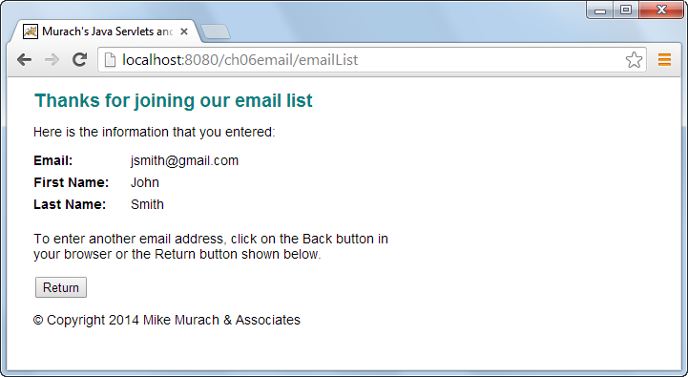

Slide 34
