Slide 3
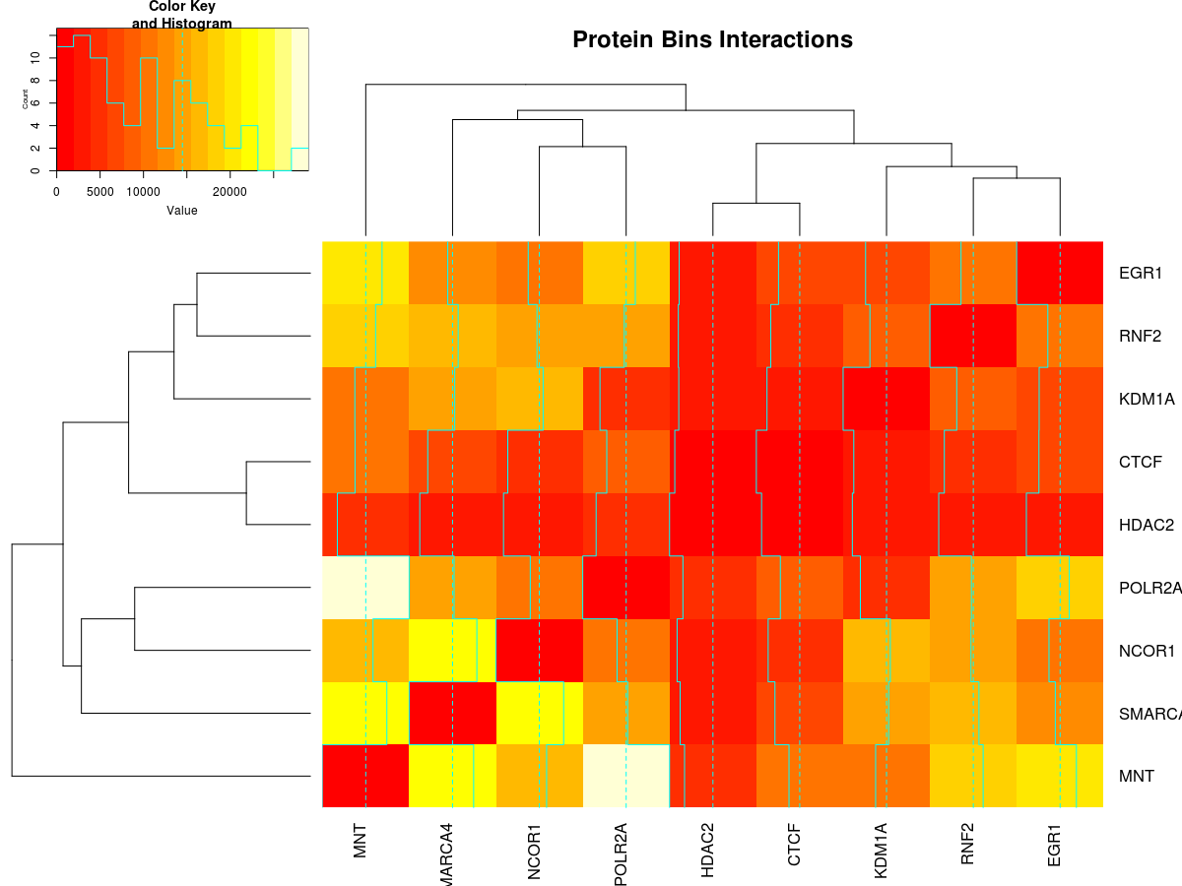
Heatmap of Protein/bins interaction

Slide 4
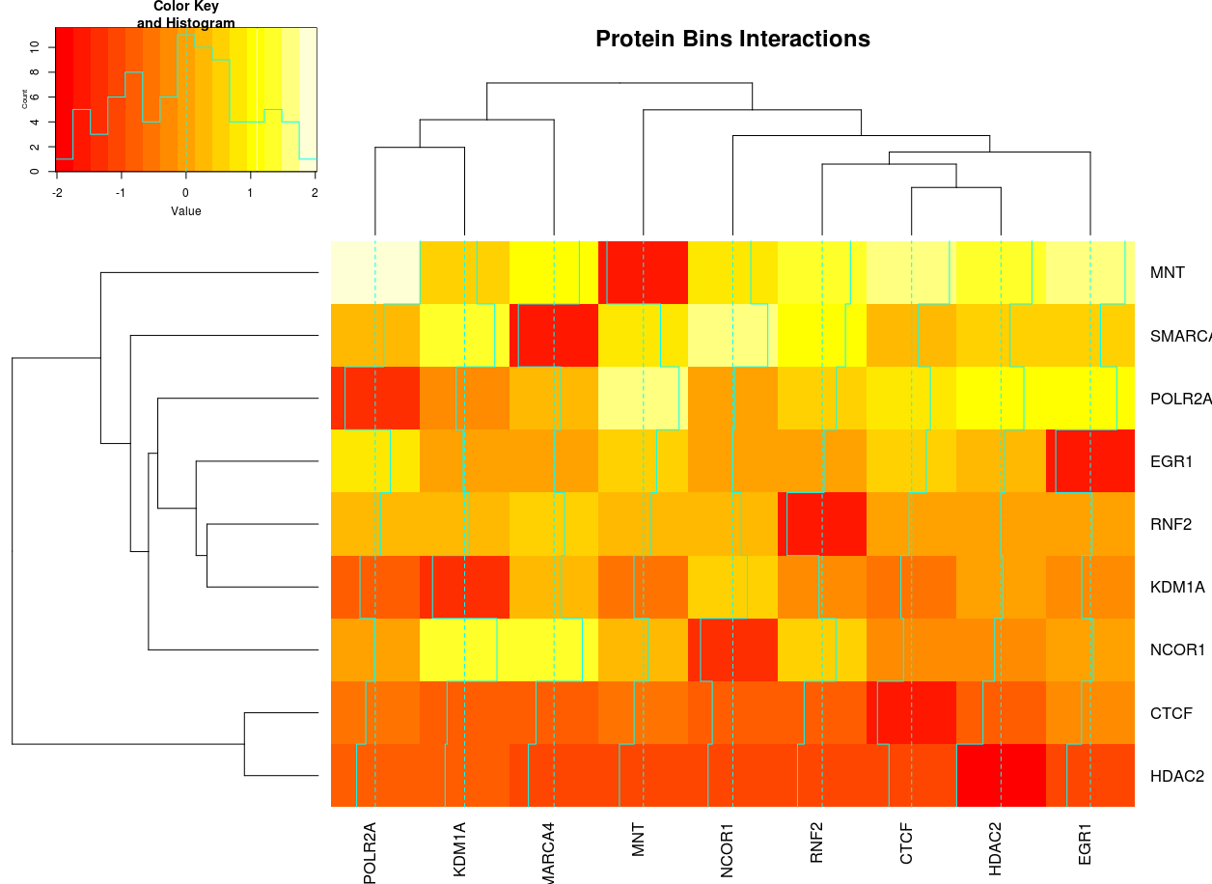
Heatmap of Protein/bins interaction (scaled)

Slide 5
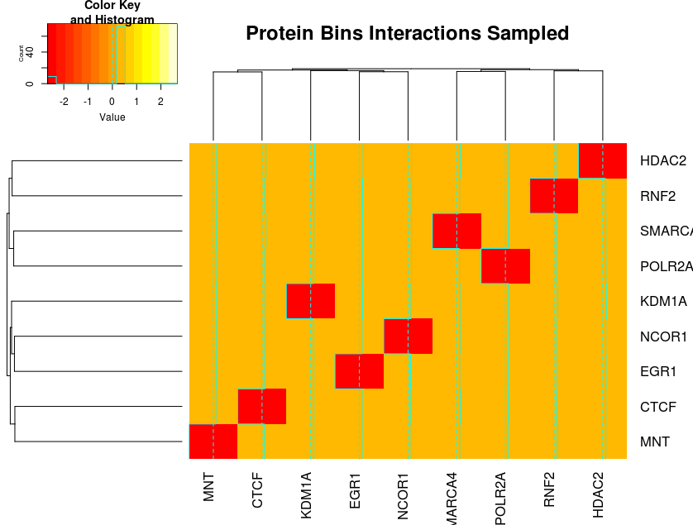
Heatmap of Protein/bins interaction sampled (scaled)

Slide 6
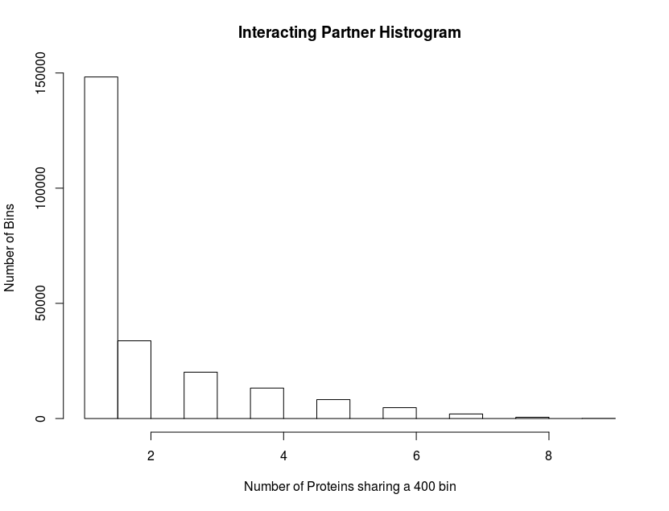
Histogram of Protein sharing the same bin

