Slide 1
Beating the sneakernet with Fipes
FOSDEM 2013

Slide 2
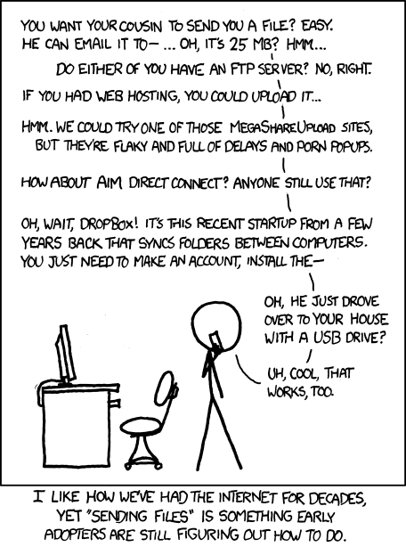

Slide 3
« Every time you email a file to yourself so you can pull it up on your friend's laptop, Tim Berners-Lee sheds a single tear. »

Slide 4
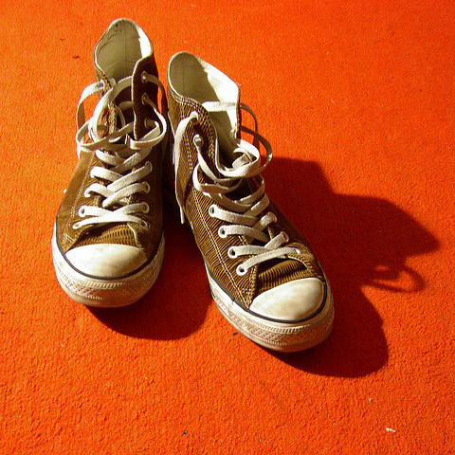
Sneakers!
/snee´ker·net/, n.
Term used (generally with ironic intent) for transfer of electronic information by physically carrying tape, disks, or some other media from one machine to another.
The Jargon File

Slide 5
Features
High throughput
Privacy friendly
Easy to use
Easy to understand
High Latency

Slide 6
What do we need to beat the sneakernet?
We need a privacy friendly open source web application that doesn't ask me for an account and doesn't keep any data about me or my files.

Slide 7
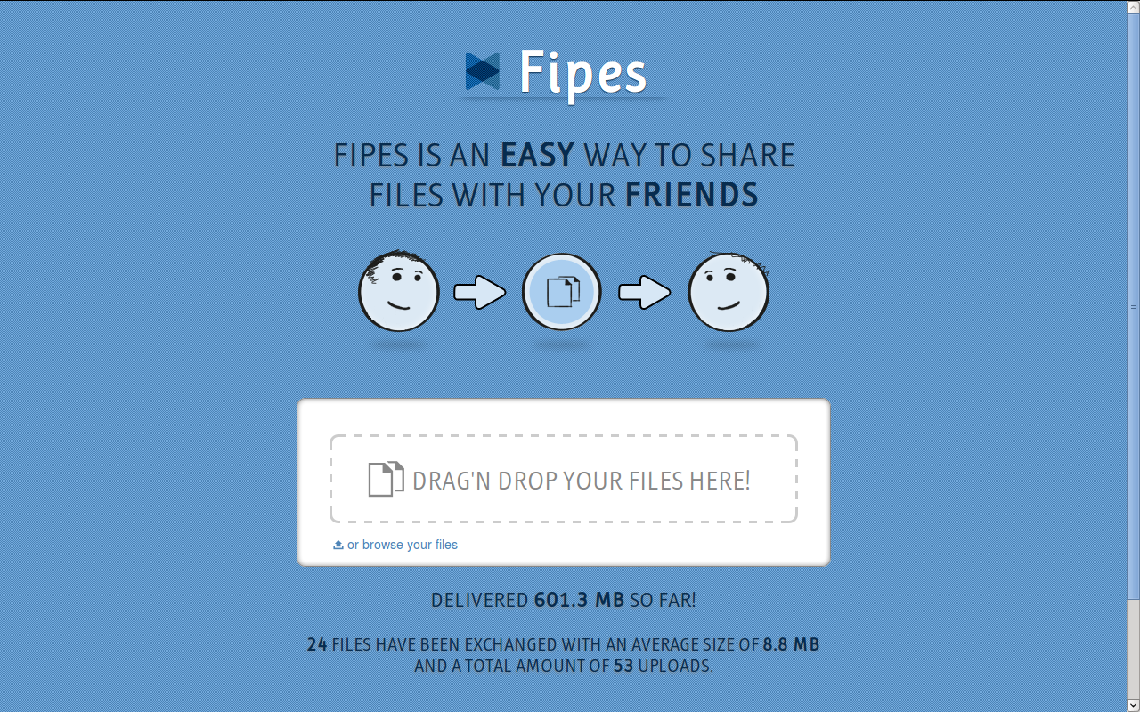

Slide 8
Files + Pipes = Fipes
A small web application
Easy to install, easy to launch, easy to use
Does not keep any data about you or your files
Free as in Freedom

Slide 9
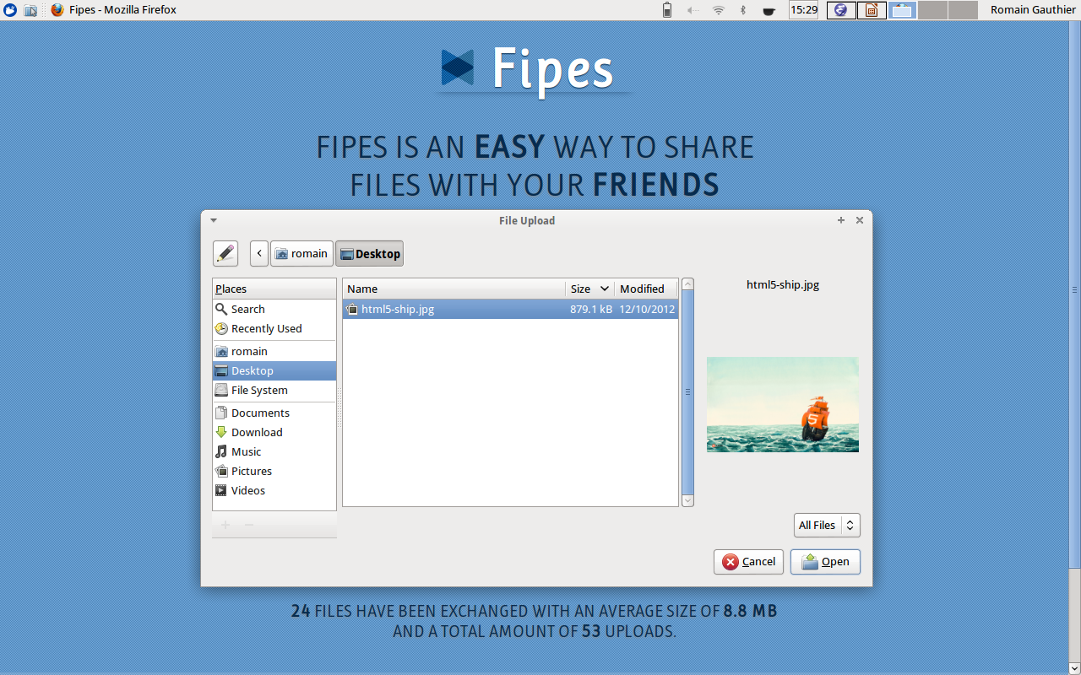

Slide 10
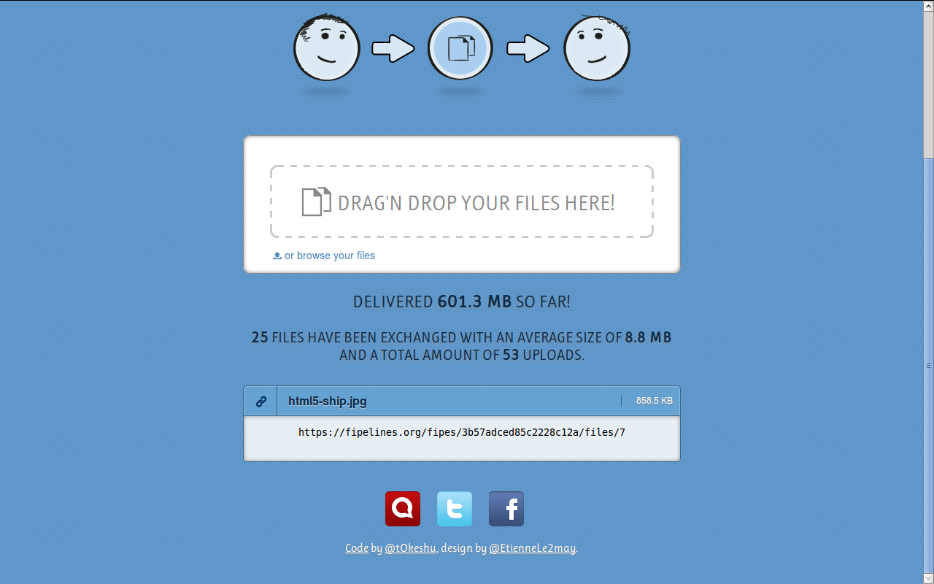

Slide 11
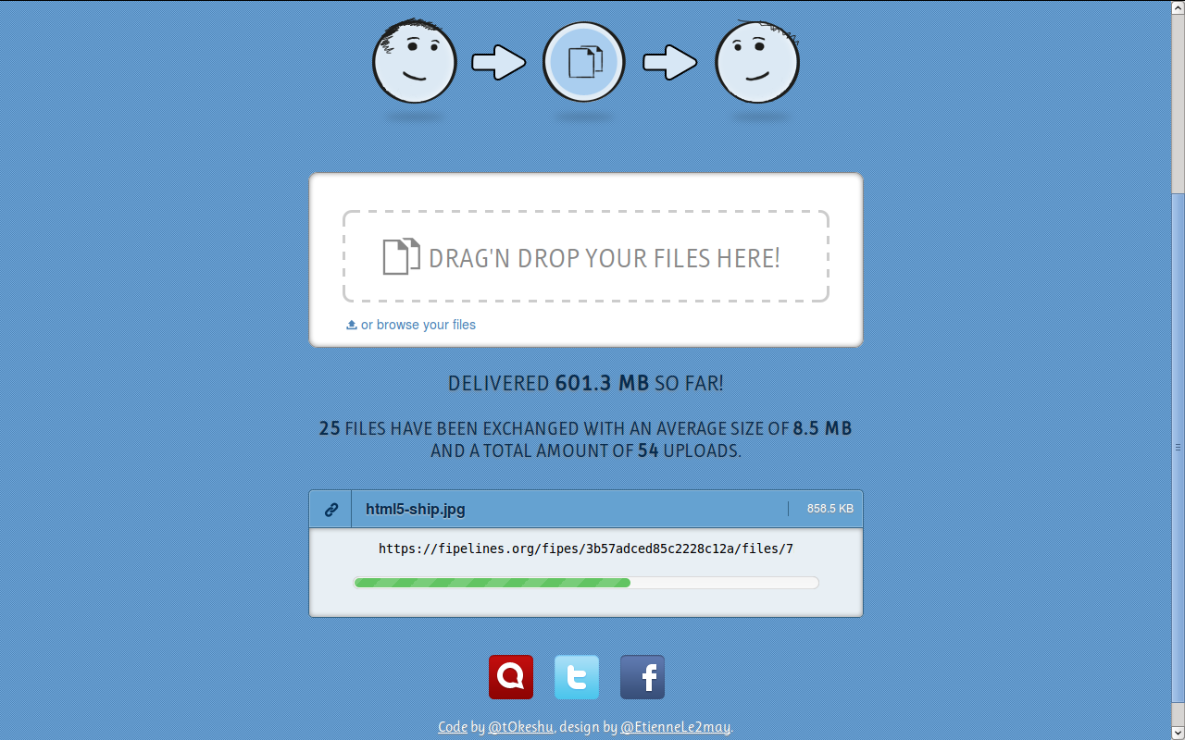

Slide 12
So, you just delete files after a certain time, right?

Slide 13
So, you just delete files after a certain time, right?
No, I don't.
I don't need to because I don't store any data on the server.

Slide 14
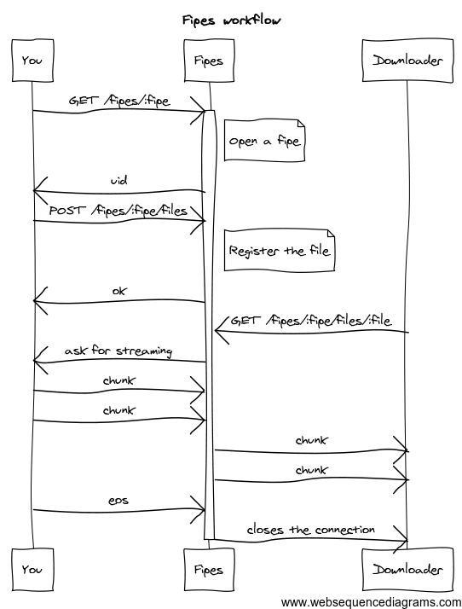

Slide 15
The future
Binary everywhere
XHR2?
WebRTC

Slide 16
Questions?
Code: https://github.com/tOkeshu/fipes
(GNU AGPLv3)
Try it online: https://fipelines.org
@fipelines

