Slide 1
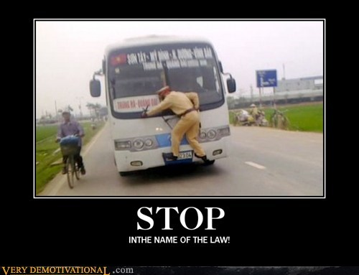
STOP THE BUS
A game by
Carles Rosell Bernat

Slide 2
DESCRIPTION
The goal of the project is to CREATE A GAME through programming and make it work.
The choice for this project is Stop the Bus, a child's game FOCUSED ON CATEGORIES AND WORDS.

Slide 3
RULES
First, decide how many rounds will have the game
Afterwards, the game starts.
A random letter is generated and each team has to find a word for each category starting with the chosen letter
Once all the categories are filled, the round ends.
The sum of the length of each word will be compared in between each team. The one team with the largest length, wins the round and scores +1
The game ends when there is no more rounds.
The team with higher score wins.

Slide 4
WORKFLOW
In the first place, I decided which steps I needed for the whole project.
Then, I decided the order for each step and started developing the game.
Once the coding was done, I checked for the bugs that I was able to fix.
Finally I tried to run the program part by part, then the whole thing together.

Slide 5
CHALLENGES
Find an appropriate game
Organizing the tasks according to the needs
Adapting the game rules
PROGRAMMING THE WHOLE GAME

Slide 6
LEARNINGS
Programmers are not lazy or sad people, they are misunderstood individuals
Having a structure in mind is not the same as implementing it
Programming is like poetry: if you use the right words and expressions in the right places, success is assured. Learning, then, is key.

Slide 7
POSSIBLE FUTURE IMPROVEMENTS
Add a timer option
Solve the bugs
Make the program simpler
Find a data base for each category
Display more items: chrono, round number, score…

Slide 8
DEMO
http://localhost:8888/notebooks/your-project/Untitled.ipynb

Slide 9

THANKS (specially you Ali)

