Slide 1

BLACKJACK with python
Miguel Simón

Slide 2

RULES

Slide 3
RULES
Get as close as 21, without going over 21 (bust)

Slide 4
RULES
Get as close as 21, without going over 21 (bust)
First hand (2 cards for player and dealer)

Slide 5
RULES
Get as close as 21, without going over 21 (bust)
First hand (2 cards for player and dealer)
Show just the first card of the dealer’s hand

Slide 6
RULES
Get as close as 21, without going over 21 (bust)
First hand (2 cards for player and dealer)
Show just the first card of the dealer’s hand
Decide if want more cards or not

Slide 7
RULES
Get as close as 21, without going over 21 (bust)
First hand (2 cards for player and dealer)
Show just the first card of the dealer’s hand
Decide if want more cards or not
count == 21
Blackjack

Slide 8

RULES
Get as close as 21, without going over 21 (bust)
First hand (2 cards for player and dealer)
Show just the first card of the dealer’s hand
Decide if want more cards or not
count == 21
Blackjack
REWARDS
Blackjack = 2.5 bet
Victory = 2 bet

Slide 9

WORKFLOW

Slide 10
WORKFLOW
Understanding the game rules

Slide 11
WORKFLOW
Understanding the game rules
General scheme of the programming (modules)

Slide 12
WORKFLOW
Understanding the game rules
General scheme of the programming (modules)
Important functions I would need (random.sample)

Slide 13
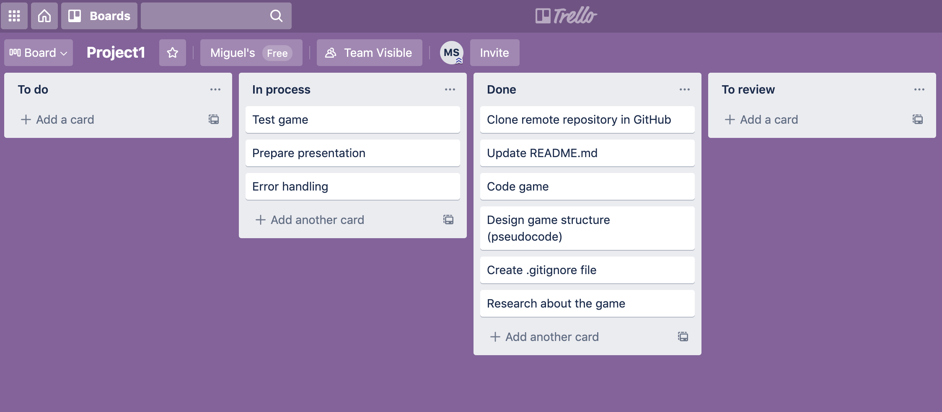
WORKFLOW
Understanding the game rules
General scheme of the programming (modules)
Important functions I would need
Coding
Fixing Errors
Improving
ideas
Future

Slide 14
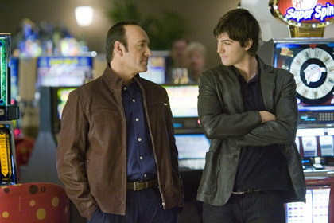
WORKFLOW
Understanding the game rules
General scheme of the programming (modules)
Important functions I would need
Coding
Fixing Errors
Improving
ideas
Future
Miguel
Pol

