Slide 1
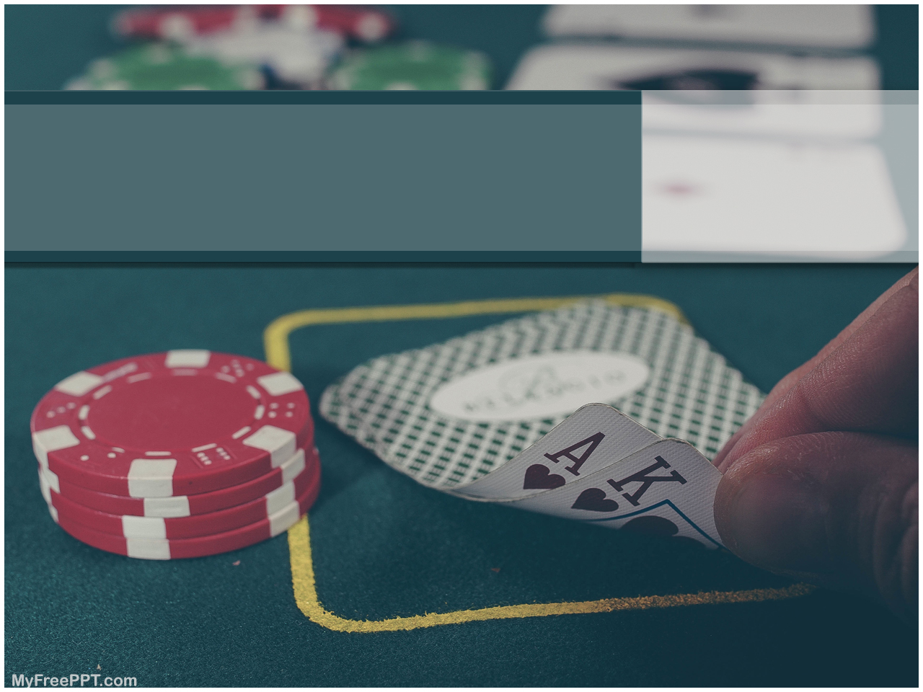
By Nick Deitmers
Project: Blackjack

Slide 2
BLACKJACK
THE GAME
Round 1:
Player 2 cards
Dealer 1 open, 1 closed
Your turn:
Hit or Pass
Dealers turn:
16: hit
>16: pass
THE CARDS
One deck of cards
Every card normal value
Aces can be 1 or 11

Slide 3
CHALLENGES
Where to begin
Input
Loops in loops

Slide 4
LET’S PLAY!

