Slide 1
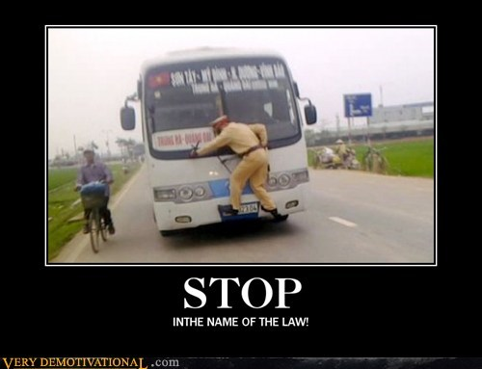
STOP THE BUS
A game by
Carles Rosell Bernat

Slide 2
DESCRIPTION
The goal of the project is to CREATE A GAME through programming and make it work.
The choice for this project is Stop the Bus, a child's game FOCUSED ON CATEGORIES AND WORDS.

Slide 3
RULES
Decide number of rounds
A random letter is generated per round and each team must fill each category starting with the chosen letter
The sum of the length of each word will be compared in between each team. The one team with the largest length, wins the round and scores +1
The team with higher score wins

Slide 4
WORKFLOW
Overview of the project
Step by step
Coding and bug tracking
Run the program

Slide 5
CHALLENGES
Find an appropriate game
Organizing the tasks according to the needs
Adapting the game rules
PROGRAMMING THE WHOLE GAME

Slide 6
LEARNINGS
Having a structure in mind is not the same as implementing it
Programming is like poetry: if you use the right words and expressions in the right places, success is assured.

Slide 7
POSSIBLE FUTURE IMPROVEMENTS
Add a timer option
Solve the bugs
Make the program simpler
Find a data base for each category
Display more items: chrono, round number, score…

Slide 8
DEMO
http://localhost:8888/notebooks/your-project/Untitled.ipynb

Slide 9

THANKS!

