Slide 1
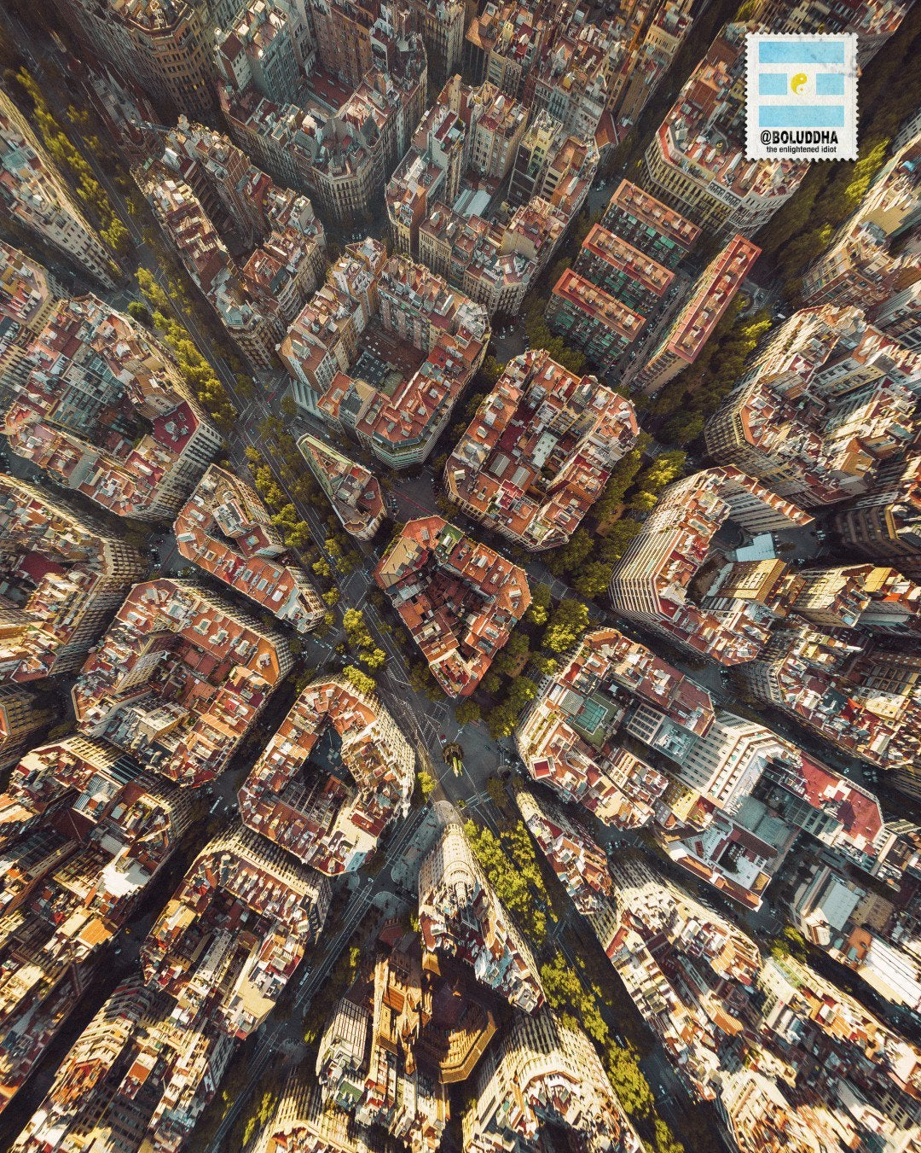
Eixample...
is it really the coolest neighbourhood
in Barcelona?
Oscar Tomás y Miguel Simón

Slide 2
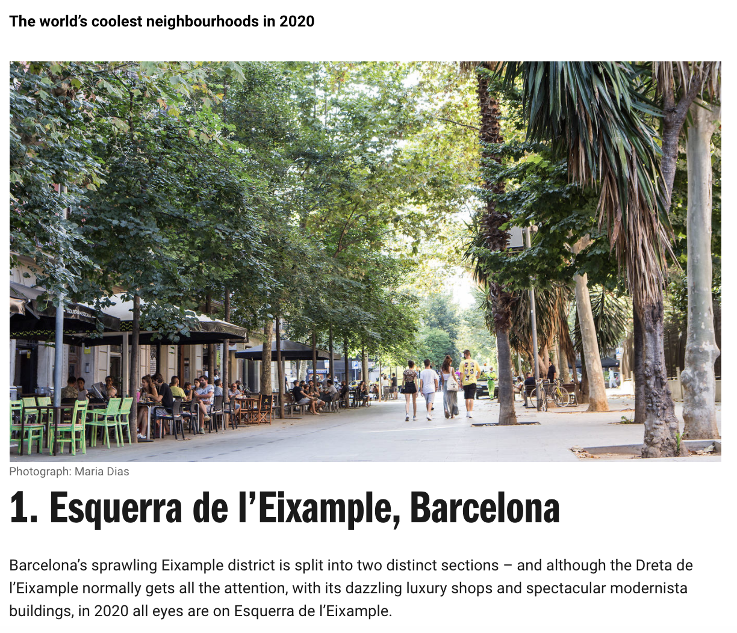

The facts

Slide 3
Define A Good Neighbourhood
“My favorite neighbourhood is that one that is coronavirus free, where I can have a beer with friends and move without restrictions..”
Erik Termes

Slide 4
Define A Good Neighbourhood
“My favorite neighbourhood is that one that is coronavirus free, where I can have a beer with friends and move without restrictions..”
Erik Termes
“A good neighbourhood has nice parks or green areas, access to several lines of public transport and commerce offers .”
Sara Peña

Slide 5
Define A Good Neighbourhood
“My favorite neighbourhood is that one that is coronavirus free, where I can have a beer with friends and move without restrictions..”
Erik Termes
“A good neighbourhood has nice parks or green areas, access to several lines of public transport and commerce offers .”
Sara Peña
“A good neighborhood is the one in which I can do my lovely Data Science without limits and help my nice students.”
Javier Pardo

Slide 6

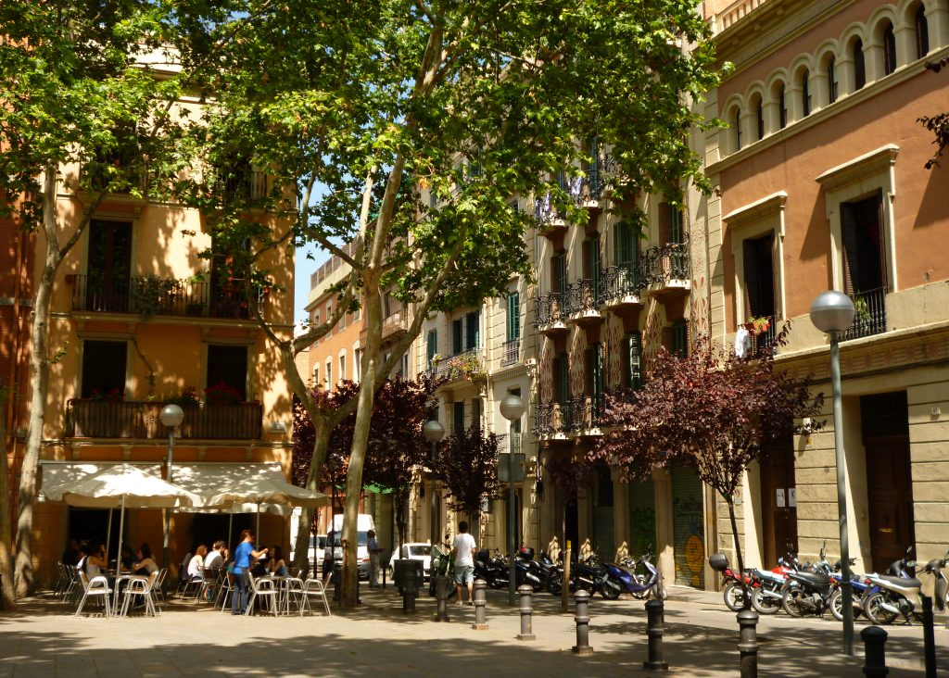
Define A Good Neighbourhood
1. It has lots of trees
2. You can move around in it without a car
3. You can find essentials nearby
4. It is safe
6. It offers a variety of housing types
5. It offers easy access to medical care
7. It provides a full range of public services
8. It looks appealing

Slide 7
Define A Good Neighbourhood
1. It has lots of trees
2. You can move around in it without a car
3. You can find essentials nearby
4. It is safe
6. It offers a variety of housing types
5. It offers easy access to medical care
7. It provides a full range of public services
8. It looks appealing

Slide 8
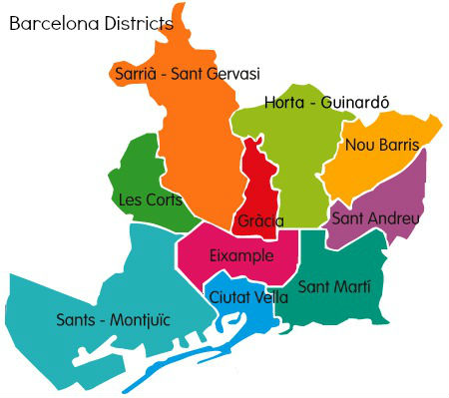
Barcelona districts and databases

Slide 9
Barcelona districts and databases
opendata-ajuntament.barcelona.cat

Slide 10
Barcelona districts and databases
opendata-ajuntament.barcelona.cat
Bus and Metro stops

Slide 11
Barcelona districts and databases
opendata-ajuntament.barcelona.cat
Bus and Metro stops
Traffic accidents (2011 – 2019)

Slide 12
Bus and Metro stops

Slide 13
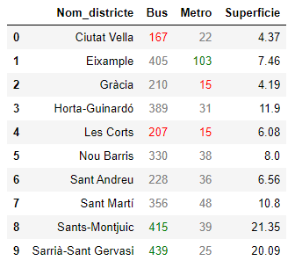
Bus and Metro stops
Number of transport stops by districts

Slide 14
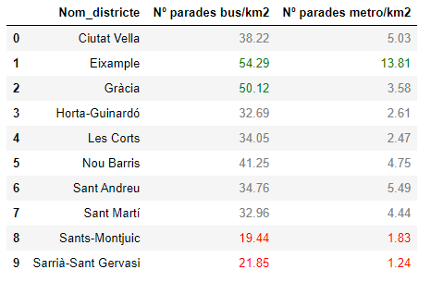
Bus and Metro stops
Number of transport stops/km² by districts

Slide 15
Traffic accidents (2011 – 2019)

Slide 16
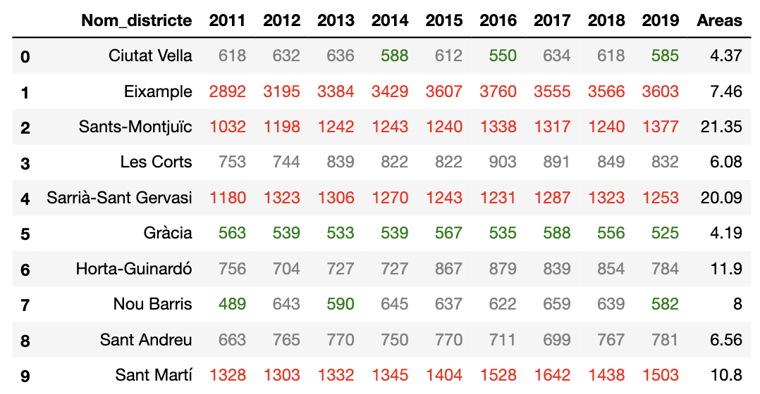
Traffic accidents (2011 – 2019)
Number of accidents by districts

Slide 17
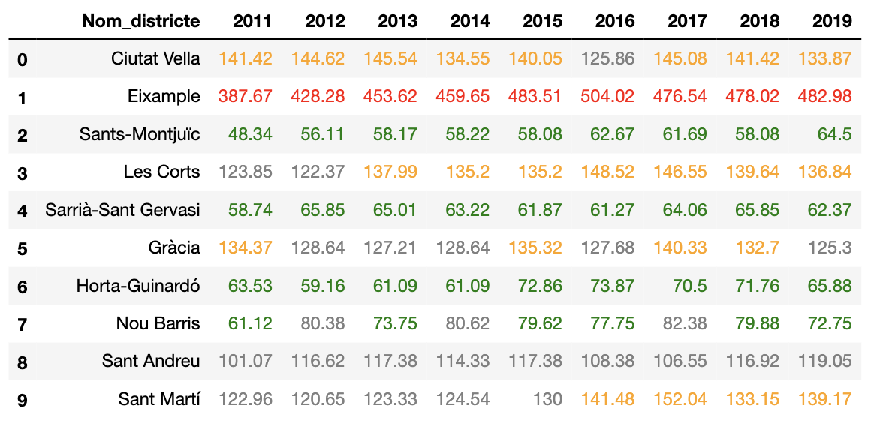
Traffic accidents (2011 – 2019)
Number of accidents/km² by districts

Slide 18
Traffic accidents (2011 – 2019)

Slide 19
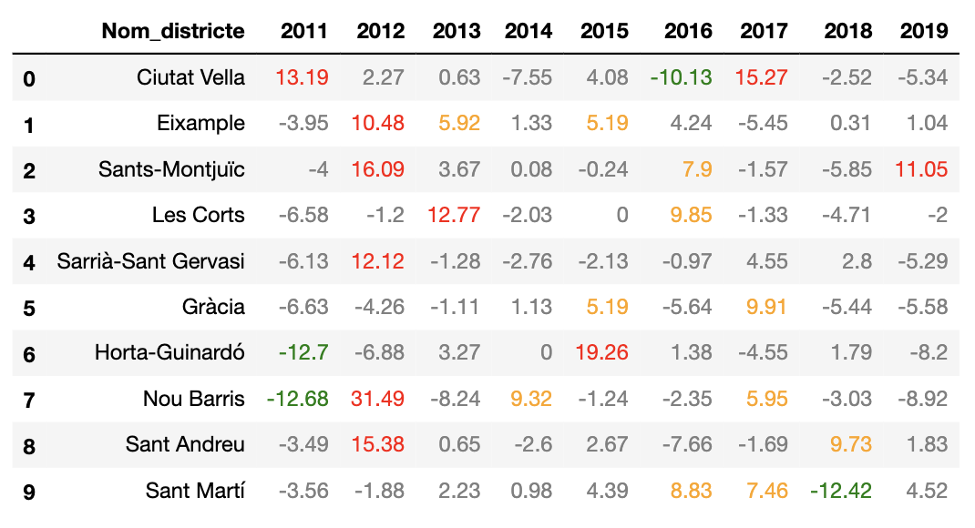
Traffic accidents (2011 – 2019)
Annual increment of accidents by districts

Slide 20
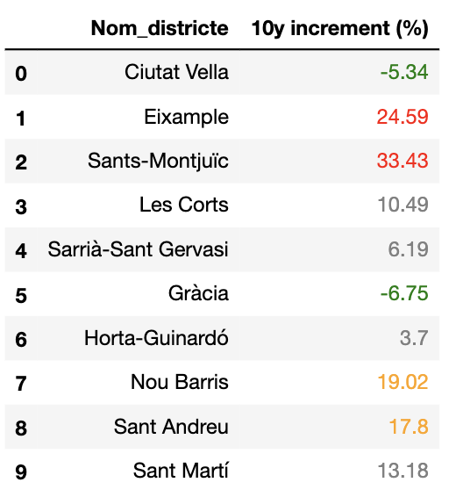
Traffic accidents (2011 – 2019)
Annual increment of accidents by districts
10-years increment of
accidents by districts

Slide 21
Conclusions
Eixample is a very well connected district, but we should be more careful when we walk in the street than in other areas of Barcelona (and it seems it is not going to change in the future years).

Slide 22
Conclusions
Eixample is a very well connected district, but we should be more careful when we walk/drive in the street than in other areas of Barcelona (and it seems it is not going to change in the future years).

Slide 23
Conclusions
Eixample is a very well connected district, but we should be more careful when we walk/drive in the street than in other areas of Barcelona (and it seems it is not going to change in the future years).

