Slide 1
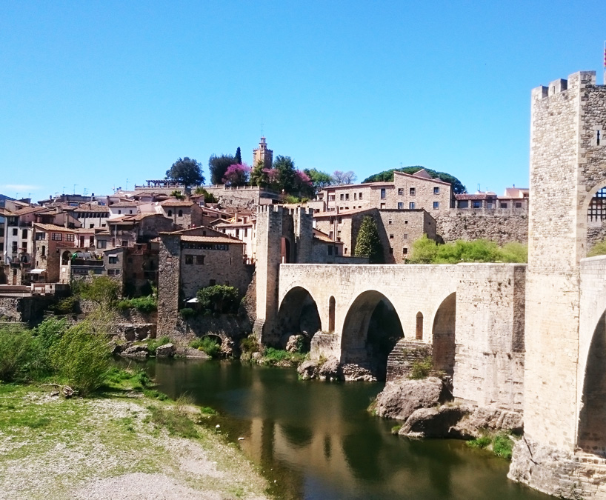

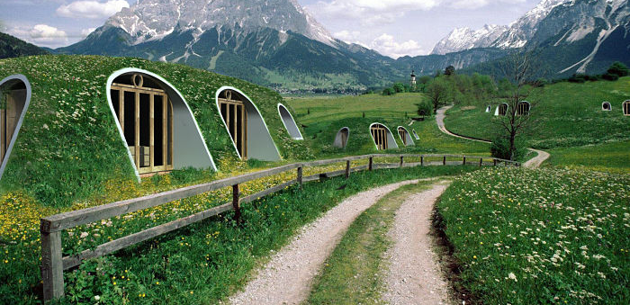
Should we get back to the countryside…

Slide 2

…with all that is happening nowadays?
Multiple crisis
Virus attack
Pollution
…

Slide 3

CHECKPOINT 1
Is there a relationship between population density and pollution in cities?
CHECKPOINT 2
Is there a relationship between population density and average price of houses?

Slide 4
Usage of data from 2013 – 2019 by Counties
PARAMETERS | DESCRIPTION
Health | Pollution in Catalunya
http://www.qualitatdelaire.cat/
Money | Average price for buying a house in Catalunya
https://www.idescat.cat/
Love | Population density in Catalan counties
https://www.idescat.cat/

Slide 5



Annual pollution < 0.5
Average price > 0.5

Slide 6
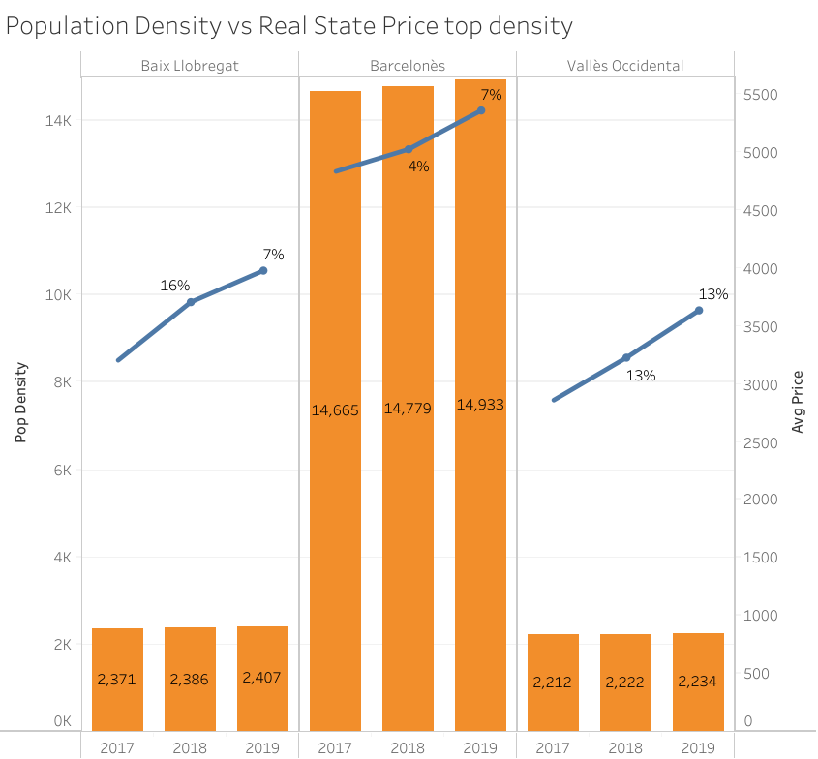
As population density grows, so does the price

Slide 7
Barcelona has almost 3 times more population density than TOP 10 cities in China
Barcelona | China
15.987 person/Km2 | 5.590 person/Km2

Slide 8
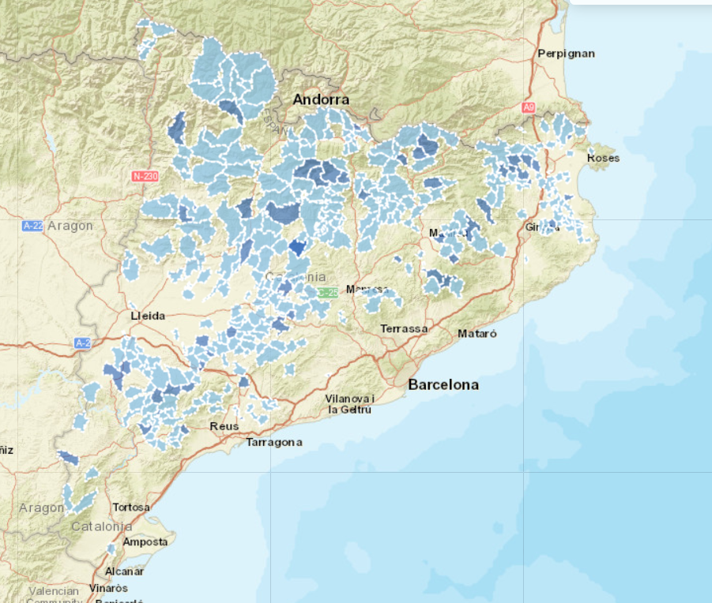
+300 abandoned towns in Catalonia
GUISASH http://atlantis.uab.cat/hamlet/public.action?request_locale=ca#
The Geographic Information System for Active and Sustainable Micropolis

Slide 9

THANKS!

