Slide 1

Internet Movie Databases Exploratory Analysis
- IMDEA -
Beto Sibileau
Barcelona, May 2020

Slide 2






Project Motivations
History !
Large Data, ≠ sources
Data driven approaches
Netflix Million Prize (2006-2009) -
2

Slide 3
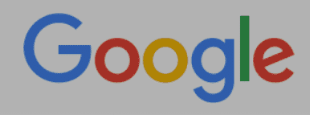

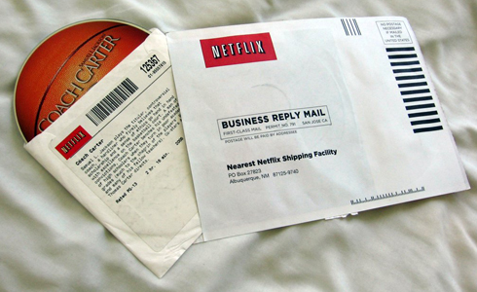
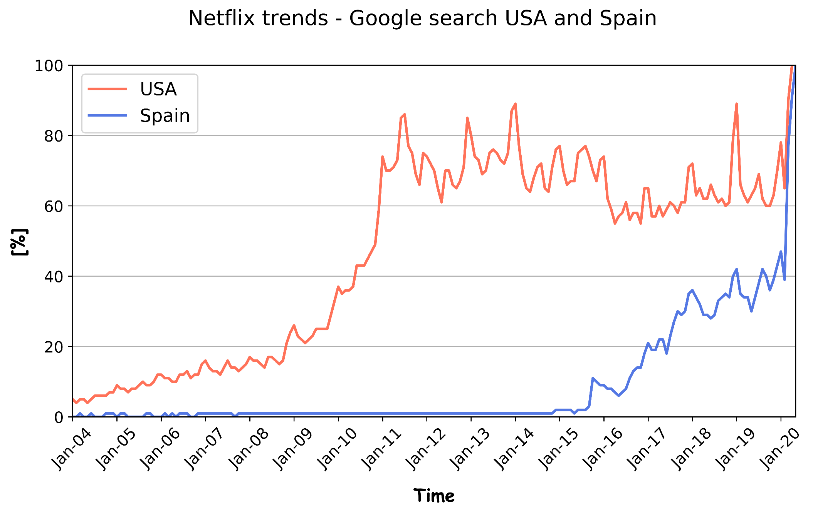


Netflix History
netflix
Meet Netflix (1997-2000)
Meet Netflix (2006)
3

Slide 4

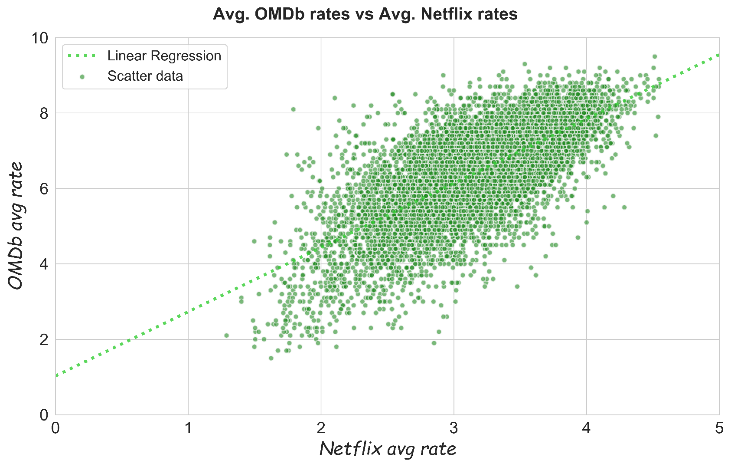
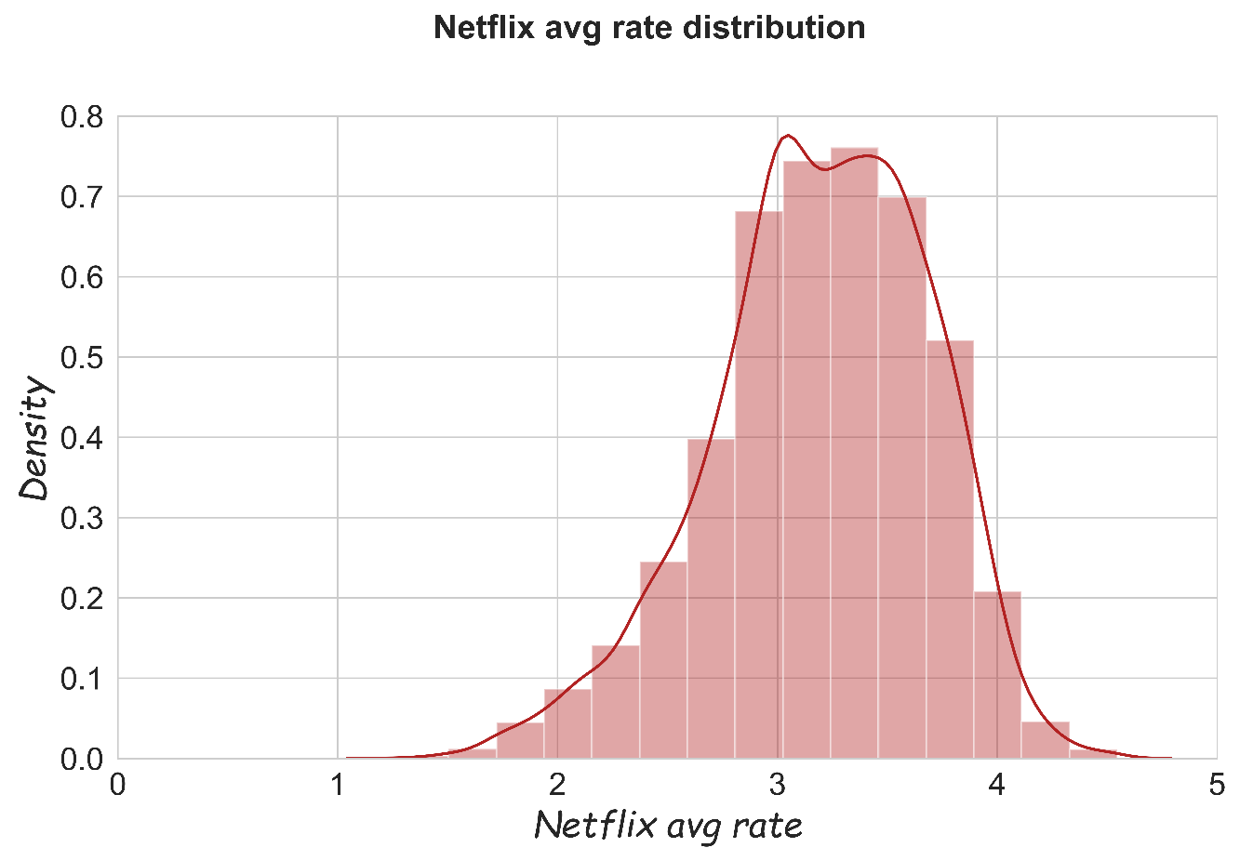
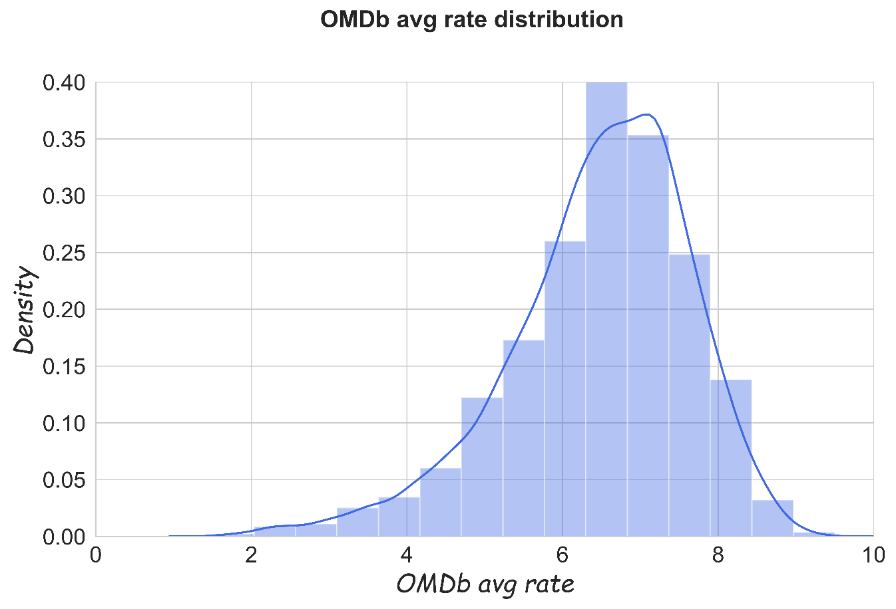


Mad about Ratings
Predictions
Correlations
(Rate)
vs.
(Duration)
4

Slide 5
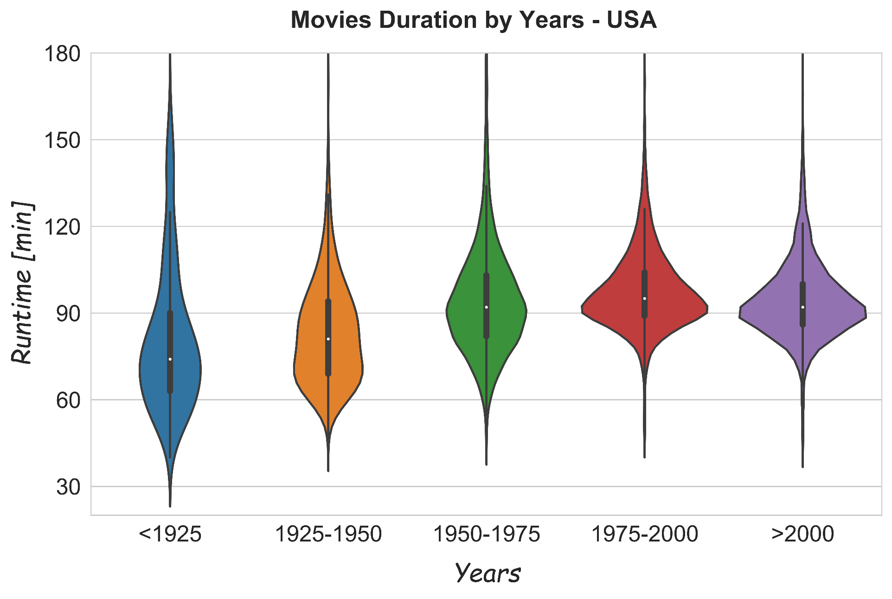


Movies Duration
USA
Countries and Years
5

Slide 6

Concluding remarks
Distinct user rating systems show strong correlation.
Movie runtimes don’t win ratings (could be targeted: country trends).
Keep our business riding: go deep into data!
Thanks for attending! Questions?

