Slide 1
Applied Data Science: Data Visualization & Machine Learning
Fundamentals of Machine Learning

Slide 2
What is Machine Learning?
Creating a “box” that given some input data will create a prediction y
Very much like a mathematical function that x -> f(x)
Then what’s all the fuss about?

Slide 3
What is Machine Learning?
In Machine Learning, we do not know up front what the function f(x) is! Therefore we need to give the Machine enough examples to figure out what is the best function. This is the component of Learning

Slide 4
What is Machine Learning?
Let’s look at an example of a problem that we might be tempted to solve with Machine Learning: Will a flight of low-cost carrier, Bryan Air be delayed?
There are two ways in which we could attack this problem that show the two types of Machine Learning Problems
Classification
Regression
How many minutes after boarding time did the flight leave? Answer is numerical and can take any real value -> Regression Problem
Was the Flight Delayed? Yes/No Output Variables are discrete -> Classification

Slide 5
Bryan Air Case Delay Algorithm
Features come in two main categories:
Categorical
Numerical
# People Booked Flight
Airport Location
Average Cost of Tickets
Name of Pilot
Average Years Experience Cabin Crew
Cabin Crew Strike?
Duration of Flight
# Flights in the airport
Aircraft Arrival Time of Previous Flight

Slide 6
Bryan Air Case Delay Algorithm
Our Features will be our input variables x that will help us predict our output variable y
To move forward in building our Machine Learning Algorithm we need data over which the machine can learn ☺
# Passengers | Airport | Flight Duration (hours) | Cabin Crew Strike | Cabin Crew Experience (years) | Cost of Tickets
150 | Lisbon | 2.5 | No | 10 | 100
250 | Porto | 8 | No | 2 | 550
10 | Lisbon | 1.5 | No | 25 | 2000
300 | Azores | 8 | No | 9 | 600
220 | Madrid | 3 | No | 1.5 | 85
150 | Orly | 4 | Yes | 25 | 120
250 | Porto | 8 | No | 2 | 550
300 | Porto | 8 | Yes | 10 | 800
By building the following table we have a possible set of features we could input into a ML Algorithm. Is this enough to answer our question?

Slide 7
Bryan Air Case Delay Algorithm
Not Enough! For most types of classification problems, we need to know the answer to previous examples. These are called the labels of our dataset
# Passengers | Airport | Flight Duration (hours) | Cabin Crew Strike | Cabin Crew Experience (years) | Cost of Tickets | Delayed Departure?
150 | Lisbon | 2.5 | No | 10 | 100 | No
250 | Porto | 8 | No | 2 | 550 | Yes
10 | Lisbon | 1.5 | No | 25 | 2000 | No
300 | Azores | 8 | No | 9 | 600 | Yes
220 | Madrid | 3 | No | 1.5 | 85 | Yes
150 | Orly | 4 | Yes | 25 | 120 | No
250 | Porto | 8 | No | 2 | 550 | Yes
300 | Porto | 8 | Yes | 10 | 800 | No

Slide 8
Fundamentals of Machine Learning
Whenever we have a machine learning problem where the data is labelled with the output variable we are trying to predict (target variable), we say this is called a supervised machine learning problem If on the other hand we do not have labelled data (The previous examples of data do not have answers), we say it is a unsupervised machine learning problem

Slide 9
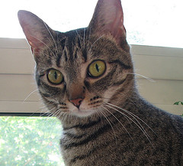
Fundamentals of Machine Learning
Whenever we have a machine learning problem where the data is labelled with the output variable we are trying to predict (target variable), we say this is called a supervised machine learning problem If on the other hand we do not have labelled data (The previous examples of data do not have answers), we say it is a unsupervised machine learning problem
An example of an unsupervised problem could be the classification problem of trying to predict if a picture has a cat or not. Even though us humans can obviously see the answer, a computer doesn’t know the answer just by reading the picture.

Slide 10
Bryan Air Case Delay Algorithm
Now we understand what is labelled data and what is a supervised learning problem. We are almost ready
# Passengers | Airport | Flight Duration (hours) | Cabin Crew Strike | Cabin Crew Experience (years) | Cost of Tickets | Delayed Departure?
150 | Lisbon | 2.5 | No | 10 | 100 | No
250 | Porto | 8 | No | 2 | 550 | Yes
10 | Lisbon | 1.5 | No | 25 | 2000 | No
300 | Azores | 8 | No | 9 | 600 | Yes
220 | Madrid | 3 | No | 1.5 | 85 | Yes
150 | Orly | 4 | Yes | 25 | 120 | No
250 | Porto | 8 | No | 2 | 550 | Yes
300 | Porto | 8 | Yes | 10 | 800 | No

Slide 11
Bryan Air Case Delay Algorithm
# Passengers | Airport … | Delayed Departure?
1000 Rows of Features
1000 Labels
Training Data aka: known data, labelled data
# Passengers | Airport … | Delayed Departure?
Test Data aka: Test set, Real world data
100 Rows of new data
?

Slide 12
Bryan Air Case Delay Algorithm
# Passengers | Airport … | Delayed Departure?
1000 Rows of Features
1000 Labels
Training Data aka: known data, labelled data
Validation Set Used to tune hyperparameters of model/unbiased evaluation
Validation Set
Validation Labels
# Passengers | Airport … | Delayed Departure?
Test Data aka: Test set, Real world data
100 Rows of new data
?

Slide 13
Bryan Air Case Delay Algorithm – Training Process
# Passengers | Airport …
1000 Rows of Features
a1, b1, c1
1000 predictions
1000 Labels
Model 1
vs
Training a particular model involves calculating the best parameters of that model that “fit” the labels of the observation This usually corresponds to an optimization problem.
Model 1 has parameters: a,b,c

Slide 14
Bryan Air Case Delay Algorithm – Training Process
# Passengers | Airport …
1000 Rows of Features
a2, b2, c2
1000 predictions
1000 Labels
Model 1
vs
The Algorithm will test different combinations of the parameters a,b,c until it converges on the best possible value.
Model 1 has parameters: a,b,c

Slide 15
Bryan Air Case Delay Algorithm – Training Process
# Passengers | Airport …
1000 Rows of Features
a2, b2, c2
1000 predictions
1000 Labels
Model 1
vs
The Algorithm will test different combinations of the parameters a,b,c until it converges on the best possible value.
Model 1 has parameters: a,b,c
How do we define what is the best value?

Slide 16
Bryan Air Case Delay Algorithm – Training Process
# Passengers | Airport …
1000 Rows of Features
a*, b*, c*
1000 predictions
1000 Labels
Model 1
vs
When we finally converge we obtain the parameters of the model a*, b*, c*
At this stage we claim that Model 1 has been trained on this dataset
Model 1 has parameters: a,b,c

Slide 17
Bryan Air Case Delay Algorithm – Training Process
# Passengers | Airport …
1000 predictions
1000 Labels
1000 Rows of Features
Model 1
vs
1000 predictions
1000 Labels
Model 2
vs
Model 3
1000 predictions
1000 Labels
vs

Slide 18
Bryan Air Case Delay Algorithm – Testing Process
# Passengers | Airport …
100 predictions
1000 Rows of Features
Model 1
vs
Validation Labels
100 predictions
Model 2
Validation Labels
vs
Model 3
100 predictions
vs
Validation Labels
Validation Set
Is this a good way to compare the results?

Slide 19
Bryan Air Case Delay Algorithm – Testing Process
100 predictions
1000 Rows of Features
Yes – 10%
Model 1
100 predictions
Model 2
Validation Set
Yes – 90%
Model 3
100 predictions
Imagine if when you split the training vs validation data set, you have an unbalanced distribution of the labels – Either your training or validation datasets are poorly representative of the population.

Slide 20
Bryan Air Case Delay Algorithm – Cross Validation
Cross Validation consists of partitioning your data into complementary subsets which will be successfully used to train the model thus arriving at independent performance metrics.
1000 Rows of Features
1000 Rows of Features
1000 Rows of Features
1000 Rows of Features
Validation Set
1000 Rows of Features
Validation Set
…
Validation Set
Validation Set
If we split the initial dataset into k-slices, we saw that we applied a k-fold cross validation method

Slide 21
Bryan Air Case Delay Algorithm – Cross Validation
1000 Rows of Features
Validation Set
Slice 1
Prediction 1
vs
Validation Labels 1
Model 1
Prediction 2
vs
Validation Labels 2
1000 Rows of Features
Slice 2
Validation Set
Prediction k
vs
Validation Labels k
1000 Rows of Features
Validation Set
Slice k

Slide 22
Bryan Air Case Delay Algorithm – Cross Validation
1000 Rows of Features
Validation Set
Slice 1
Prediction 1
vs
Validation Labels 1
Model 1
Prediction 2
vs
Validation Labels 2
1000 Rows of Features
Slice 2
Validation Set
Prediction k
vs
Validation Labels k
1000 Rows of Features
Validation Set
Slice k
For each one you evaluate the performance of the trained algorithm and then calculate an overall performance metric for the model

Slide 23
Bryan Air Case Delay Algorithm – Cross Validation
1000 Rows of Features
Validation Set
K validation
Model 1
Overall Accuracy = 75%
1000 Rows of Features
Model 2
Overall Accuracy = 85%
Validation Set
Model 3
1000 Rows of Features
Overall Accuracy = 83%
Validation Set
Finally you repeat this for all the models you are considering and are finally in a position to evaluate which model you want to use

Slide 24
Bryan Air Case Delay Algorithm – Cross Validation
The general procedure is as follows:
Shuffle the dataset randomly.
Split the dataset into k groups
For each unique group:
Take the group as a hold out or validation data set
Take the remaining groups as a training data set
Fit a model on the training set and evaluate it on the validation set
Retain the evaluation score and discard the model
4. Summarize the skill of the model using the sample of model evaluation scores

Slide 25
Summary
So far we have looked at: - Overall machine learning workflow.
Classification vs Regression Machine Learning problems
Supervised vs Unsupervised Machine learning problems (we will review this again) we are missing:
How do we evaluate the quality/performance of a Machine Learning Algorithm?

Slide 26
Evaluating Machine Learning Algorithms
In the training phase, when we are selecting which algorithms we want, we must select the performance metric over which our algorithm will be trained. Several performance metrics exist:
Classification Accuracy
Confusion Matrix
Logarithmic Loss
F1 Score
Etc…

Slide 27
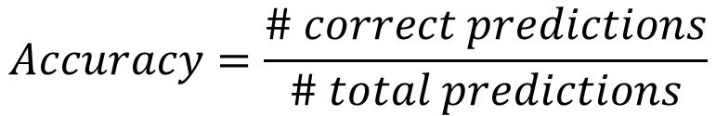
Machine Learning Evaluation Metrics
Classification Accuracy
Simple to calculate, use and explain:
$$Accuracy=\frac{\# correct predictions}{\# total predictions}$$

Slide 28
Machine Learning Evaluation Metrics
Classification Accuracy
Simple to calculate, use and explain:
$$Accuracy=\frac{\# correct predictions}{\# total predictions}$$
Predicted labels
Yes
No
Yes
Yes
Yes
No
Yes
No
Yes
Real Labels
Yes
Yes
No
Yes
Yes
No
Yes
No
Yes

Slide 29
Machine Learning Evaluation Metrics
Classification Accuracy
Simple to calculate, use and explain:
$$Accuracy=\frac{\# correct predictions}{\# total predictions}$$
Predicted labels
Yes
No
Yes
Yes
Yes
No
Yes
No
Yes
Real Labels
Yes
Yes
No
Yes
Yes
No
Yes
No
No

Slide 30
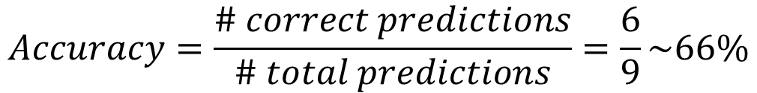
Machine Learning Evaluation Metrics
Classification Accuracy
Simple to calculate, use and explain:
$$Accuracy=\frac{\# correct predictions}{\# total predictions}=\frac{6}{9}\sim 66\%$$
Predicted labels
Yes
No
Yes
Yes
Yes
No
Yes
No
Yes
Real Labels
Yes
Yes
No
Yes
Yes
No
Yes
No
No

Slide 31
Machine Learning Evaluation Metrics
Confusion Matrix Useful in Classification problems of two or more target classes. This method is the basis for many other evaluation metrics.
Prediction
 | A | B | C
a
b
c
True Class

Slide 32
Machine Learning Evaluation Metrics
Confusion Matrix Useful in Classification problems of two or more target classes. This method is the basis for many other evaluation metrics.
Prediction
 | A | B | C | Row Totals
a
b
c
Column Totals
True Class

Slide 33
Machine Learning Evaluation Metrics
Confusion Matrix
We start off by filling in the True Positive Values
These are the values whose class was correctly predicted
Prediction
 | A | B | C | Row Totals
a | 33
b |  | 22
c |  |  | 11
Column Totals
True Class

Slide 34
Machine Learning Evaluation Metrics
Confusion Matrix
We then include the values that were incorrectly predicted as class A
Prediction
 | A | B | C | Row Totals
a | 33
b | 3 | 22
c | 7 |  | 11
Column Totals | 43
True Class

Slide 35
Machine Learning Evaluation Metrics
Confusion Matrix
And so on…
Prediction
 | A | B | C | Row Totals
a | 33 | 12 | 4 | 49
b | 3 | 22 | 5 | 30
c | 7 | 3 | 11 | 21
Column Totals | 43 | 37 | 20 | 100
True Class

Slide 36
Machine Learning Evaluation Metrics
Confusion Matrix
Based on the matrix below we can now define two new metrics: precision & recall
Prediction
 | A | B | C | Row Totals
a | 33 | 12 | 4 | 49
b | 3 | 22 | 5 | 30
c | 7 | 3 | 11 | 21
Column Totals | 43 | 37 | 20 | 100
True Class

Slide 37
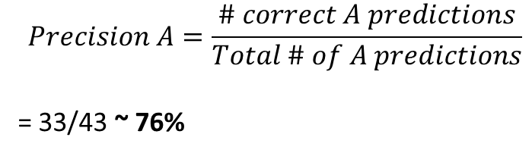
Machine Learning Evaluation Metrics
Confusion Matrix
Based on the matrix below we can now define two new metrics: precision & recall
Prediction
 | A | B | C | Row Totals
a | 33 | 12 | 4 | 49
b | 3 | 22 | 5 | 30
c | 7 | 3 | 11 | 21
Column Totals | 43 | 37 | 20 | 100
$$Precision A=\frac{\# correct A predictions}{Total \# of A predictions}$$
= 33/43 ~ 76%
True Class

Slide 38
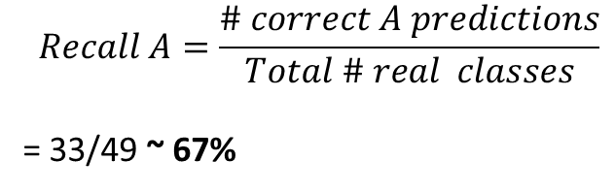
Machine Learning Evaluation Metrics
Confusion Matrix
Based on the matrix below we can now define two new metrics: precision & recall
Prediction
 | A | B | C | Row Totals
a | 33 | 12 | 4 | 49
b | 3 | 22 | 5 | 30
c | 7 | 3 | 11 | 21
Column Totals | 43 | 37 | 20 | 100
$$Recall A=\frac{\# correct A predictions}{Total \# real classes}$$
= 33/49 ~ 67%
True Class
Recall is also known as sensitivity

Slide 39
Machine Learning Evaluation Metrics
Confusion Matrix
Depending on the type of machine learning problem you have, you might want to prioritize recall or precision:
Predicting Cancer in a patient – Precision or Recall?
Distributing Scarce Vaccines to suspected cancer patients – Precision or Recall?

Slide 40
Machine Learning Evaluation Metrics
Confusion Matrix
Depending on the type of machine learning problem you have, you might want to prioritize recall or precision:
Predicting Cancer in a patient – Precision or Recall?
Distributing Scarce Vaccines to suspected cancer patients – Precision or Recall?

Slide 41
Machine Learning Evaluation Metrics
Going back to a Binary Classification problem, this reasoning allows us to identify 4 important types of classification
True Positive
True Negative
False Positive False Negative

Slide 42
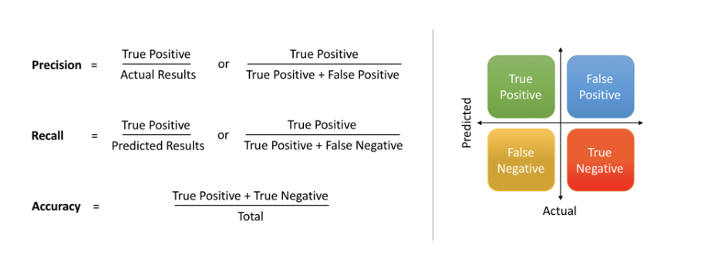
Machine Learning Evaluation Metrics
Going back to a Binary Classification problem, this reasoning allows us to identify 4 important types of classification

Slide 43
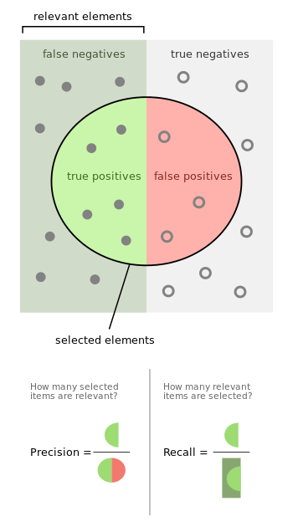
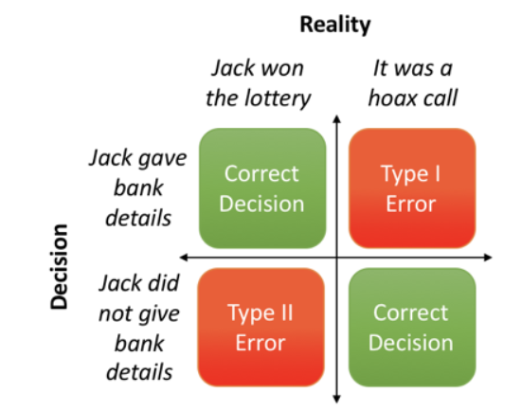
Machine Learning Evaluation Metrics
Deep relationship with Type I, Type II errors

Slide 44
Applied Data Science: Data Visualization & Machine Learning
Fundamentals of Machine Learning II

Slide 45
Machine Learning Algorithms
Some of the most common algorithms include:
Linear Regression
Decision Trees
Naïve-Bayes Classifier
Logistic Regression
K-means Clustering
K Nearest Neighbours
SVM – Support Vector Machines
Neural Networks

Slide 46
Machine Learning Algorithms
The process of training a machine learning algorithm involves:
Identifying the parameters of the ML algorithms
Defining a Loss function that will “weigh” & attribute a penalty to incorrect predictions
Re-definition of the parameters in order to minimize the cost function (minimize the error)

Slide 47
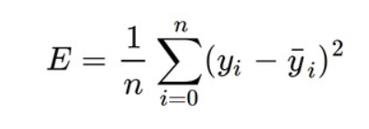


Loss functions
The cost function has to be such that it will receive a prediction and the real value of a label to then return a quantity that the error of a model in performing the predictions.
An example of a Loss function can be that used in linear regression known as the squared error.
$$y_{i}=mx_{i}+c$$
$${\overline{y}}_{i}$$
The function above will be the result of our trained model
Let this be the real value of a given label
If we have n points over which to train

Slide 48
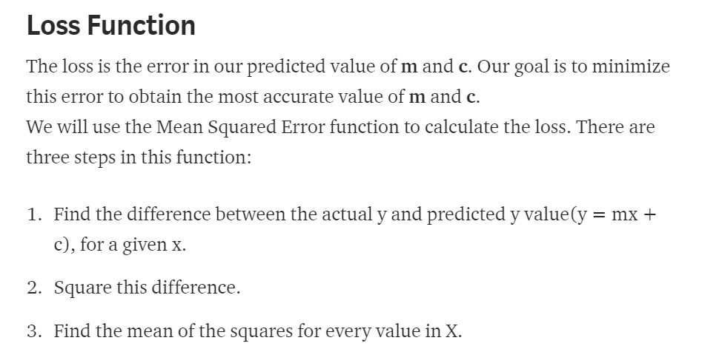
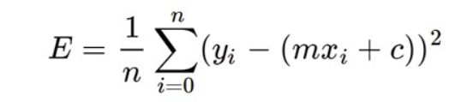
Loss function - Means Square

Slide 49
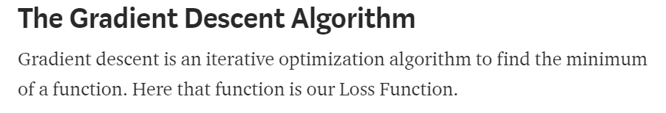
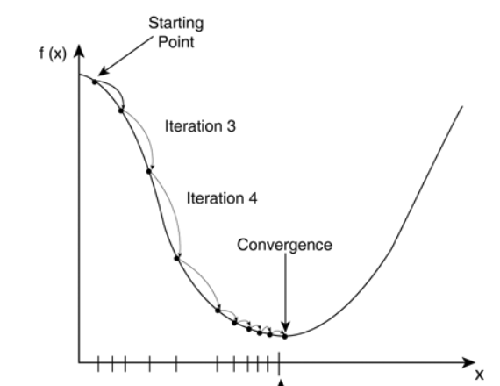
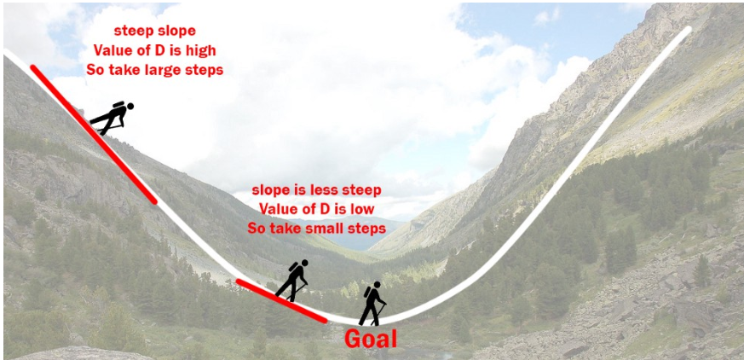
Loss function - Minimization
We now need to find the best possible values of m,c that minimize the loss function. For that we can apply an algorithm called gradient descent

Slide 50
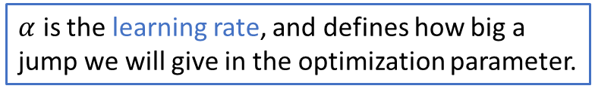
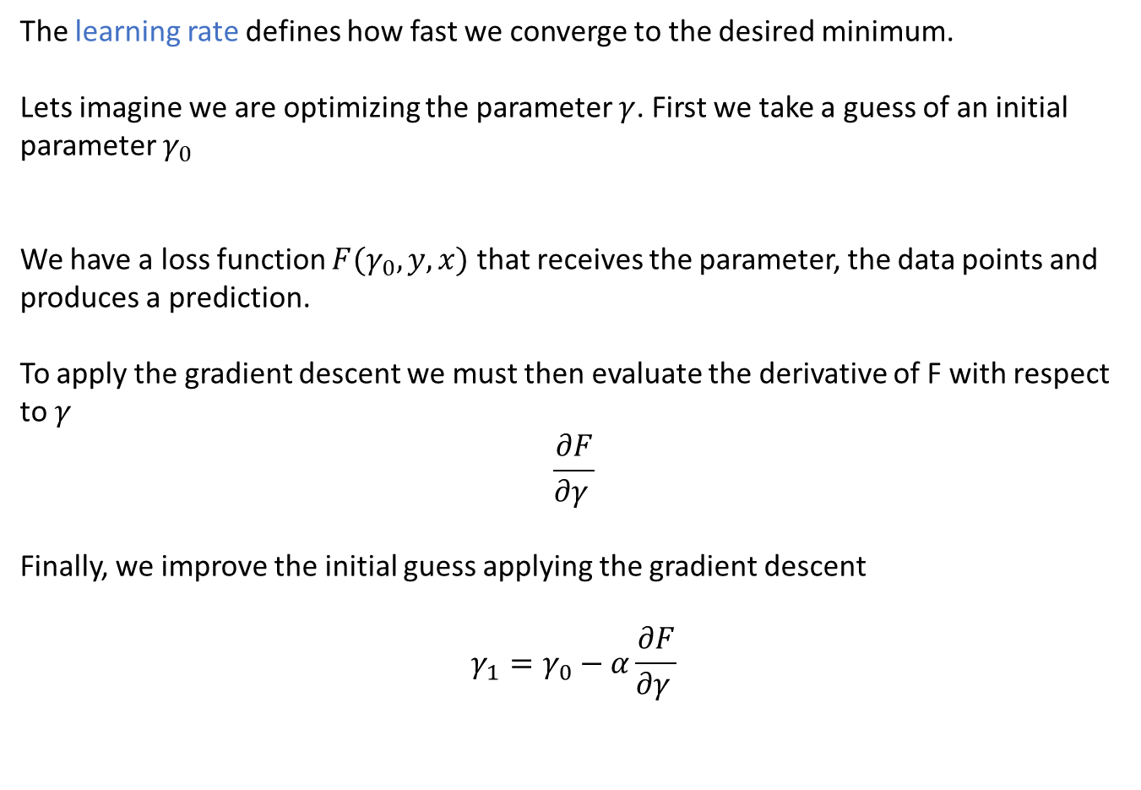
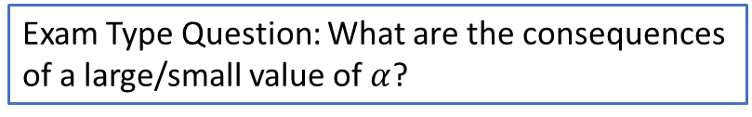
Gradient Descent– Learning Rate
The learning rate defines how fast we converge to the desired minimum. Lets imagine we are optimizing the parameter $γ$. First we take a guess of an initial parameter $γ_{0}$
We have a loss function $F(γ_{0},y,x)$ that receives the parameter, the data points and produces a prediction.
To apply the gradient descent we must then evaluate the derivative of F with respect to $γ$
$$\frac{∂F}{∂γ }$$
Finally, we improve the initial guess applying the gradient descent
$$γ_{1}=γ_{0}−α\frac{∂F}{∂γ }$$
$α$ is the learning rate, and defines how big a jump we will give in the optimization parameter.
Exam Type Question: What are the consequences of a large/small value of $α$?

Slide 51
Loss function – Gradient Descent
The algorithm of Gradient descent is therefore: 1. Guess an initial value of the parameter
2. Evaluate the function you want to minimize at that point
3. Compute the gradient of the function at that point
4. Shift the parameter value in the direction of decreasing gradient
5. Repeat process until convergence criteria is met

Slide 52
Loss function – Convergence Criteria
There are two usual types of convergence criteria used:
Convergence after a certain error boundary limit is reached. Example: whenever the values of my loss function is smaller than 0.001
Convergence after a fixed number of iterations. Example: Improve parameter 10000 times and then exit.

Slide 53
Loss function – Gradient Descent
Let’s design an Algorithm that implements gradient descent for the linear regression
Define x values and y values
Initial guess for m, c
Evaluate the Loss Function
Evaluate the derivatives of the loss function
Re-calculate new parameters m,c using gradient descent (chose a learning rate)
Repeat this process until some convergence criteria is met

Slide 54
Applied Data Science: Data Visualization & Machine Learning
Fundamentals of Machine Learning III

Slide 55
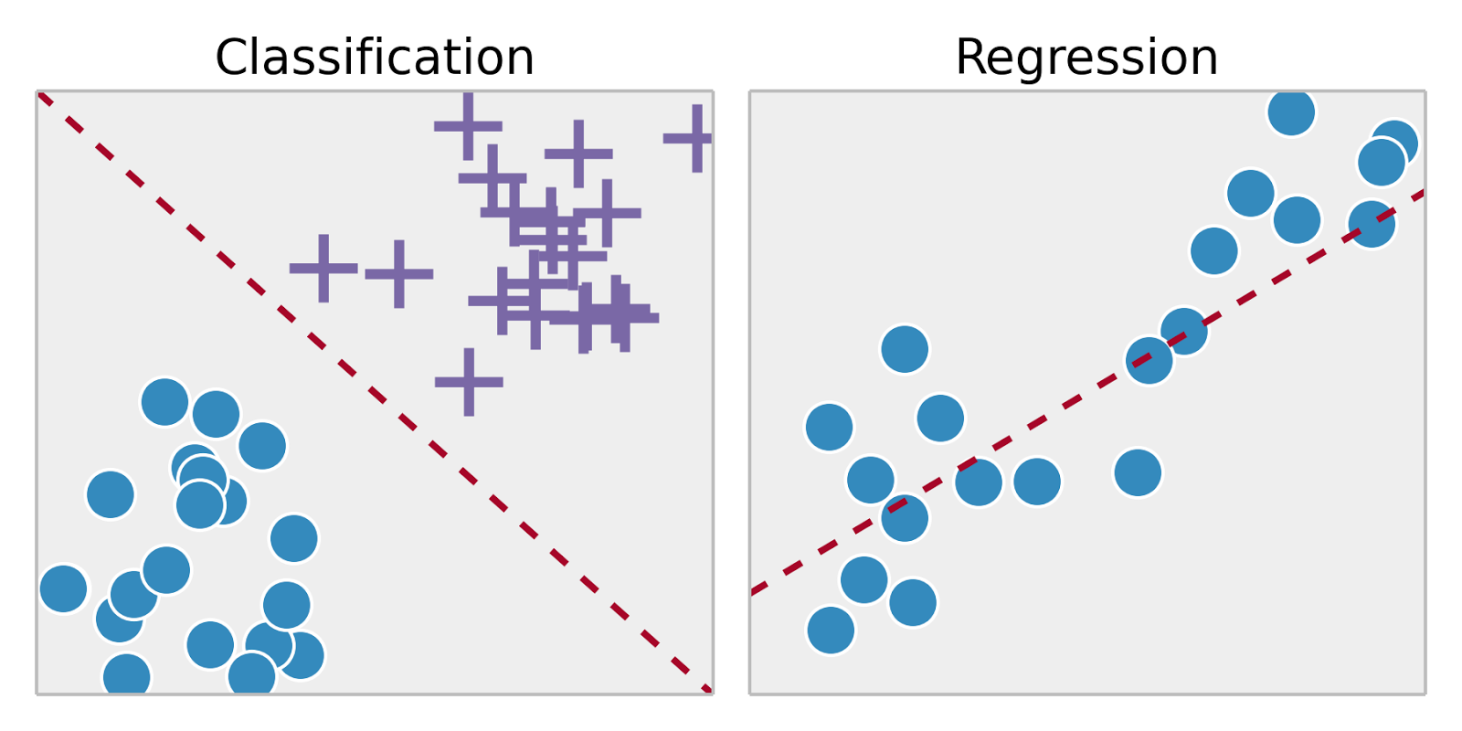
Machine Learning Algorithms
A visual way to remember the difference between supervised and unsupervised

Slide 56
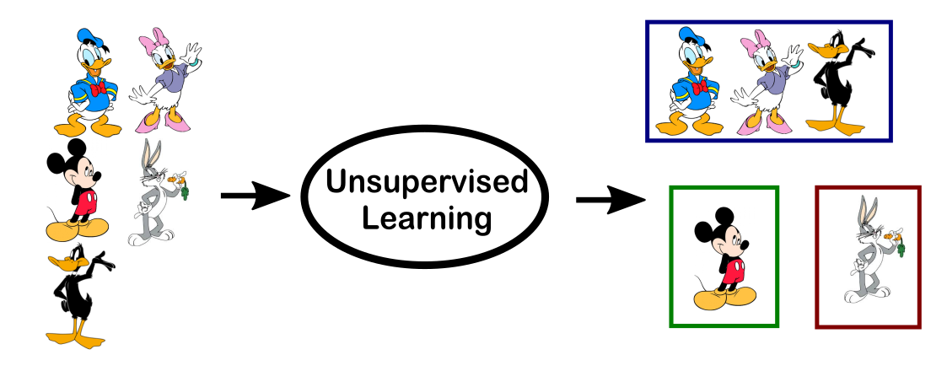
Machine Learning Algorithms
A visual way to remember the difference between supervised and unsupervised

Slide 57
Machine Learning Algorithms
Over the years, several machine learning algorithms have appeared and been studied and applied extensively. In the end of the day, remember the large classes of machine learning algorithms:
 | Supervised | Unsupervised
Discrete | Classification or Categorization | Clustering
Continuous | Regression | Dimensionality Reduction

Slide 58
Machine Learning Algorithms
Some of the most common algorithms include:
Linear Regression
Decision Trees
Naïve-Bayes Classifier
Logistic Regression
K-means Clustering
K Nearest Neighbours
SVM – Support Vector Machines
Neural Networks

Slide 59
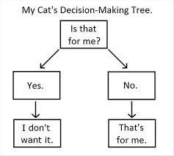
Decision Trees
Objective is to split data according to different conditions
Some can be simple

Slide 60
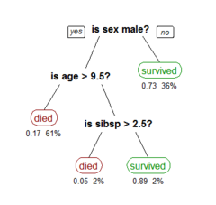
Decision Trees
Objective is to split data according to different conditions.
Flow-Chart structure where each node represents a test on a feature
Corresponding branches represent the different outcomes
Usually used in the context of classifications problems (where target variable is discrete/categorical) but in the case where the target variable takes continuous values there can be regression trees

Slide 61
Decision Trees
Objective is to split data according to different conditions.
Each leaf of the tree is labeled with class probability according to observtions.
Algorithm used to build decisions trees is known as ID3 algorithm (by Quinlan). A description of the algorithm is: Select the best feature ->
Assign test case for the node ->
for each value of the feature, create a new descendant node ->
sort training examples to the appropriate descendent leaf ->
If examples are perfectly classified -> stop.
Else iterate over the new leaf nodes.

Slide 62
Decision Trees
Advantages:
Simple to understand and interpret
Able to handle both numerical and categorical data
Requires little data preparation
Performs well for large datasets
Disadvantages:
Can be extremely non-robust for future training, small change in training data can lead to different tree
Greedy Algorithm and NP Complete problem (reseach further in future course)
Can create over-complex trees too particular to training datasets. This is known as overfitting

Slide 63
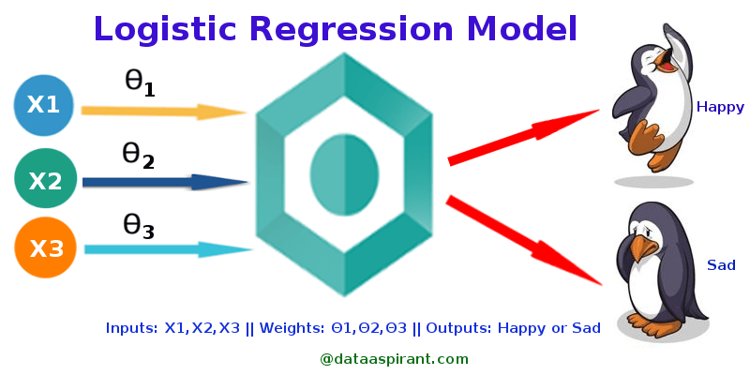
Logistic Regression

Slide 64
Logistic Regression
Logistic Regression uses the concepts of linear regression but generalizes the problem to then create a binary classification as a result. You can think of it as a case of linear regression where target variable is categorical. In it’s most common form, Logistic Regression is used as a statistical learning model to find the probability of something happening or not, being true/false ,etc. One or more independent variables are used to predict outcome of a dichotomous variable

Slide 65
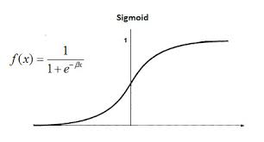
The Mathematical Formalism

Slide 66
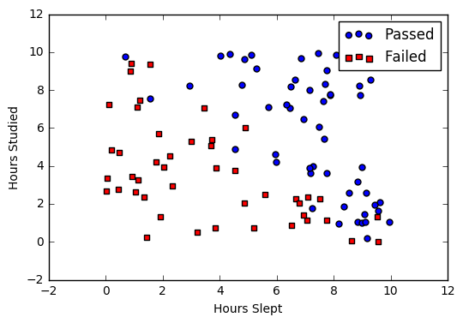
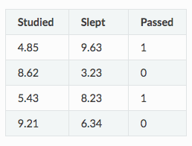
Logistic Regression - Example
Suppose we have the following dataset

Slide 67
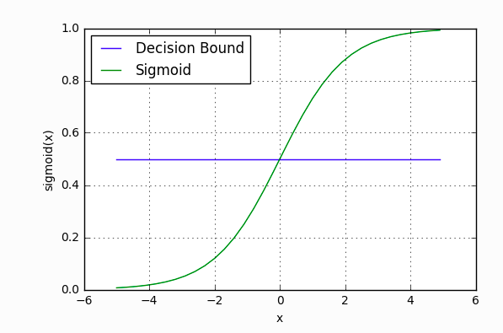
Logistic Regression - Example
Exam type question: how can we relate the Decision Boundary to precision vs recall and the type of errors we wish to minimize?

Slide 68
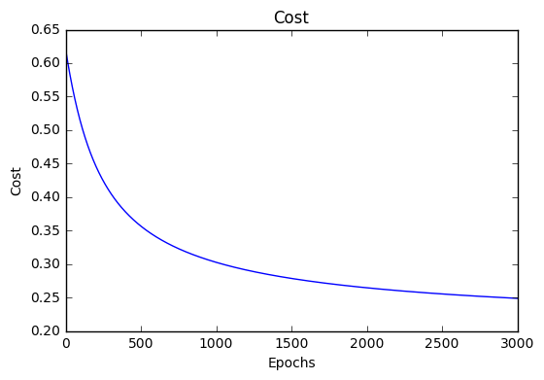


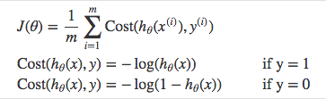
Logistic Regression - Example
Objective is to train parameters W0, W1, W2 to shape the optimal sigmoid function that reduces the cost function

Slide 69
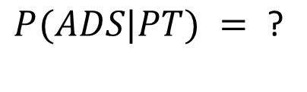
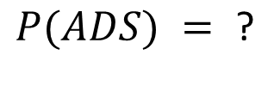
Naïve-Bayes Classifier
Let’s recall a bit of Bayes Theorem from probability
ADS Course
Portfolio Theory Course
$$P(ADS) =\text{ ? }$$
8
4
10
$$P(ADS|PT) =\text{ ? }$$
20

Slide 70
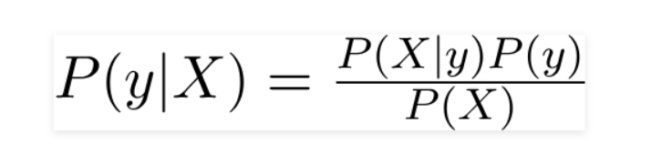
Naïve-Bayes Classifier
The Naïve-Bayes Classifier applies Bayes theorem to build conditional probabilities that predict the label given the features observed
Prior probability of target variable Y
Prior probability of target variable Y
We want to calculate this for a new data point
Prior probability of feature X

Slide 71
Naïve-Bayes Classifier
The Naïve-Bayes Classifier applies Bayes theorem to build conditional probabilities that predict the label given the features observed
Bayes theorem is applied to calculate the probability of a specific target variable given the input features and then the class with the largest probability is chosen as the prediction
As you will see, NB Classifier assumes that:
Features are independent of each other
All features have equal predictive power

Slide 72
Naïve-Bayes Classifier
The Naïve-Bayes Classifier applies Bayes theorem to build conditional probabilities that predict the label given the features observed
Advantages:
If features are truly independent then NB performs better compared to many other models.
Requires small amount of data to estimate test data
Easy to implement

Slide 73
Naïve-Bayes Classifier
The Naïve-Bayes Classifier applies Bayes theorem to build conditional probabilities that predict the label given the features observed
Disadvantages:
In practice its very hard/impossible that all features are mutually independent
Zero frequency problem: What is a given categorical variable has a value in the test data set which was never observed during training? This can be solved with a process called regularization/smoothing.

Slide 74
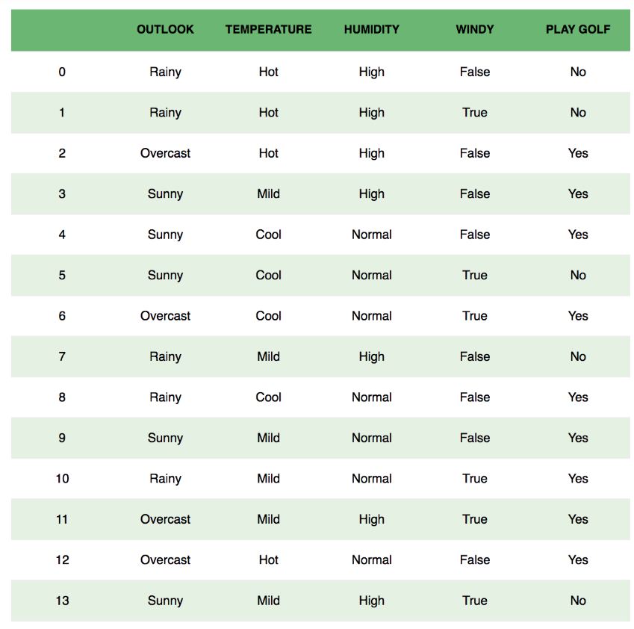
Naïve-Bayes Classifier

Slide 75
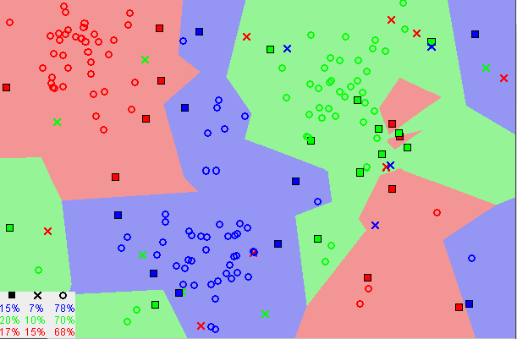
K Nearest Neighbours – KNN
- Classification or Regression Algorithm - Supervised ML Algorithm
K-Nearest Neighbours assumes that similar things are “close” to each other
3 classes to classify: red green and blue

Slide 76
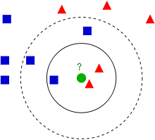
K Nearest Neighbours – KNN
Classification process of new point ( green) depends on the distance to the surrounding neighbours. The number of neighbours parameter (k), dictates how far out we must go.

Slide 77
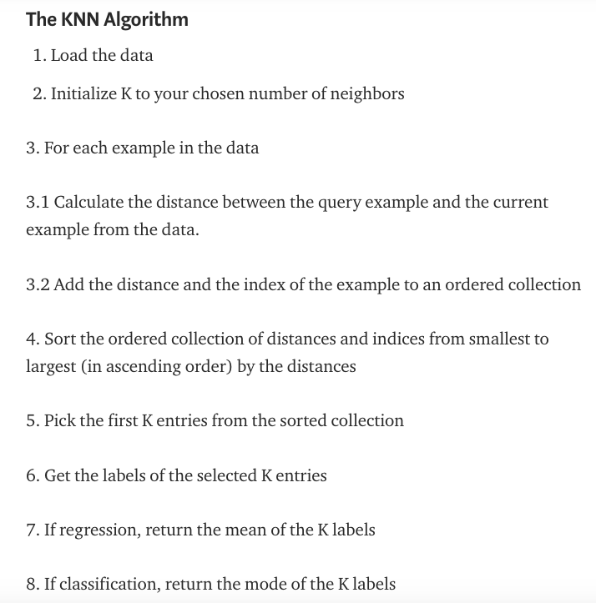
K Nearest Neighbours – KNN
It is common to assign a different weight to each neighbour based on the distance.

Slide 78
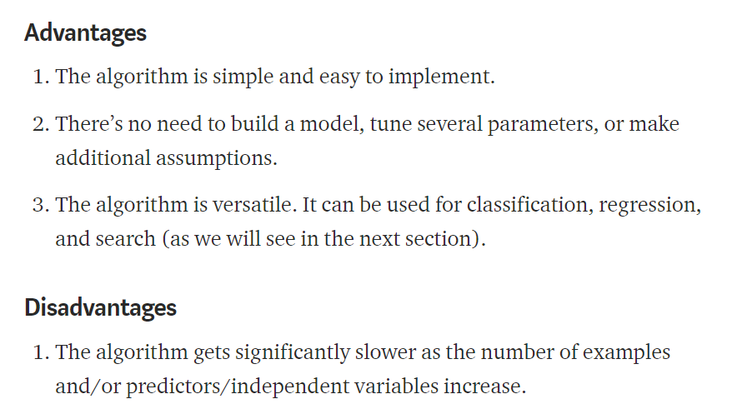
K Nearest Neighbours – KNN
Curse of dimensionality!

Slide 79
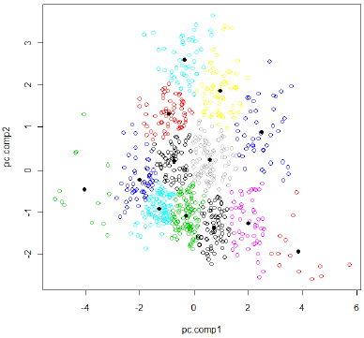
K-Means Clustering
Unsupervised Machine Learning technique used to detect clusters of similarities in data.

Slide 80
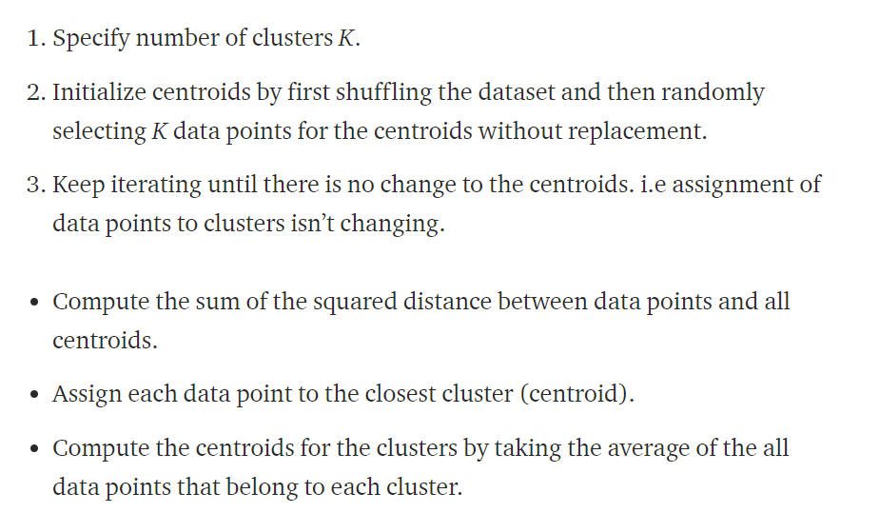
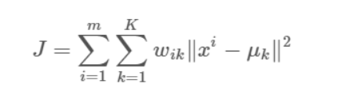
K-Means Clustering
Optimization metric used is minimization of within cluster sum of squares (variance)

Slide 81

K-Means Clustering
Optimization metric used is minimization of within cluster sum of squares (variance)

Slide 82
K-Means Clustering
Optimization metric used is minimization of within cluster sum of squares (variance)
Distance from that point to centroid
For each point inside cluster
Weight assigned to point
For each cluster K

Slide 83
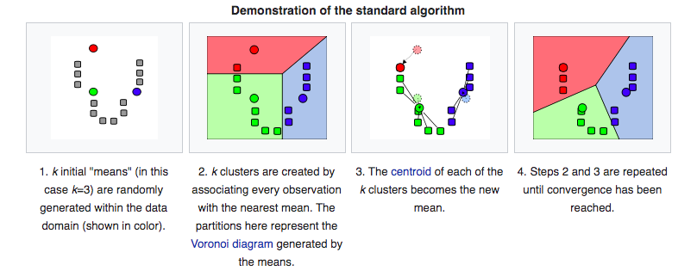
K-Means Clustering
Euclidean Distance is used to define proximity to clusters
Can you think of any problems related to that? Imagine one axis is height in meters and the other is weight in kilograms?

Slide 84
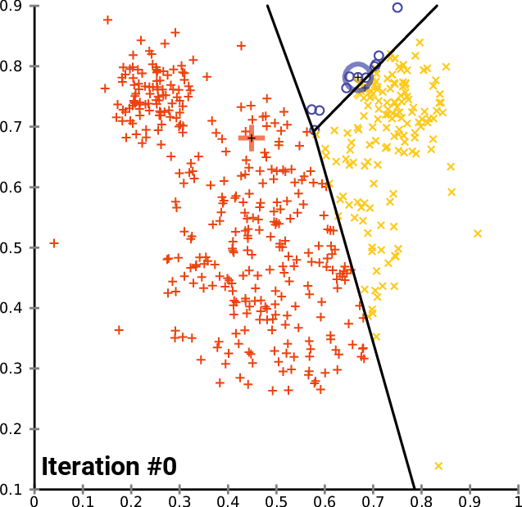
K-Means Clustering - Convergence
https://upload.wikimedia.org/wikipedia/commons/e/ea/K-means_convergence.gif

Slide 85
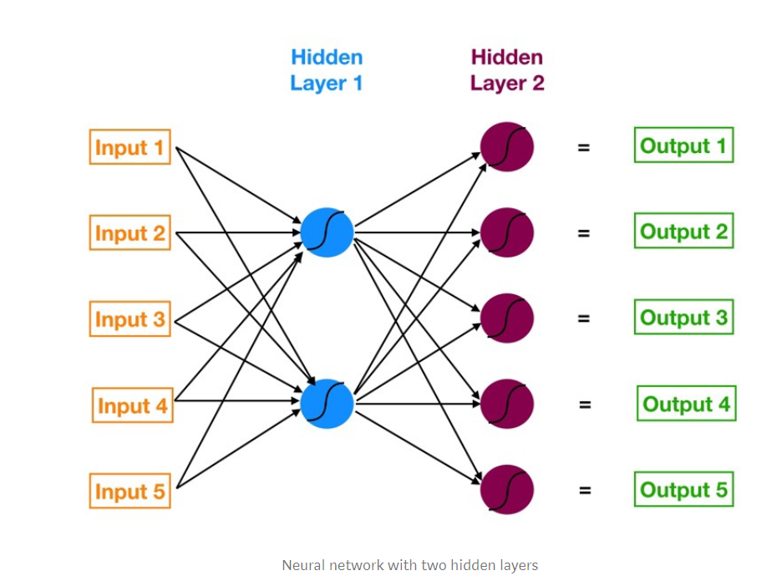
Neural Networks & Deep Learning
Input Layer

Slide 86
Neural Networks & Deep Learning
Hidden Layers
Neurons
Weights connecting neurons

Slide 87
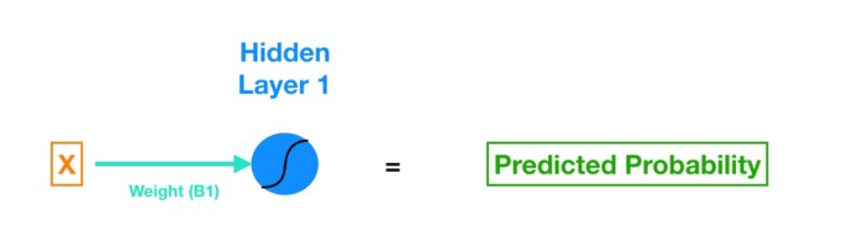
Neural Networks & Deep Learning
Consider a much simpler Neural Network for now
Sigmoid function
This is equivalent to a simple logistic regression!

Slide 88
Neural Networks & Deep Learning
Lets see each component
Activation function. In this case it’s a sigmoid
Input Feature
Weight that is equivalent to the slope parameter of our logistic regression. This is one of the parameters we must optimize!
Bias parameter which is equivalent to the intercept term of a regression
Our desired output

Slide 89
Neural Networks & Deep Learning
Going back to the full NN

Slide 90
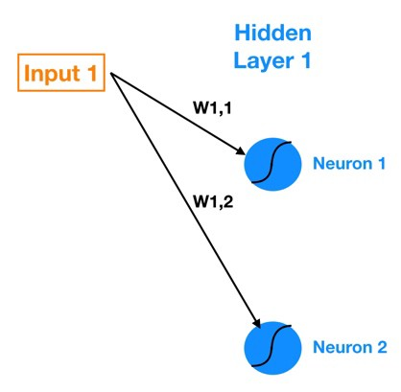
Neural Networks & Deep Learning
We can focus on a particular node
What does this mean mathematically in terms of parameters?

Slide 91
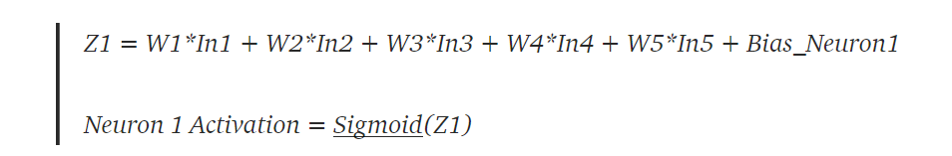
Neural Networks & Deep Learning
We can focus on a particular node
What does this mean mathematically in terms of parameters?

Slide 92
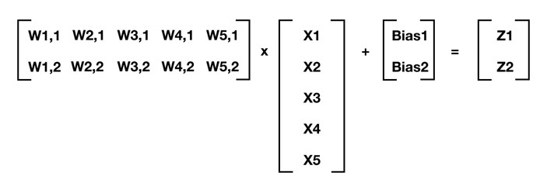
Neural Networks & Deep Learning
Or as a matrix
z1
=
z2

Slide 93
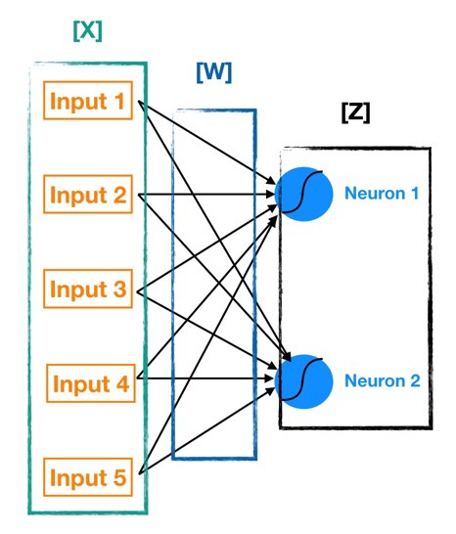
Neural Networks & Deep Learning
z1
Given a set of inputs and weights we can therefore move throughout the neural network calculating the outputs of all the corresponding neurons. This is known as forward propagation
z2

Slide 94
Neural Networks & Deep Learning
But where is the learning?
So far we have only looked at how to move forward mathematically within the Neural Network
As always the steps are:
Define a cost function
Minimize it by fine-tuning the parameters

Slide 95
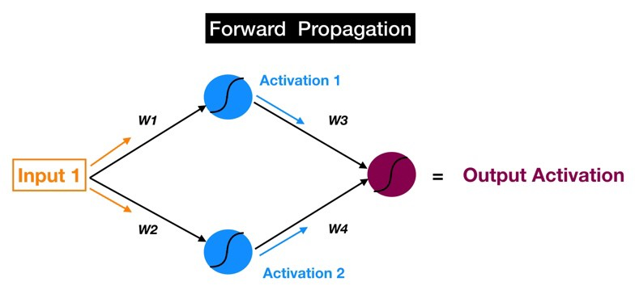
Neural Networks & Deep Learning
But where is the learning?
Each of the output nodes will generate an output activation

Slide 96
Neural Networks & Deep Learning
But where is the learning?
Label 1
During the forward propagation we reach a point where we obtain outputs! The learning process consists of comparing the outputs obtained with the labels of the training data.
Label 2
vs
Label 3
Label 4
Label 5
This process leads to the computation of an error function , given this set of parameters.
Now we have to train!

Slide 97
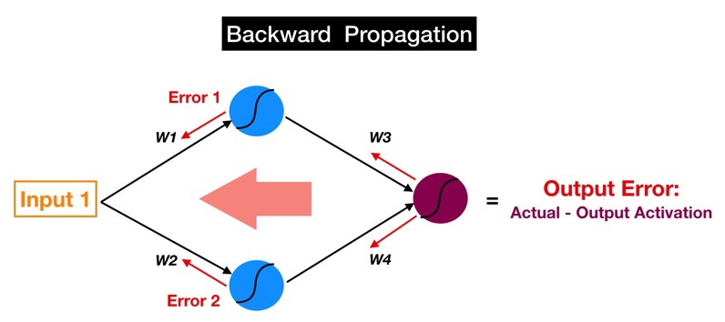
Neural Networks & Deep Learning
The Training process for a neural network occurs by now going back in the network and tweak the weights and biases of each layer. This process is called Back-Propagation
Going back through the network all the way until the inputs means that all weights were updated.
What do you do now?

Slide 98
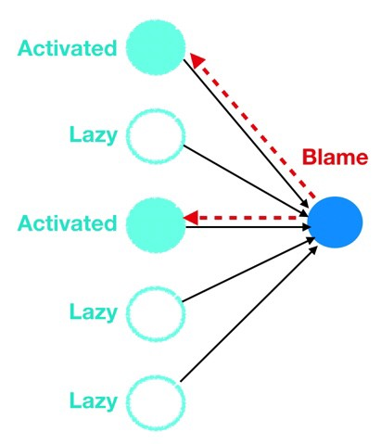
Neural Networks & Deep Learning
An Analogy that Helps — The Blame Game
Almost everyone has had a terrible colleague at some point in his or her life — someone who would always play the blame game and throw coworkers or subordinates under the bus when things went wrong.
Well neurons, via backpropagation, are masters of the blame game. When the error gets backpropagated to a particular neuron, that neuron will quickly and efficiently point the finger at the upstream colleague (or colleagues) who is most at fault for causing the error (i.e. layer 4 neurons would point the finger at layer 3 neurons, layer 3 neurons at layer 2 neurons, and so forth).
This process is then repeated until you obtain the best possible weights.

Slide 99
Neural Networks & Deep Learning - Advantages
Have the ability to learn and model non-linear and complex relationships. This is helpful when applying to real life problems.
Can Generalize: After learning the initial inputs and corresponding relationships in the test phase, the network can infer new relationships in ways that we were not expecting.
Does not impose any assumptions or restrictions on input variables.

Slide 100
Neural Networks & Deep Learning - Disadvantages
Black Box Solution – its hard to interpret the final solutions in terms of the business logic. What does each activation node mean? What determines how many layers the NN must have? These factor make NN hard to explain to management.
Data requirements – require tremendous amounts of data to be correctly trained and used to make accurate predictions. Unlike other algorithms that can be quite accurate with smaller amounts of data
Computational Cost – To train a fully developed NN may require extensive computing power -> example: training a image recognizer/Text creator.

