Slide 1
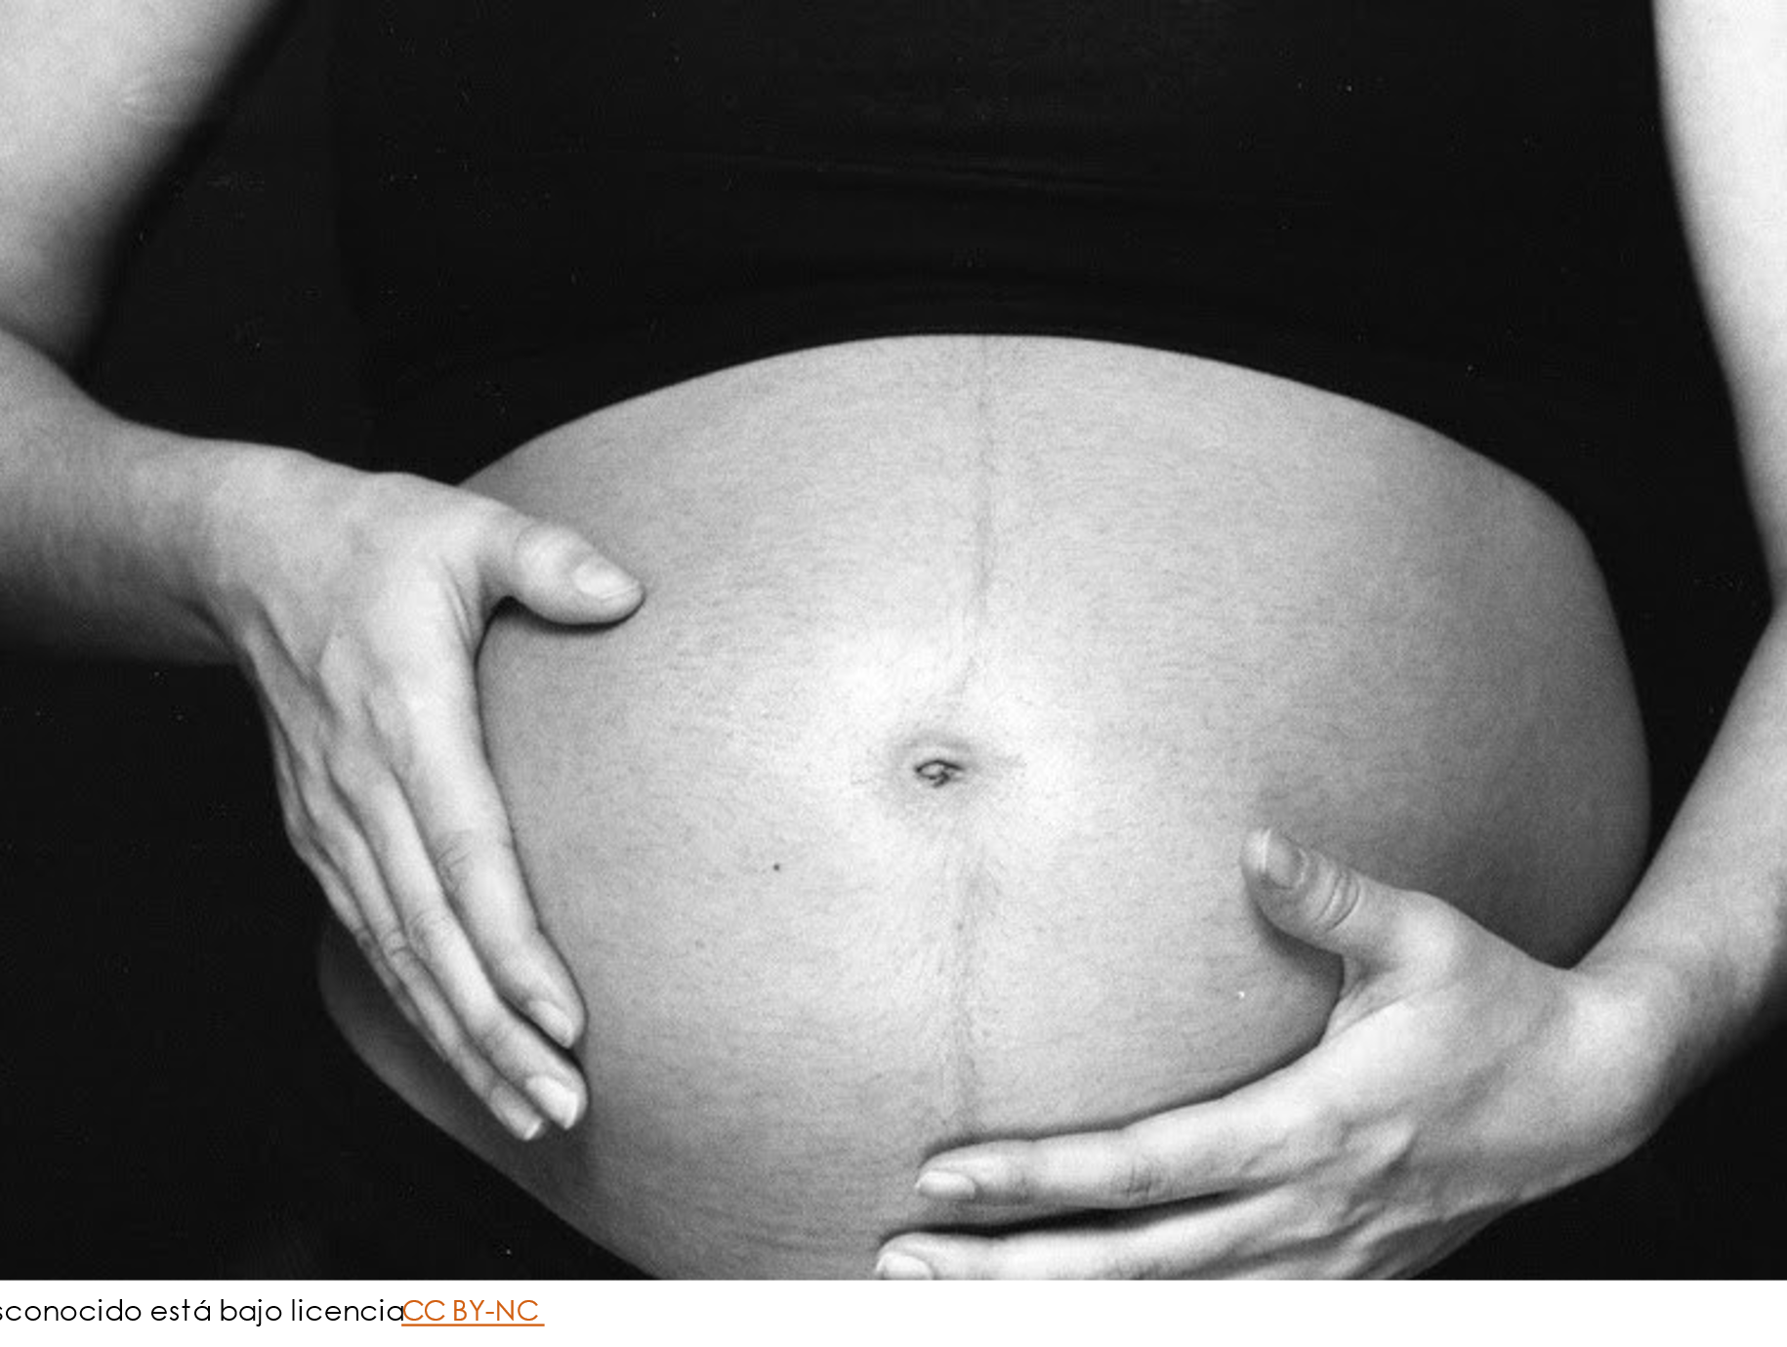
Mortalidad Materna en México
Contraste estadístico a la perspectiva política
Notes:
I'm talking about maternal mortality in Mexico; this is a statistical contrast with a political approach.

Slide 2
El embarazo en México
FUENTE: Datos del Consejo Nacional de Población (CONAPO)
En los últimos 50 años, la tasa global de fecundidad ha bajado de 6.62 a 2.05 hijos en promedio por mujer**
En 2020, siete de cada 10 mujeres de 15 años y más han tenido al menos un hijo nacido vivo
FUENTE: Censo Nacional de Población y Vivienda, 2020 (INEGI)
Notes:
Here are just a few insights regarding the pregnancy in Mexico that I’ve discovered in official data sources.
7 out of 10 women had at least one child born alive in Mexico.
In the last 50 years, the global fecundity rate has experienced a drop from 6.62 to 2.05 average children per woman.

Slide 3
Perspectiva política
Principales causas de mortalidad materna:
Entidades con más defunciones:
Grupo | %
COVID-19 confirmado | 38.7
Probable COVID-19 | 4.5
Edema, proteinuria y trastornos hipertensivos | 11.8
Hemorragia obstétrica | 9.8
Entidad Federativa | Total
Estado de México | 62
CDMX | 28
Jalisco | 27
Puebla | 22
Michoacán | 16
De acuerdo a la OMS, 810 mujeres
mueren cada día por causas prevenibles relacionado al embarazo
Notes:
The past August 7th, 2019, senator Salomón Jara Cruz presented an agreement to the chamber where he proposed measures to various authorities to reduce maternal mortality.
In this agreement, there's an evident lack of actual proposals. The proposed measures are no other than exhorting the authorities to execute needed actions to strengthen health services and generate conditions that allow reducing the majority of preventable deaths.
Besides that, it called to my attention that the approach given by this senator to the problem might not be the best one. Therefore, I decided to try and perform some analysis to validate or refute his approach.
His proposal claims that in a sample of 2021, the main reasons (apart from COVID) are edema, proteinuria, high blood pressure, and obstetric hemorrhage.
Also, he highlighted the states with more maternal deaths and listed the top 5. Here, we can infer that those are the ones that need urgent action; here is the hypothesis: the state where the child is supposed to be born influences whether the mother survives or not.

Slide 4
Prueba de hipótesis
Población = 1,709,443 casos
Muestra = 169,636 casos
z-test = 0.7295
p-value = 0.4656
El estado de nacimiento no afecta significativamente las posibilidades de sobrevivencia de la madre.
Notes:
For this analysis, I collected the data from the Borns Subsystem of Information (SINAC by its alias in Spanish), the 2020 version. The total usage of this dataset is 97% (1,709,443 out of 1,747,847 cases); our sample is the cases that happen in a determined state; for example, Estado de Mexico's sample size is 169,636 cases.
Our null hypothesis is that the probabilities of survival in each state are no different from those in the country. Let's continue with Estado de Mexico's sample. The test statistic for one sample z-test is 0.7295, and the corresponding p-value is 0.4656.
Since this p-value is not less than .05, we do not have sufficient evidence to reject the null hypothesis. In other words, the state in which the baby is supposed to be born does not affect significantly if the mother survives or not.

Slide 5
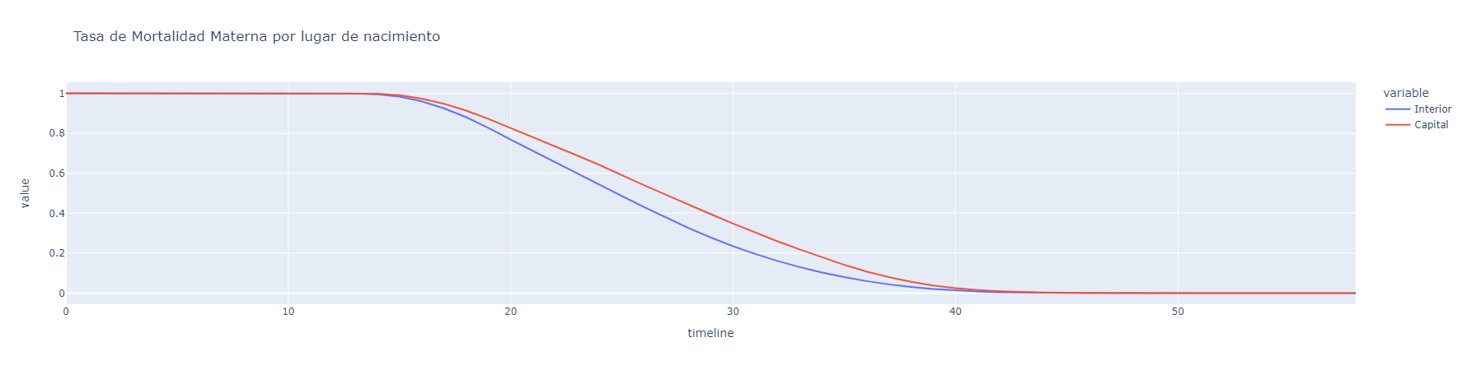
Análisis de supervivencia
Notes:
A survival analysis model of the mothers where the variables are if the case is in CDMX or the rest of the country (let's remember that CDMX was the number 2 state in the proposal). Here, we can observe that the chances of survival are better in the capital, contrary to the assumption of the proposal.

Slide 6
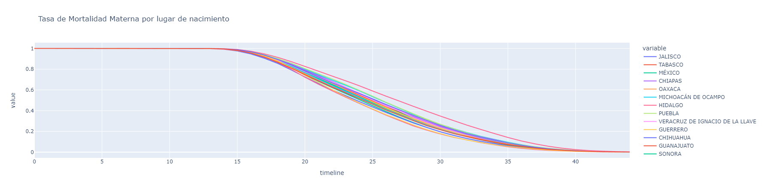
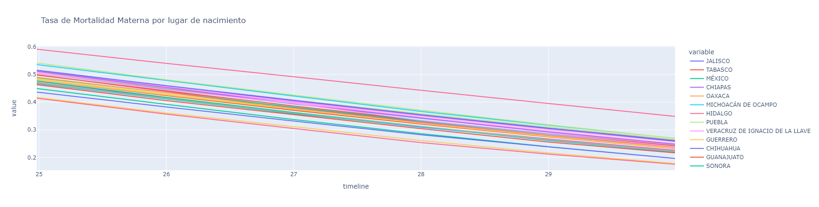
Análisis de supervivencia
Notes:
Suppose we plot all the states and zoom in to a range to identify the ones with the worst odds of survival. In that case, we can observe that Quintana Roo, Baja California, Chihuahua, Estado de México, and Aguascalientes have the worst odds, again, contrary to the political proposal.
In conclusion, we need to use data to prioritize the actions taken across the country. The suggested action can’t be oriented to take place in some states when the data shows that this is not a decisive factor.
Nowadays, we have easy access to data, and it's inconceivable that politicians still make decisions with no foundation.

