Slide 1
Mexico Car Sales, INEGI
Joaquín González; May, 13th, 2022

Slide 2
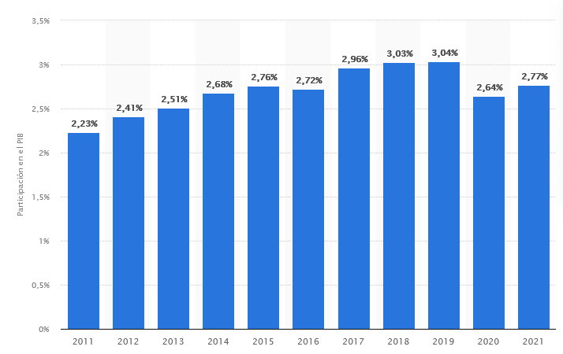
Automotive industry in Mexico
STATISTA
Mexico’s automotive industry, % of GDP⁶
IMCO
Mexico’s economy has been contracting (0.2%) during 3Q2021, contrary to what has been happening in the US, where the economy has been growing.²
Notes:
Statista
989K people employed by automotive industry in Dec 2021, 3% more than in 2020 Dec
1.08 Trillion USD Mexico GDP and 3% = 32 MILLION USD

Slide 3

Car sales in Mexico
What is the current status?
Notes:
https://olbios.org/change-and-the-world-changes-with-you/ - Image source

Slide 4
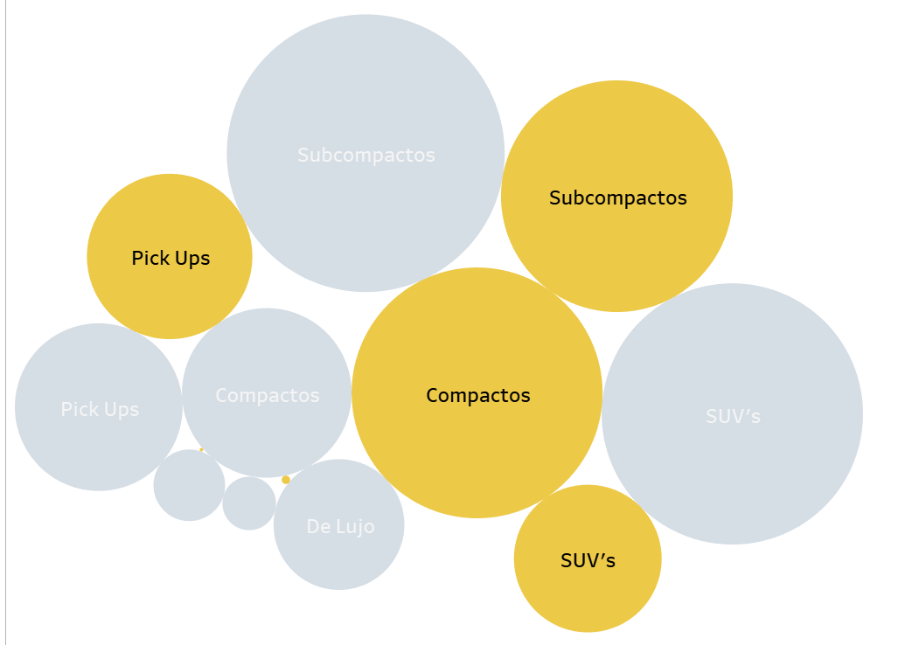
Imported vs National manufactured car sales¹
Both “Segment” and “Origin” of the car have a statistical significant impact in the quantity of units sold
(ANOVA)

Slide 5
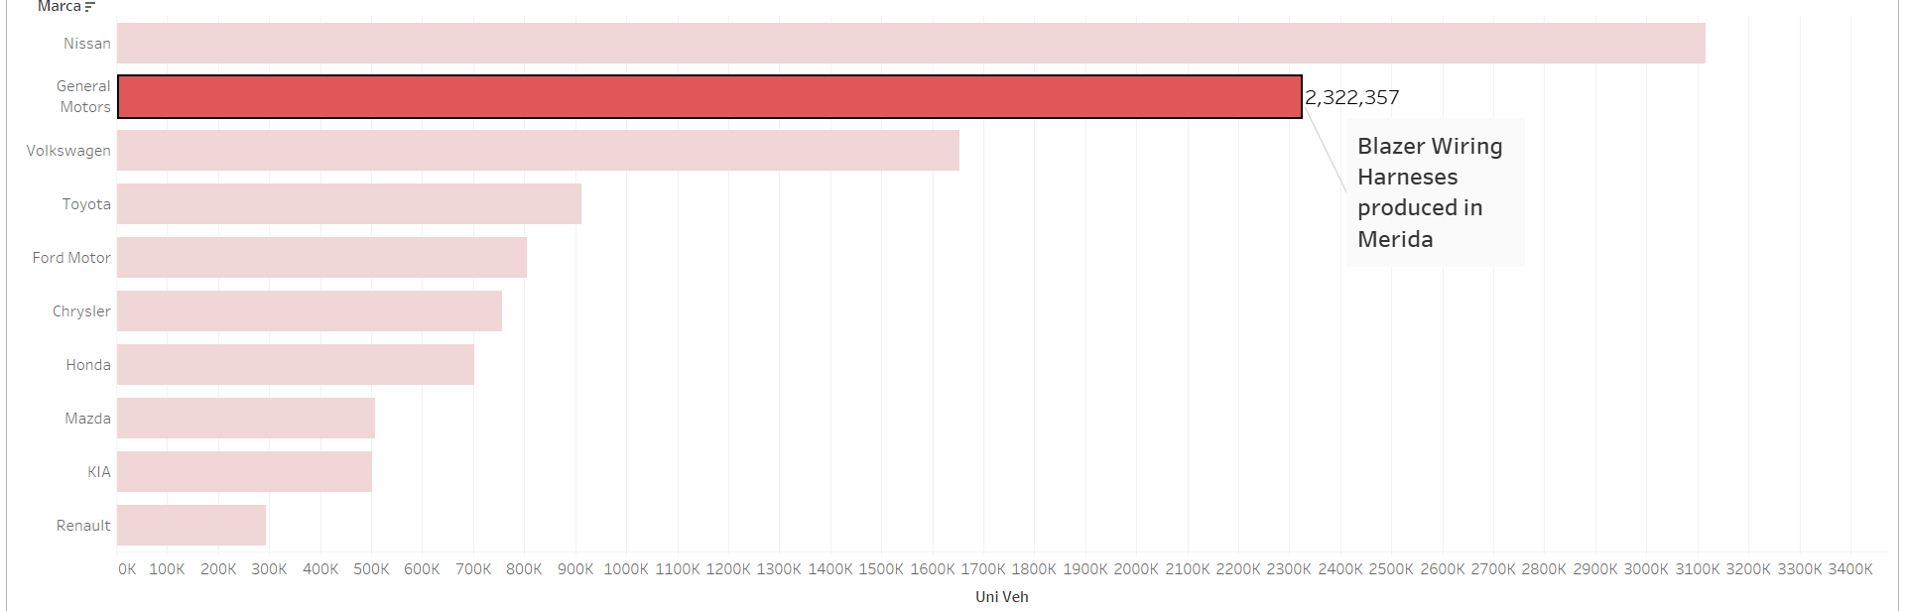
Top 10 Brands by Car Sales in Mexico¹
GM shows to be different than the other brands as the mean is statistically different than that of the population (Z-TEST)

Slide 6
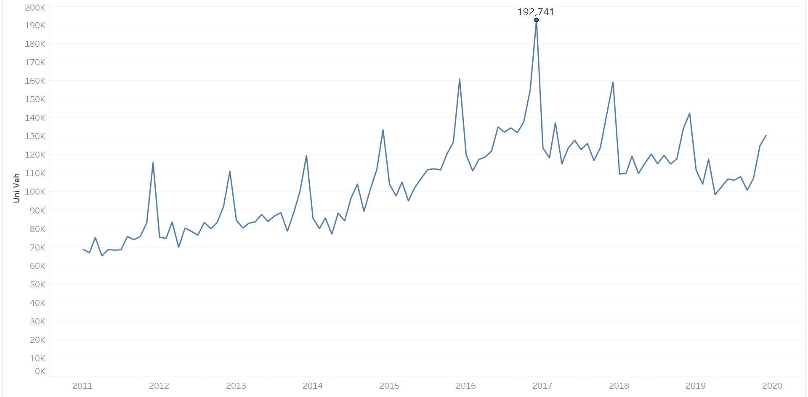
Monthly Car Sales 2011 - 2019

Slide 7
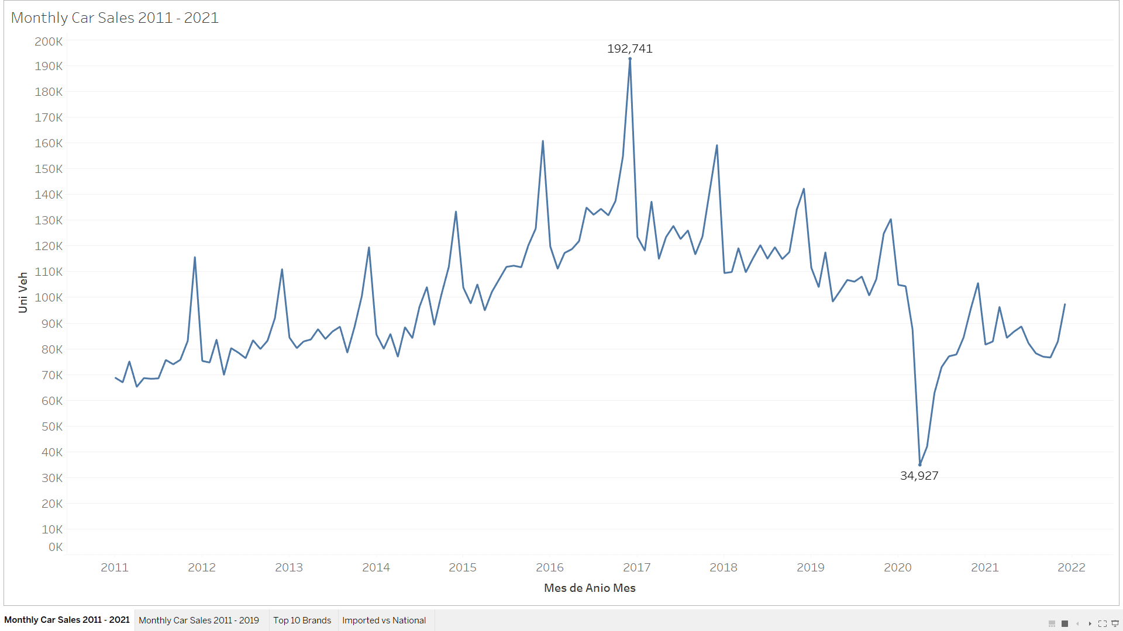
Monthly Car Sales 2011 - 2021
-82%
Notes:
Dec 2016, apr 2020

Slide 8
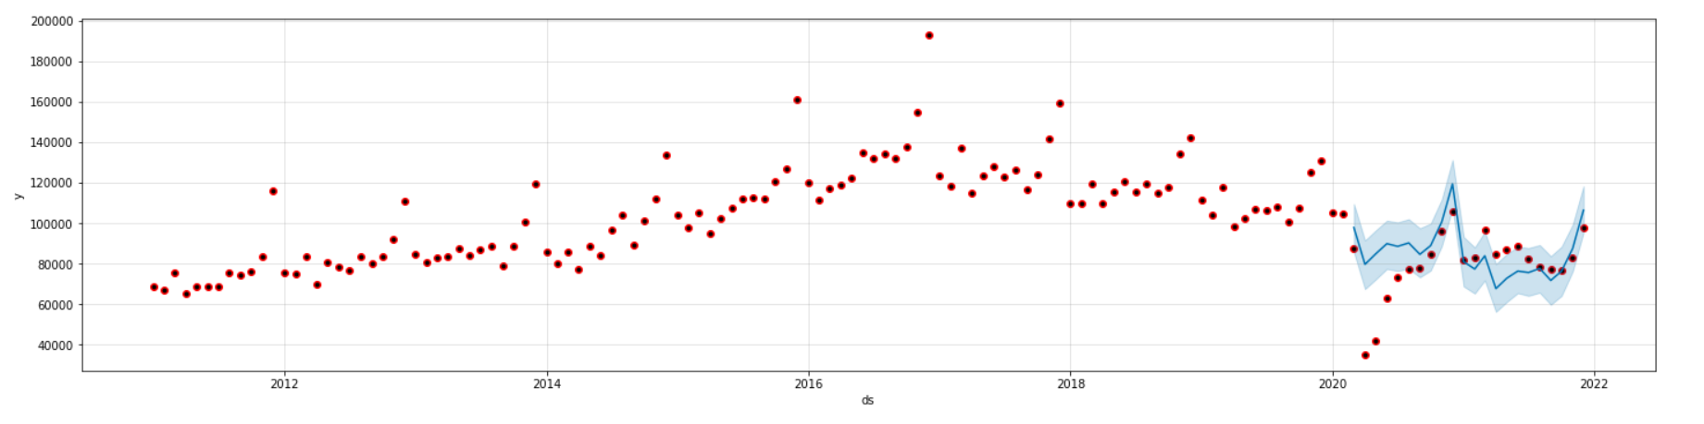
Monthly Car Sales 2011 – 2022 projection model
The model (FB Prophet) loses efficiency due to the outliers caused by the pandemic, however, returns to be a good estimator for future periods
(Time Series, MAPE = 20.71)
Notes:
mean_absolute_percentage_error

Slide 9

Conclusion and next steps
Recovery
There is a recovery in the current months, compared with the impact in the pandemic
Strenght
Recovery is not achieving levels as in years before the pandemic
Next Steps

Slide 10
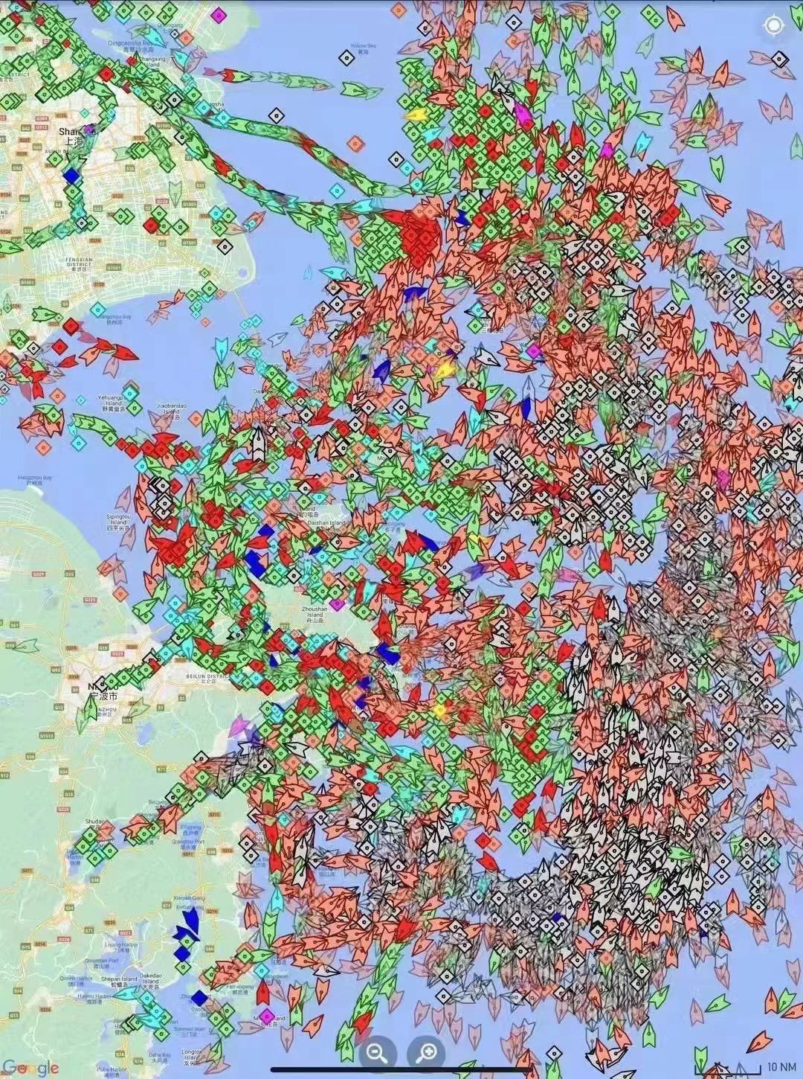
Boats waiting to dock in China⁴
What will be the impact in the automotive (or any) industry with all these boats stopped?

Slide 11
Thank you
Any questions?

Slide 12
Sources:
https://www.inegi.org.mx/datosprimarios/iavl/#Datos_abiertos, extracted on 10-May-2022
https://imco.org.mx/de-reversa-el-sector-automotriz/, extracted on 13-May-2022
https://www.automotores-rev.com/descendio-participacion-de-la-industria-automotriz-en-el-pib-de-mexico-en-2020/, extracted on 13-May-2022
https://twitter.com/DanCollins2011/status/1515851777224155139, extracted on 13-May-2022
https://www.clusterindustrial.com.mx/noticia/4387/la-industria-automotriz-mexicana-2021-en-cifras-datos-y-análisis, extracted on 13-May-2022
https://es.statista.com/estadisticas/644312/participacion-industria-automotriz-pib-nacional-mexico/, extracted on 13-May-2022

