Slide 1
Presidential elections in USA
Kamalah Chang
DAPTMX
December 2020

Slide 2
History of the Electoral College
"The function of the College of Electors in choosing the president can be likened to that in the Roman Catholic Church … College of Cardinals selecting the Pope. The original idea was for the most knowledgeable and informed individuals from each State to select the president based solely on merit and without regard to State of origin or political party.”
Election expert, William C. Kimberling

Slide 3
Win the Popular Vote Lose the Election
Year | Candidate | Popular Vote | Electoral Votes | Winner
1876 | Rutherford B. Hayes (R) | 4,024,311 | 185 | Rutherford B. Hayes (R)
 | Samuel Tilden (D) | 4,288,546 | 184
1888 | Benjamin Harrison (R) | 5,443,892 | 233 | Benjamin Harrison (R)
 | Grover Cleveland (D) | 5,534,488 | 168
2000 | George W. Bush (R) | 50,456,002 | 271 | George W. Bush (R)
 | Al Gore (D) | 50,999,897 | 266
2016 | Donald J. Trump (R) | 62,984,828 | 304 | Donald J. Trump (R)
 | Hilary Clinton (D) | 65,853,514 | 227
4 OUT OF 58

Slide 4
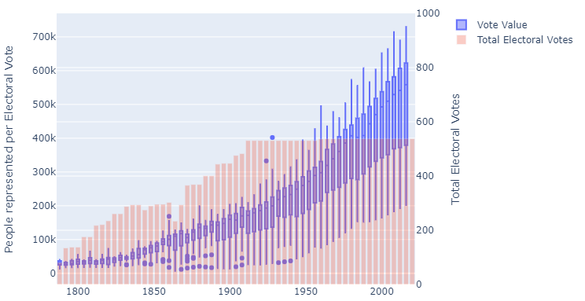
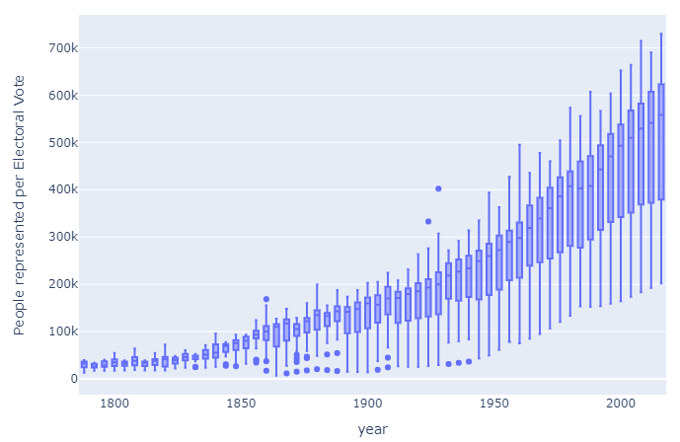
Electoral vote value (Traditional)
Current Electoral College
Electors decided based on number of senators (2)
Number of representatives: based on relative population (minimum of 1) currently capped at 535
Each state has a minimum of 3 electors
527k
27k

Slide 5
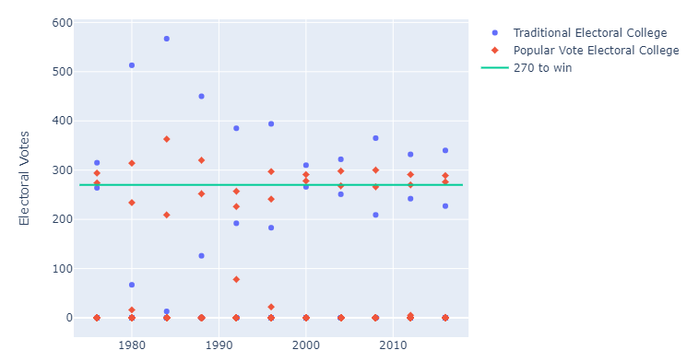
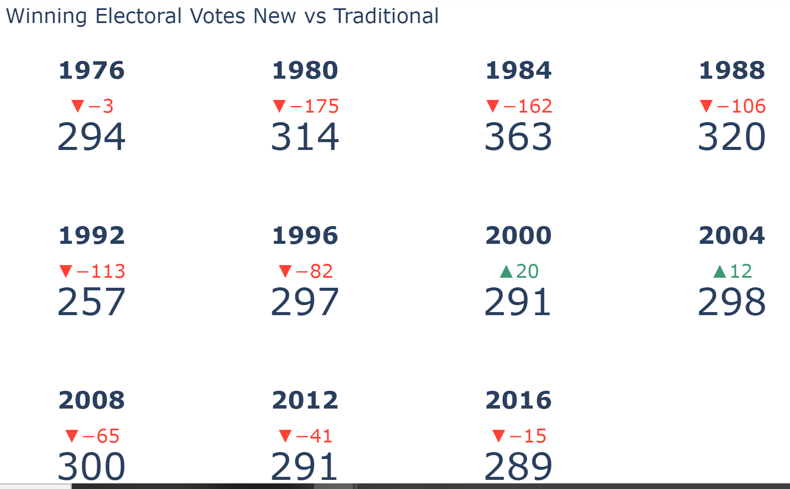
Alternative #1: Popular vote with electoral college
No outcomes changed

Slide 6
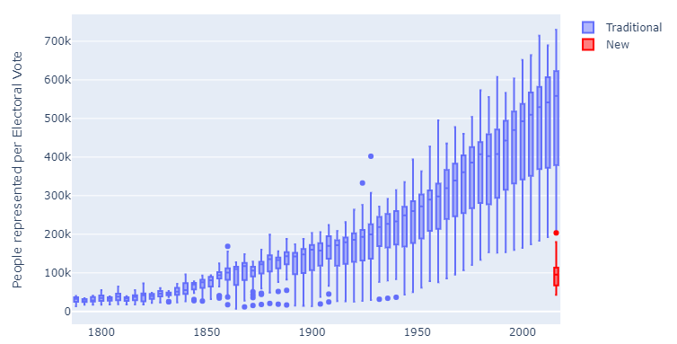
Alternative #2: Increase Congressional representation
New Electoral College
Electors decided based on number of senators (2)
Number of representatives: based on relative population (minimum of 1) capped at 2712
Each state has a minimum of 14 electors
No outcomes changed

Slide 7
Conclusions
There would have to be significant changes to the allocation to impact the outcome and maintain the electoral college
Unchanged since 1940
Alternatively, change to a straight popular vote. ☺

