Slide 1
Ironhack Strategic
Positioning
PTR 2024

Slide 2
The Competition
15 Data Analytics Schools
What Metrics?
IQR – 6 outliers, we can include these for $
Quantitative vs Categorical
Standardization, review tend to be positive
Notes:
More data required

Slide 3
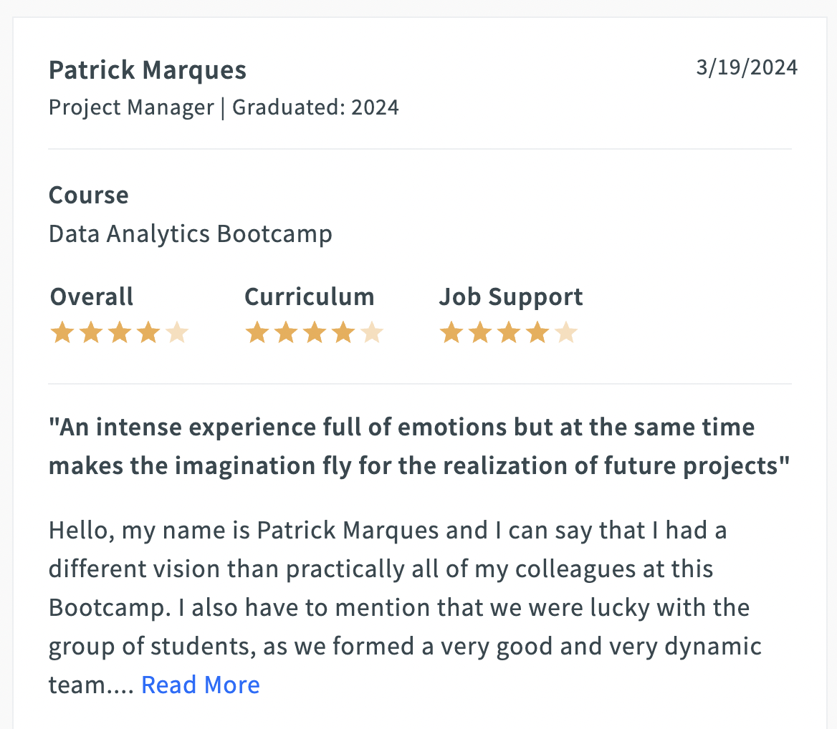
The Data
Notes:
No significant difference between Anonymous or named reviews

Slide 4
Reviews

Slide 5
An Overview

Slide 6
Overall

Slide 7
Curriculum

Slide 8
Job Support

Slide 9
Too Many Labs?
Job Support
ronhack #1
Overall
Ironhack #2
94%
6%
Curriculum
Everyone Else
Ironhack #3 (biggest gap to leader)
Everyone else sucks
But! Ironhack’s key area for improvement is curriculum
Notes:
Source: Random number generator

Slide 10
SWOT
S
W
Remote Learning Leader
Too Many Labs
SWOT
Other Bootcamps going online
And giving less labs
T
O
Expanding Remote Learning

Slide 11
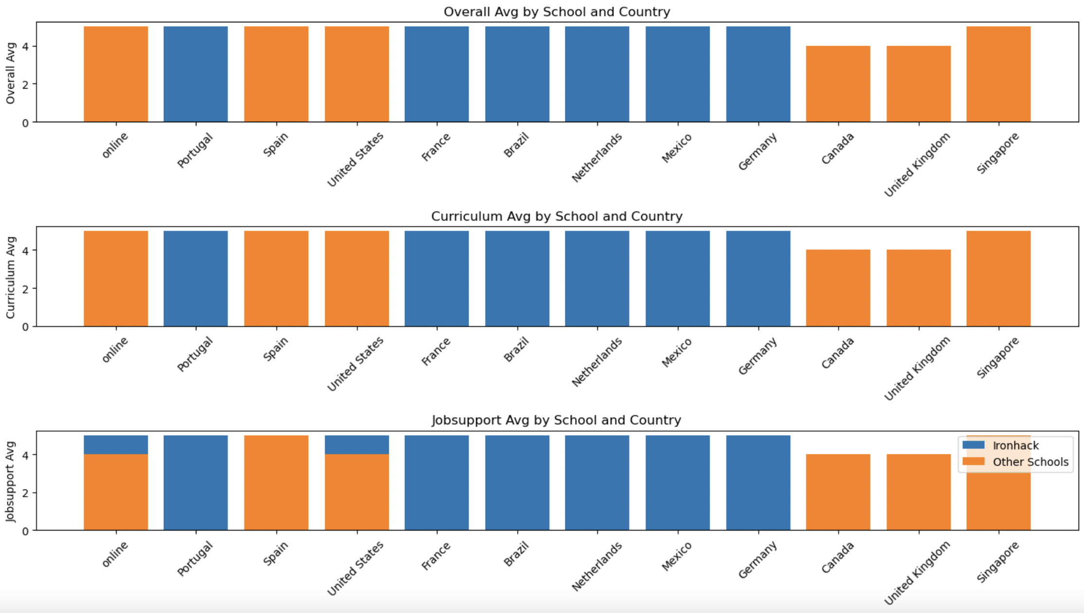
Potential Untapped Markets

Slide 12
Costs in $s

Slide 13
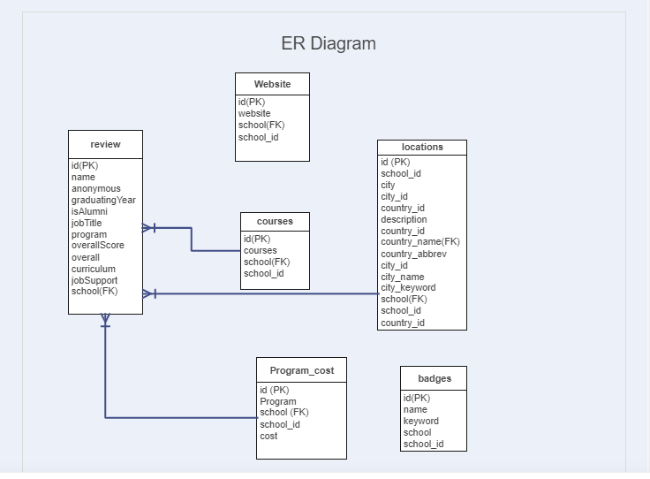

Slide 14
Quantitative Reviews
Works Better with your Computer On!
Please don’t attach Post-its to screen

Slide 15
Qualitative Conclusions
3%
1293 Ironhack Reviews
883 = 5/5 || 38 =< 3/5
3 Potential Areas for Improvement:
No Experience
Job Search
Not Enough
mainly students with 0 previous experience find it hard to follow the course's space
most of the students are not satisfied with the job search support, they didn't manage to connect with companies at the end of the course
some of them feels the gained knowledge during the bootcamp is a good start but not enough to find a job in the field

Slide 16
Overcome Challenges
and Subsequent Analysis
Less Labs!
You’ll make her cry
No @ in SQL!
SQLAlchemy
Better Data Sources
Anonymous honesty
One school_id table
In Depth Price

Slide 17
Thanks!
Questions?

