Slide 1
Space Station Escape Room Game
Reserve your life-changing journey
to the edge of space today
Amandine Croset
Irina Markova
Nhan Nguyen
Gonzalo Benitez
Group Orange 🍊

Slide 2
Index
Escape room game overview
Features + Demo
Technicalities
Future improvements

Slide 3

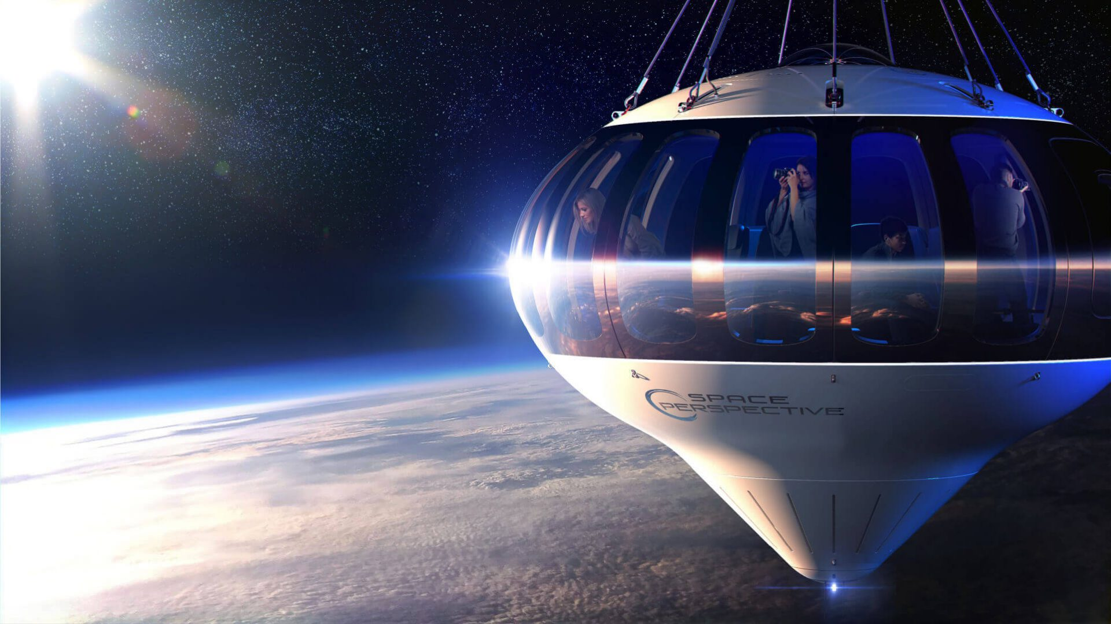
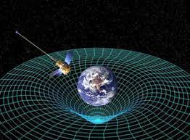
The adventure
WHO
Curious about the universe
Passion for exploration
Don’t care about gravity
WHAT
Embark a spaceship
Explore, examine, escape
Find your way home
Get rewards : island trekking, space touring
HOW
Rooms to explore
Objects to examine
Doors to open
Treasure to hunt

Slide 4
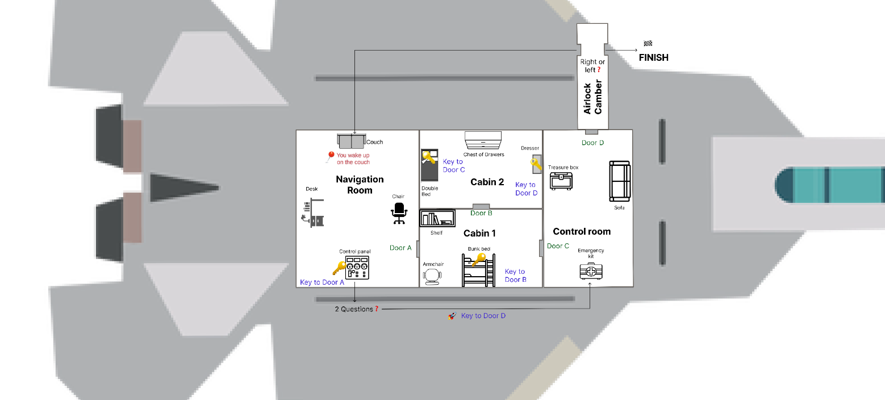
Escape room game overview

Slide 5

Features + Demo
Scenario 2

Slide 6
Features + Demo
Scenario 2

Slide 7
The creations by Orange Team
The Narrative
Features & Challenges
Player experience
The game is narrated to space theme. New items is added to enrich the game's environment and enhances player engagement.
Treasure box is a surprise reward for those who cares
Quiz is a challenge for ones who wants skip steps
Airlock dilemma is the last thrilling factor
Add exit options for emergency exit
Background music keep your company throughout the journey
New items are defined as dictionaries, each with a "name" and "type" attribute and added in the object_relations dictionary
"Treasure Box" handled with random.choice() added to examine_item function
Ask.question() presents the quiz with boolean validation
left_or_right() pops up question for the last challenge
exit.game() added to play_room function next to examine and explore options
Pygame library integrated to enable the incorporation of background music within the game.

Slide 8
Narrative Creation

Slide 9
New items to the spaceship by Irina
Description
New items have been introduced into different rooms of the spaceship escape game.
What's great about this feature?
The addition of these new items enriches the game's environment and enhances player engagement.
Players can now explore and interact with a wider variety of objects within the spaceship, making the game world feel more immersive.
Technicalities
New items are defined as dictionaries, each with a "name" and "type" attribute.
Items added in the object_relations dictionary.

Slide 10
Features and Challenges

Slide 11
Treasure box with rewards by Amandine
Description
The "Treasure Box" is a newly added item within the spaceship escape game. When players encounter the "Treasure Box" and choose to examine it, they have the opportunity to discover one of several random rewards. These rewards include items like a "free rocket travel pass," "rocket stickers," or "island trip vouchers."
What's great about this feature?
This surprise box injects an element of surprise and excitement into the game for the player.
It introduces a more commercial aspect to the game. Players are motivated by the potential for rewards.
Creates engagement by enticing players with the company's offerings, reinforcing brand recognition.
Technicalities
The "Treasure Box" is defined as item and added in the object_relations dictionary.
Contains a list of possible rewards. One selected randomly ( random.choice()) when the box is examined.
The examine_item function is modified to handle the examination of the "Treasure Box" and reveal the randomly selected reward. The function removes the "Treasure Box" from the current room after it has been examined.

Slide 12
Shortcut to the control room by Gonzalo
Description
This feature introduces a quiz challenge for players who have found the key for door A. After obtaining the key, players are presented with two questions related to the game's spaceship theme. They must answer both questions correctly to advance to the final room and use their key for door D.
What's great about this feature?
An enhanced quiz challenge adds an interactive and educational element to the game.
It engages players in a fun way, testing their knowledge about space-related topics and the room layout in the game, creating a sense of accomplishment when they answer correctly.
Technicalities
The ask_questions function is responsible for presenting a quiz challenge to the player after they have found the key for door A and was added to the loop in the def examine_item function.
Boolean validation (returns “True” or “False” regarding the input entered by user).

Slide 13
The airlock chamber dilemma by Nhan
Description
This feature introduces a new room in the spaceship escape game, specifically an "airlock chamber." In this chamber, the player is presented with a pivotal decision to choose between turning left or right. The consequence of this choice determines whether the player can successfully exit the spaceship or if they are redirected back to the navigation room and start over.
What's great about this feature?
The addition of the "airlock chamber" enhances the game's narrative by simulating a critical moment in the player's escape journey.
The limited exit possibility adds a challenge.
Technicalities
The "airlock chamber" defined as a new room and added in the object_relations dictionary.
The left_or_right function is created to handle the player's choice in the airlock chamber.
Boolean validation (returns “True” or “False” regarding the input entered by user).

Slide 14
Player experience enhancement

Slide 15
“Exit” action by Amandine
Description
The "exit function" is a newly added element that enables players to exit the game at any time.
What's great about this feature?
Offers players more flexibility in the game.
Technicalities
exit_game function is implemented as a part of the game's control flow.
Added to the play_room function, next to examine or explore as intended actions.
It presents players with a choice to either exit the game or continue playing.
If the player chooses to exit, a courteous message is displayed.

Slide 16
Background music + Narrative by Orange team
Description
The addition of background music ("Space Chillout" track).
Description
The game's narrative, furniture, and rooms have been adapted to the space theme.
What's great about this feature?
Enhances the game's narrative and player’s immersive experience.
What's great about this feature?
Allows to deliver a consistent and compelling story, and enhances the player's immersion.
Technicalities
The Pygame library is integrated to enable the incorporation of background music within the game.
The music is set to loop continuously, ensuring a consistent audio backdrop throughout the game.
Technicalities
Refining the in-game text and dialogues to match the sales pitch.
Furniture and room elements are adjusted to fit seamlessly into the game's space-themed environment.

Slide 17
Future Improvements
Aesthetic
Add sounds for actions
Add pictures for furniture and rooms
Add game map/floorplan to see current location
Format instructions (Fonts, lines spacing, etc) to look more clear
Functional
Add timer to limit escape time
Add more different keys and remove door indication (a,b,c,d)
Shuffle keys and furniture around after each game to have new scenario
Add more rooms and levels
Gather the coins along the game to use them during future space trip
Implement error handling to gracefully manage unexpected user inputs or potential exceptions

