Slide 1
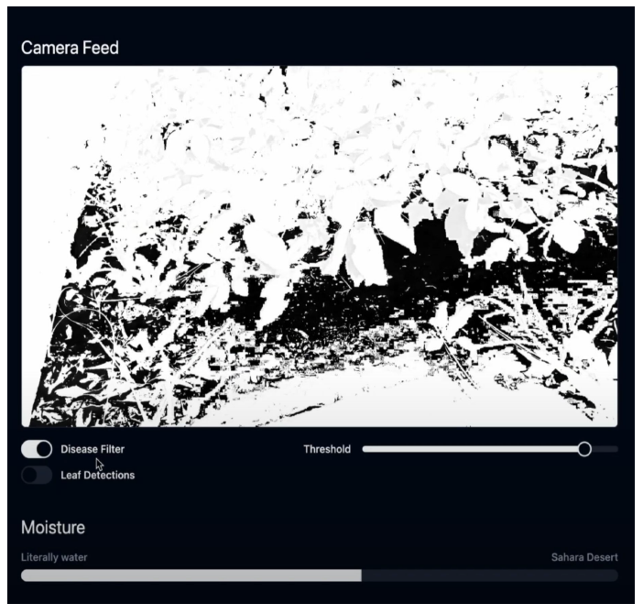
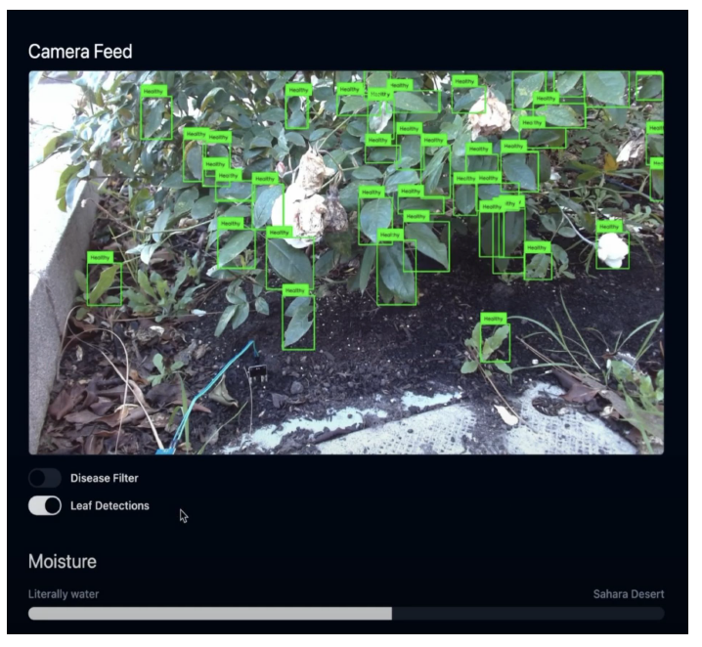
Figure showing the threshold based disease filter applied to the live camera feed, helps isolate potential problems by making inspection easier.
Figure showing the leaf detection live camera where each detected leaf is outlined with a bounding box and labeled as healthy based on the classifier's output.

Slide 2
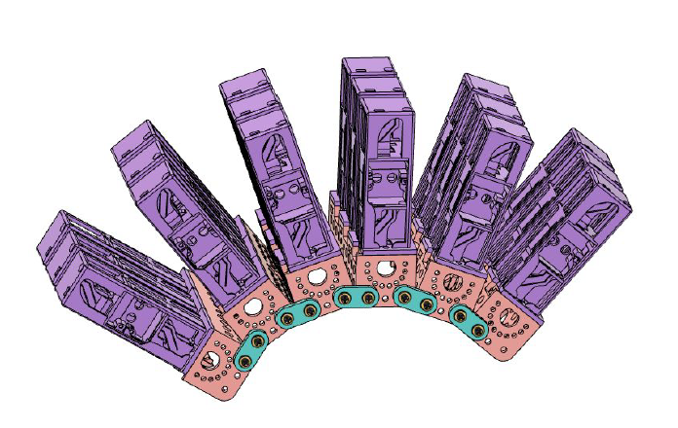
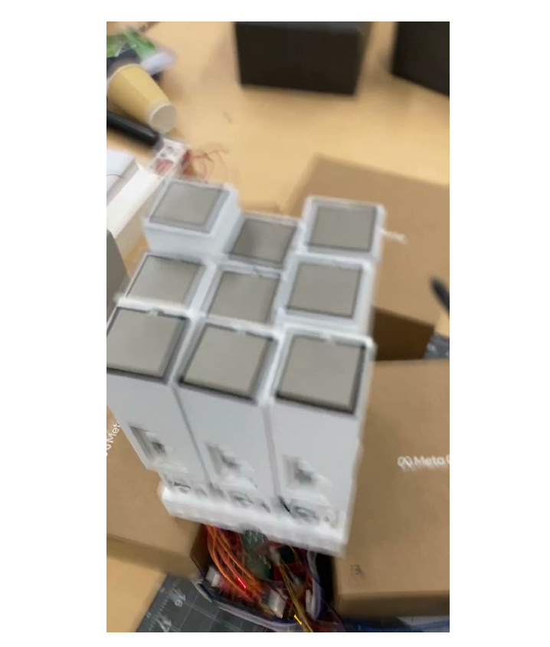
Figure showcasing a 3D model of the complete 18-unit actuator array in its assembled layout.
A video demonstration of the actuator array activating multiple modules in coordinated sequences, displaying smooth vertical motion and responsive shape changes across the full 18 unit grid.

Slide 3
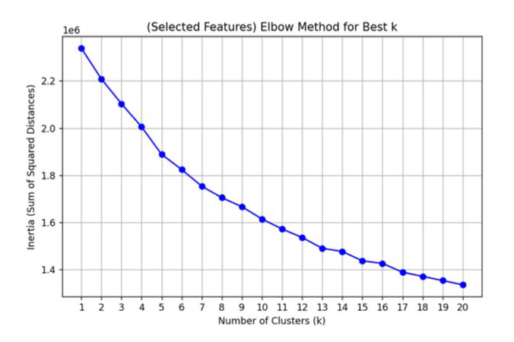
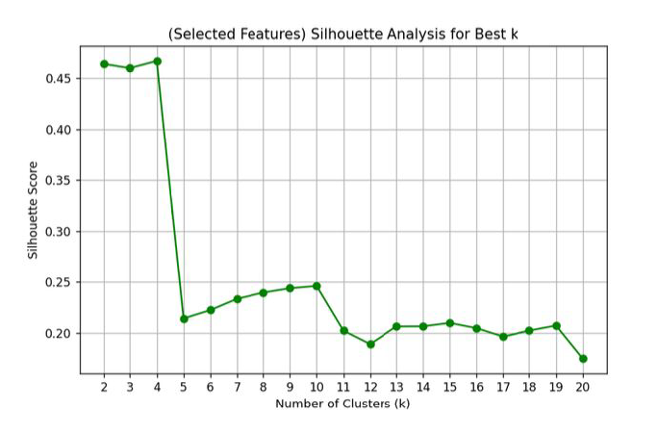
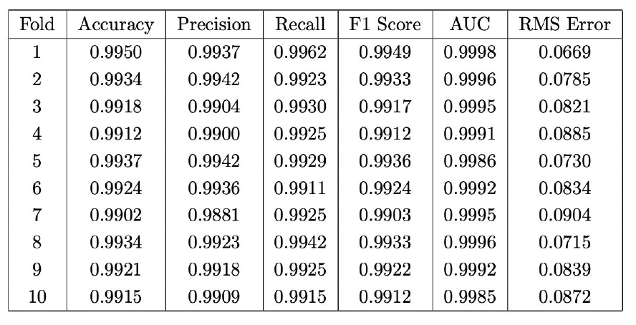
Figure 3: Elbow method for select standardized data.
Figure 4: Sihouette analysis for select standardized data.
Table showing the 10 fold cross validation results for the neural network classifier, demonstrating consistently high performance across all folds with accuracy near 99 percent and AUC values close to 1.0.

Slide 4
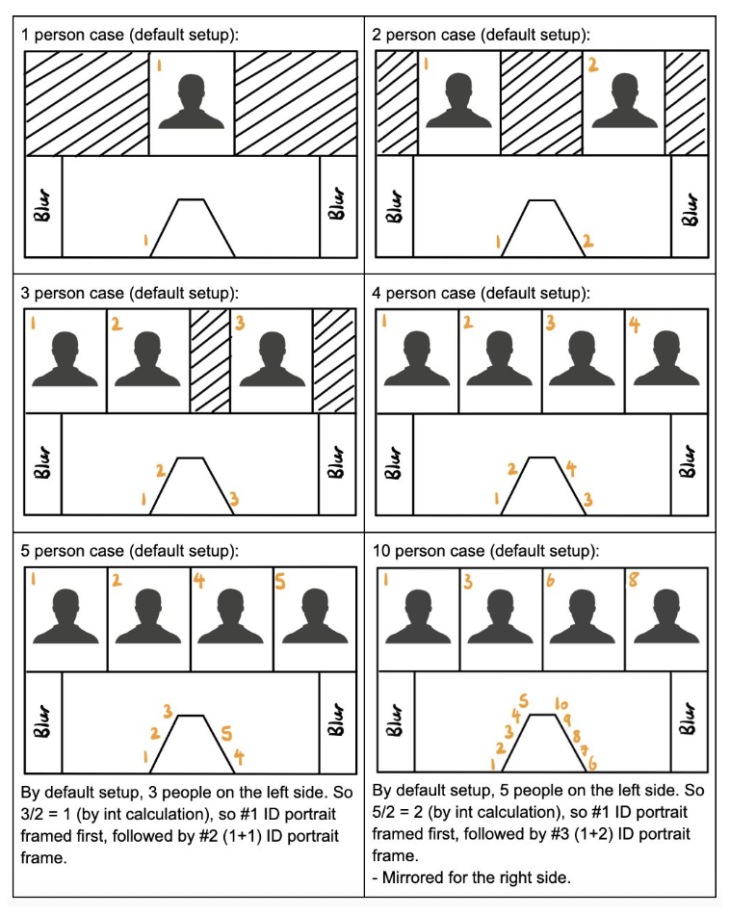
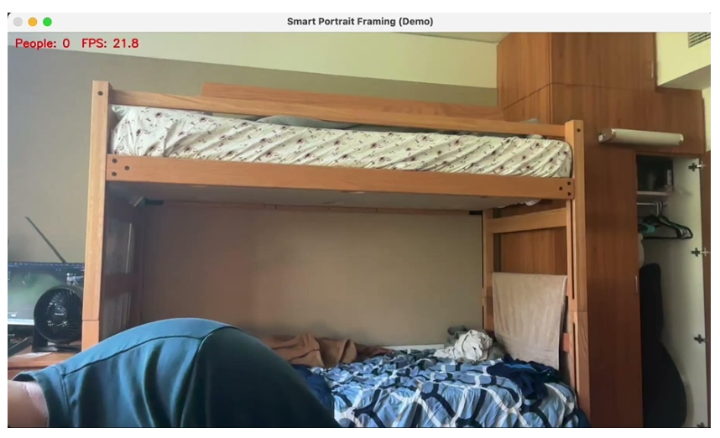

A video demonstration of the portrait framing system in action, demonstrating real-time portrait insertion and removal, active speaker highlighting, and identity de-duplication as multiple faces enter or leave the scene.
The figure above illustrates the framing algorithm design, showing how the system arranges portrait crops for 1 to 10 people by dividing subjects into left and right-hand groups and assigning stable ID-based positions.

