Slide 1
Preparing your own PYPI repository
by
RAGE Uday Kiran

Slide 2


Today’s Class
How to make?
We will learn it today
pip install packageName

Slide 3
Outline
Overview of PyPI system
Creating a Repository and Package in GitHub
Adding Necessary Meta-Data Files
Installing Dev Packages
Testing the Service
Speed up with Shell Scripting

Slide 4
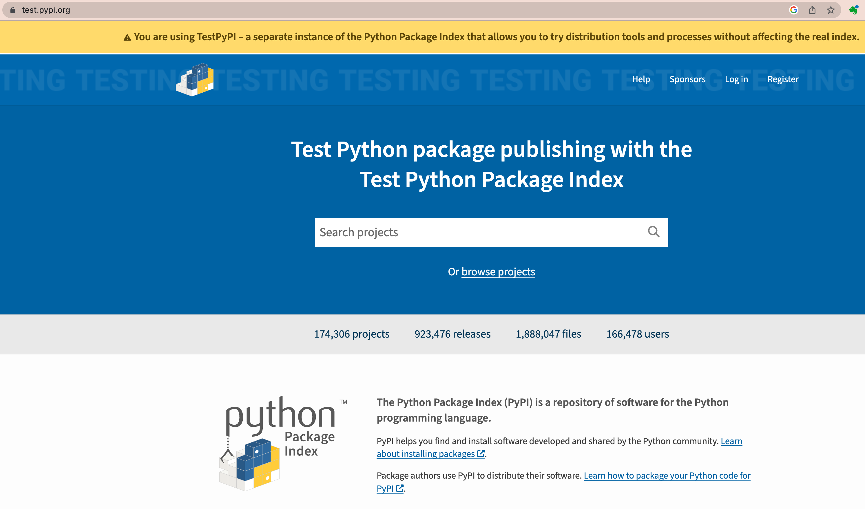
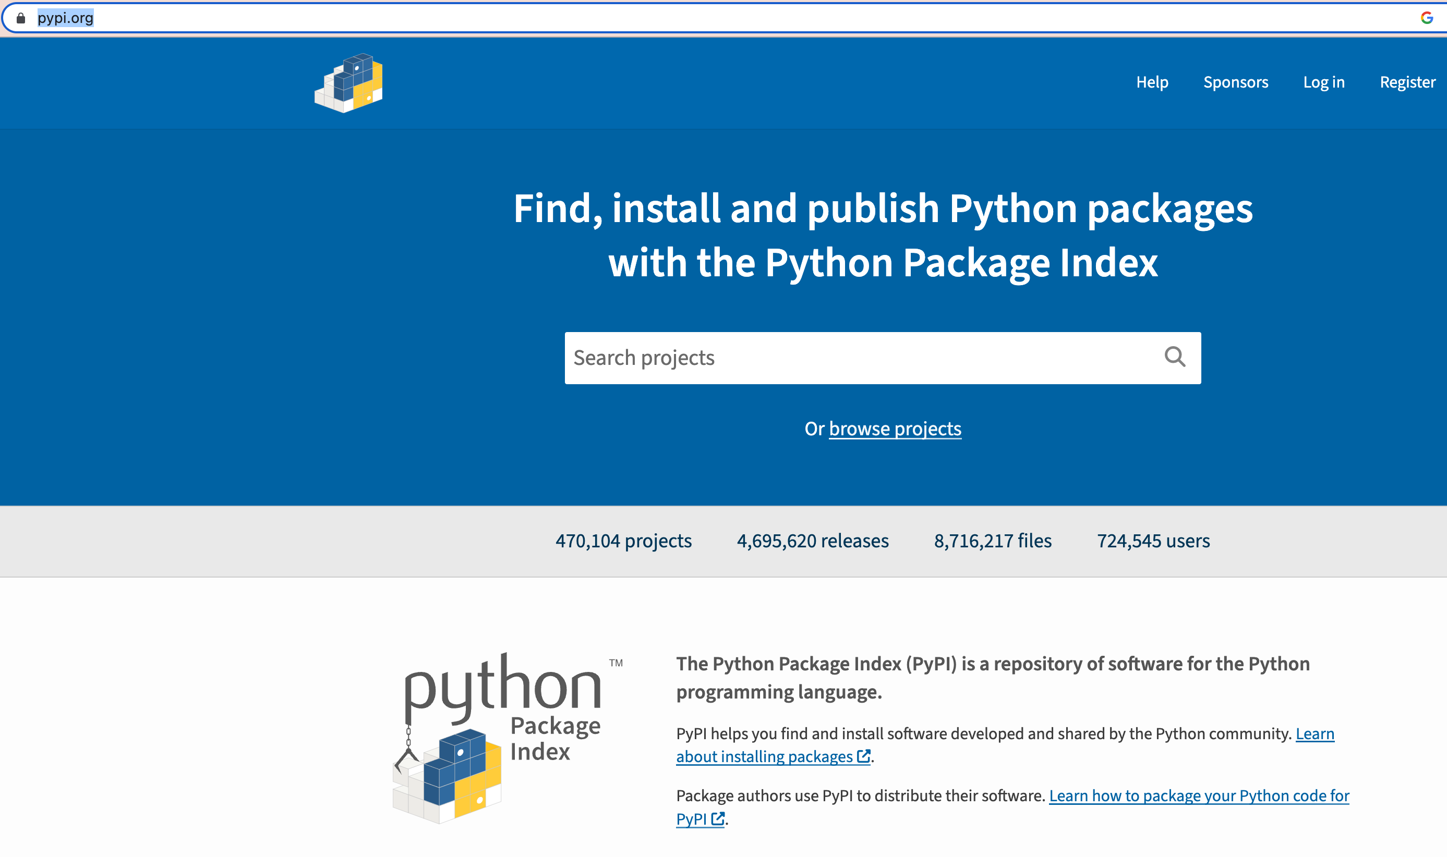
Overview of PyPI system
PyPI: Python Package Index
https://test.pypi.org/
https://pypi.org/
Test PyPI server
PyPI server

Slide 5
Upload progress
Step 0 (one time process)
Step 1
Step 2
Step 3
Step 4
Create userAccounts in testPyPI and PyPI
Github public repository
Run the Setuptools
Upload to testPyPI
Upload to PyPI
test the installation and usage of packages
test the installation and usage of packages
* Use Github accounts

Slide 6

Step 1: Github public repository
Let the public repository name is: studentGHrepo
studentGHrepo

Slide 7
Step 1: Github public repository
Let the public repository name is: studentGHrepo
Create another sub-folder/package with repository name
studentGHrepo
This is the directory for pip install
studentGHrepo
some people use the word: src folder

Slide 8

Step 1: Github public repository
Let the public repository name is: studentGHrepo
Create another sub-folder/package with repository name
Put your source code and other files in this folder
studentGHrepo
This is the directory for pip install
studentGHrepo
__init__.py
run.py
subPackage
__init__.py
similarity.py

Slide 9
Step 1: Github public repository
Let the public repository name is: studentGHrepo
Create another sub-folder/package with repository name
Put your source code and other files in this folder
You can create additional folders and files in the GitHub main repository.
studentGHrepo
This is the directory for pip install
studentGHrepo
__init__.py
run.py
subPackage
__init__.py
similarity.py
notebooks
test.ipynb

Slide 10
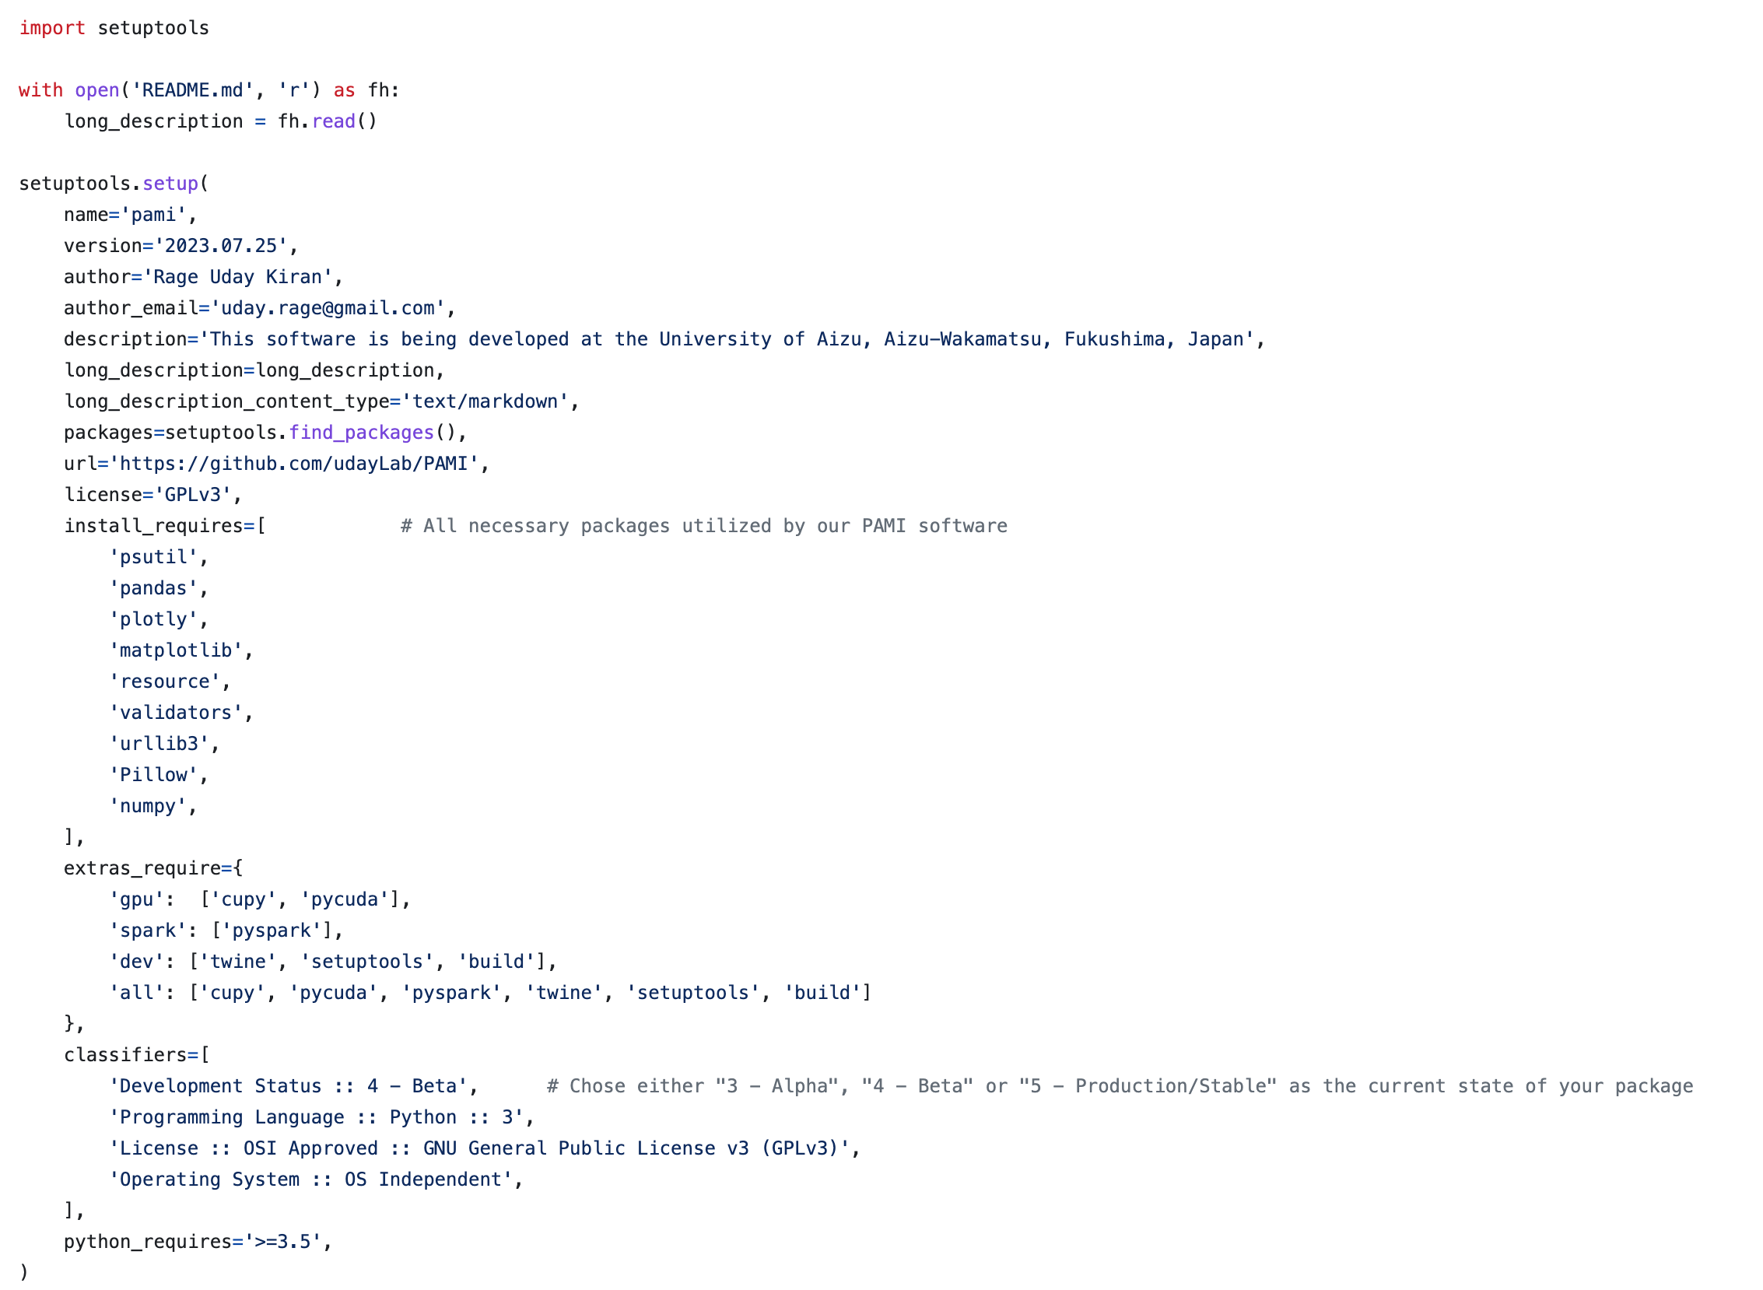
Step 1: Github public repository
Create a setup.py file
Open the file and add the following contents
studentGHrepo
setup.py
studentGHrepo
__init__.py
run.py
subPackage
__init__.py
similarity.py
notebooks
test.ipynb

Slide 11
version should change everytime
pip install pami
pip install ’pami[gpu]’

Slide 12
Step 1: Github public repository
Create a Liscence.txt file and add liscence contet
studentGHrepo
setup.py
Liscence.txt
studentGHrepo
__init__.py
run.py
subPackage
__init__.py
similarity.py
notebooks
test.ipynb

Slide 13
Step 2: Running the setup tools
pip uninstall -y packageName #remove the older version
pip install twine setuptools wheel #install necessary dev packages
python3 setup.py sdist bdist_wheel

Slide 14
Step 3: Upload to testPyPI
python3 -m twine upload --repository-url https://test.pypi.org/legacy/ dist/*
When asked, enter the userName and password used for testPyPi server
python3 -m pip install --index-url https://test.pypi.org/simple/ --no-deps packageName
install the repository from testPyPI
Wait for 3 to 5 minutes

Slide 15
Step 4: Upload to PyPI
python3 -m twine upload dist/*
rm -rf dist/ packageName.egg-info/ build/
delete the previously created files

Slide 16
Speed Up the Installation with Shell script
Create a file: uploadPackage.sh
Add the following content
echo "Uninstall old Package version"
pip uninstall -y packageName
echo "Running setup"
python3 setup.py sdist bdist_wheel
echo "Uploading to test repository"
python3 -m twine upload --repository-url https://test.pypi.org/legacy/ dist/*
echo "Wait for 5 minute to update the repository"
sleep 60
echo "installing Package from the testPYPI"
python3 -m pip install --index-url https://test.pypi.org/simple/ --no-deps packageName
echo "Uploading Package to main PYPI repository"
python3 -m twine upload dist/*
echo "Deleting unnecessary files"
rm -rf dist/ packageName.egg-info/ build/
echo "Completed."

