Slide 1
Polyhedra - note
Cschen 陳鍾樞

Slide 2
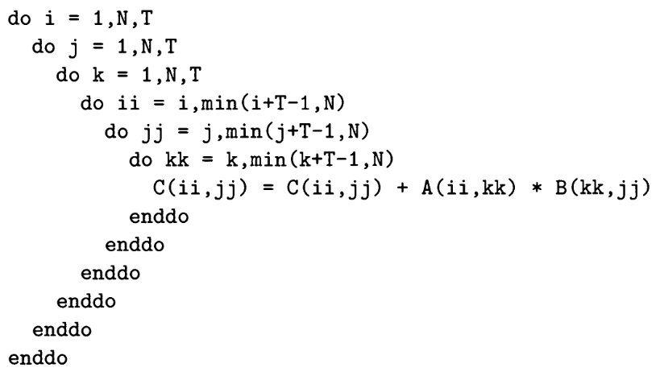
Tiling correctness – Fit in L2
1. a1*b1 (k=1)
2. aT1*bT1 (k=T+1)
3. aT2*bT2 (k=2T+1)
aT1
aT2
b1
a1
bT1
Fit in L2 → better
performance
bT2
A
B

Slide 3
Advance
ACCESS | AFFINE EXPRESSION | RANK | NULLILTY | BASIS OF NULL SPACE
for (i = 1; i <= m; i++)
for (j = 1; j <= n; j++) {
...Y[ i+j+1, 2i+2j];
}
Computer use algorithm 11.13
(P797) can get the result. We
use algebra here for human.
for (p = 2; p <= m+n; p++)
for (j = max(p-m, 1); j <= min(p-1, n); j++) {
...Y[ p+1, 2p];
}
Set p=i+j. Then set inner loop j to
j=p-i, imply the j is in the null space.

Slide 4
Advance
Y[3,4] Y[4,6] Y[5,8] ...Y[2+n,2+2n]
Y[4,6] Y[5,8] Y[6,10] ...Y[3+n,4+2n]
…
Y[m+1,2m] Y[m+2,2m+2] Y[m+3,2m+4]...Y[m+n+1,2m+2n]
Y[m+2,2m+2] Y[m+3,2m+4] Y[m+4,2m+6]...
for (i = 1; i <= m; i++)
for (j = 1; j <= n; j++) {
...Y[ i+j+1, 2i+2j];
}
for (p = 2; p <= m+n; p++)
for (j = max(p-m, 1); j <= min(p-1, n); j++) {
...Y[ p+1, 2p];
}
Y[3,4]
Y[4,6] Y[4,6]
Y[5,8] Y[5,8] Y[5,8]
Y[6,10] Y[6,10] Y[6,10] Y[6,10]
…
Y[m+2,2m+2] Y[m+2,2m+2]...Y[m+2, 2m+2]
Y[m+3,2m+4] ...

Slide 5
Advance
Y[m+n+1, 2m+2n, n];
for (i = 1; i <= m; i++)
for ( j = 1; j <= n; j++) {
...Y[ i+j+1, 2i+2j, 1];
}
for (p = 2; p <= m+n; p++)
for ( j = max(p-m, 1); j <= min(p-1, n); j++) {
...Y[ p+1, 2p, 1];
}

Slide 6
Small n
Small n :
  can be unrolled
  Check dependence by array and apply in non-linear affine expression

