Slide 1
Principle of Polyhedra model
cschen 陳鍾樞2014/04/30

Slide 2
Outline
Polygon space → Polyhedron space
Processor (partition) mapping
Formulate
  Iteration (Variable) space: loop index i, j, …
  Data dependence
  Processor mapping
Code generation
Primitive affine transforms
Pipelining

Slide 3
Affine expression
An expression is affine with respect to variables Vl , V2 , . . . , Vn if it can be expressed as Co + CI VI + . . . + CnVn, where Co , Cl , . . . , Cn are constants.
Such expressions are informally known as linear expressions.
Strictly speaking, an affine expression is linear only if Co is zero.

Slide 4
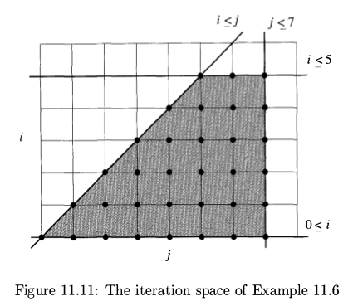
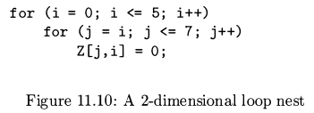
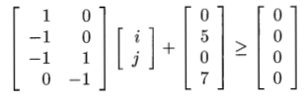

Polygon space

Slide 5
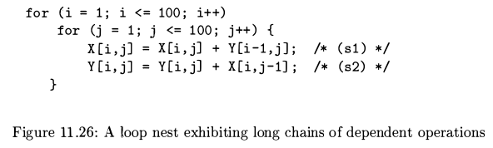
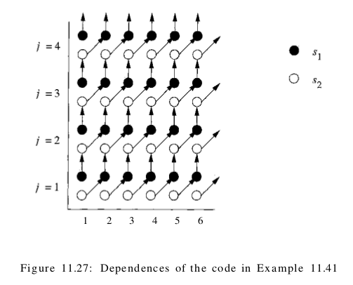
Loop optimization
– data locality & parallel
Data dependence,
Synchronization,
communication

Slide 6
Processor (partition) mapping

Slide 7
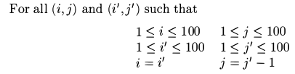
Processor mapping – get mapping function

Slide 8
Processor mapping – get mapping function

Slide 9
Formulate – variable space & processor mapping

Slide 10
Formulate – variable space & processor mapping
<=>
Convex region in d-dimension
space.
It can be reduced to
integer-linear-programming
which use linear algebra.

Slide 11
Formulate – data dependence

Slide 12
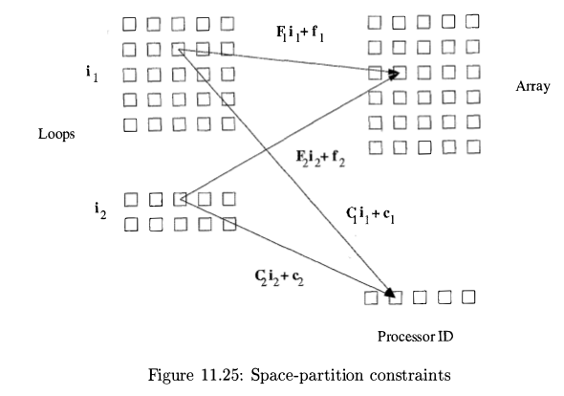
Formulate – variable space, data dependence & processor mapping

Slide 13
Formulate – variable space dimension
int X[100][100][100][100];
for (i=0; i<100; i++)
for (j=0; j<100; j++)
for (k=0; k<100; k++)
for (l=0; l<100; l++)
X[i][j][k][l] = X[i][j][k+1][l-1];
for (k=0; k<100; k++)
for (l=0; l<100; l++)
X[k][l][k][l+1] = X[k][l][k][l];

Slide 14
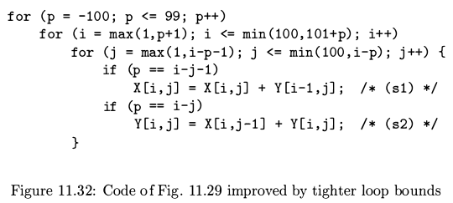
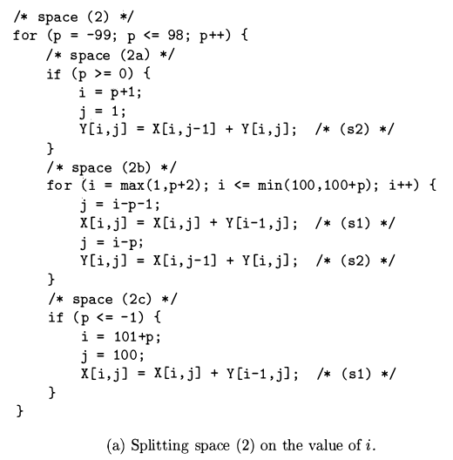
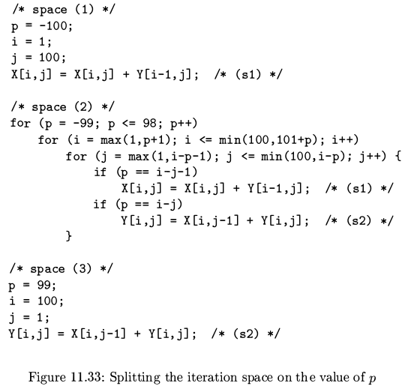
Code generation

Slide 15
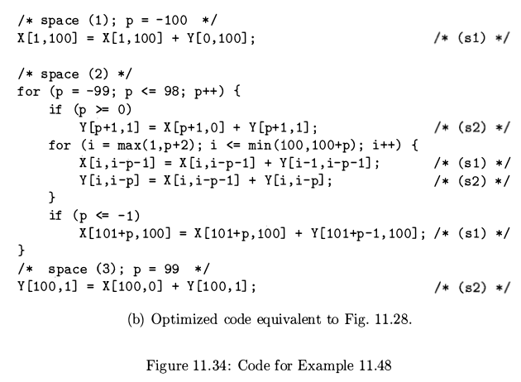
Code generation

Slide 16
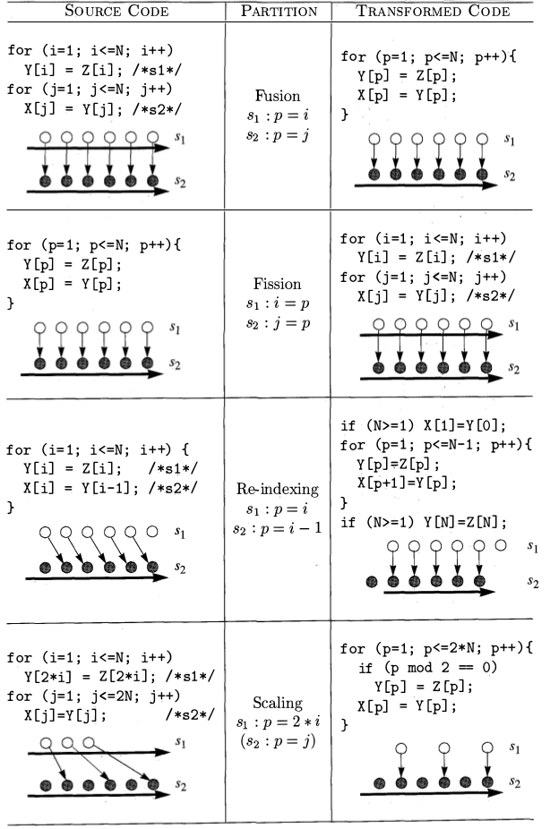
Primitive affine transforms

Slide 17
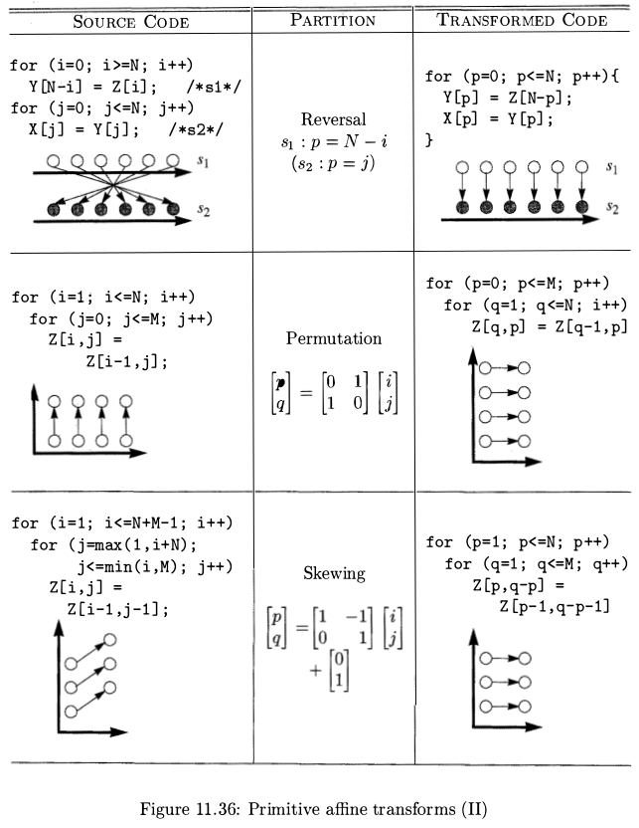
Primitive affine transforms

Slide 18
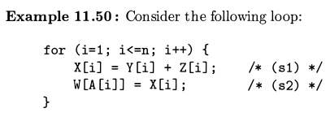
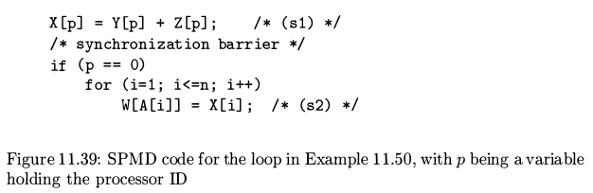
Primitive affine transforms - fission

Slide 19
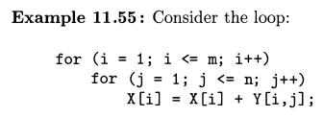
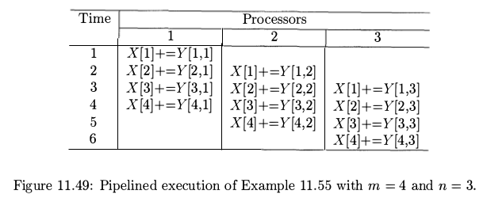
Pipelining

Slide 20
Pipelining
When Y is stored in column-major
→ locality in processor.

Slide 21
Pipelining – time partition
Time |  | Function unit per Bus
 | 1 | 2 | 3
1 | X[1]+=Y[1,1]
2 | X[2]+=Y[2,1]
3 | X[3]+=Y[3,1]
4 | X[4]+=Y[4,1] | X[1]+=Y[1,2]
5 | X[5]+=Y[5,1] | X[2]+=Y[2,2]
6 | X[6]+=Y[6,1] | X[3]+=Y[3,2]
7 | X[7]+=Y[7,1] | X[4]+=Y[4,2] | X[1]+=Y[1,3]
8 | X[8]+=Y[8,1] | X[5]+=Y[5,2] | X[2]+=Y[2,3]
9 |  | X[6]+=Y[6,2] | X[3]+=Y[3,3]
10 |  | X[7]+=Y[7,2] | X[4]+=Y[4,3]
11 |  | X[8]+=Y[8,2] | X[5]+=Y[5,3]
12 |  |  | X[6]+=Y[6,3]
13 |  |  | X[7]+=Y[7,3]
14 |  |  | X[8]+=Y[8,3]

Slide 22
Pipelining
for ( i = 1 ; i <= m ; i++)
for ( j = 1 ; j <= n; j ++) {
If (j%3 == 0)
X[i] = X[i] + Y [i , j ] ;
If (j%3 == 1)
X[i] = X[i] * Y [i , j ] ;
If (j%3 == 2)
X[i] = X[i] - Y [i , j ] ;
}
Time |  | Function unit
 | 1 | 2 | 3
1 | X[1]+=Y[1,1]
2 | X[2]+=Y[2,1] | X[1]*=Y[1,2]
3 | X[3]+=Y[3,1] | X[2]*=Y[2,2] | X[1]-=Y[1,3]
4 | X[4]+=Y[4,1] | X[3]*=Y[3,2] | X[2]-=Y[2,3]
5 | X[5]+=Y[5,1] | X[4]*=Y[4,2] | X[3]-=Y[3,3]
6 | X[6]+=Y[6,1] | X[5]*=Y[5,2] | X[4]-=Y[4,3]
7 | X[7]+=Y[7,1] | X[6]*=Y[6,2] | X[5]-=Y[5,3]
8 | X[8]+=Y[8,1] | X[7]*=Y[7,2] | X[6]-=Y[6,3]
9 |  | X[8]*=Y[8,2] | X[7]-=Y[7,3]
10 |  |  | X[8]-=Y[8,3]

Slide 23
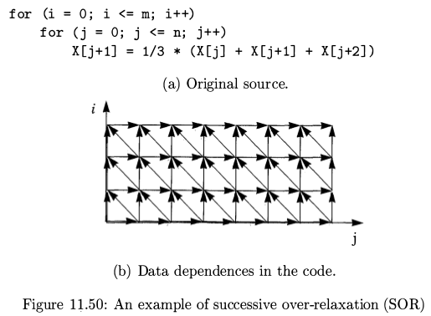
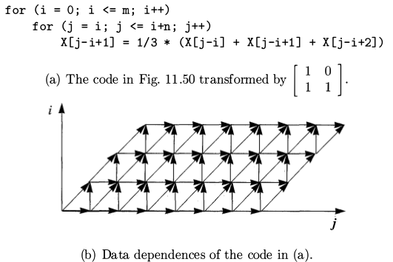
Pipelining

Slide 24
Pipelining
Ring above (mesh, cube)
connected processors.

Slide 25
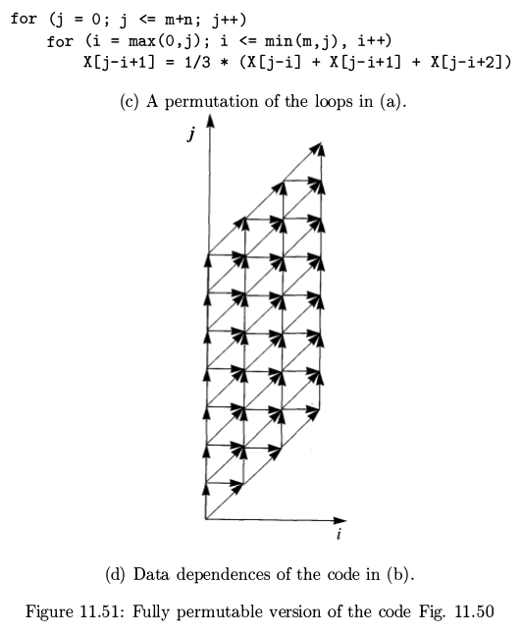
Pipelining

Slide 26
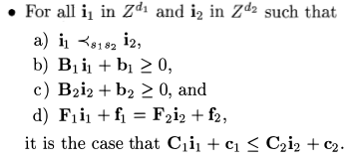
Pipelining (time partition) - formulate

