Slide 1
Principle of Polyhedral model
– for loop optimization
cschen 陳鍾樞2014/5/7

Slide 2
Outline
Abstract model
  Affine expression, Polygon space → Polyhedron space
Space partition
  Formulate include:
    Iteration (Variable) space: loop index i, j, …
    Data dependence
    Processor mapping
    Code generation
    Primitive affine transforms
Pipelining
  Formulate
Other uses of affine transforms
  Machine model & features

Slide 3
Affine expression
Such expressions are informally known as linear expressions.
Strictly speaking, an affine expression is linear only if is zero.

Slide 4
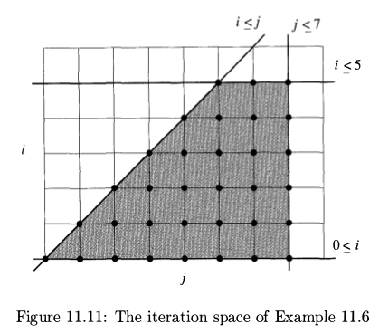
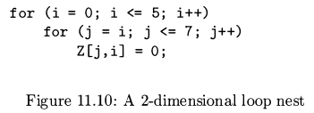
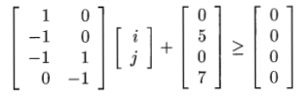

Polygon space

Slide 5
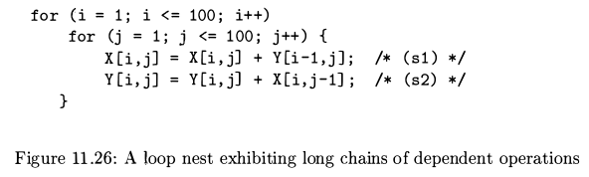
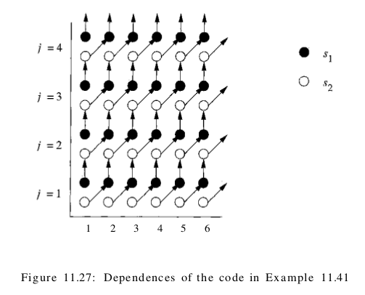
Loop optimization
– data locality & parallel
Data dependence,
Synchronization,
communication

Slide 6
Processor (partition) mapping

Slide 7
Processor (partition) mapping

Slide 8
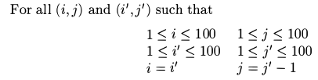
Processor mapping – get mapping function

Slide 9
Processor mapping – get mapping function

Slide 10
Formulate – variable space & processor mapping

Slide 11
Formulate – variable space & processor mapping
<=>
Convex region in d-dimension
space.
It can be reduced to
integer-linear-programming
which use linear algebra.

Slide 12
Formulate – data dependence

Slide 13
Null space
Thus, two iterations refer to the same array element if the difference of their loop-index vectors belongs to the null space of matrix F.
for (i = 0; i <= m; i++)
for (j = 1; j <= n; j++)
Y[j, j+1] = 1+Y[j, j+1];

Slide 14

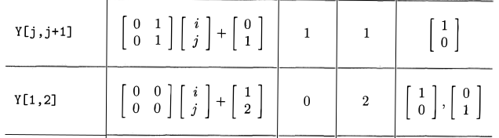
Null space
for (i = 0; i <= m; i++)
for (j = 1; j <= n; j++)
Y[1, 2] = 1+Y[1, 2];

Slide 15
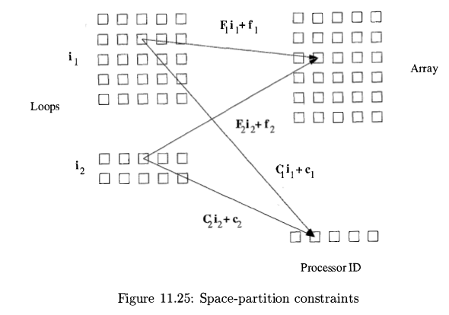
Formulate – variable space, data dependence & processor mapping

Slide 16
Formulate – variable space dimension
int X[100][100][100][100];
for (i=0; i<100; i++)
for (j=0; j<100; j++)
for (k=0; k<100; k++)
for (l=0; l<100; l++)
X[i][j][k][l] = X[i][j][k+1][l-1];
for (k=0; k<100; k++)
for (l=0; l<100; l++)
X[k][l][k][l+1] = X[k][l][k][l];

Slide 17
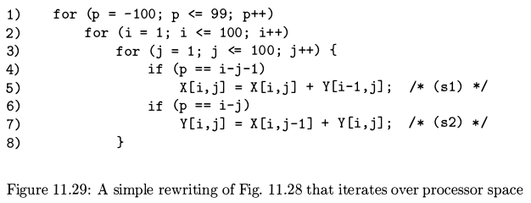
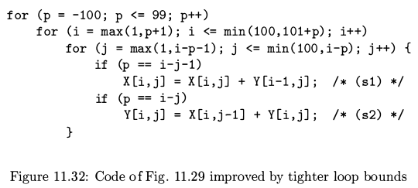
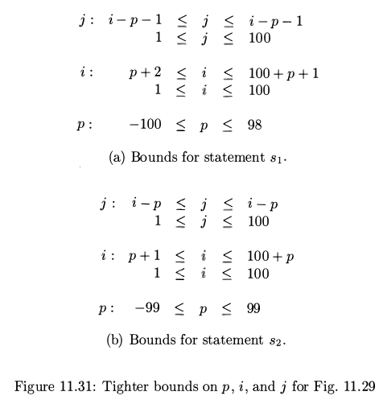
Code generation
Eliminating Empty Iterations

Slide 18
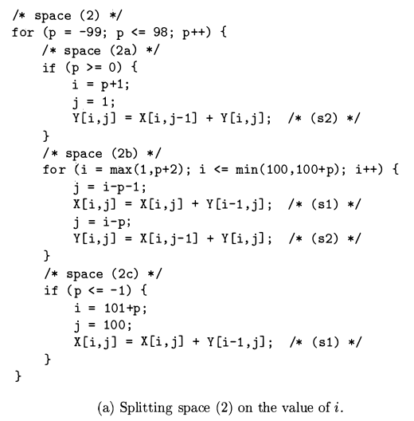
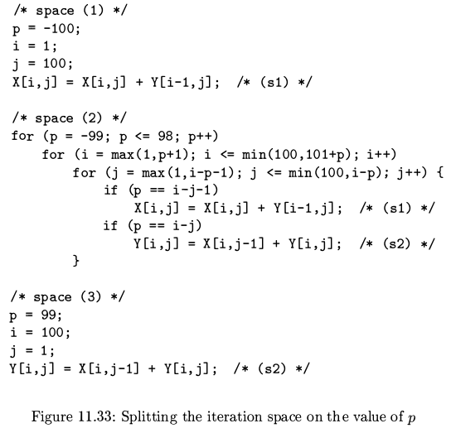
Code generation

Slide 19
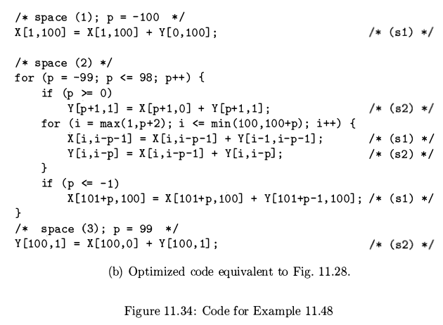
Code generation

Slide 20
Code generation
// processor[0]
/* space ( 1 ) ; p = - 100 */
X[1, 100] = X[1, 100 ] + Y[0, 100]; /* (s1) */
/* space ( 2 ) */
for (p = -99; p <= -50; p++) {
for (i = max(1 , p+2); i <= min(100 , 100+p) ; i++) {
X[i, i-p-1] = X[i, i-p-1] + Y[i-1, i-p-1] ; /* (s1) */
Y[i, i-p] = X[i, i-p-1] + Y[i, i-p] ; /* (s2) */
}
if (p <= -1)
X[101+p, 100] = X[101+p, 100] + Y[101+p-1, 100]; /* (s1) */
}
// processor[7]
/* space ( 2 ) */
for (p = 51; p <= 99; p++) {
if (p >= 0)
Y[p+1, 1] = X[p+1 , 0] + Y[p+1 , 1]; /* (s2) */
for (i = max(1 , p+2); i <= min(100 , 100+p) ; i++) {
X[i, i-p-1] = X[i, i-p-1] + Y[i-1, i-p-1] ; /* (s1) */
Y[i, i-p] = X[i, i-p-1] + Y[i, i-p] ; /* (s2) */
}
}
/* space (3) ; p = 99 */
Y[100, 1] = X[100, 0] + Y[100, 1];

Slide 21
Code generation
void AssignProcess() {
processor[0].assignProcess(-100, -99, -98, ...);
processor[1].assignProcess(-59, -58, -57, ...);
…
}
if (processor[pId].hasProcess(-100)) // pId: processor Id
/* space ( 1 ) ; p = - 100 */
X[1, 100] = X[1, 100 ] + Y[0, 100]; /* (s1) */
/* space ( 2 ) */
for (it=processor[pId].begin(); it != processor[pId].end(); it++) {
p = *it;
if (p >= 0)
Y[p+1, 1] = X[p+1 , 0] + Y[p+1 , 1]; /* (s2) */
for (i = max(1 , p+2); i <= min(100 , 100+p) ; i++) {
X[i, i-p-1] = X[i, i-p-1] + Y[i-1, i-p-1] ; /* (s1) */
Y[i, i-p] = X[i, i-p-1] + Y[i, i-p] ; /* (s2) */
}
if (p <= -1)
X[101+p, 100] = X[101+p, 100] + Y[101+p-1, 100]; /* (s1) */
}
If (processor[pId].hasProcess(99))
/* space (3) ; p = 99 */
Y[100, 1] = X[100, 0] + Y[100, 1] ; /* (s2) */

Slide 22
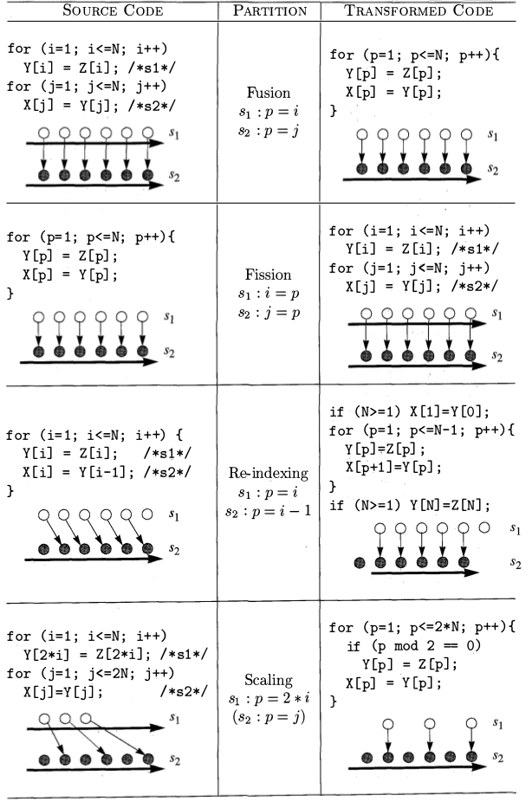
Primitive affine transforms

Slide 23
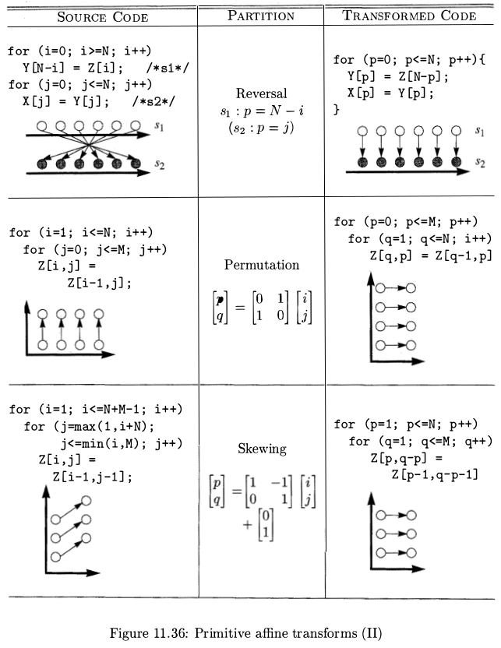
Primitive affine transforms
This example
is error

Slide 24
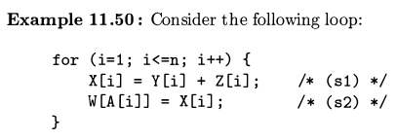
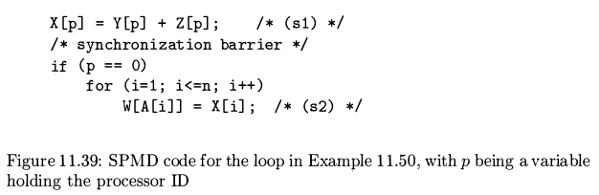
Primitive affine transforms - fission

Slide 25
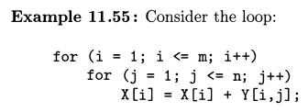
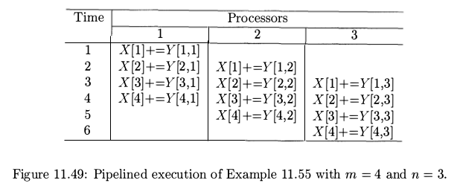
Pipelining

Slide 26
Pipelining
When Y is stored in column-major
→ locality in processor.

Slide 27
Pipelining – time partition
Time |  | Function unit per Bus
 | 1 | 2 | 3
1 | X[1]+=Y[1,1]
2 | X[2]+=Y[2,1]
3 | X[3]+=Y[3,1]
4 | X[4]+=Y[4,1] | X[1]+=Y[1,2]
5 | X[5]+=Y[5,1] | X[2]+=Y[2,2]
6 | X[6]+=Y[6,1] | X[3]+=Y[3,2]
7 | X[7]+=Y[7,1] | X[4]+=Y[4,2] | X[1]+=Y[1,3]
8 | X[8]+=Y[8,1] | X[5]+=Y[5,2] | X[2]+=Y[2,3]
9 |  | X[6]+=Y[6,2] | X[3]+=Y[3,3]
10 |  | X[7]+=Y[7,2] | X[4]+=Y[4,3]
11 |  | X[8]+=Y[8,2] | X[5]+=Y[5,3]
12 |  |  | X[6]+=Y[6,3]
13 |  |  | X[7]+=Y[7,3]
14 |  |  | X[8]+=Y[8,3]
SIMD instruction

Slide 28
Software pipeline
for ( i = 1 ; i <= m ; i++)
for ( j = 1 ; j <= n; j+=3) {
X[i] = X[i] + Y [i , j ] ;
X[i+1] = X[i+1] * Y [i+1 , j ] ;
X[i+2] = X[i+2] - Y [i+2 , j ] ;
}
Time |  | Function unit
 | 1 | 2 | 3
1 | X[1]+=Y[1,1]
2 | X[2]+=Y[2,1] | X[1]*=Y[1,2]
3 | X[3]+=Y[3,1] | X[2]*=Y[2,2] | X[1]-=Y[1,3]
4 | X[4]+=Y[4,1] | X[3]*=Y[3,2] | X[2]-=Y[2,3]
5 | X[5]+=Y[5,1] | X[4]*=Y[4,2] | X[3]-=Y[3,3]
6 | X[6]+=Y[6,1] | X[5]*=Y[5,2] | X[4]-=Y[4,3]
7 | X[7]+=Y[7,1] | X[6]*=Y[6,2] | X[5]-=Y[5,3]
8 | X[8]+=Y[8,1] | X[7]*=Y[7,2] | X[6]-=Y[6,3]
9 |  | X[8]*=Y[8,2] | X[7]-=Y[7,3]
10 |  |  | X[8]-=Y[8,3]

Slide 29
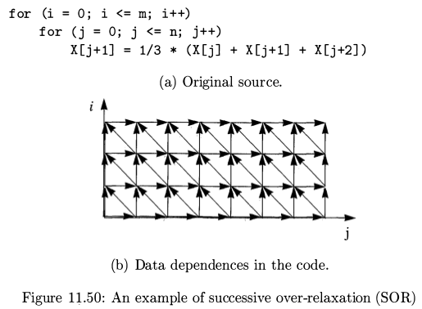
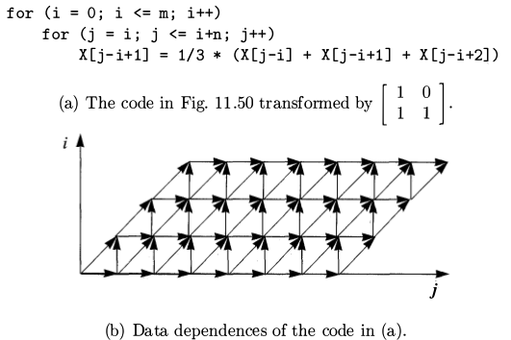
Pipelining

Slide 30
Pipelining
Linear, Ring above (mesh, cube)
connected processors.

Slide 31
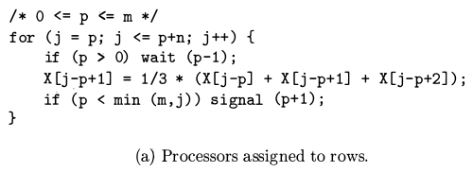
Pipelining - synchronize

Slide 32
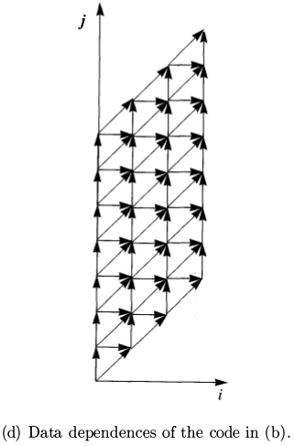
Pipelining
for (j = 0; j <= m+n; i++)
for (i = max(0,j-n); i <= min(m,j); j++)
X[j-i+1] = 1/3 * (X[j-i] + X[j-i+1] + X[j-i+2];

Slide 33
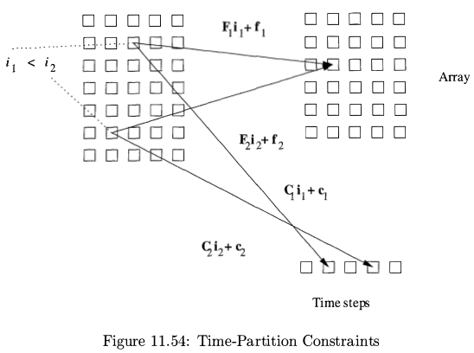
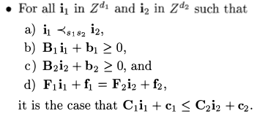
Pipelining formulate – variable space, data dependence & time steps mapping

Slide 34
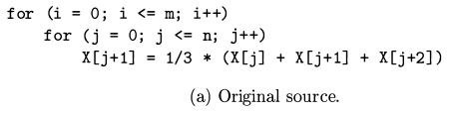
Pipelining – time steps mapping
consider all processors have the same time steps mapping function
1 . True dependence from write access X[j + 1] to read access X [j + 2]. eg. X[1+1](i=0,j=1), X[0+2](i'=1,j'=0).
2. Antidependence from read access X[j + 2] to write access X [j + 1] . eg. X[1+2](i=1,j=1), X[2+1](i'=1,j'=2).
3. Output dependence from write access X [j + 1] back to itself. eg. X[0+1](i=1,j=0), X[1+0](i'=2,j'=0).
Conclusion:

Slide 35
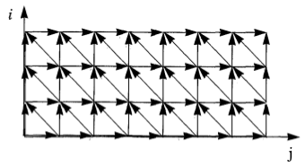
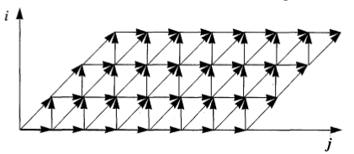
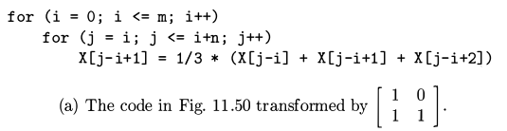
Pipelining – Code generation
for (i' = 0; i' <= m; i'++)
for (j' = i'; j' <= i'+n; j'++)
X[j'-i'+1] = 1/3 * (X[j'-i'] + X[j'-i'+1] + X[j'-i'+2];

Slide 36
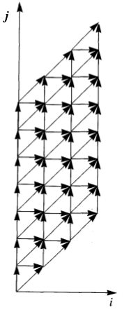
Pipelining – Code generation
for (i' = 0; i' <= m+n; i'++)
for (j' = 0; j' <= m; j'++) {
if ((i'-j' >= 0)&&(i'-j' <=n))
X[i'-j'+1] = 1/3 * (X[i'-j'] + X[i'-j'+1] + X[i'-j'+2];
}
for (j = 0; j <= m+n; j++)
for (i = max(0,j-n); i <= min(m,j); j++)
X[j-i+1] = 1/3 * (X[j-i] + X[j-i+1] + X[j-i+2];
for (i' = 0; i' <= m+n; i'++)
for (j' = max(0,i'-n); j <= min(m,i'); j'++)
X[i'-j'+1] = 1/3 * (X[i'-j'] + X[i'-j'+1] + X[i'-j'+2];
m=3,n=6
j=0 → i=0
=1 → i=0,1
=2 → i=0,1,2
=3 → i=0,1,2,3
=4 → i=0,1,2,3
=5 → i=0,1,2,3
=6 → i=0,1,2,3
=7 → i=1,2,3
=8 → i=2,3
=9 → i=3

Slide 37
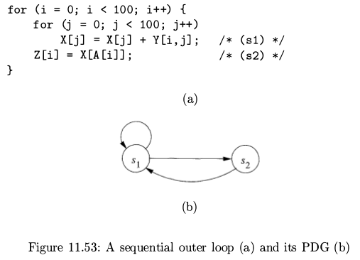
Pipelining – no time steps mapping

Slide 38
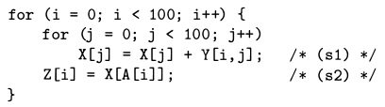
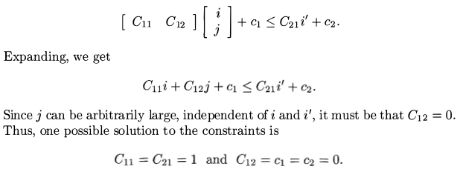
Pipelining – no time steps mapping
1. True dependence from write access X[j] to read access X[A[i]]
2. Anti-dependence from read access X[A[i]] to write access X[j]
Conclusion, only one solution → no time steps mapping

Slide 39
Other uses of affine transforms
Distributed memory machines
Multi-instruction-issue processors
Vector and SIMD instructions
Prefetching

Slide 40
Reference
Chapter 11 of Compilers principles, techniques, & tools 2nd edition

