Slide 1
LLVM Polly
cschen 陳鍾樞2014/03/25

Slide 2
Outline
Loop tiling
Clang -O3 benchmark (tiling v.s. No-tiling)
Reference

Slide 3
Outline
Loop tiling – Reduce data cache miss
Clang -O3 benchmark (tiling v.s. No-tiling)
Reference

Slide 4
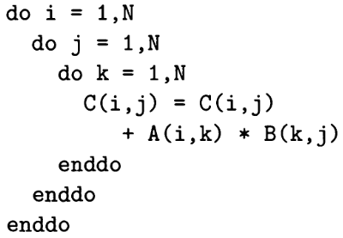
Data cache miss
Assume data cache line size is 4 words,
When B(-,j) is read, the B(-,j+1) is in
cache too.
When N is large, the A(i,-)*B(-,j+1) will
cache miss.
j j+1
i

Slide 5
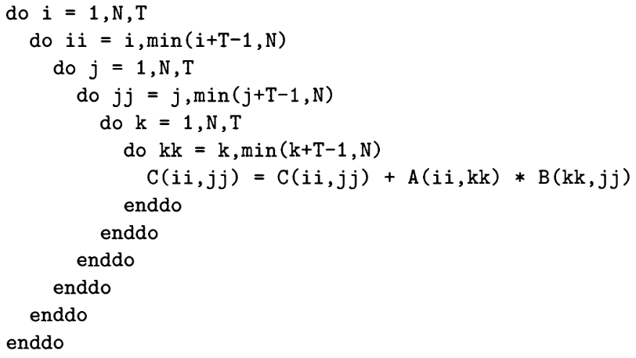
Tiling

Slide 6
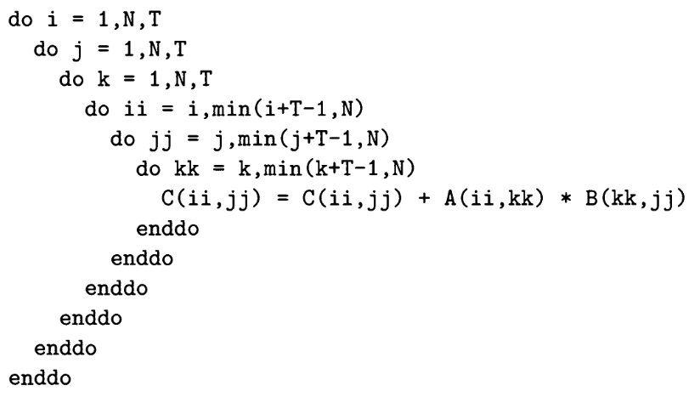
Tiling - Reduce data cache miss
Cache hit!
jj jj+1
ii

Slide 7
Oprofile – analysis on X86
sudo time ./ocount --events=l1d_pend_miss:pending ./matmul
  l1d_pend_miss:
  0x01: (name=pending) L1D miss oustandings duration in cycles

Slide 8
Oprofile – analysis on X86
N=256
  (0.018 Sec/0.018=1, 0.332 Giga cycles/0.015=22)
N=512
  (0.16/0.13=1.2, 3.9/1.4=2.7)
N=768
  (1.35/0.42=3.2, 11.1/2.7=4.1)
N=1024
  (6.62/1.21=5.4, 103.6/13.6=7.6)
N=1536
  (22.7/3.6=6.3, 277.5/34.8=7.9)
N=2048
  (65.8/9.6=6.8, 1792.4/93.9=19.0
N=3072
  (239.9/33.0=7.24, 6714.1/375.5=17)
N=4096
  (644.9/84.2=7.65, 18740.3/821.2=22.7) (661.5/83.9=7.8, 19326.8/793.2=24.3)
N=5120
  (1235.6/149.3=8.2, 33463.1/1447.0=23.1) (1198.8/150.0=7.9, 33551.3/1469.6=22.8)
Cache up 22 but the total data cache
miss amount is low as 0.332G. The
Instruction cycles take most of time.
X86 has L2.
Note:
1. Both the instruction cycles and data cache miss rate is variable.

Slide 9
Oprofile – analysis on X86
Conclusion:
1. N up => (no tile / tile) data cache miss up
significantly.
2. N 1024 → 4096, data cache miss 7.6 → 22,
speed up 5.4 → 7.6 (because instruction cycles
up too).

Slide 10
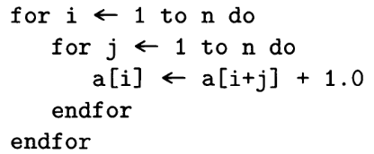
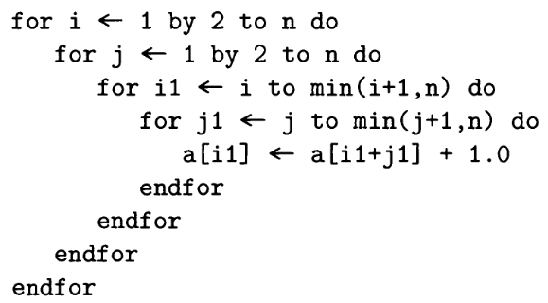
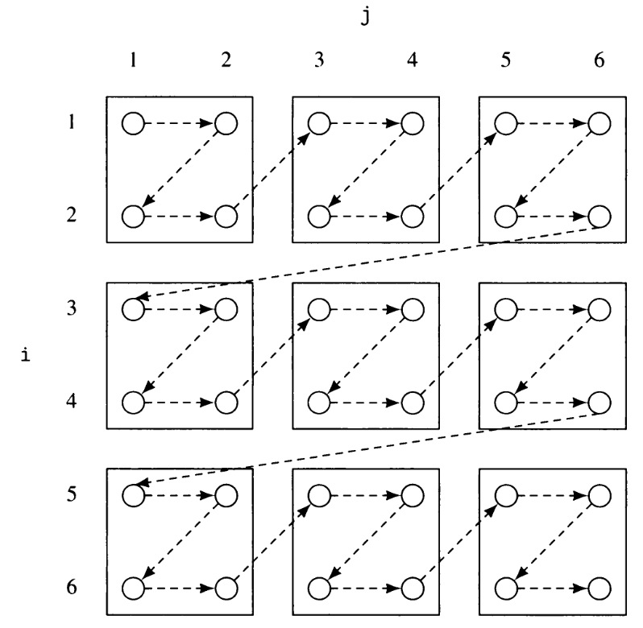
Data dependence, tile, and parallel processing
a tile is atomically executed on a processor with communication required only before and after execution

Slide 11
Reference
Advanced compiler design implementation
  20.4.2 Loop Transformations
  20.4.3 Locality and Tiling
http://pluto-compiler.sourceforge.net/
  http://drona.csa.iisc.ernet.in/~uday/publications/uday-cc08.pdf

