Slide 1
AskAlice chatbot evaluation
Initial rag pipeline evaluation on a labeled dataset

Slide 2
Evaluation details
Dataset
Metrics
25 question-answer pairs provided by Sandro
Final answers constructed by ChatGPT
Similarity between generated and correct answer
Lexical overlap: BLEU and ROUGE scores
Embedding based: Cosine similarity
Learned judgement: LLM-as-judge

Slide 3
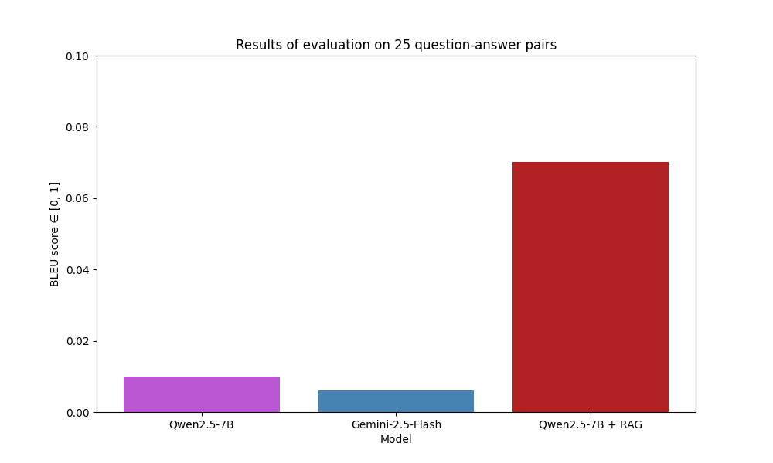
BLEU score comparison
(Probably the least appropriate metric, as it is literal and precision based)

Slide 4
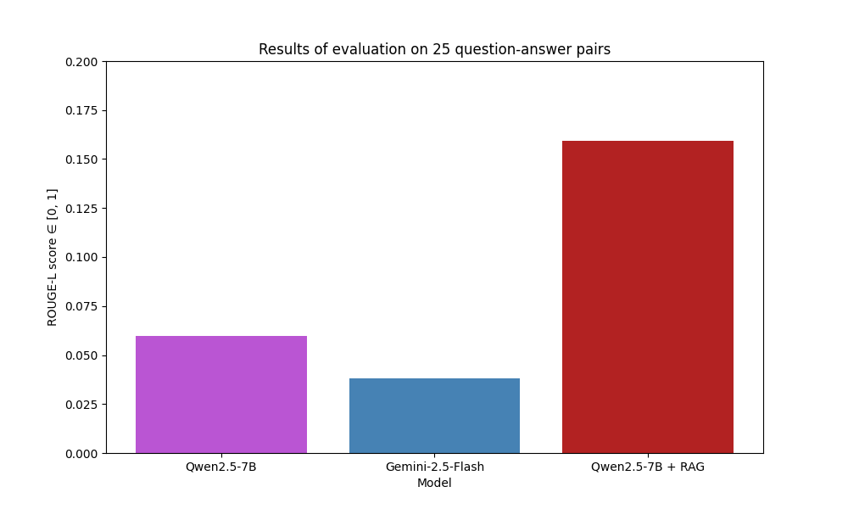
ROUGE-L score comparison

Slide 5
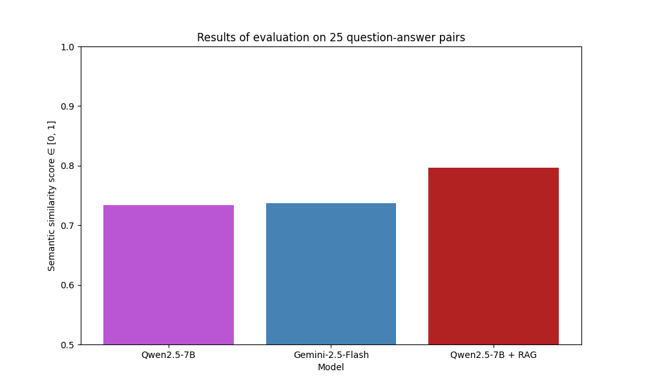
Semantic similarity comparison

Slide 6
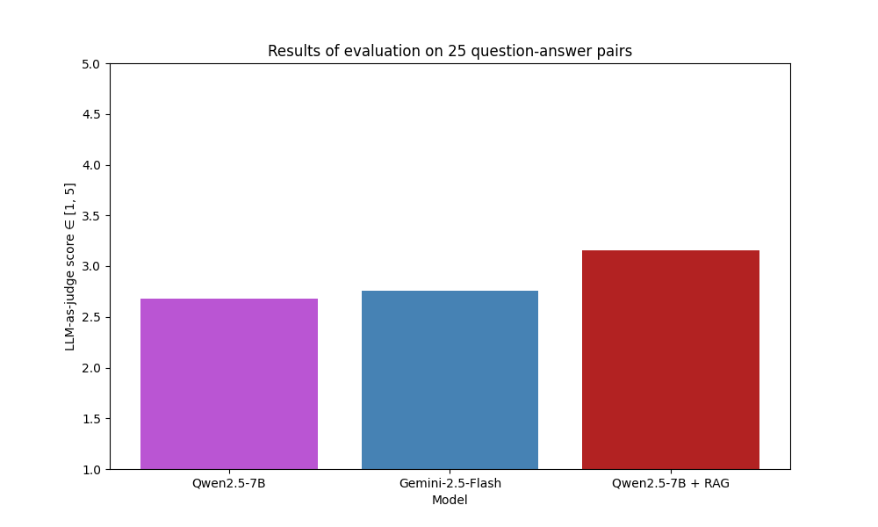
LLM-as-judge score comparison
We should aim for 3.5 or higher (note that 5 is only given to almost exact matches)

Slide 7
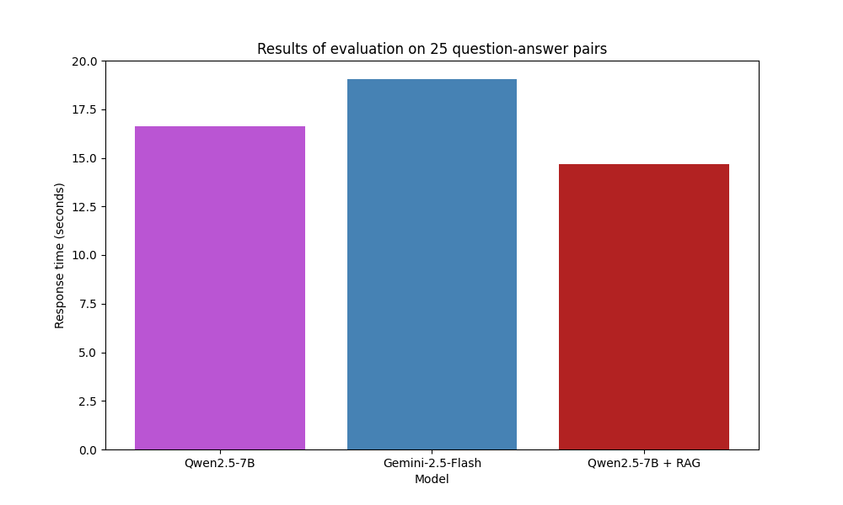
Average response time comparison
The RAG chatbot generates responses only based on the retrieved context!

Slide 8
Next steps
Extend the dataset with more question-answer pairs
Evaluate more base models (Mistral, Llama, Gemma)
Optimize RAG parameters

