Slide 1
データベース基礎

Slide 2
課題1
■テーブル作成
create table profiles(profilesID int, name varchar(255), tell varchar(255), age int, birthday date);
■INSERT文
insert into profiles(profilesID,name,tell,age,birthday)
values(1,'田中 実', '012-345-6789', '30', '1994-02-01');
insert into profiles(profilesID,name,tell,age,birthday)
values(2, '鈴木 茂', '090-1122-3344', '37', '1987-08-12');
insert into profiles(profilesID,name,tell,age,birthday)
value(3, '鈴木 実', '080-5566-7788', 24, '2000-12-24');
insert into profiles(profilesID,name,tell,age,birthday)
value(4, '佐藤 清', '012-0987-6543', 19, '2005-08-01');
insert into profiles(profilesID,name,tell,age,birthday)
value(5, '高橋 清', '090-9900-1234', 24, '2000-12-24');
SELECT * FROM profiles;
Notes:
pic1

Slide 3
課題2〜5
■課題2
SELECT * FROM profiles
WHERE profilesID=3;
■課題3
SELECT * FROM profiles
WHERE name=‘高橋 清’;
■課題4
SELECT * FROM profiles
WHERE age=24;
■課題5
SELECT * FROM profiles
WHERE age>=25;

Slide 4
課題6〜8
■課題6
SELECT * FROM profiles
WHERE name LIKE ‘%実%’;
■課題7
UPDATE profiles SET name=‘吉田 茂’
WHERE profilesID=2;
SELECT *FROM profiles
WHERE profilesID=2;
■課題8
DELETE FROM profiles
WHERE birthday=‘2000-12-24’;
SELECT * FROM profiles;

Slide 5
課題9 department
■department
insert into department(departmentID, departmentName)
values(1,'開発部');
insert into department(departmentID, departmentName)
values(2,'営業部');
insert into department(departmentID, departmentName)
values(3,'総務部');

Slide 6
課題9 station
■station
insert into station(stationID, stationName)
values(2,'永田町');
insert into station(stationID, stationName)
values(3,'渋谷');
insert into station(stationID, stationName)
values(4,'神保町');
insert into station(stationID, stationName)
values(5,'上井草');

Slide 7
課題9 user
■user
create table user(userID int primary key, name varchar(255), tell varchar(255), age int, birthday date, departmentID int, stationID int)engine=InnoDB;
insert into user(userID,name,tell,age,birthday,departmentID,stationID)
values(1,'田中 実','012-345-6789',30,'1994-02-01',3,1);
insert into user(userID,name,tell,age,birthday,departmentID,stationID)
values(2,'鈴木 茂','090-1122-3344',37,'1987-08-12',3,4);
insert into user(userID,name,tell,age,birthday,departmentID,stationID)
values(3,'鈴木 実','080-5566-7788',24,'2000-12-24',2,5);
insert into user(userID,name,tell,age,birthday,departmentID,stationID)
values(4,'佐藤 清','012-0987-6543',19,'2005-08-01',1,5);
insert into user(userID,name,tell,age,birthday,departmentID,stationID)
values(5,'高橋 清','090-9900-1234',24,'2000-12-24',3,5);
SELECT * FROM user;

Slide 8
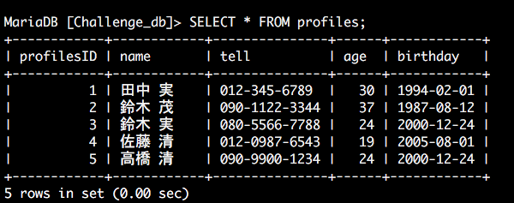
課題1

Slide 9
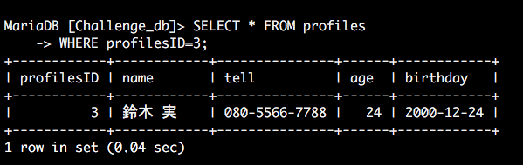
課題2

Slide 10
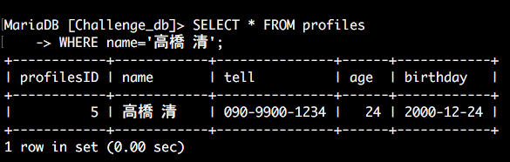
課題3

Slide 11
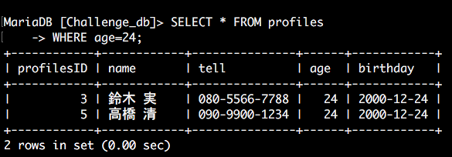
課題4

Slide 12
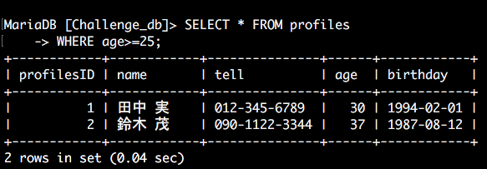
課題5

Slide 13
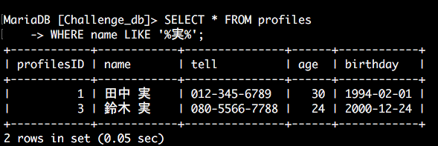
課題6

Slide 14
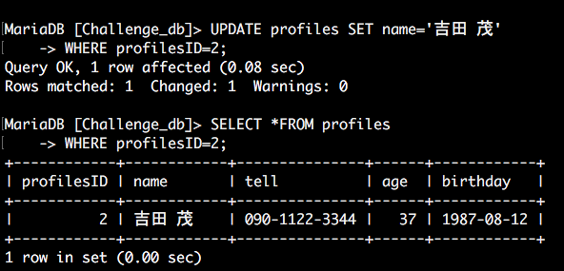
課題7

Slide 15
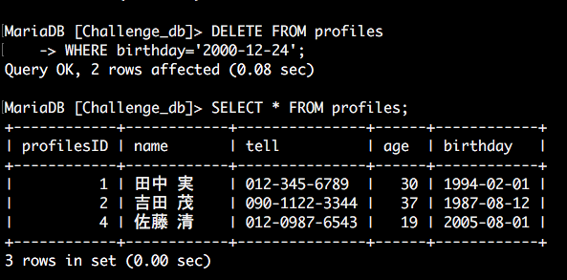
課題8

Slide 16
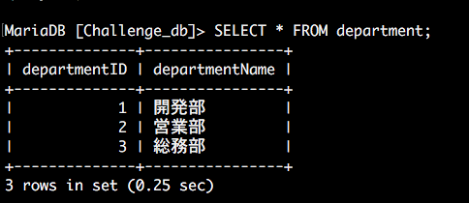
課題9 department

Slide 17
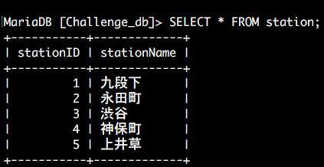
課題9 station

Slide 18
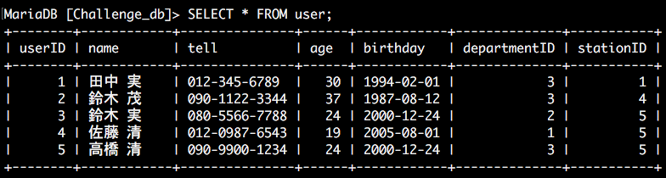
課題9 user

Slide 19
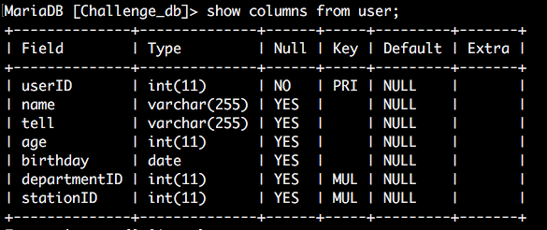
課題9 主キー&外部キー

