Slide 1


Computer Networks - 1
Lars Mortensen
Litterature:
http://en.wikipedia.org/wiki/Internet_protocol_suite
http://en.wikipedia.org/wiki/Domain_Name_System

Slide 2
Learning Goals
Network - Week 1
Main Topics | TCP/IP and the OSI model Network analysis/sniffing Application Layer Protocols DNS HTTP
When this lesson is over you should be able to: | Explain what a network protocol suite is Describe the layers of the TCP/IP protocol system and the purpose of each layer Explain about the OSI model and how the OSI layers relate to TCP/IP layers Describe the purpose of network sniffing/analysis tools, an use nslookup, ipconfig (ifconfig), ping, traceroute (tracert) and Wireshark for simple analysis scenarios Give examples of popular Application Layer Protocols Explain and demonstrate details about the HTTP protocol using Wireshark and/or Google developer tools. Describe the overall details of the DNS system, and demonstrate the protocol details using relevant tools.

Slide 3
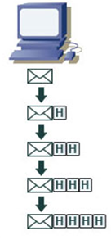
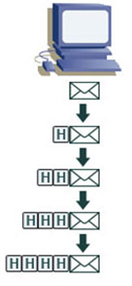
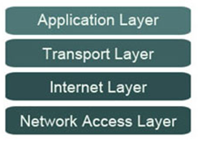
The TCP/IP Protocol Suite
A network protocol Suite is a system of protocols that helps define the complex process of network communication.
Protocols guide the process of sending data from an application on one computer, through the networking components of the operating system, to the network hardware, across the transmission medium, and up through the destination computer’s network hardware and operating system to a receiving application
The TCP/IP model and related protocols are maintained by the Internet Engineering Task Force (IETF).

Slide 4
TCP-IP Explained using animation

Slide 5
The TCP/IP Animation
TCP/IP Interactive Animation

Slide 6
The TCP/IP Protocol Stack
The application layer contains all protocols for specific data communications services on a process-to-process level.
HTTP, DNS, FTP, POP, Telnet ....
Application Layer
Transport
Layer
The transport layer handles host-to-host communication.
TCP, UDP
Internet
Layer
Network Layer
The internet layer (IP) connects local networks, that is, it establishes internetworking.
The link layer contains communication technologies for a local network.

Slide 7
The Application Layer
The application layer contains the higher-level protocols used by most applications for network communication.
Data coded according to application layer protocols are then encapsulated into a transport layer protocol (such as TCP or UDP), which in turn use lower layer protocols to effect actual data transfer.
Application layer protocols generally treat the transport layer (and lower) protocols as black boxes which provide a stable network connection across which to communicate, although the applications are usually aware of key qualities of the transport layer connection such as the end point IP addresses and port numbers
Application Layer
Transport
Layer
Internet
Layer
Network Layer

Slide 8
The Transport Layer
The transport layer establishes host-to-host connectivity.
Its responsibility includes end-to-end message transfer independent of the underlying network, along with error control, segmentation, flow control, congestion control, and application addressing (port numbers).
The two major protocols in this layer are:
TCP (Transmission Control Protocol)
  a connection-oriented protocol that addresses numerous reliability issues to provide a reliable connection
  data arrives in-order
  data is error free
  duplicate data is discarded
  lost/discarded packets are resent
  includes traffic congestion control
UDP (User Datagram Protocol )
  a connectionless unreliable datagram protocol.
Application Layer
Transport
Layer
Internet
Layer
Network Layer
What address information would you expect to find at this layer?

Slide 9
The Internet Layer
Provides logical addressing so that data can pass among subnets of different types.
Provides packet routing, the task of sending packets of data (datagrams) from source to destination by sending them to the next network node (router) closer to the final destination
Relates physical addresses (used at the Network Access layer) to logical addresses.
Application Layer
Transport
Layer
Internet
Layer
Network Layer
What address information would you expect to find at this layer?

Slide 10
The Network Layer
The link layer is the networking scope of the local network connection to which a host is attached.
As a result TCP/IP is able to be implemented on top of virtually any hardware networking technology.
The link layer is used to move packets between the Internet layer interfaces of two different hosts on the same link. The processes of transmitting and receiving packets on a given link can be controlled both in the software device driver for the network card, as well as on firmware or specialized chipsets.
Application Layer
Transport
Layer
Internet
Layer
Network Layer
What address information would you expect to find at this layer?

Slide 11
The OSI model
TCP/IP can both refer to a standard (a system of rules defining communication on TCP/IP network) and an implementation which is the software component(s) that performs the functions that enable a computer to participate in a TCP/IP network.
There are other standards with the OSI model as the most prominent one.
The Open Systems Interconnect Model (the OSI Model) is a theoretical model of networking that organizes network functions into seven layers.
You are supposed to know about the OSI model, but the reference model used this semester (an on the internet) is TCP/IP.

Slide 12
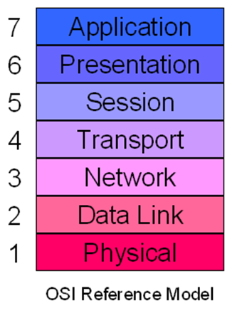
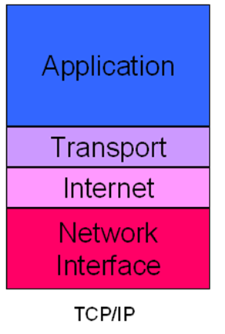
The OSI model
The OSI, or Open System Interconnection, model defines a networking framework to implement protocols in seven layers. Control is passed from one layer to the next, starting at the application layer in one station, and proceeding to the bottom layer, over the channel to the next station and back up the hierarchy

Slide 13
The OSI model
Provides a network interface for applications
Translates data to a standard format; manages encryption and data compression
Establishes sessions between communicating applications on the communicating computers
Provides error control and flow control for the internetwork
Supports logical addressing and routing
Provides an interface with the network adapter; maintains logical links for the subnet
Converts the data into the stream of electric or analog pulses that will actually cross the transmission medium

Slide 14
Tools we will use this semester
nslookup
ipconfig (MAC ifconfig)
ping
TraceRoute (Windows tracert)
Wireshark

Slide 15

Exercise Network Tools
Use Google and/or the help to investigate nslookup. What kind of information do we get from this program.
Use Google and/or the help to investigate ipconfig. What kind of information do we get from this program.
Use Google and/or the help to investigate ping. What kind of information do we get from this program.
Use Google and/or the help to investigate tracert (Traceroute). What kind of information do we get from this program.
Install Wireshark

Slide 16
Packet sniffers
The basic tool for observing the messages exchanged between executing protocol entities is called a packet sniffer.
A packet sniffer captures (“sniffs”) messages being sent/received from/by your computer
it will also typically store and/or display the contents of the various protocol fields in these captured messages
A packet sniffer itself is passive. It observes messages being sent and received, but never sends packets itself
Similarly, received packets are never explicitly addressed to the packet sniffer. Instead, a packet sniffer receives a copy of packets that are sent/received from/by application and protocols executing on your machine.
Packet Sniffer Texts are based on Labs. supplied with ”Computer Networking – Kurose & Ross”

Slide 17
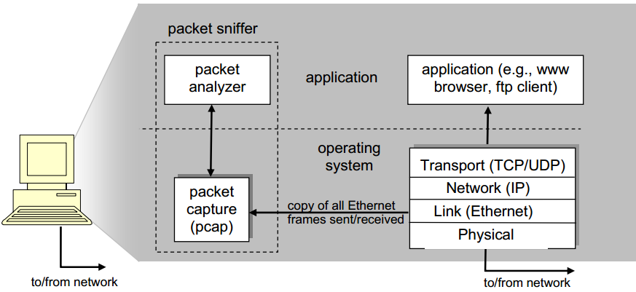
Packet sniffers
Recall from the introduction of the TCP/IP Protocol Stack that messages exchanged by higher layer protocols all are eventually encapsulated in network-layer frames that are
transmitted over a physical media.
Capturing all network-layer frames thus gives us all messages sent/received from/by all protocols and applications executing in our computer

Slide 18
Packet sniffers
In order to display packet information, the packet analyzer must “understand” the structure of all messages exchanged by protocols.
With HTTP as an example, the packet analyzer understands the format of :
Ethernet frames, and so can identify the IP datagram within an Ethernet frame.
The IP datagram format, so that it can extract the TCP segment within the IP datagram.
The TCP segment structure, so it can extract the HTTP message contained in the TCP segment.
Finally, it understands the HTTP protocol and knows for example, that the first bytes of an HTTP message will contain the string “GET,” “POST,” or “HEAD

Slide 19

Demo WireShark

Slide 20
Application Layer Protocols
DHCP - DHCPv6 – DNS – FTP – HTTP - IMAP – IRC – LDAP – MGCP – NNTP – BGP – NTP – POP – RPC – RTP – RTSP – RIP - SIP – SMTP – SNMP – SOCKS - SSH - Telnet - TLS/SSL …

Slide 21
The Hyper Text Transport Protocol (HTTP)
Covered in the Main part of this semester
You are however, for the network part, expected to know the details about the protocol and how to monitor it using relevant tools.

Slide 22
The Domain Name System
The Domain Name System, or DNS, is a globally distributed, scalable, reliable, dynamic database, used to map between hostnames and IP addresses, and to provide electronic mail routing information.
Basically three components are involved:
A Domain Name Space
Servers making the Domain Name Space available
Clients which query the servers about the name space
Each site (university, campus, company as examples) maintains their own database of information and runs a server program that other clients on the internet can query.
The DNS provides the protocol that allows clients and servers to communicate with each other

Slide 23
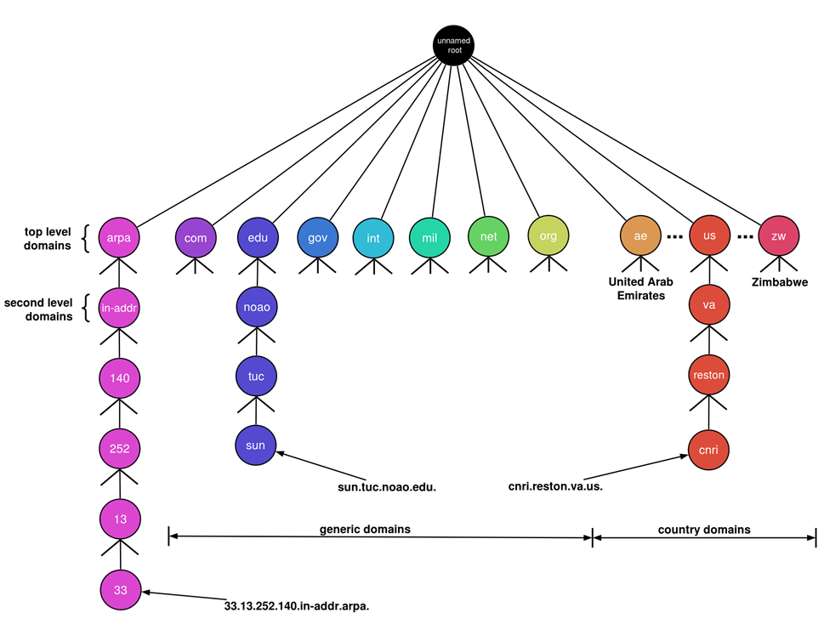
The Domain Name Space
In the Internet, the domain name space (tree) is divided into three different sections: generic domains, country domains and the inverse domain.

Slide 24
The Domain Name Space
Domain names read from right to left:
amazon.co.uk. -> root uk co amazon
Fully Qualified Names
A domain name that ends with a period (referring to the root) is called an absolute domain name or a fully qualified domain name (FQDN)
Top Level Domains (TLDs)
Below the root are the top level domains or TLDs. These are the highest names in the name space, for example, .com or .net
TLDS are maintained by the Internet corporation for assigned names and numbers, or ICANN (www.icann.com).

Slide 25
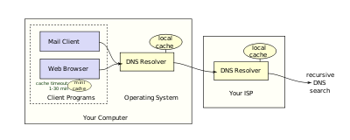
DNS Resolving

Slide 26
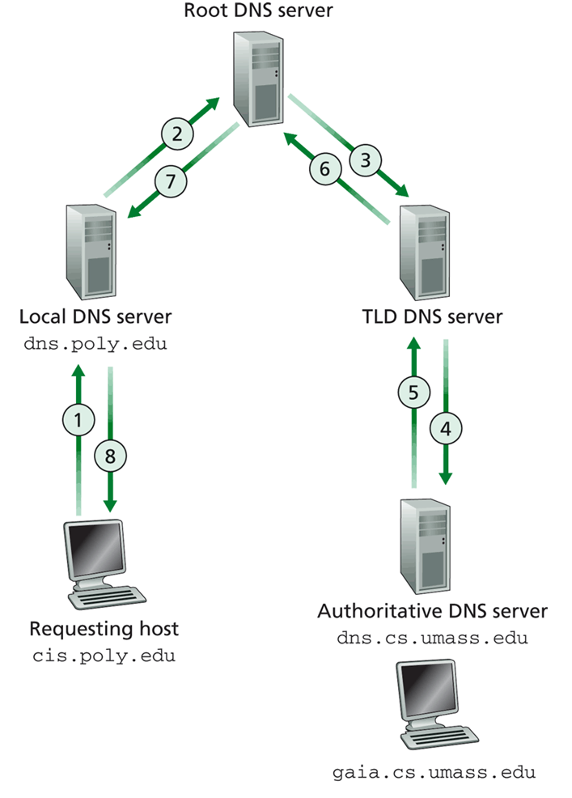
Name Servers
Root
Name Server
Authoritative
Name Server
Top Level Domain
Name Server
Authoritative
Name Server

Slide 27
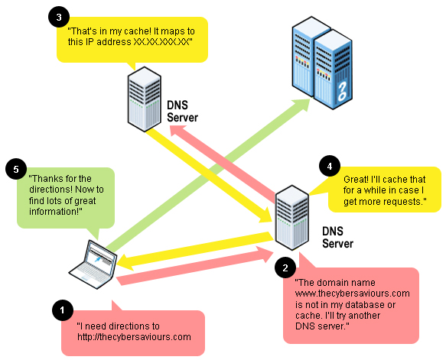
DNS Caching

Slide 28
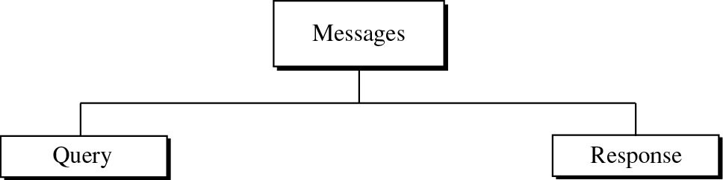
DNS Messages
DNS has two type of messages:
  Query
  Response
Both type of messages has the same format:

Slide 29
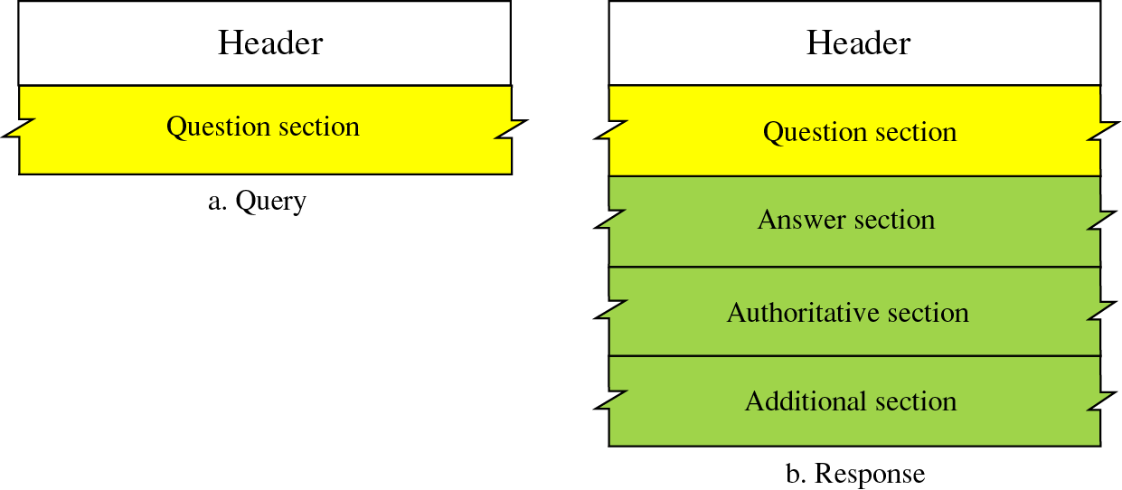
DNS Messages
DNS has two type of messages: query and response
Both type of messages has the same format:
We will investigate the details with WireShark

Slide 30
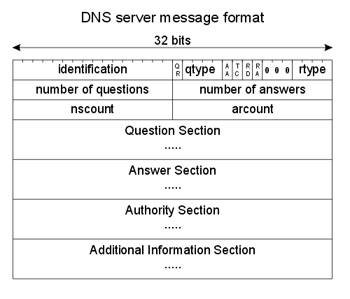
DNS Messages
DNS has two type of messages: query and response
Both type of messages has the same format:
The Query Message
Header
Question Records
The Response Message
Header
Answer Records
Authoritative Records
Additional Records
We will investigate the details with WireShark

Slide 31
Query Types
Type | Description
A | Name is a HostName and Value is an IP address
NS | Name is a domain (amazon.com) and Value is the host name of an authoritative server that knows how to obtain the IP for hosts in that domain
CNAME | Canonical Name. Defines an alias for the official name of a host
PTR | Pointer. Used to convert an IP address to a Domain Name
MX | MailExchange (it redirects mail to a mail server)
AAAA | An IPv6 Address

