Slide 1
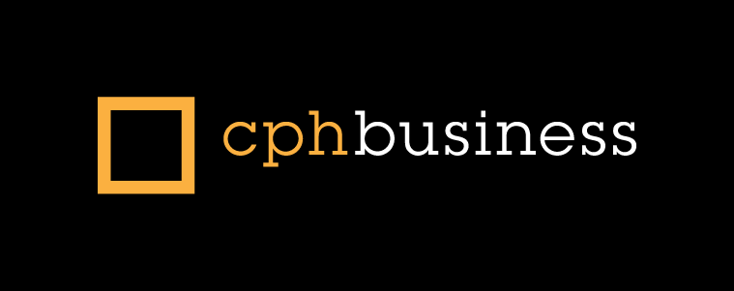

Computer Networks – 3
TCP/IP’s Internet Layer
Routing
Lars Mortensen
Literature:
TCP/IP Protocol Suite, Forouzan - chapter 4,5,6 +8 (slides are based on these chapter)
http://en.wikipedia.org/wiki/Internet_protocol_suite
http://en.wikipedia.org/wiki/Internet_layer
http://en.wikipedia.org/wiki/IPv4_Header

Slide 2
Learning Goals
Network - Week 3
Main Topics | The TCP/IP IP-layer Routers and routing
When this lesson is over you should be able to: | Explain the responsibility of the IP layer Explain about IPV4-addressing including Classful Addressing Classless Addressing Subnets IPV6 addresses Explain the fields in the IPv4-header Explain the topic IP-fragmentation Explain about routing and routers Explain briefly the functionality/protocols DHCP and ICMP Use relevant tools like traceroute and wireshark to monitor IP, ICMP and IP header datagrams, and investigate terms like fragmentation from real life monitored data.

Slide 3
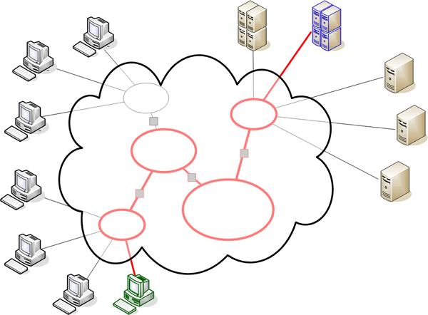
The Internet Layer

Slide 4
The Internet Layer
Provides logical addressing so that data can pass among subnets of different types.
Provides packet routing, the task of sending packets of data (datagrams) from source to destination by sending them to the next network node (router) closer to the final destination
Relates physical addresses (used at the Network Access layer) to logical addresses
Application Layer
DHCP
Transport
Layer
We will also take a quick look at these two protocols
Internet
Layer
IP
ICMP
Network Layer

Slide 5
IPV4 Adresses
An IP address is a 32-bit address.
Binary Notation
10000001 10100101 00001101 11100100
Decimal
129
165
13
228
Hex
81
A5
0D
E4
= 0x81A50DE4

Slide 6
IPV4 Adresses
Change the following IP address from binary notation to dotted-decimal notation.
10000001 00001011 00101000 11101111
129 11 40 239

Slide 7
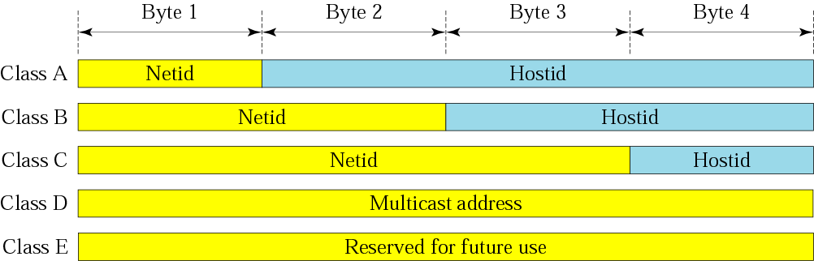
Classful Adressing
Classful addressing, was the Internet's first major addressing scheme. The IP address was 32 bits in size, just as today, but was managed considerably differently.

Slide 8
Network Address
The network address is the first address.
The network address defines the network to the rest of the Internet.
Given the network address, we can find the class of the address, the block, and the range of the addresses in the block

Slide 9
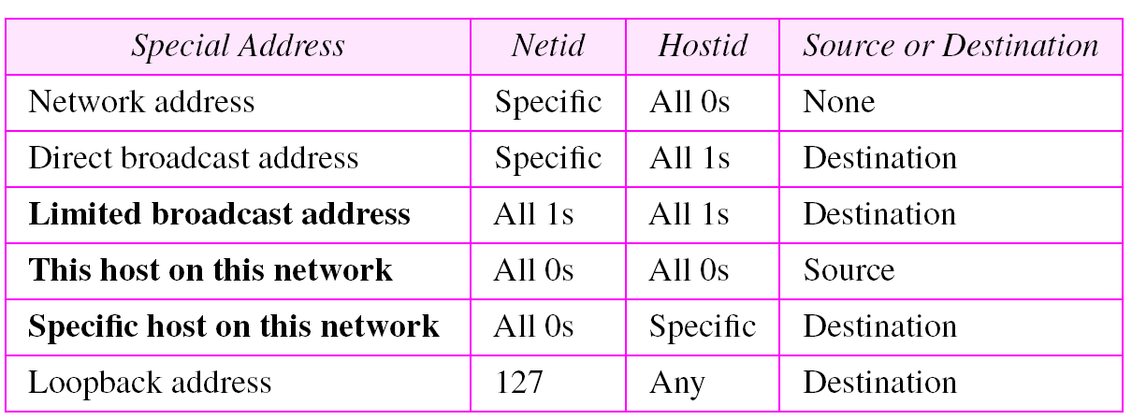
Special Addresses

Slide 10
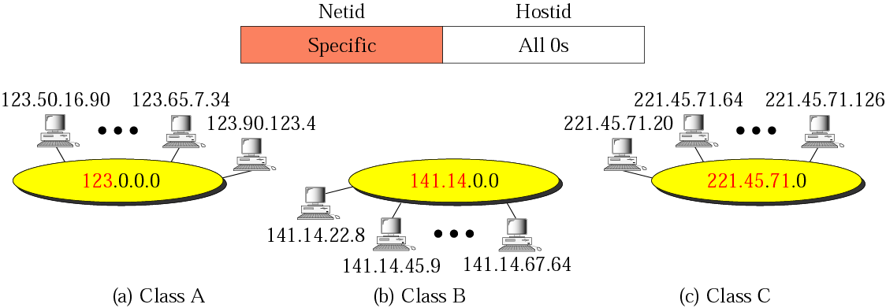
Special Addresses
Network Address
Example of three different network addresses (one for each class)

Slide 11
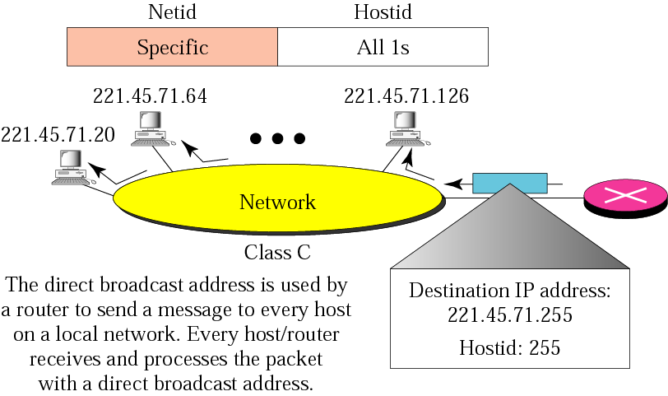
Special Addresses
Direct Broadcast Address

Slide 12
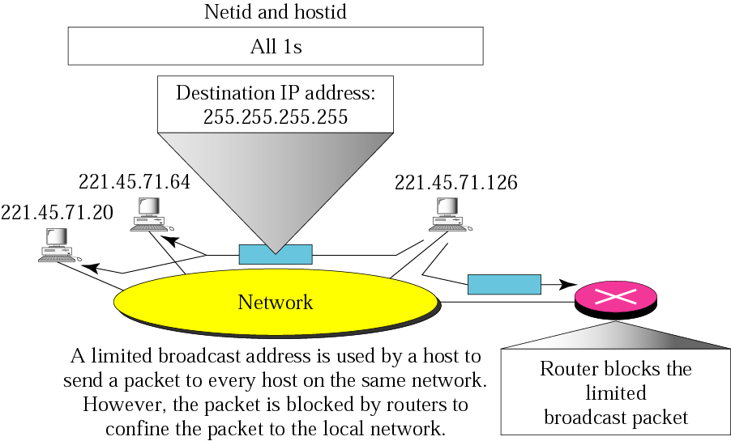
Special Addresses
Limited Broadcast address

Slide 13
Special Addresses
Multicast
Unicast
Broadcast
Multicast
Why Multicast
  Better bandwidth utilization
  Less host/router processing
  Quicker participation
Applications
  Video/Audio broadcast (One sender)
  Video conferencing (Many senders)
  Real time news distribution
  Interactive gaming

Slide 14
Special Addresses
Multicast
IP multicast address | Description
224.0.0.0 | Base address (reserved)
224.0.0.1 | The All Hosts multicast group addresses all hosts on the same network segment.
224.0.0.2 | The All Routers multicast group addresses all routers on the same network segment.
224.0.0.4 | This address is used in the Distance Vector Multicast Routing Protocol (DVMRP) to address multicast routers.
…. | ….

Slide 15
Special Addresses
Private IPV4 Address Ranges
IANA-reserved private IPv4 network ranges
 | Start | End | No. of addresses
24-bit block ClassA | 10.0.0.0 | 10.255.255.255 | 16777216
20-bit ClassB | 172.16.0.0 | 172.31.255.255 | 1048576
16-bit block Class C | 192.168.0.0 | 192.168.255.255 | 65536
Used with NAT (Network Address Translation)

Slide 16
Finding the network address from a MASK
Given the address 23.56.7.91 and the default class A mask (255,0,0,0), find the beginning address (network address).
Solution
ANDing the mask 255.0.0.0 with 23.56.7.91 leaves only the first byte preserved and the other 3 bytes are set to 0s.
The network address is 23.0.0.0.

Slide 17
Investigation our local network
What is your IP right now?
What is the network address of the current network
What is the amount of addresses on the current network?

Slide 18
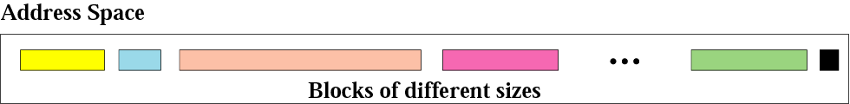
Classless Addressing
On the internes Classful addressing are no longer used, but for local networks connected to the internet it still makes sense.
In classless addressing variable-length blocks are assigned that belong to no class
Restrictions
The number of addresses in a block must be a power of 2 (2, 4, 8, . . .)
The beginning address must be evenly divisible by the number of addresses. For example, if a block contains 4 addresses, the beginning address must be divisible by 4.

Slide 19
IP subnetworks
IP networks may be divided into subnetworks in both IPv4 and IPv6. For this purpose, an IP address is logically recognized as consisting of two parts:
The network prefix
The host identifier
Either the subnet mask or the CIDR (Classless Inter-Domain Routing) prefix determines how the IP address is divided into network and host parts.
Subnet Mask
For example, an IPv4 address and its subnet mask may be 192.0.2.1 and 255.255.255.0.
CIDR notation for the same address:
192.0.2.1/24 (the first 24 bits of the IP address indicate the network and subnet).

Slide 20
CIDR Notation
A.B.C.D/n
The Mask

Slide 21
ex1
A small organization is given a block with the beginning address and the prefix length 205.16.37.24/29 (in slash notation).
What is the range of the block?
How would we write the mask in subnet-mask notation?
Solution
The beginning address is 205.16.37.24. To find the last address we keep the first 29 bits and change the last 3 bits to 1s.
Beginning 11001111 00010000 00100101 00011000
Ending : 11001111 00010000 00100101 00011111
There are only 8 addresses in this block.
Address in subnet notation 205.16.37.24 subnet 255.255.255.248
Address 11001111 00010000 00100101 00011000
Subnet : 11111111 11111111 11111111 11111000
Only 8 addresses in the subnet

Slide 22
ex2
What is the network address if one of the addresses is 167.199.170.82/27?
Solution
The prefix length is 27, which means that we must keep the first 27 bits as is and change the remaining bits (5) to 0s.
The 5 bits affect only the last byte. The last byte is 01010010. Changing the last 5 bits to 0s, we get 01000000 or 64.
The network address is 167.199.170.64/27.

Slide 23
Subnets
When an organization is granted a block of addresses it can create subnets to meet its needs.
The network administrator can design a subnet mask for each subnet (The prefix length (n) increases to define the subnet prefix length).
If the number of subnets is s, the number of extra 1s in the prefix length I log2s
Example
An organization is granted the block 130.34.12.64/26.
The organization needs to have four subnets.
What are the subnet addresses and the range of addresses for each subnet?
What is the amount of available addresses in each subnet

Slide 24
Solution
The suffix length is 6. This means the total number of addresses in the block is 64 (26). If we create four subnets, each subnet will have 16 addresses.
Let us first find the subnet prefix (subnet mask). We need four subnets, which means we need to add two more 1s to the site prefix.
The subnet prefix is then /28.
Subnet 1: 130.34.12.64/28 to 130.34.12.79/28.
Subnet 2: 130.34.12.80/28 to 130.34.12.95/28.
Subnet 3: 130.34.12.96/28 to 130.34.12.111/28.
Subnet 4: 130.34.12.112/28 to 130.34.12.127/28.

Slide 25
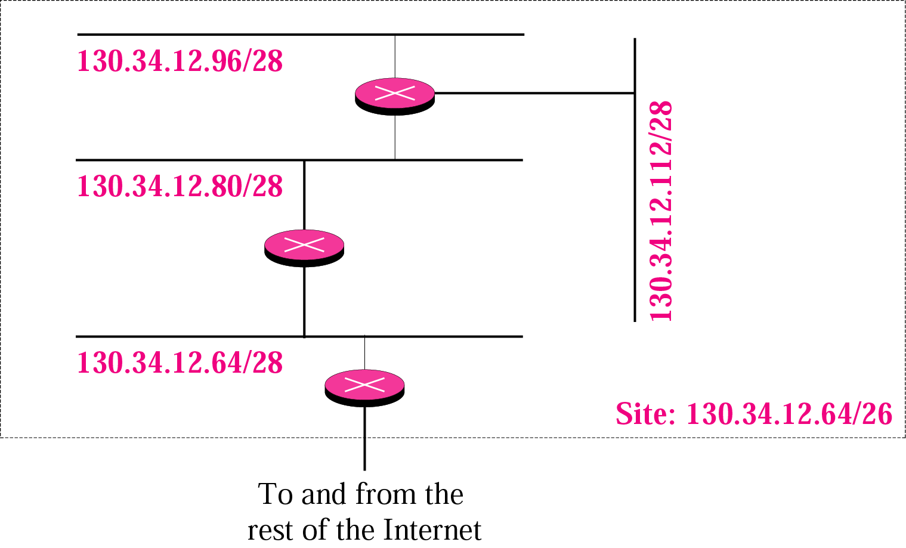
Subnets

Slide 26
Obtaining Network IP-Addresses
In order for an organization to obtain a block of iP-addresses they can :
Contact its own ISP which would provide addresses from a larger block of addresses already allocated to the ISP
Get the block from the Internet Corporation for Assigned Names and Numbers (ICANN) , a non-profit corporation created in 1998 to assume responsibility for IP numbers.

Slide 27
Obtaining Host IP-Addresses
For Routers, IP addresses are usually set by the system administrator
For Host machines there are two ways:
Manual configuration
Use the Dynamic Host Configuration Protocol
  DHCH allows a host to obtain an IP address automatically, as well as learn additional information, such as the address of the default gateway (first hop router) and the DNS server.
CMD

Slide 28
IPV6 – In one slide
Internet Protocol version 6 (IPv6) is the latest revision of the Internet Protocol (IP), the communications protocol that routes traffic across the Internet. It is intended to replace IPv4, which still carries the vast majority of Internet traffic as of 2013
IPv6 has these advantages over IPv4:
Larger address space IPv6 uses a 128-bit address, allowing for 2¹²⁸, or more than 7.9×10²⁸ times as many as IPv4, which uses 32-bit addresses.
Better header format
New options
Allowance for extension (protocol can be extended if necessary)
Support for resource allocation
Support for more security (encryption and authentication options provide confidentiality)

Slide 29
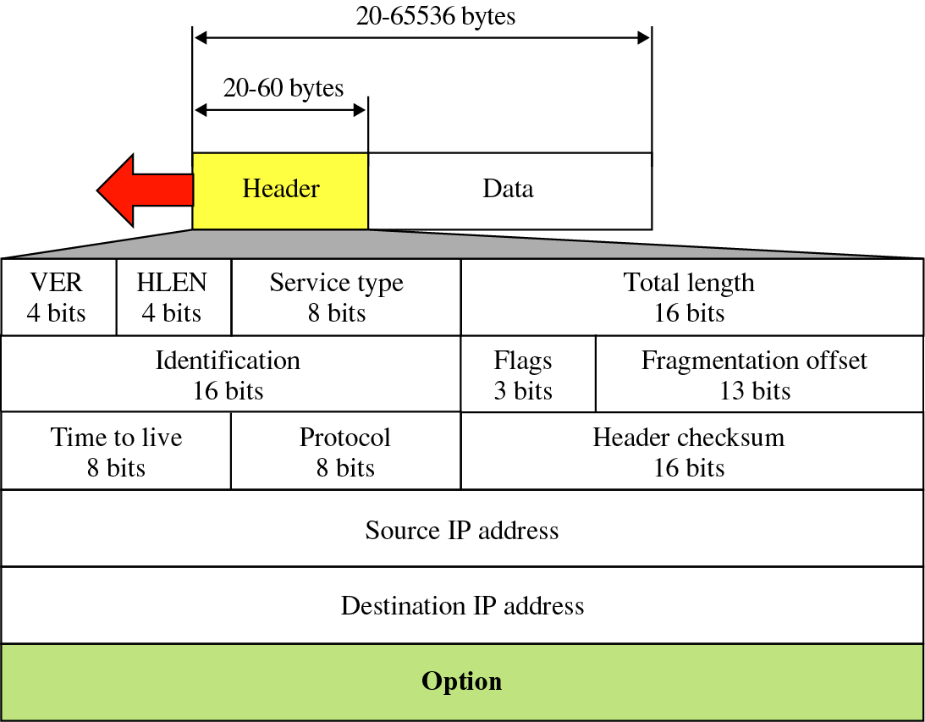
The IP Header
Header length (bytes) Necessary, since header length can vary (but usually 20 bytes)
Giving a minimum overhead of 40 bytes for a TCP packet
Typically a TCP or UDP segment
Total datagram
length (bytes)
IP protocol version
number
Upper layer protocol
to deliver payload to.
  ICMP: 1
  TCP: 6
  UDP: 17

Slide 30
The IPV4 Datagram
Time to live field (TTL) is include to ensure that datagrams do not circulate forever (due for example, a long-lived router loop.
This value is decremented each time the datagram is processed by a router.
Related to IP-fragmentation

Slide 31
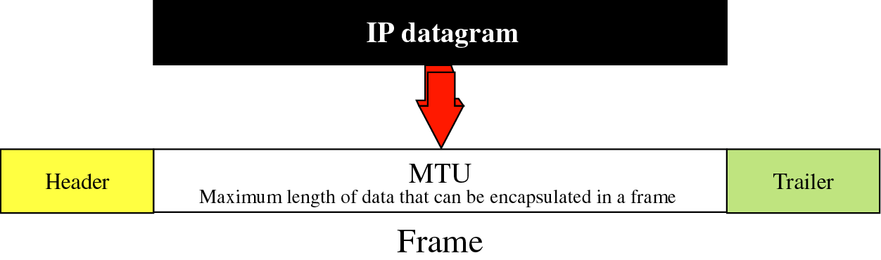
IP Fragmentation
Not all network layer protocols can carry packets of the same size. Some protocols can carry packets up to 2¹⁶ bytes, while for example Ethernet can carry no more than 1500 bytes of data.
The maximum amount of data that a network layer packet can carry is called the
MTU (Maximun Transfer Unit)
This is not a problem on a single network, but if an IP-packet goes through a router (which will decapsulate the frame, process it, and encapsulate it in its own frame) this causes problem if the network protocols on each side of the router uses different MTU values.

Slide 32
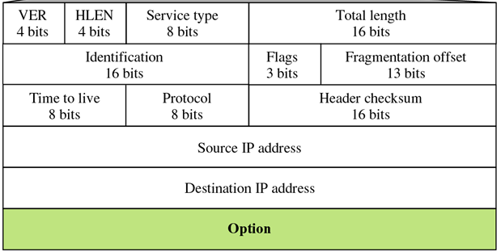
Fields related to fragmentation
An 16-bit identifying value that the sender assigns to aid in assembling a datagram’s fragments.
In order to create unique values, a counter is incremented each time a new set of fragments is created.

Slide 33
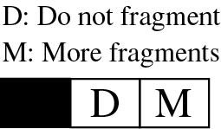
Fields related to fragmentation
Bit | Description
1 | Bit is reserved
2 | The ”Do Not Fragment” bit. If this value is set, and the router cannot pass the data through any available network, it discards the packet and sends and ICMP error to the source host.
3 | The ”More Fragment” bit. If set, it means this is not the last fragment (others are following). If unset, it means this is the last (or only) fragment.

Slide 34
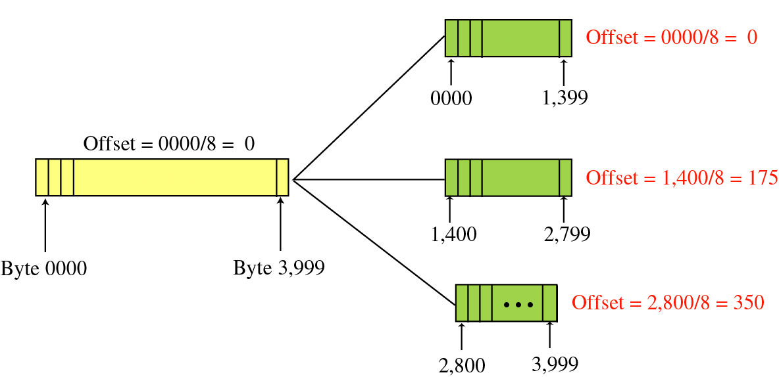
Fields related to fragmentation
This 13-bit field shows the relative position of this fragment with respect to the whole datagram
The offset is measured in units of 8 byte (since otherwise we could not have represented sequences larger than 8191)
Hosts, or routers that fragments datagram must therefore chose the size of each fragment so that it is divisible by 8

Slide 35
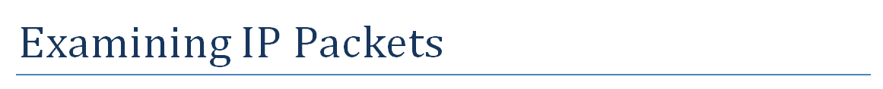
Exercise

Slide 36
Routing

Slide 37
Routing
Routing is the process of moving a packet of data from source to destination.
It is either performed by a dedicated device called a router or a traditional computer with more than one network interface, acting as a router.
Routing is a key feature of the Internet because it enables messages to pass from one computer to another and eventually reach the target machine.
Each intermediary computer performs routing by passing along the message to the next computer. Part of this process involves analyzing a routing table to determine the best path.

Slide 38
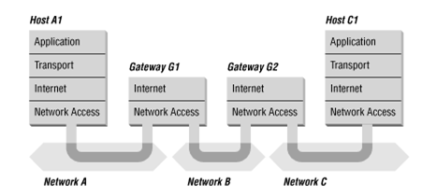
Routers in one slide ;-)
The router receives data from one of its attached networks.
The router passes the data up the protocol stack to the Internet layer. In other words, the router discards the Network Access layer header information and reassembles (if necessary) the IP datagram.
The router checks the destination address in the IP header.
If the data is destined for a different network, the router consults a routing table to determine where to forward the data.
After the router determines which of its adapters will receive the data, it passes the data down through the appropriate Network Access layer software for transmission through the adapter.

Slide 39
Routing Types
Static routing
Requires the network administrator to enter route information manually.
Dynamic routing
Builds the routing table dynamically based on routing information obtained one of the dynamic routing protocols such as RIP, OSPF, or BGP.
Obviously static routing does not adapt well to large networks with hundreds of possible routes that constantly might change.
But due time given, we will NOT focus on routing protocols/-algorithms.

Slide 40
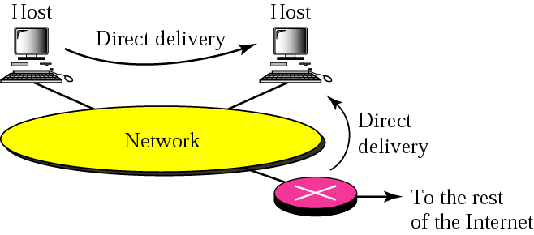
Direct Routing
When a host can send an IP packet to another host without going through a router, the route the packet will travel is said to be a “direct route”.
The sender can easily determine if the delivery is direct, by extracting the network address of the destination and compare this to the network address to which it is connected.

Slide 41
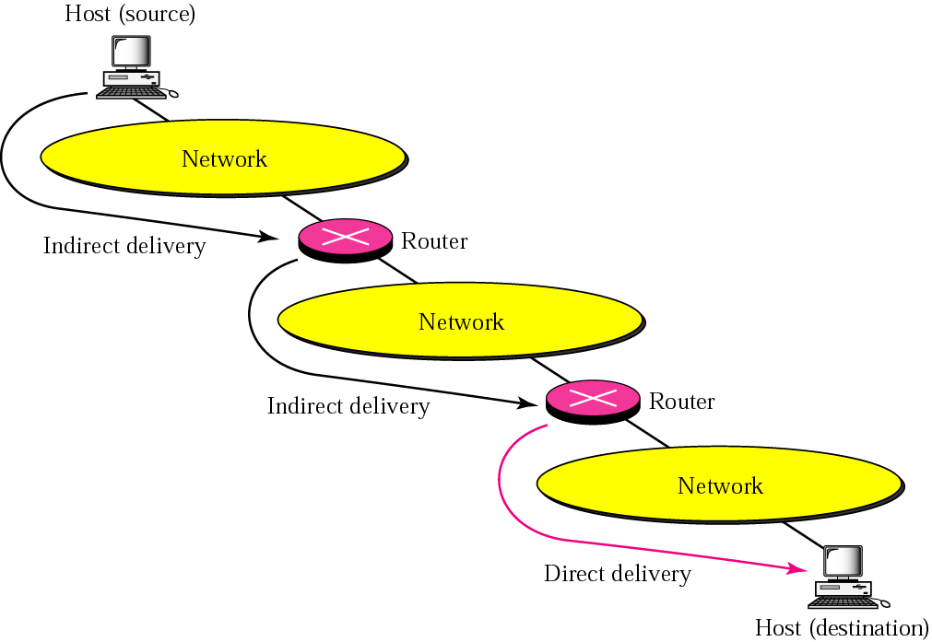
Indirect Routing
When a packet from host A to B must go through a Router, the route the packet will travel is said to be an "indirect route".
The router, has connections to more than one network and is said to provide a gateway between the networks. Therefore, a router may also be called a "network gateway"

Slide 42
Forwarding
IP forwarding means to place the packet in its route to the destination.
Forwarding requires a host or a router to have a routing table.
When a host or a router has a packet to be forwarded, it looks in this table to find the route to the final destination.
Obviously a single host or router can not hold all entries to give all routes through the internet
The following slides will briefly introduce methods to make these tables more manageable.
(In general most routing software determines its route through a shortest path algorithm)

Slide 43
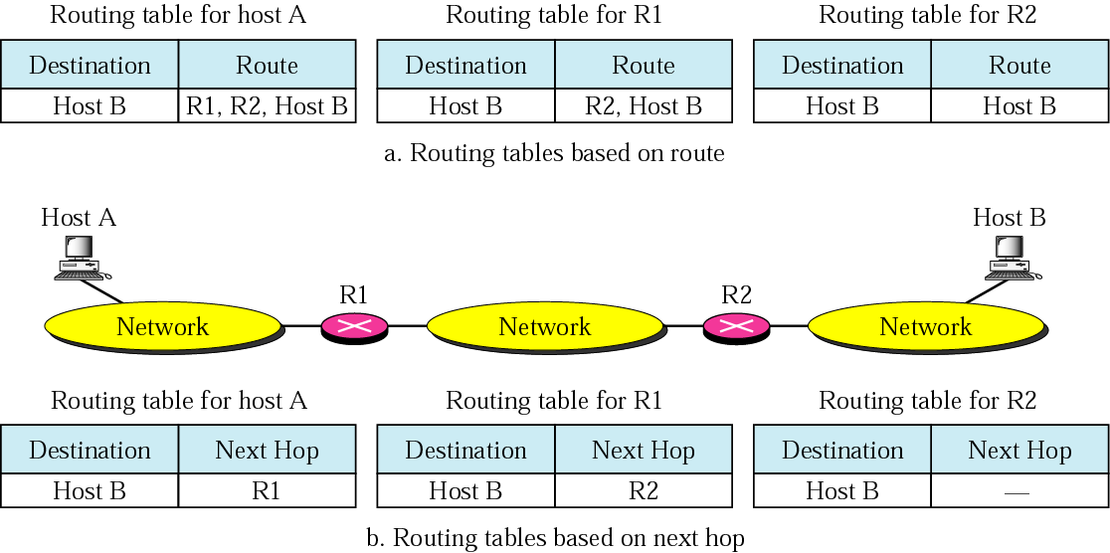
Next Hop Routing

Slide 44
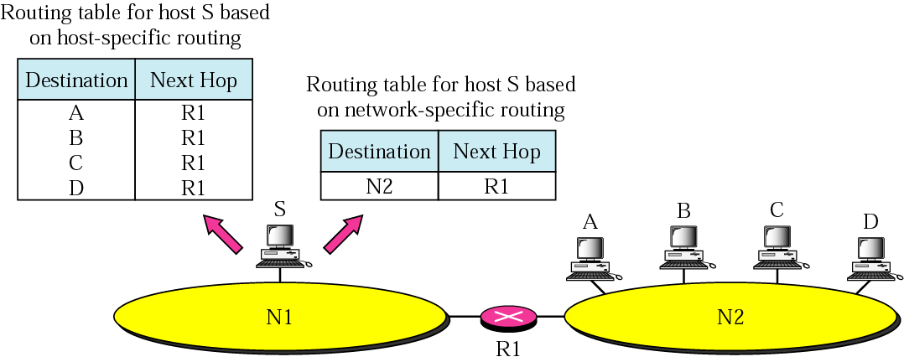
Network Specific Routing
Instead of having an entry for every distination host connected to the same physical network, we have only one entry that defines the route to the destination network itself.

Slide 45
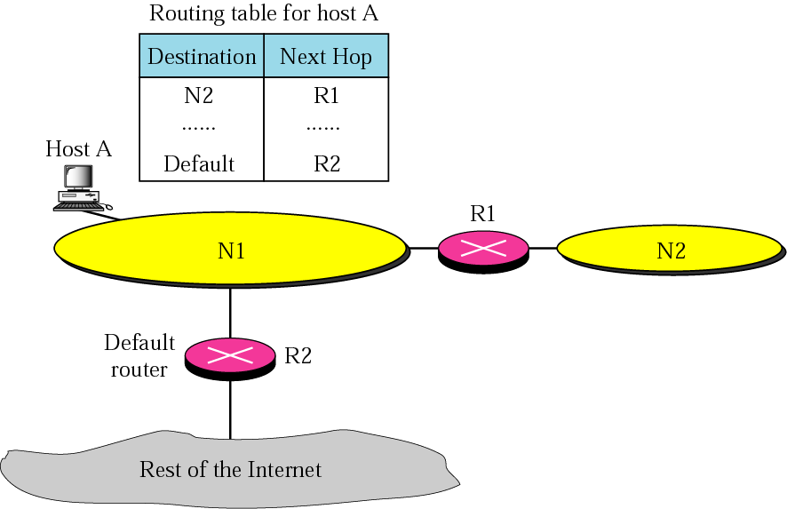
Default Routing
Router R1 routes packages to Network N2. For the rest of the internet Router R2 is used.
So instead of listing all networks in the entire internes host A can just have one entry called the default (normally defined as network address 0.0.0.0)
Test Route print

Slide 46
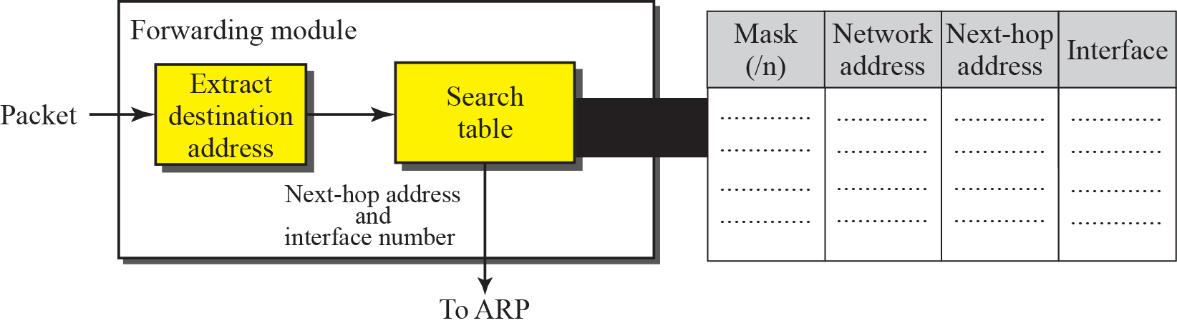
Forwarding with classless addressing
Address Resolution Protocol
(will be dealt with next week)

Slide 47
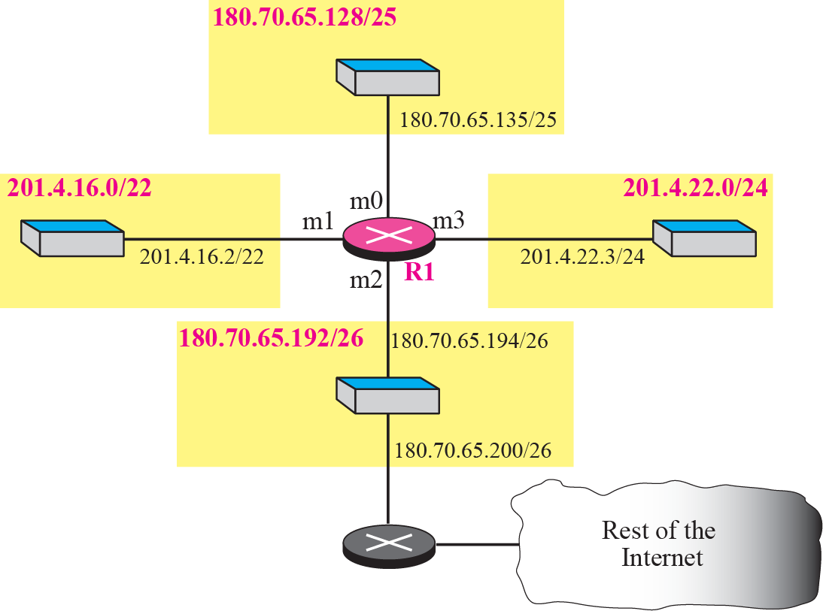
Example
Make a routing table for router R1 using the configuration shown below

Slide 48
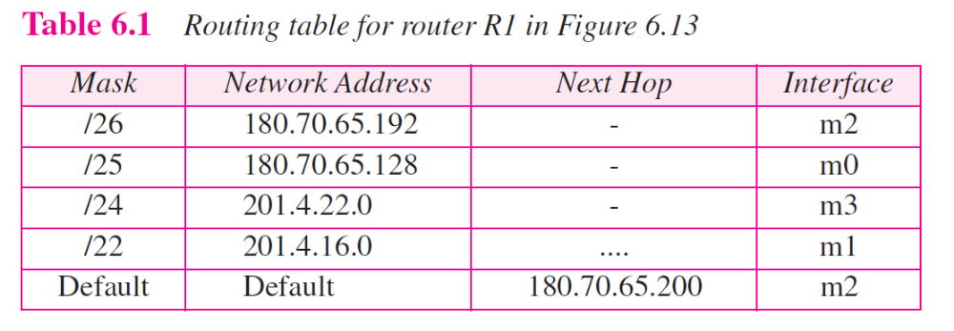
Routing Table
Solution

Slide 49
Example -1
Show the forwarding process if a packet arrives at R1 (previous slide) with the destination address 180.70.65.140.
Solution
The router performs the following steps:
The first mask (/26) is applied to the destination address. The result is 180.70.65.128, which does not match the corresponding network address.
The second mask (/25) is applied to the destination address. The result is 180.70.65.128, which matches the corresponding network address. The next-hop address (the destination address of the packet in this case) and the interface number m0 are passed to ARP in the network layer for further processing.

Slide 50
Example-2
Show the forwarding process if a packet arrives at R1 with the destination address 201.4.22.35
Solution
The router performs the following steps:
The first mask (/26) is applied to the destination address. The result is 201.4.22.0, which does not match the corresponding network address (row 1).
The second mask (/25) is applied to the destination address. The result is 201.4.22.0, which does not match the corresponding network address (row 2).
The third mask (/24) is applied to the destination address. The result is 201.4.22.0, which matches the corresponding network address.

Slide 51
Example-3
Show the forwarding process if a packet arrives at R1 with the destination address 18.24.32.78
Solution
This time all masks are applied to the destination address, but no matching network address is found. When it reaches the end of the table, the module gives the next-hop address 180.70.65.200 and interface number m2 to ARP in the network layer. This is probably an outgoing package that needs to be sent, via the default router, to someplace else in the Internet.

Slide 52
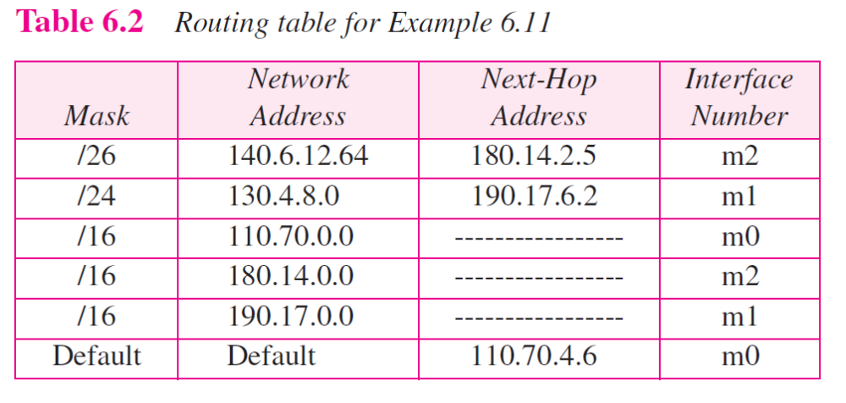
Ex. Topology from a table
Now let us give a different type of example. Can we find the configuration of a router if we know only its routing table? The routing table for router R1 is given in below. Can we draw its topology?

Slide 53
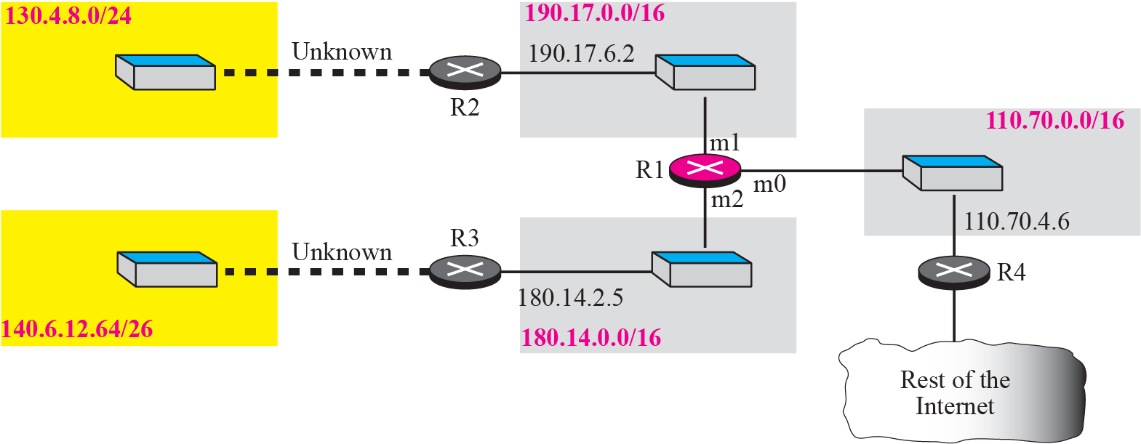
Solution Topology from a table
We know some facts but we don’t have all for a definite topology. We know that router R1 has three interfaces: m0, m1, and m2. We know that there are three networks directly connected to router R1. We know that there are two networks indirectly connected to R1. There must be at least three other routers involved (see next-hop column). We do not know if network 140.6.12.64 is connected to router R3 directly or through a point-to-point network (WAN) and another router.

Slide 54
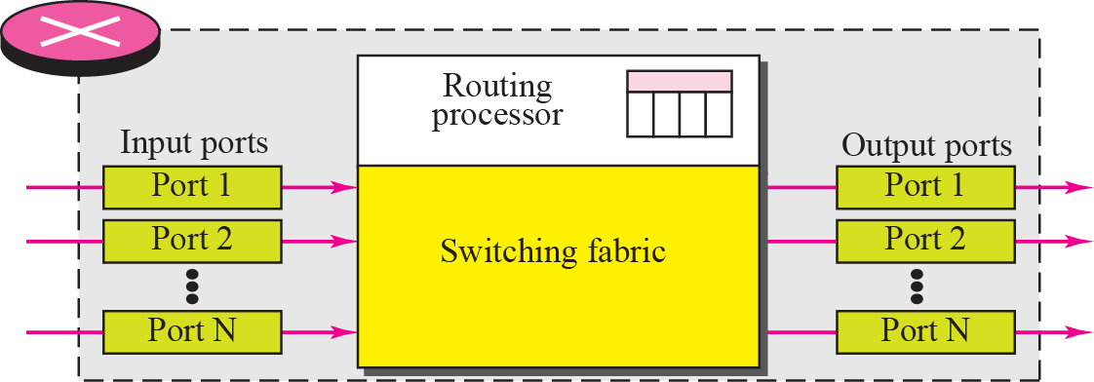
Structure of a router

Slide 55
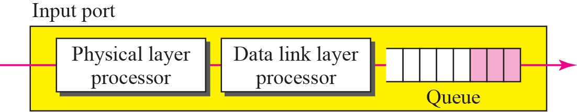
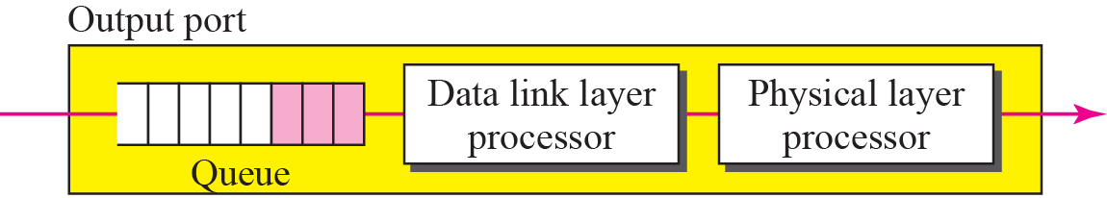
Structure of a router

