Slide 1


Computer Networks – 4
TCP/IP’s Network Layer (Link + physical layer)
The ARP + RARP protocol
Lars Mortensen
Literature:
TCP/IP Protocol Suite, Forouzan - chapter 3+7 (slides are based on these chapter)
http://en.wikipedia.org/wiki/Internet_protocol_suite
http://en.wikipedia.org/wiki/Address_Resolution_Protocol

Slide 2
Learning Goals
Network - Week 5
Main Topics | TCP/IP’s Network Layer (the Link and physical layer) Network devices ARP and RARP
When this lesson is over you should be able to: | Explain about the TCP/IP’s Network Layer (the Link and physical layer) Explain about Ethernet, types, and the fundamentals of CSMA/CD Explain about the Ethernet Frame Explain about IEEE 802.11 and how the Media Access Protocol differs from wired Ethernet Explain about network devices like, Repeaters, Hubs, Bridges, Routers and Switches. Explain about ARP and RARP and the Arp Packet Use relevant tools to monitor and explain Ethernet, ARP and RARP packets.

Slide 3

The Layers – a refresher ☺

Slide 4
The Underlying Technologies
The TCP/IP model in general does not consider physical specifications, rather it assumes a working network infrastructure that can deliver media level frames on the link.
Therefore RFC 1122 and RFC 1123, the definition of the TCP/IP model, do not discuss hardware issues and physical data transmission and set no standards for those aspects, other than broadly including them as link-layer components
Application Layer
Transport Layer
Provides an interface with the network adapter; maintains logical links for the subnet
Internet Layer
Link Layer
Converts the data into the stream of electric or analog pulses that will actually cross the transmission medium
Physical Layer

Slide 5
The Network Layer
We will use this an excuse ;-) to touch this layer only very briefly mainly argued in lack of time.
We will take a quick look at Lan tecnologies
The ARP and RARP protocols
And finally we will introduce a number of network devices
Application Layer
Transport Layer
Internet Layer
ARP
Link Layer
RARP
Physical Layer

Slide 6
Local Area Networks
A local area network (LAN) is a computer network that interconnects computers in a limited area such as a home, school, computer laboratory, or office building using network media.
The defining characteristics of LANs, in contrast to wide area networks (WANs), include their usually higher data-transfer rates, smaller geographic area, and lack of a need for leased telecommunication lines.
Today the two most common technologies currently used to build LANs are:
  Ethernet over twisted pair cabling
  Wi-Fi

Slide 7
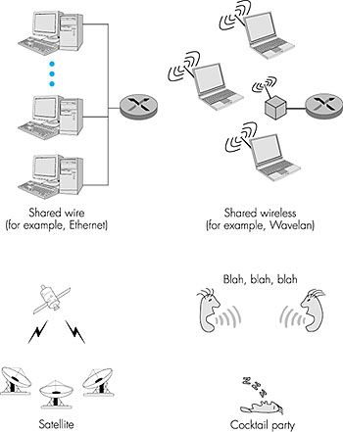
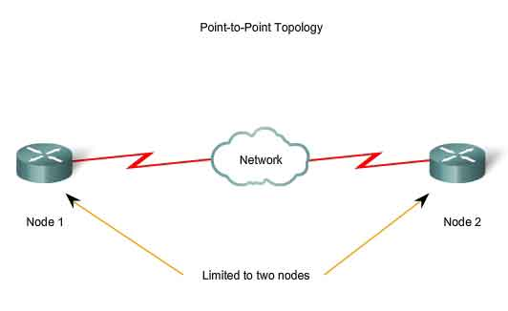
Network links
Two types of network links exists:
Point to point Links
Broadcast links
Broadcast links
Point to point Link

Slide 8

Multiple Access Protocols
A central problem with Multiple Access Protocols is who gets to talk (transmit)
An example:
A classroom, with broadcast medium air using a Human protocol
“Give everyone a chance to speak”
“Don’t speak until you are spoken to”
“Don’t monopolize the conversation”
“Raise your hand if you have a question”
“Don’t interrupt when someone is speaking”
“Don’t fall asleep when someone else is talking”
If more than 2 users send at the same time a
Collision will occur

Slide 9
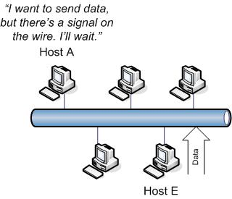
Access Method CSMA/CD
Carrier Sense Multiple Access with Collision Detection
The first rule of CSMA/CD is this: Any host on the segment that wants to send data must check the segment to see if another host is already sending data.
This is called "listening to the wire", and is the Carrier Sense part of CSMA/CD
All the hosts on the segment will do this - that's the Multiple Access part
http://www.thebryantadvantage.com/Network+FreeTutorialCollisionDomainsAndSwitches.htm

Slide 10
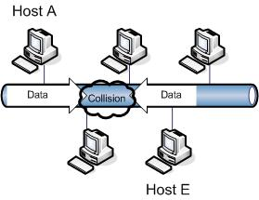
Access Method CSMA/CD
Carrier Sense Multiple Access with Collision Detection
If Host A and Host E listen to the wire at the exact same time, determine that no one else is sending data, and then send their data onto the segment at the same time, a collision will occur.
http://www.thebryantadvantage.com/Network+FreeTutorialCollisionDomainsAndSwitches.htm

Slide 11
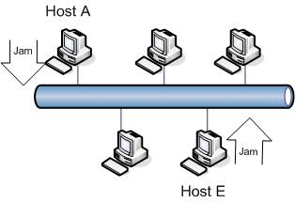
Access Method CSMA/CD
Carrier Sense Multiple Access with Collision Detection
Collisions cause what we refer to as "noise", but is really a change in the voltage of the signals on the wire.
The sending hosts detect this voltage change
The hosts that send the now-useless data will send a jam signal out to tell the other stations not to send data at this time due to the collision
http://www.thebryantadvantage.com/Network+FreeTutorialCollisionDomainsAndSwitches.htm

Slide 12
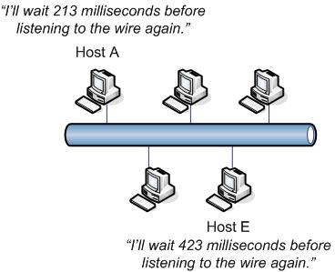
Access Method CSMA/CD
Carrier Sense Multiple Access with Collision Detection
Both Host A and Host E need to retransmit their data.
To avoid a new collision, both hosts will start a random timer that determines how long it will be until they begin the entire CSMA/CD process again by listening to the wire.
Since this random timer is set in milliseconds, the chance of both hosts setting this timer to the exact same value is remote at best
http://www.thebryantadvantage.com/Network+FreeTutorialCollisionDomainsAndSwitches.htm

Slide 13
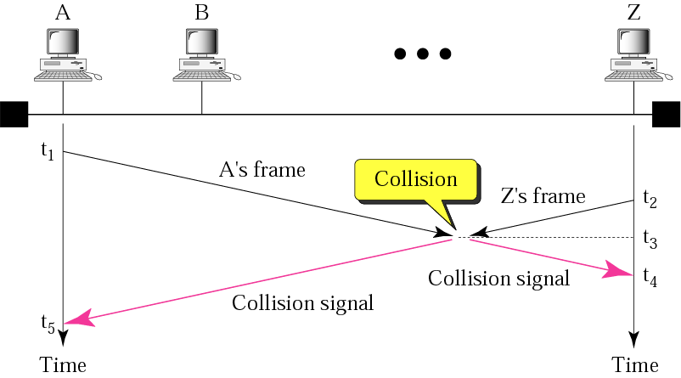
Access Method CSMA/CD
Carrier Sense Multiple Access with Collision Detection
Three factors are related in the CSMA/CD standard:
The minimum frame length (520 bit (65B) for a traditional 10 Mbps Ethernet)
The data transmission rate
The collision Domain (the maximum network distance)
Minimum frame length/Transmission rate is proportional to
Collision domain / Propagation speed

Slide 14
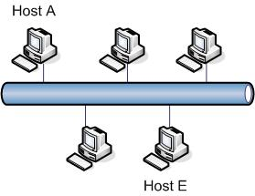
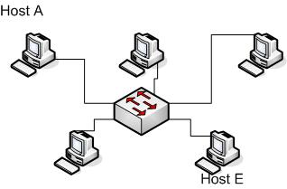
Access Method CSMA/CD
Carrier Sense Multiple Access with Collision Detection
The bus topology used in the previous example is rarely used anymore.
It's much more efficient to have a switch connecting separate hosts where each host is connected to its own dedicated switch port.
Each switch port is a collision domain, so when hosts are all connected to their own port, collisions no longer occur.
CSMA/CD is however still very much relevant for WIFI networks
http://www.thebryantadvantage.com/Network+FreeTutorialCollisionDomainsAndSwitches.htm

Slide 15
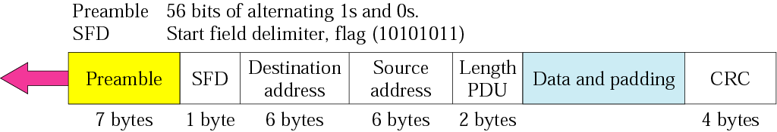
The Ethernet Frame
The preamble is not typically used in modern ethernet networks as it’s function is to provide signal startup time for 10Mbps ethernet signals.
Modern 100Mbps, 1000Mbps or 10Gbps ethernet use a technique, which avoids the need for the preamble.
The preamble is preserved to avoid making any changes to the Ethernet frame format.
The start of frame delimiter is a 1 byte field that serves as a signal to the Network Interface Controller (NIC) that the data immediately following the SFD is the beginning of the actual frame

Slide 16
The Ethernet Frame
The MAC address for the source “transmitting system” and the destination “target system”.
Carries data encapsulated from the upper layer protocols.
It is a minimum of 46 bytes and maximum of 1500 bytes.
WHY is there a minimum value?
(Padding fills up to the minimum value, if necessary)
Meaning depends on the value:
If < 1518 : Defines the length of the data that follows
If > 1536 : Defines the upper layer protocol
The end of the frame contains a 32 bit field which is a Cyclic Redundancy Checksum (CRC).
This is a mechanism to check the integrity of a frame upon arrival at it’s destination.

Slide 17
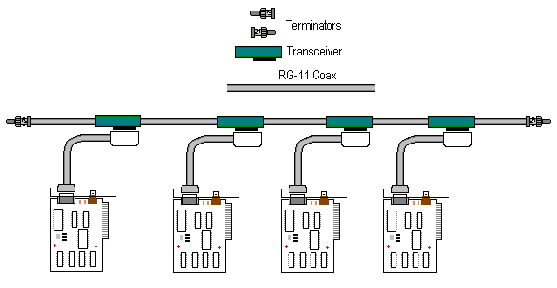
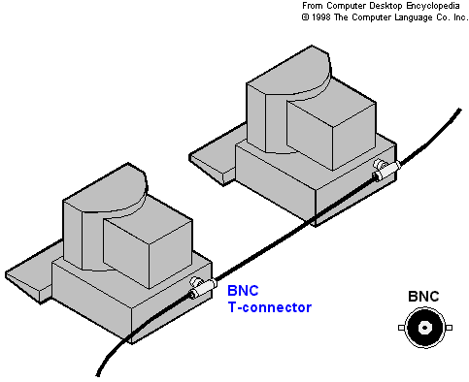
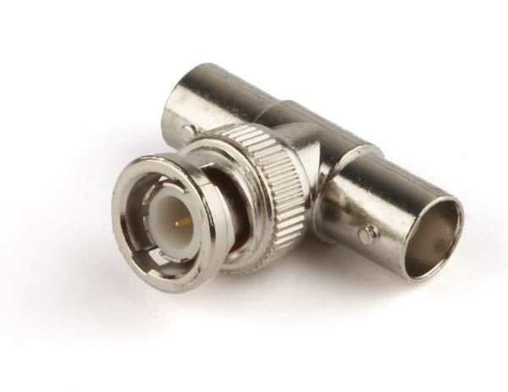
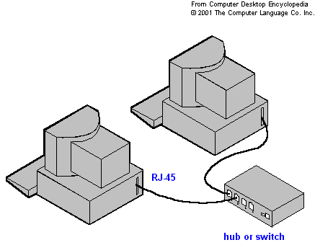
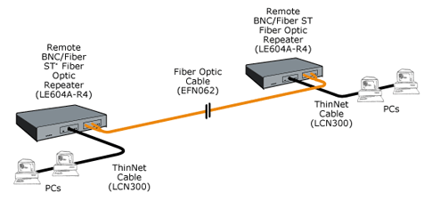
Ethernet Implementations
Traditional Ethernet
10BASE5
10BASE2
10BASE-T
10BASE-FL

Slide 18
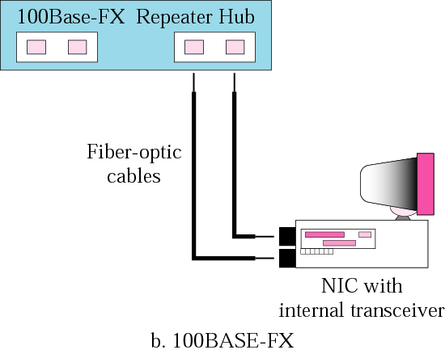
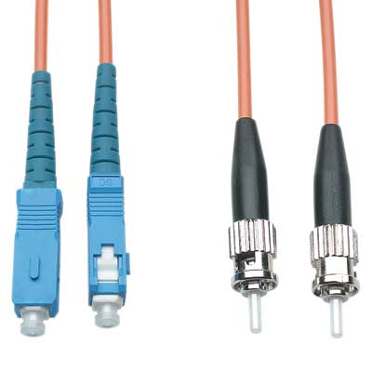
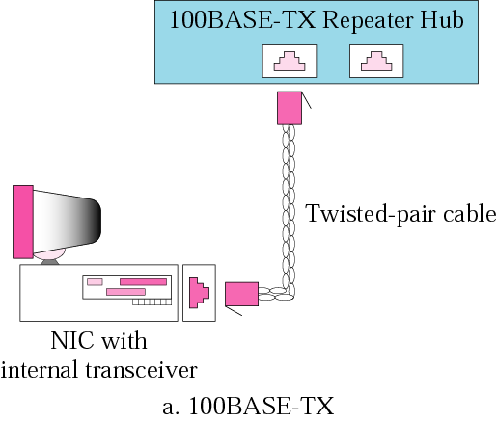
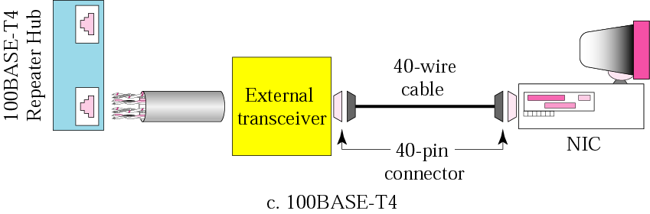
Ethernet Implementations
Fast Ethernet

Slide 19
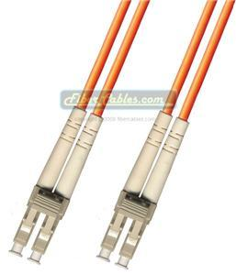
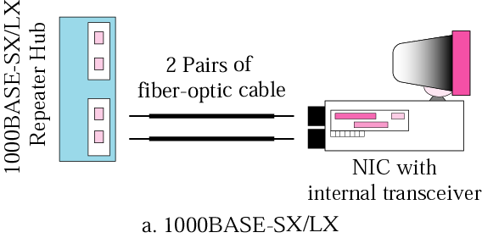
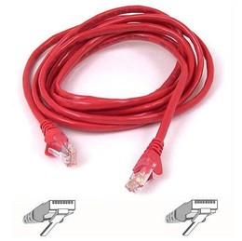
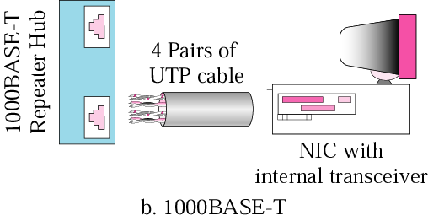
Ethernet Implementations
Gigabit Ethernet

Slide 20
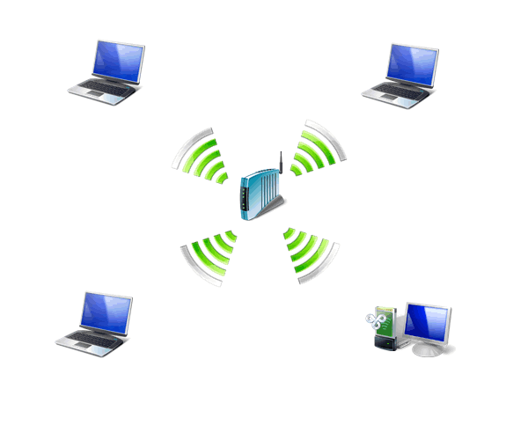
Wireless LANs: IEEE 802.11
The IEEE 802.11 group of standards specify the technologies for wireless LANs.
802.11 standards use the Ethernet protocol and CSMA/CA (carrier sense multiple access with collision avoidance)
It include an encryption method, the Wired Equivalent Privacy algorithm.

Slide 21
Wireless LANs: IEEE 802.11
Architecture
The standard defines two kind of services:
BSS: Basic Service Set , the building block of a wireless LAN
ESS: Extended Service set

Slide 22
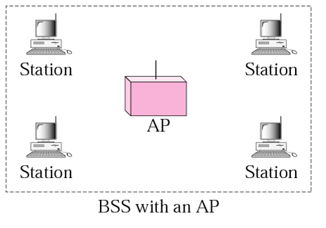
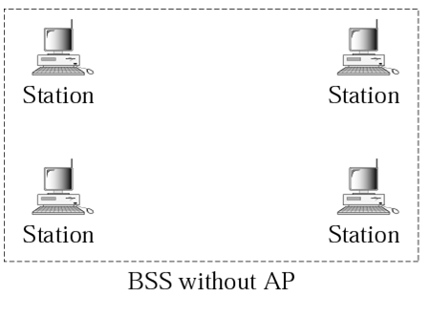
Wireless LANs: IEEE 802.11
BSS Basic Service Set
In this topology, all stations within the BSS communicate with each other through an access point (AP). In this situation, the AP establishes the BSS network. In addition, an infrastructure BSS can consist of more than one interconnected APs that establishes an extended service set (ESS) network
In this topology, all stations within the BSS communicate directly with each other. In this situation, one station creates, or starts, the BSS network and other stations join the BSS network
IBSS networks, also known as "ad hoc" networks, provide limited support for 802.11 authentication, authorization, and privacy services for the BSS network

Slide 23
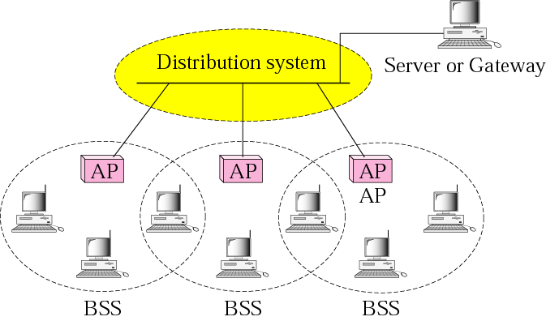
Wireless LANs: IEEE 802.11
ESS Extended Service Set
One or more interconnected basic service sets (BSSs) and their associated LANs. Each BSS consists of a single access point (AP) together with all wireless client devices (stations, also called STAs) creating a local or enterprise 802.11 wireless LAN (WLAN).
Note that a mobile station can belong to more than one BSS at the same time

Slide 24
Wireless LANs: IEEE 802.11
Media Access Protocol
IEEE 802.11 use an access method called Carrier Sense Multiple Access with Collision Avoidance (CSMA/CA).
The first two principles of CSMA/CD also apply to (CSMA/CA):
Each station has equal access to the medium (multiple Access)
Each station senses the medium before sending
However collision detection is NOT applicable mainly because of the Hidden Terminal Problem.

Slide 25
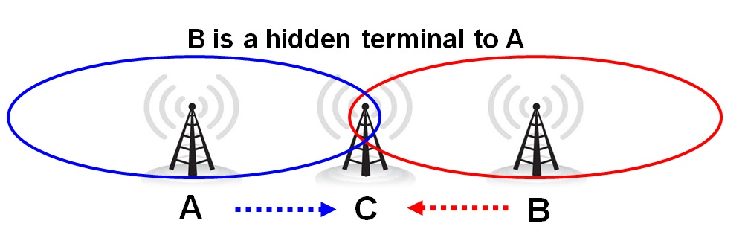
Wireless LANs: IEEE 802.11
The Hidden Terminal Problem
A problem that manifests in wireless networks where some of the nodes are unaware of each other. Specifically, it can occur when all nodes are within signal range of the network's access point, but some are out of range of each other

Slide 26
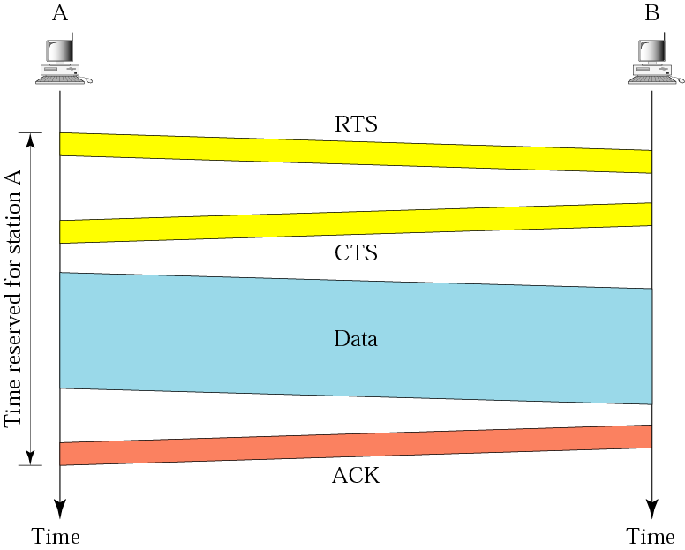
Wireless LANs: IEEE 802.11
CSMA/CA
Since we can not rely on collision detection, collisions must be avoided
After sensing that the media is idle, sends a special frame Request To Send (RTS). In this message the sender defines the total time it needs the medium
The Receiver, acknowledges the request via a Clear To Send (CTS) message sent to all.
All other stations that hearing the RTS and CTS can now avoid interfering in the transmission.
The sender sends the Data Frame
The Receiver acknowledges the receipt of the data (necessary since the sender has no guarantee that data has arrived without a collision)

Slide 27
Network Devices

Slide 28
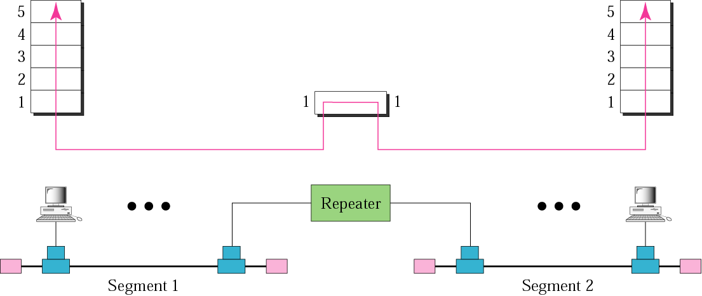
Network Devices
Repeaters
A network repeater is a device used to expand the boundaries of a wired or wireless LAN.
It operates on the lowest (physical) network layer
A repeater does not connect two different LAN’s, it connects two segments of the same LAN
A Repeater forwards every bit it receives, it has no filtering capability.
Modern Ethernet networks typically use more sophisticated switching devices, leaving repeaters as device more useful for with wireless LANs (WLANs).

Slide 29
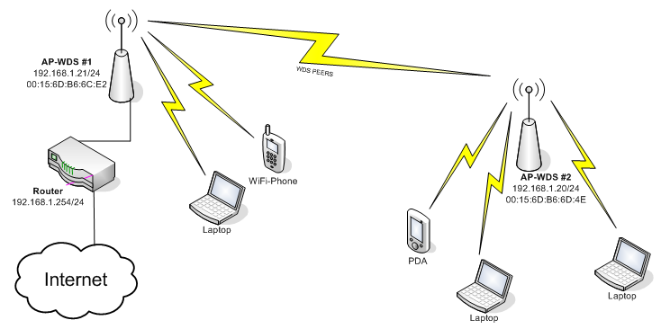
Network Devices
Wireless Repeater

Slide 30
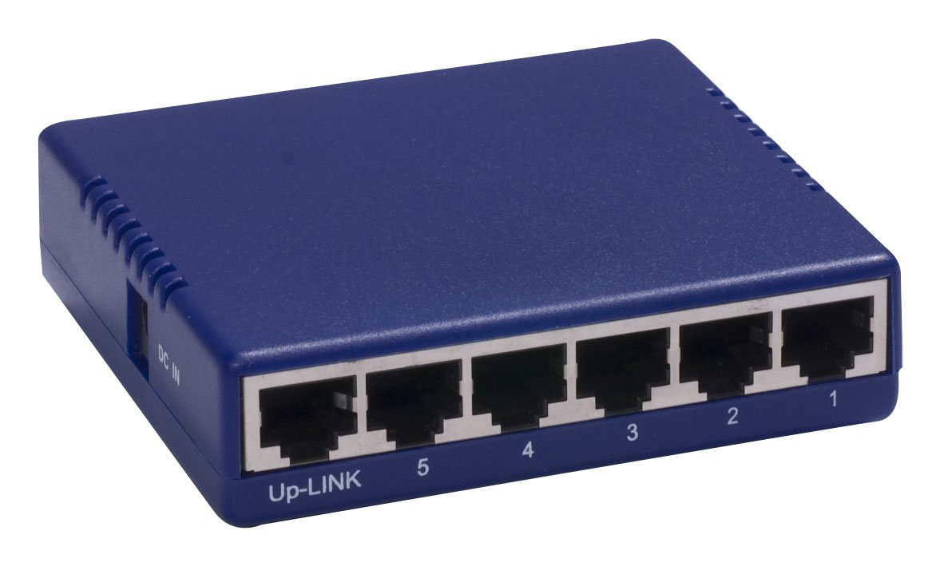
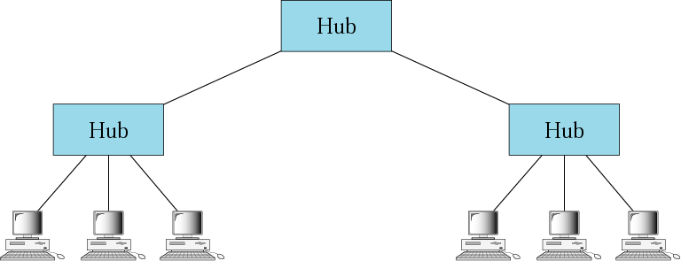
Network Devices
Hubs
A network hub is like a multiport repeater.
It operates on bits, that is on the lowest (physical) network layer
Like a repeater it does not connect different LAN’s, but connects segments of the same LAN
All packages received are broadcasted to all interfaces
A Repeater forwards every bit it receives, it has no filtering capability.
Historically, the main reason for purchasing hubs rather than switches was their price. This motivator has largely been eliminated by reductions in the price of switches, but hubs can still be useful in special circumstances, for example insert a protocol analyzer into a network

Slide 31
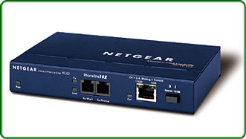
Network Devices
Bridges
A network Bridge operate in both the physical and data link layer
  A physical layer device it regenerates the signal it receives
  As a data link layer the bridge checks the MAC address contained in a frame
Like a repeater it does not connect different networks, but connects segments witch together forms a LAN (since it does not operate on the IP layer).
In contrast to the repeater/hub, it provides isolated Collision Domains, so in theory we could build a LAN, spanning the whole globe with bridges
Bridges can combine segments using different Ethernet technologies for example Fast Ethernet with Gigabit Ethernet.
It is self-learning (plug-and play)

Slide 32
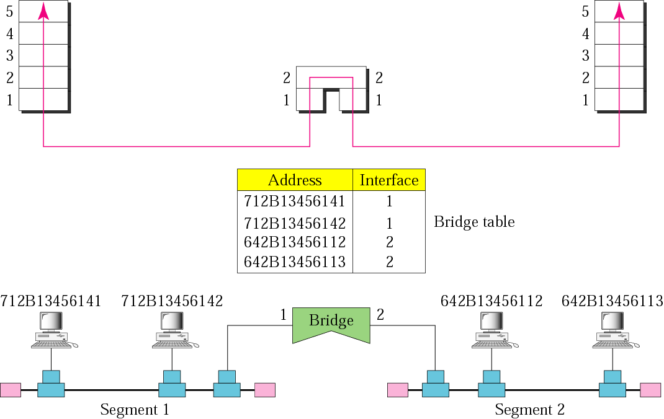
Network Devices
Bridges – self learning
When a frame arrives on one of the interfaces, and the frame’s destination address is not in the table the bridge forwards the frame to all its other interfaces.
For each frame received, the bridge store in it’s table the address and the interface from which the frame arrived
When a frame arrives on an interface, and the frame destination address is in the table the bridge forwards the frame to appropriate interface.
The bridge deletes an address in the table after a given amount of time (the aging time)

Slide 33
Network Devices
Routers
A Router is a three layer device
  As a physical layer device it regenerates the signal it receives
  As a data link layer device it checks the MAC address contained in a frame
  As a IP layer device it checks the network addressed in the IP packets
A Router connects independent networks (LANS or WANS ) to create an internetwork whereas a Bridge connect segments of a LAN
A Router changes the physical address in a packet
Application
Application
Transport
Transport
Internet
Internet
Internet
Link
Link
Link
Link
Physical
Physical
Physical
Physical

Slide 34
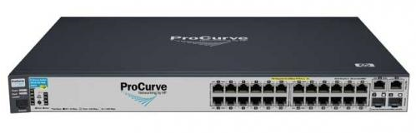
Network Devices
Switches
A switch is more or less the same as a Bridge, typically just with a may more ports
One difference however is, that switches can operate in full duplex mode (send an receive at the same time) while bridges only operate in half duplex.
The great advantage over the Hub´, is that a switch is only forwards packets to the appropriate interface.
As mentioned before, due to pricing Switches has almost completely replaced the market for hubs.

Slide 35
ARP
Address Resolution Protocol (ARP) is a protocol used for resolution of network layer addresses into link layer addresses.
It is Internet Standard STD 37.
It is also the name of the program for manipulating these addresses in most operating systems
Application Layer
Transport
Layer
Internet
Layer
ARP
Network Layer
RARP

Slide 36
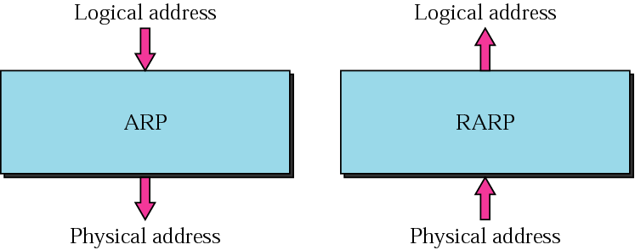
ARP and RARP

Slide 37
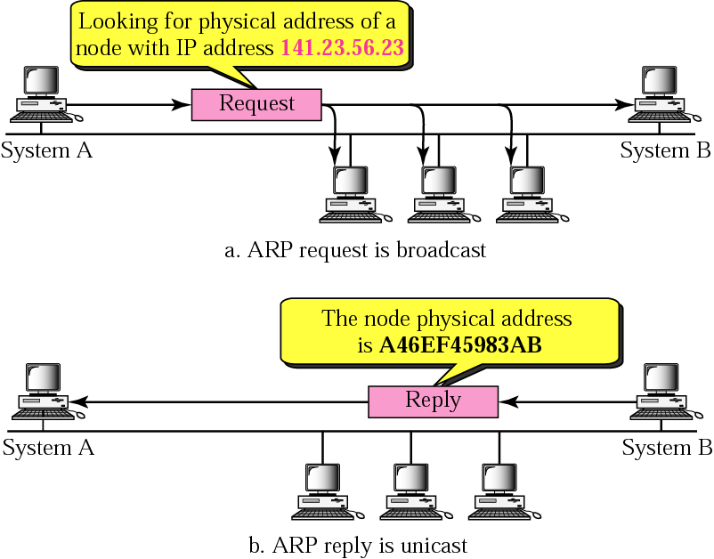
ARP operation

Slide 38
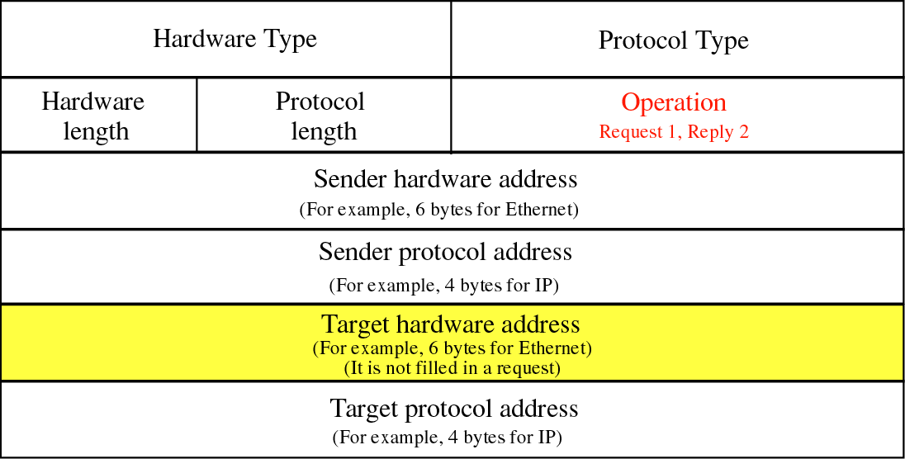
ARP Packet
Hardware type: Specifies the network protocol type. Example: Ethernet is 1
Protocol type: Specifies the internetwork protocol for which the ARP request is intended. For IPv4, this has the value 0x0800.
Hardware Length (in octets) of a hardware address. Ethernet addresses size is 6.
Protocol Length: (in octets) of addresses used in the upper layer protocol. (The upper layer protocol specified in Protocol Type.) IPv4 address size is 4
Operation: The operation that the sender is performing: 1 for ARP-request, 2 for ARP-reply

Slide 39
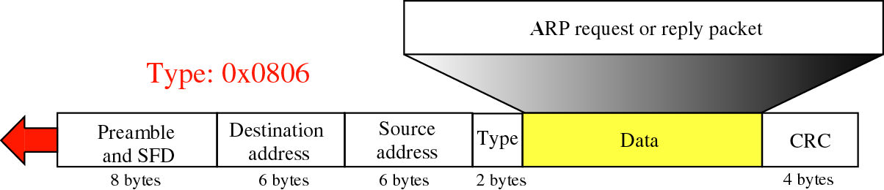
Encapsulation of an ARP Packet
An ARP packet is encapsulated directly in a Data Link Frame

Slide 40
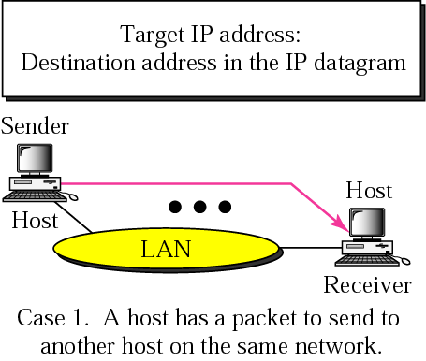
Four cases of using ARP

Slide 41
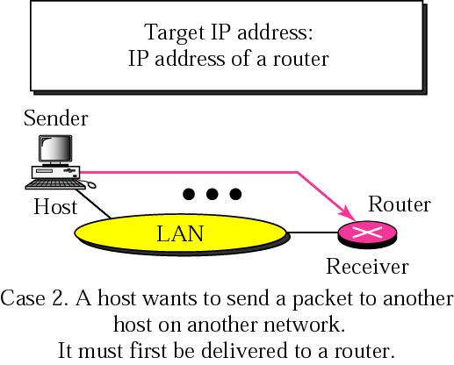
Four cases of using ARP

Slide 42
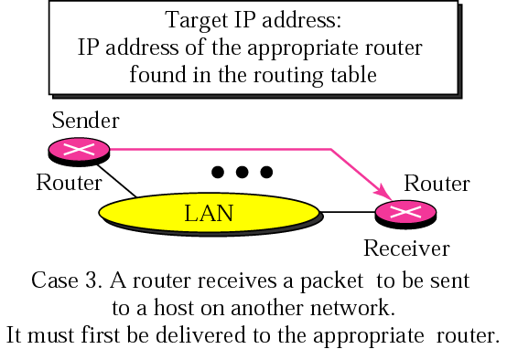
Four cases of using ARP

Slide 43
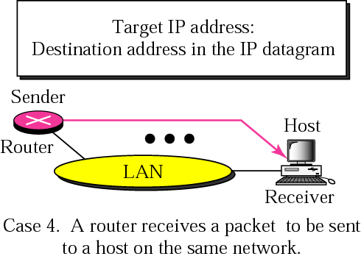
Four cases of using ARP

Slide 44
Exercise
Ethernet and ARP

