Slide 1
Computer Organization and Assembly Language Programming
Dr. Adnan Ghafoor

Slide 2
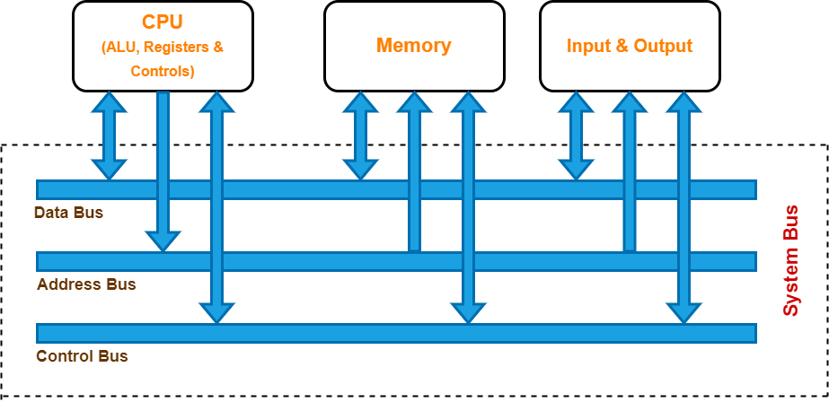

Slide 3
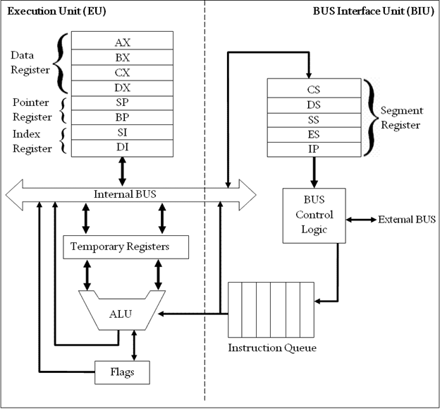
Inside Intel 8086 Microprocessor
AX | Accumulator Register
BX | Base Register
CX | Counter Register
DX | Data Register
SI | Source Index
DI | Destination Index
BP | Base Pointer
SP | Stack Pointer

Slide 4
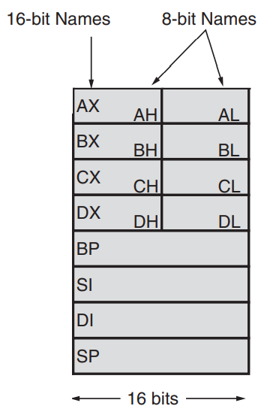
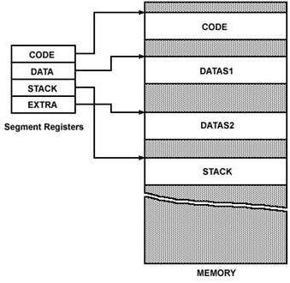

Slide 5
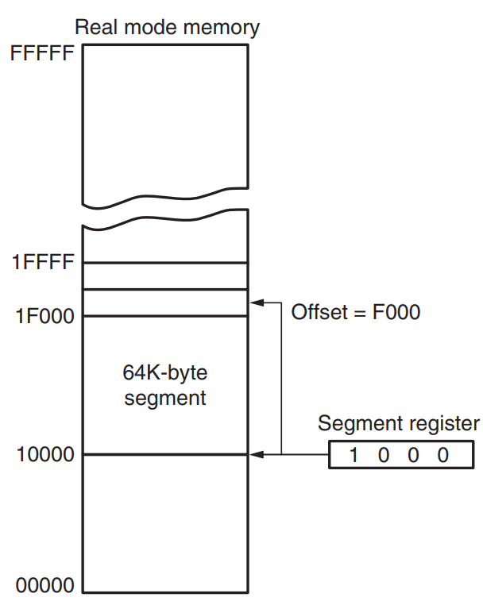
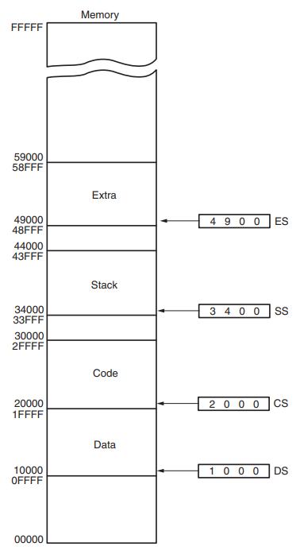

Slide 6
Assembler Directives/Program Structure
.Model
.Data
.stack 100
.code
.exit

Slide 7
Basic Instructions
MOV
Used to move data between registers and memory
ADD
Used to add two operands
SUB
Used to subtract two operands

Slide 8
Addressing modes
Immediate Addressing Modes
Register Addressing Mode
Direct Addressing Mode
Register Indirect Addressing Mode

Slide 9
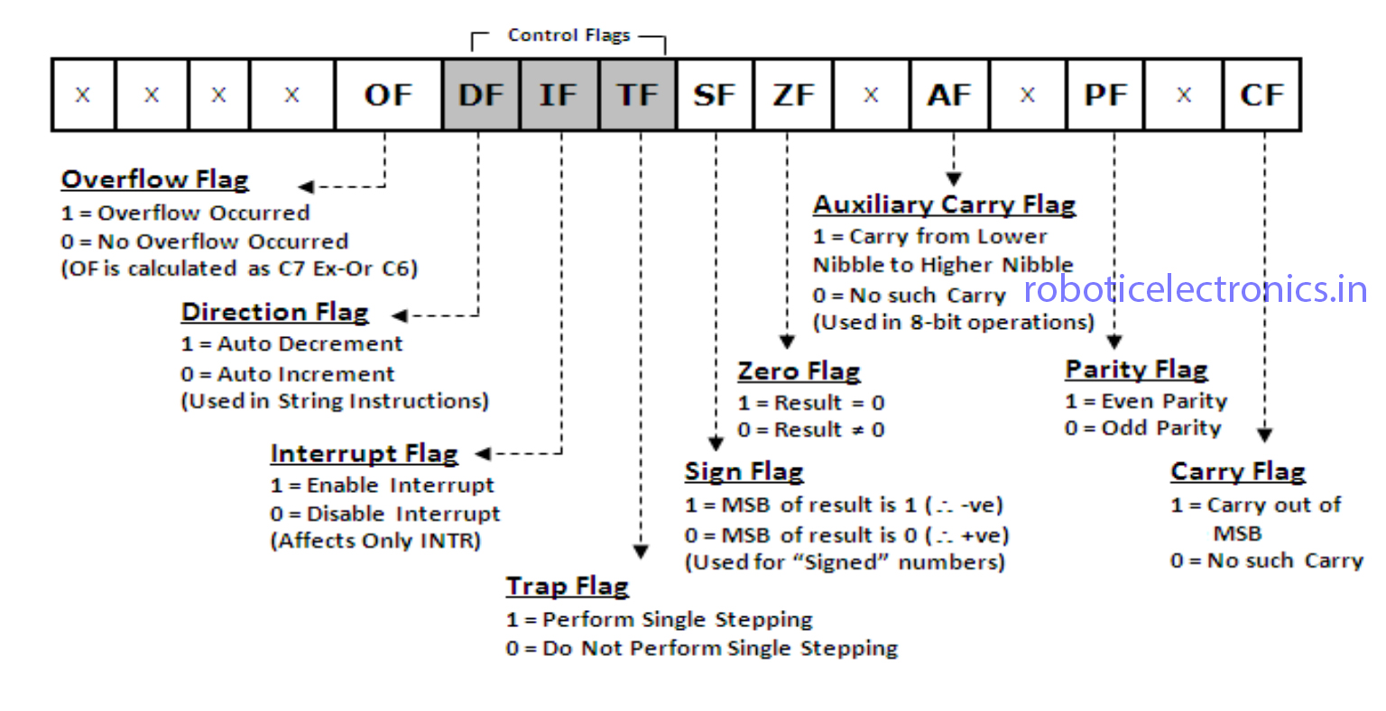

Slide 10
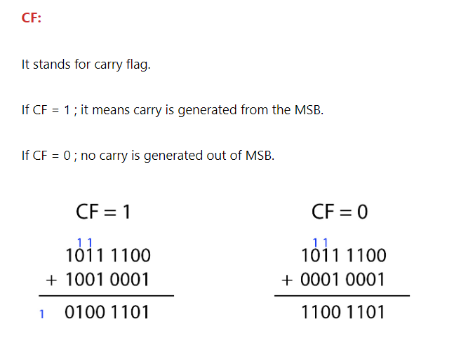

Slide 11
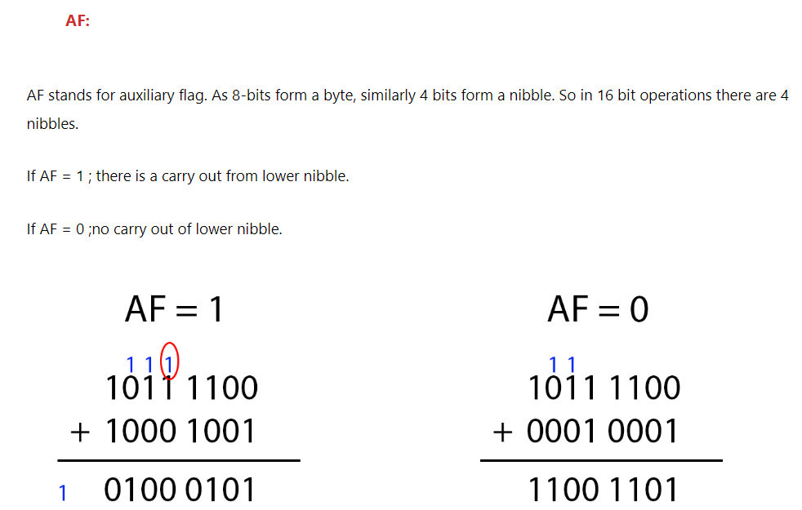

Slide 12
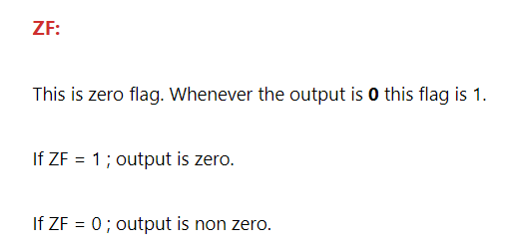

Slide 13
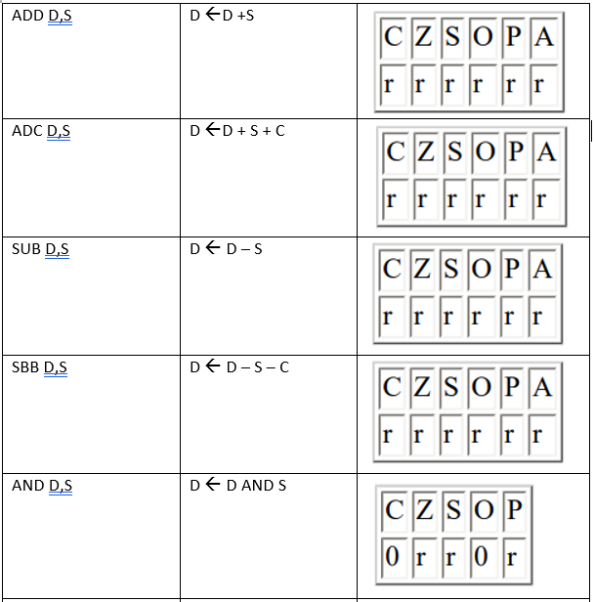

Slide 14
