Slide 1

Introduction to Python

Slide 2
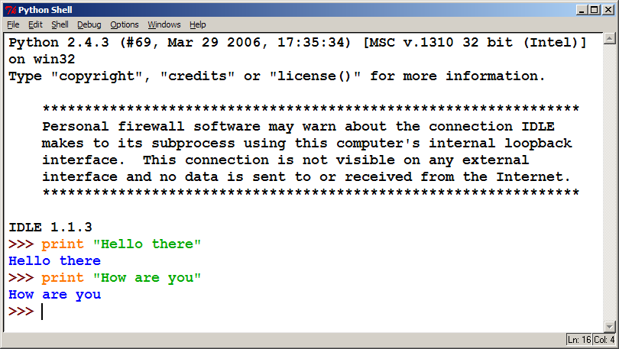
Interpreted Languages
Java:
Code
Compiler
Runtime
Environment
Computer
Python:
Code
Interpreter
Computer
interpreted
Not compiled like Java
Code is written and then directly executed by an interpreter
Type commands into interpreter and see immediate results

Slide 3
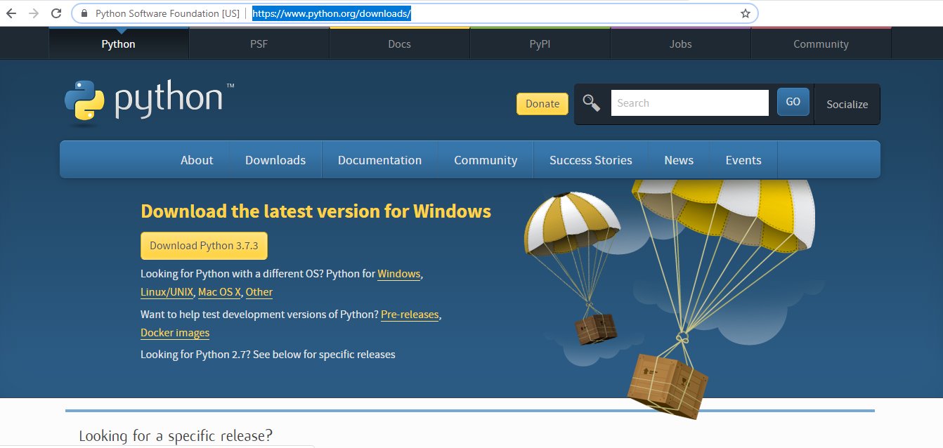
Installing Python for Windows
https://www.python.org/downloads/

Slide 4
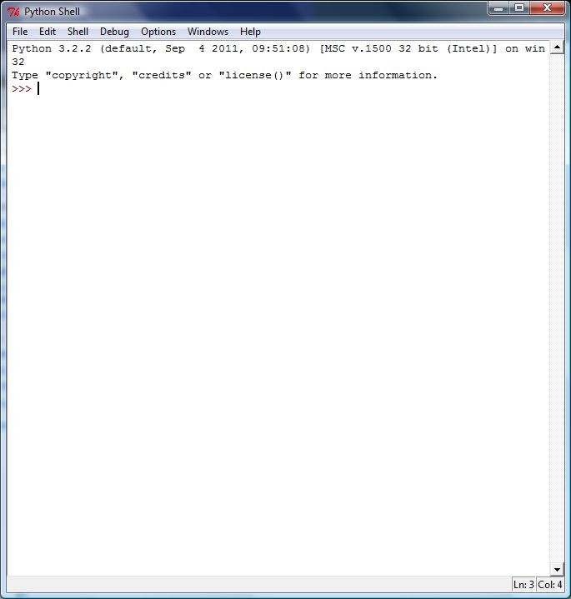


IDE for Python
IDLE
PyCharm
https://www.jetbrains.com/pycharm/
Anaconda
https://www.anaconda.com/distribution/

Slide 5
Python Math functions
Symbol Function Example Result
+ addition 5 + 3 8
– subtraction 10 – 6 4
* multiplication 3 * 7 21
// integer division 15 // 6 2
/ float division 15 / 6 2.5
** power 7 ** 2 49

Slide 6

Expressions
Arithmetic is very similar to Java
Operators: + - * / % (plus ** for exponentiation)
Precedence: () before ** before * / % before + -
Integers vs. real numbers (doubles)
You may use // for integer division
>>> 1 + 1
2
>>> 1 + 3 * 4 - 2
11
>>> 7 // 2
3
>>> 7 / 2
3.5
>>> 7.0 / 2
3.5
6

Slide 7
The print Statement
swallows.py
1 2 3 4 | print("Hello, world!”) print() print("Suppose two swallows \"carry\" it together.”) Print('African or "European" swallows?’)
print("text”)
print() (a blank line)
Escape sequences such as \" are the same as in Java
Strings can also start/end with '

Slide 8
Variables
Declaring
no type is written; same syntax as assignment
Operators
no ++ or -- operators (must manually adjust by 1)
Java | Python
int x = 2; x++; System.out.println(x); x = x * 8; System.out.println(x); double d = 3.2; d = d / 2; System.out.println(d); | x = 2 x = x + 1 print(x) x = x * 8 print(x) d = 3.2 d = d / 2 print(d)
8

Slide 9
4
2
1
5
3
Example:
x = 1 + 5 ** (3 // 2) – 6 % 4
Order of Operations
1. ( )
2. **
3. * / // %
4. + –
5. left to right
x = 1 + 5 ** (3 // 2) – 6 % 4
1
x = 1 + 5 ** (3 // 2) – 6 % 4
5
5
x = 1 + 5 ** (3 // 2) – 6 % 4
2
x = 1 + 5 ** (3 // 2) – 6 % 4
6
2
x = 1 + 5 ** (3 // 2) – 6 % 4
4

Slide 10
The ‘in’ Operator
Boolean test whether a value is inside a container:
>>> t = [1, 2, 4, 5]
>>> 3 in t
False
>>> 4 in t
True
>>> 4 not in t
False
For strings, tests for substrings
>>> a = 'abcde'
>>> 'c' in a
True
>>> 'cd' in a
True
>>> 'ac' in a
False
Be careful: the in keyword is also used in the syntax of for loops and list comprehensions

Slide 11
range
range gives a sequence of integers “to” means up to but not including.
range(2, 10, 3) # returns [2, 5, 8]
for i in range(5): [0, 1, 2, 3, 4]
for i in range(7, 9): [7, 8]
for i in range(1, 10, 2): [1, 3, 5, 7, 9]
for i in range(10, 6, -1): [10, 9, 8, 7]
from
(Inclusive.
Default 0)
to
(Not inclusive)
step
(Default 1)
Notes:
Range is often used in for loops to iterate through values.

Slide 12
list indexing
lists can be indexed with positive or negative numbers (we’ve seen this before!)
index | 0 | 1 | 2 | 3 | 4 | 5 | 6 | 7
value | 9 | 14 | 12 | 19 | 16 | 18 | 24 | 15
index | -8 | -7 | -6 | -5 | -4 | -3 | -2 | -1

Slide 13
indexing
Access any item in the sequence using its index
String
x = 'frog'
print (x[3]) # prints 'g'
List
x = ['dog', 'cow', 'horse']
print (x[1]) # prints 'cow'

Slide 14
slicing
Slice out substrings, sublists, subtuples using indexes [start : end : step]
x = 'computer'
Code | Result | Explanation
x[1:4] | 'omp' | Items 1 to 3
x[1:6:2] | 'opt' | Items 1, 3, 5
x[3:] | 'puter' | Items 3 to end
x[:5] | 'compu' | Items 0 to 4
x[-1] | 'r' | Last item
x[-3:] | 'ter' | Last 3 items
x[:-2] | 'comput' | All except last 2 items
Notes:
“end” means up to, but not including.

Slide 15
The + Operator
The + operator produces a new tuple, list, or string whose value is the concatenation of its arguments.
>>> (1, 2, 3) + (4, 5, 6)
(1, 2, 3, 4, 5, 6)
>>> [1, 2, 3] + [4, 5, 6]
[1, 2, 3, 4, 5, 6]
>>> “Hello” + “ ” + “World”
‘Hello World’

Slide 16
adding / concatenating
Combine 2 sequences of the same type using +
String
x = 'horse' + 'shoe'
print (x) # prints 'horseshoe'
List
x = [‘dog', 'cow'] + ['horse']
print (x) # prints [‘dog', 'cow', 'horse']

Slide 17
The * Operator
The * operator produces a new tuple, list, or string that “repeats” the original content.
>>> (1, 2, 3) * 3
(1, 2, 3, 1, 2, 3, 1, 2, 3)
>>> [1, 2, 3] * 3
[1, 2, 3, 1, 2, 3, 1, 2, 3]
>>> “Hello” * 3
‘HelloHelloHello’

Slide 18
String Concatenation
Integers and strings cannot be concatenated in Python.
Workarounds:
str(value) - converts a value into a string
print(value, value) - prints values, separated by a space
>>> x = 4
>>> print("Thou shalt not count to " + x + ".")
TypeError: cannot concatenate 'str' and 'int' objects
>>> print("Thou shalt not count to " + str(x) + ".")
Thou shalt not count to 4.
>>> print(x + 1, "is out of the question.")
5 is out of the question.
18

Slide 19
SEQUENCES String List Tuple
multiplying
Multiply a sequence using *
String
x = ‘bug' * 3
print (x) # prints ‘bugbugbug'
List
x = [8, 5] * 3
print (x) # prints [8, 5, 8, 5, 8, 5]

Slide 20
SEQUENCES String List Tuple
checking membership
Test whether an item is in or not in a sequence
String
x = 'bug'
print ('u' in x) # prints True
List
x = [‘dog', 'cow', 'horse']
print ('cow' not in x) # prints False
Notes:
This returns a boolean result.

Slide 21
SEQUENCES String List Tuple
iterating
Iterate through the items in a sequence
Item
x = [7, 8, 3]
for item in x:
print (item * 2) # prints 14, 16, 6
Index & Item
x = [7, 8, 3]
for index, item in enumerate(x):
print (index, item) # prints 0 7, 1 8, 2 3

Slide 22
SEQUENCES String List Tuple
number of items
Count the number of items in a sequence
String
x = 'bug'
print (len(x)) # prints 3
List
x = [‘dog', 'cow', 'horse']
print (len(x)) # prints 3

Slide 23
SEQUENCES String List Tuple
sum
Find the sum of items in a sequence
entire sequence must be numeric type
String -> Error
x = [5, 7, 'bug‘]
print (sum(x)) # error!
List
x = [2, 5, 8, 12]
print (sum(x)) # prints 27
print (sum(x[-2:])) # prints 20

Slide 24
SEQUENCES String List Tuple
sorting
Returns a new list of items in sorted order
Does not change the original list
String
x = 'bug'
print (sorted(x)) # prints ['b', 'g', 'u']
List
x = ['pig', 'cow', 'horse']
print (sorted(x)) # prints ['cow', ‘dog', ‘horse']

Slide 25
SEQUENCES String List Tuple
count (item)
Returns count of an item
String
x = 'hippo'
print (x.count('p')) # prints 2
List
x = ['dog', 'cow', 'horse', 'cow']
print (x.count('cow')) # prints 2

Slide 26
SEQUENCES String List Tuple
index (item)
Returns the index of the first occurrence of an item
String
x = 'hippo'
print (x.index('p')) # prints 2
List
x = ['dog', 'cow', 'horse', 'cow']
print (x.index('cow')) # prints 1

Slide 27
LISTS
All operations from Sequences, plus:
constructors
del list1[2] delete item from list1
list1.append(item) appends an item to list1
list1.extend(sequence1) appends a sequence to list1
list1.insert(index, item) inserts item at index
list1.pop() pops last item
list1.remove(item) removes first instance of item
list1.reverse() reverses list order
list1.sort() sorts list in place
list1.clear() empties list

Slide 28
LISTS
delete
Delete a list or an item from a list
x = [5, 3, 8, 6]
del(x[1]) # [5, 8, 6]
del(x) # deletes list x
append
Append an item to a list
x = [5, 3, 8, 6]
x.append(7) # [5, 3, 8, 6, 7]

Slide 29
extend: Append an sequence to a list
x = [5, 3, 8, 6]
y = [12, 13]
x.extend(y) # [5, 3, 8, 6, 7, 12, 13]
insert: Insert an item at given index x.insert(index, item)
x = [5, 3, 8, 6]
x.insert(1, 7) # [5, 7, 3, 8, 6]
x.insert(1,['a','m']) # [5, ['a', 'm'], 7, 3, 8, 6]

Slide 30
The extend method vs +
+ creates a fresh list with a new memory ref
extend operates on list li in place.
>>> li.extend([9, 8, 7])
>>> li
[1, 2, ‘i’, 3, 4, 5, ‘a’, 9, 8, 7]
Potentially confusing:
extend takes a list as an argument.
append takes a singleton as an argument.
>>> li.append([10, 11, 12])
>>> li
[1, 2, ‘i’, 3, 4, 5, ‘a’, 9, 8, 7, [10, 11, 12]]

Slide 31
LISTS
pop: Pops last item off the list, and returns item
x = [5, 3, 8, 6]
x.pop() # [5, 3, 8] and returns the 6
print(x.pop()) # prints 8, x is now [5, 3]
remove: Remove first instance of an item
x = [5, 3, 8, 6, 3]
x.remove(3) # [5, 8, 6, 3]

Slide 32
LISTS
reverse: Reverse the order of the list
x = [5, 3, 8, 6]
x.reverse() # [6, 8, 3, 5]
sort: Sort the list in place
x = [5, 3, 8, 6]
x.sort() # [3, 5, 6, 8]

Slide 33
LISTS
clear: delete all items from the list
x = [5, 3, 8, 6]
x.clear() # []

Slide 34
Dictionaries
Dictionaries are lookup tables.
They map from a “key” to a “value”.
symbol_to_name = {
"H": "hydrogen",
"He": "helium",
"Li": "lithium",
"C": "carbon",
"O": "oxygen",
"N": "nitrogen"
}
Duplicate keys are not allowed
Duplicate values are just fine

Slide 35
DICTIONARIES
constructors – creating a new dict
x = {'lamb':25.3, 'beef':33.8, 'chicken':22.7}
x = dict([('lamb', 25.3),('beef', 33.8),('chicken', 22.7)])
x = dict(lamb=25.3, beef=33.8, chicken=22.7)

Slide 36
DICTIONARIES
basic dict operations
Description | Code
Add or change item in dict x | x['beef'] = 25.2
Remove item from dict x | del x['beef']
Get length of dict x | len(x)
Check membership in x (only looks in keys, not values) | item in x item not in x
Delete all items from dict x | x.clear()
Delete dict x | del x

Slide 37
DICTIONARIES
accessing keys and values in a dict
x.keys() # returns list of keys in x
x.values() # returns list of values in x
x.items() # returns list of key-value tuple pairs in x
item in x.values() # tests membership in x: returns boolean

Slide 38
DICTIONARIES
iterating a dict
for key in x: # iterate keys
print(key, x[key]) # print all key/value pairs
for k, v in x.items(): # iterate key/value pairs
print(k, v) # print all key/value pairs
Note:
Entries in a dict are in random order.

Slide 39
Functions
Function:
Syntax:
def name():
statement
statement
...
statement
Must be declared above the 'main' code
Statements inside the function must be indented
hello2.py
1 2 3 4 5 6 7 | # Prints a helpful message. def hello(): print("Hello, world!") # main (calls hello twice) hello() hello()

Slide 40
Whitespace Significance
Python uses indentation to indicate blocks, instead of {}
Makes the code simpler and more readable
In Java, indenting is optional. In Python, you must indent.
You may use either tabs or spaces, but you must be consistent
hello3.py
1 2 3 4 5 6 7 8 | # Prints a welcoming message. def hello(): print("Hello, world!") print("How are you?") # main (calls hello twice) hello() hello()

Slide 41
Default Parameter Values
def name(parameter=value, ..., parameter=value):
statements
Can make parameter(s) optional by specifying a default value
Exercise: Modify stars.py to add an optional parameter for the character to use for the outline of the box (default "*").
>>> def print_many(word, n=1):
... for i in range(n):
... print(word)
>>> print_many("shrubbery")
shrubbery
>>> print_many("shrubbery", 4)
shrubbery
shrubbery
shrubbery
shrubbery

Slide 42
Parameter Keywords
name(parameter=value, ..., parameter=value)
Can specify the names of parameters as you call a function
This allows you to pass the parameters in any order
>>> def print_many(word, n):
... for i in range(n):
... print(word)
>>> print_many(word="shrubbery", n=4)
shrubbery
shrubbery
shrubbery
shrubbery
>>> print_many(n=3, word="Ni!")
Ni!
Ni!
Ni!

Slide 43
Returning Values
def name(parameters):
statements
...
return value
>>> def ftoc(temp):
... tempc = 5.0 / 9.0 * (temp - 32)
... return tempc
>>> ftoc(98.6)
37.0

Slide 44
Simple functions: ex.py
"""factorial done recursively and iteratively"""
def fact1(n):
ans = 1
for i in range(2,n):
ans = ans * n
return ans
def fact2(n):
if n < 1:
return 1
else:
return n * fact2(n - 1)

Slide 45
Simple functions: ex.py
671> python
Python 2.5.2 …
>>> import ex
>>> ex.fact1(6)
1296
>>> ex.fact2(200)
78865786736479050355236321393218507…000000L
>>> ex.fact1
<function fact1 at 0x902470>
>>> fact1
Traceback (most recent call last):
File "<stdin>", line 1, in <module>
NameError: name 'fact1' is not defined
>>>

Slide 46
The for Loop
for name in range(max):
statements
Repeats for values 0 (inclusive) to max (exclusive)
>>> for i in range(5):
... print(i)
0
1
2
3
4
46

Slide 47
for Loop Variations
for name in range(min, max):
statements
for name in range(min, max, step):
statements
Can specify a minimum other than 0, and a step other than 1
>>> for i in range(2, 6):
... print(i)
2
3
4
5
>>> for i in range(15, 0, -5):
... print(i)
15
10
5
47

Slide 48
Nested Loops
Nested loops are often replaced by string * and +
....1
...2
..3
.4
5
Java
1 2 3 4 5 6 | for (int line = 1; line <= 5; line++) { for (int j = 1; j <= (5 - line); j++) { System.out.print("."); } System.out.println(line); }
Python
1 2 | for line in range(1, 6): print((5 - line) * ".", line, sep="")
48

Slide 49
input
input : Reads a string from the user's keyboard.
reads and returns an entire line of input
>>> name = input("Howdy. What's yer name? ")
Howdy. What's yer name? Paris Hilton
>>> name
'Paris Hilton'

Slide 50
input for numbers
to read a number, cast the result of input to an int
Only numbers can be cast as ints!
Example:
age = int(input("How old are you? "))
print("Your age is", age)
print("You have", 65 - age, "years until retirement“)
Output:
How old are you? 53
Your age is 53
You have 12 years until retirement

Slide 51
if/else
if condition:
statements
elif condition:
statements
else:
statements
Example:
gpa = int(input("What is your GPA? "))
if gpa > 3.5:
print("You have qualified for the honor roll.")
elif gpa > 2.0:
print("Welcome to Moon University!")
else:
print("Apply again in Spring.")

Slide 52
if ... in
if value in sequence:
statements
The sequence can be a range, string, tuple, or list
Examples:
x = 3
if x in range(0, 10):
print("x is between 0 and 9“)
name = input("What is your name? ")
name = name.lower()
if name[0] in "aeiou":
print("Your name starts with a vowel!“)
Notes:
52

Slide 53
while Loops
while test:
statements
>>> n = 91
>>> factor = 2 # find first factor of n
>>> while n % factor != 0:
... factor += 1
...
>>> factor
7

Slide 54
Logical Operators
Operator | Meaning | Example | Result
== | equals | 1 + 1 == 2 | True
!= | does not equal | 3.2 != 2.5 | True
< | less than | 10 < 5 | False
> | greater than | 10 > 5 | True
<= | less than or equal to | 126 <= 100 | False
>= | greater than or equal to | 5.0 >= 5.0 | True
Operator | Example | Result
and | (2 == 3) and (-1 < 5) | False
or | (2 == 3) or (-1 < 5) | True
not | not (2 == 3) | True

Slide 55
Another example
bag.py
class Bag:
def __init__(self):
self.data = []
def add(self, x):
self.data.append(x)
def addtwice(self,x):
self.add(x)
self.add(x)
invoke:
>>> from bag import *
>>> l = Bag()
>>> l.add('first')
>>> l.add('second')
>>> l.data
['first', 'second']

Slide 56
Defining a Class
Declaring a class:
class Name:
...
class name is capitalized (e.g. Point)
saved into a file named name.py (filename is lowercase)
Notes:
56

Slide 57
Fields
Declaring a field:
name = value
Example:
class Point:
x = 0
y = 0
point.py
1 2 3 | class Point: x = 0 y = 0
Notes:
57

Slide 58
Using a Class
from name import *
client programs must import the classes they use
the file name (lowercase), not class name, is used
point_main.py
1 2 3 4 5 6 7 8 | from point import * # main p1 = Point() p1.x = 7 p1.y = -3 ...

Slide 59
"Implicit" Parameter (self)
Java object methods refer to the object's fields implicitly:
public void translate(int dx, int dy) {
x += dx;
y += dy; // change this object's x/y
}
Python's implicit parameter is named self
self must be the first parameter of any object method
access the object's fields as self.field
def translate(self, dx, dy):
self.x += dx
self.y += dy
Notes:
59

Slide 60
Methods
def name(self [, parameter, ..., parameter]):
statements
Example:
class Point:
def translate(self, dx, dy):
self.x += dx
self.y += dy
...
Exercise: Write the following methods in class Point:
set_location
draw
distance
Notes:
60

Slide 61
Exercise Answer
point.py
1 2 3 4 5 6 7 8 9 10 11 12 13 14 15 16 17 18 19 20 | from math import * class Point: x = 0 y = 0 def set_location(self, x, y): self.x = x self.y = y def draw(self, panel): panel.canvas.create_oval(self.x, self.y, \ self.x + 3, self.y + 3) panel.canvas.create_text(self.x, self.y, \ text=str(self), anchor="sw") def distance(self, other): dx = self.x - other.x dy = self.y - other.y return sqrt(dx * dx + dy * dy)

Slide 62
Initializing Objects
Right now, clients must initialize Points like this:
p = Point()
p.x = 3
p.y = -5
We'd prefer to be able to say:
p = Point(3, -5)
Notes:
62

Slide 63
Constructors
def __init__(self [, parameter, ..., parameter]):
statements
a constructor is a special method with the name __init__ that initializes the state of an object
Example:
class Point:
def __init__(self, x, y):
self.x = x
self.y = y
Notes:
63

Slide 64
More About Fields
point.py
1 2 3 4 5 | class Point: def __init__(self, x, y): self.x = x self.y = y ...
fields can be declared directly inside class, or just in the constructor as shown here (more common)
>>> p = Point(5, -2)
>>> p.x
5
>>> p.y
-2
Notes:
64

Slide 65
Printing Objects
By default, Python doesn't know how to print an object:
We'd like to be able to print a Point object and have its state shown as the output.
>>> p = Point(5, -2)
>>> print p
<Point instance at 0x00A8A850>

Slide 66
Printable Objects: __str__
def __str__(self):
return string
converts an object into a string (like Java toString method)
invoked automatically when str or print is called
def __str__(self):
return "(" + str(self.x) + ", " + str(self.y) + ")"
>>> p = Point(5, -2)
>>> print p
(5, -2)
>>> print "The point is " + str(p) + "!"
The point is (5, -2)!

Slide 67
Complete Point Class
point.py
1 2 3 4 5 6 7 8 9 10 11 12 13 14 15 16 17 18 19 20 21 | from math import * class Point: def __init__(self, x, y): self.x = x self.y = y def distance_from_origin(self): return sqrt(self.x * self.x + self.y * self.y) def distance(self, other): dx = self.x - other.x dy = self.y - other.y return sqrt(dx * dx + dy * dy) def translate(self, dx, dy): self.x += dx self.y += dy def __str__(self): return "(" + str(self.x) + ", " + str(self.y) + ")"

Slide 68
Python Object Details
Drawbacks
Does not have encapsulation like Java (ability to protect fields' data from access by client code)
Not easy to have a class with multiple constructors
Must explicitly declare self parameter in all methods
Strange names like __str__, __init__
Benefits
operator overloading: Define < by writing __lt__ , etc.
http://docs.python.org/ref/customization.html

Slide 69
Reading Files
name = open("filename")
opens the given file for reading, and returns a file object
name.read() - file's entire contents as a string
>>> f = open("hours.txt")
>>> f.read()
'123 Susan 12.5 8.1 7.6 3.2\n
456 Brad 4.0 11.6 6.5 2.7 12\n
789 Jenn 8.0 8.0 8.0 8.0 7.5\n'

Slide 70
Line-based File Processing
name.readline() - next line from file as a string
Returns an empty string if there are no more lines in the file
name.readlines() - file's contents as a list of lines
(we will discuss lists in detail next week)
>>> f = open("hours.txt")
>>> f.readline()
'123 Susan 12.5 8.1 7.6 3.2\n'
>>> f = open("hours.txt")
>>> f.readlines()
['123 Susan 12.5 8.1 7.6 3.2\n',
'456 Brad 4.0 11.6 6.5 2.7 12\n',
'789 Jenn 8.0 8.0 8.0 8.0 7.5\n']

Slide 71
Writing Files
name = open("filename", "w") # write
name = open("filename", "a") # append
opens file for write (deletes any previous contents) , or
opens file for append (new data is placed after previous data)
name.write(str) - writes the given string to the file
name.close() - closes file once writing is done
>>> out = open("output.txt", "w")
>>> out.write("Hello, world!\n")
>>> out.write("How are you?")
>>> out.close()
>>> open("output.txt").read()
'Hello, world!\nHow are you?'

