Slide 1
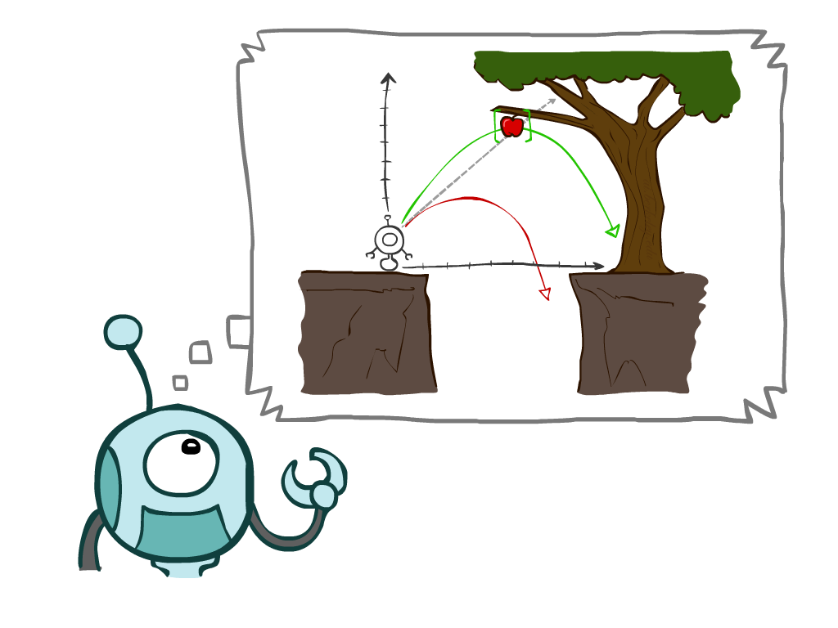
Intelligent Agents
Instructor: Dr. Rabia Tehseen
Slide credits: AI BERKELEY

Slide 2
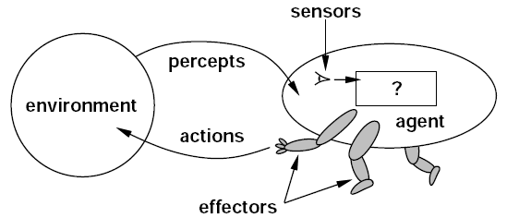
What is an Agent?
“Intelligent agents continuously perform three functions: perception of dynamic conditions in the environment; action to affect conditions in the environment; and reasoning to interpret perceptions, solve problems, draw inferences, and determine actions.”

Slide 3
Intelligent Agents
An intelligent agent may learn from the environment to achieve their goals.
Following are the main four rules for an AI agent:
Rule 1: An AI agent must have the ability to perceive the environment.
Rule 2: The observation must be used to make decisions.
Rule 3: Decision should result in an action.
Rule 4: The action taken by an AI agent must be a rational action.

Slide 4
Example of Agents
Human Agent
eyes, ears, skin, taste buds, etc. for sensors
hands, fingers, legs, mouth, etc. for actuators
Robot
camera, infrared, bumper, etc. for sensors
grippers, wheels, lights, speakers, etc. for actuators
Software Agent
functions as sensors
information provided as input to functions in the form of encoded bit strings or symbols
functions as actuators
results deliver the output

Slide 5
Rational Agent
Rational Agent:
For each possible percept sequence, a rational agent should select an action that is expected to maximize its performance measure, given the evidence provided by the percept sequence and whatever built-in knowledge the agent has.
Rationality is distinct from omniscience (all-knowing with infinite knowledge)
Actual (perfection) vs. Expected
Best vs. Optimal

Slide 6
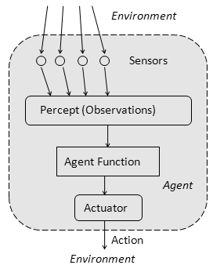
Agent Function and Program
Behavior of Agent − It is the action that agent performs after any given sequence of percepts
Agent’s behavior is mathematically described by
Agent function
A function mapping any given percept sequence to an action
Practically it is described by
An agent program
The real implementation
Problems:
what is “ the right thing”
how do you measure the “best outcome”

Slide 7
Specifying the Task Environment
Performance of Agents

Slide 8
Performance of Agents
Behaviour and performance of Intelligent Agent in terms of agent program.
Perception to Action Mapping
Ideal mapping: specifies which actions an agent ought to take at any point in time.
Performance measure: a subjective measure to characterize how successful an agent is (e.g., speed, power, accuracy, etc.)
PEAS:
Performance measure,
Environment,
Actuators,
Sensors

Slide 9
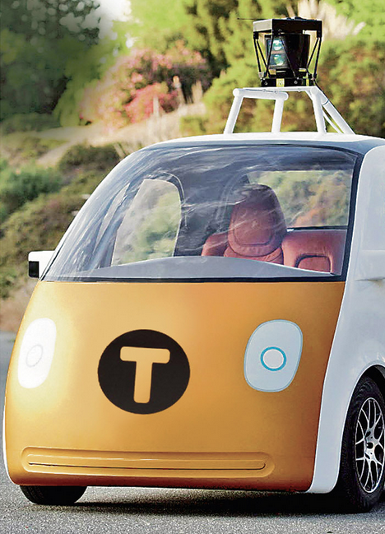
PEAS: Automated Taxi
Performance measure
Correct Destination, Fuel, time, cost, violations, safety, comfort, profit
Environment
rural, urban, other drivers, customers
Actuators
Steering, brake, fuel, display/speaker
Sensors
Camera, radar, accelerometer, engine sensors, microphone

Slide 10
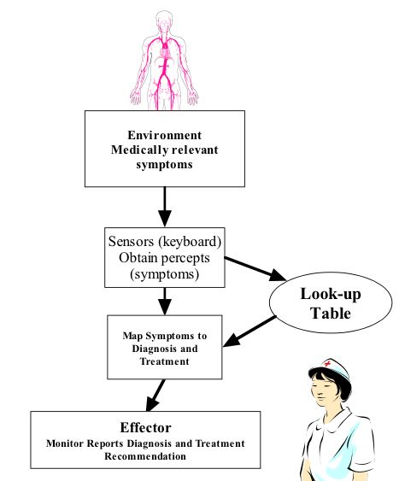
PEAS: Medical diagnosis system
Performance measure:
Healthy patient, minimize costs, lawsuits
Environment:
Patient, hospital, staff
Actuators:
Screen display (questions, tests, diagnoses, treatments, referrals)
Sensors:
Keyboard (entry of symptoms, findings, patient's answers)

Slide 11
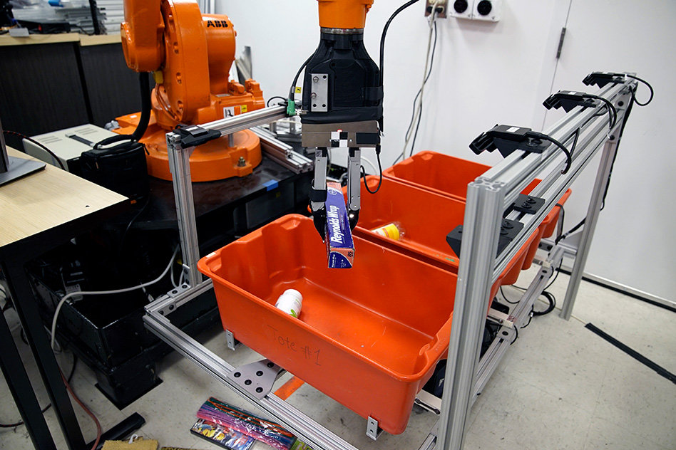
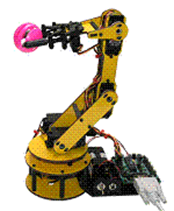
PEAS: Part-picking robot
Performance measure:
Percentage of parts in correct bins
Environment:
Conveyor belt with parts, bins
Actuators:
Jointed arm and hand
Sensors:
Camera, joint angle sensors

Slide 12
PEAS: Interactive English tutor
Activity
Performance measure:
Maximize student's score on test
Environment:
Set of students
Actuators:
Screen display (exercises, suggestions, corrections)
Sensors:
Keyboard

Slide 13
Environment Types

Slide 14
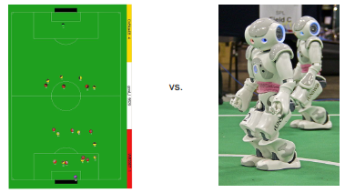
Properties of environments
Fully observable vs. partially observable
Or Accessible vs. inaccessible
Can the agent observe the complete state of the environment?
If an agent’s sensors gives it access to the complete state of the environment, then we say that environment is fully observable to the agent.
A fully observable environment is convenient because the agent need not maintain any internal state to keep track of the world.
Is the current state of the world fully known at each step?

Slide 15
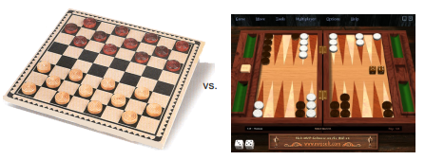
Properties of environments
Deterministic vs. nondeterministic (Stochastic).
Is there uncertainty in how the world works?
If the next state of the environment is completely determined by the current state and the actions selected by the agents, then we say the environment is deterministic.
If the environment is inaccessible, then it may appear to be nondeterministic (bunch of uncertainties).
Example:
Taxi driving is clearly stochastic in this sense, because one can never predict the behavior of traffic exactly.

Slide 16
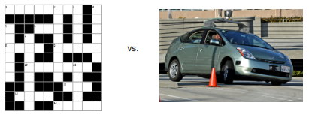
Environment Types
Episodic vs. Sequential:
Episodic: next episode doesn’t depend on previous actions.
The agent's experience is divided into atomic "episodes"
each episode consists of the agent perceiving and then performing a single action, and
the choice of action in each episode depends only on the episode itself.
the next episode does not depend on the actions taken in previous episodes
For example, an agent that has to spot defective parts on an assembly line (EPISODIC)
Chess and Taxi driver (SEQUENTIAL).

Slide 17
Environment Types
Static vs. Dynamic:
If the environment can change while an agent is performing action, then we say the environment is dynamic for that agent; otherwise, it is static.
Dynamic environments are continuously asking the agent what it wants to do
Static environments are easy to deal with, because the agent does not keep on looking at the environment while it is deciding on an action.
The environment is semi-dynamic if the environment itself does not change with the passage of time but the agent's performance score does.

Slide 18
Environment Types
Discrete vs. continuous:
Is there a finite (or countable) number of possible environment states?
The environment is discrete if the number of actions and possible states of the environment is finite otherwise it is continuous.
If there are a limited number of distinct, clearly defined percepts and actions, we say that the environment is discrete.
Chess, since there are a fixed number of possible moves on each turn.
Taxi driving is continuous.

Slide 19
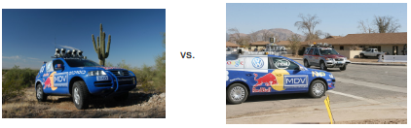
Types of Environment
Single Agent vs. Multi Agent
Is the agent the only thing acting in the world?
In the single agent environment there is only one agent
A computer software playing crossword puzzle
In multi-agent systems, there are more than one active agents
Video games

Slide 20
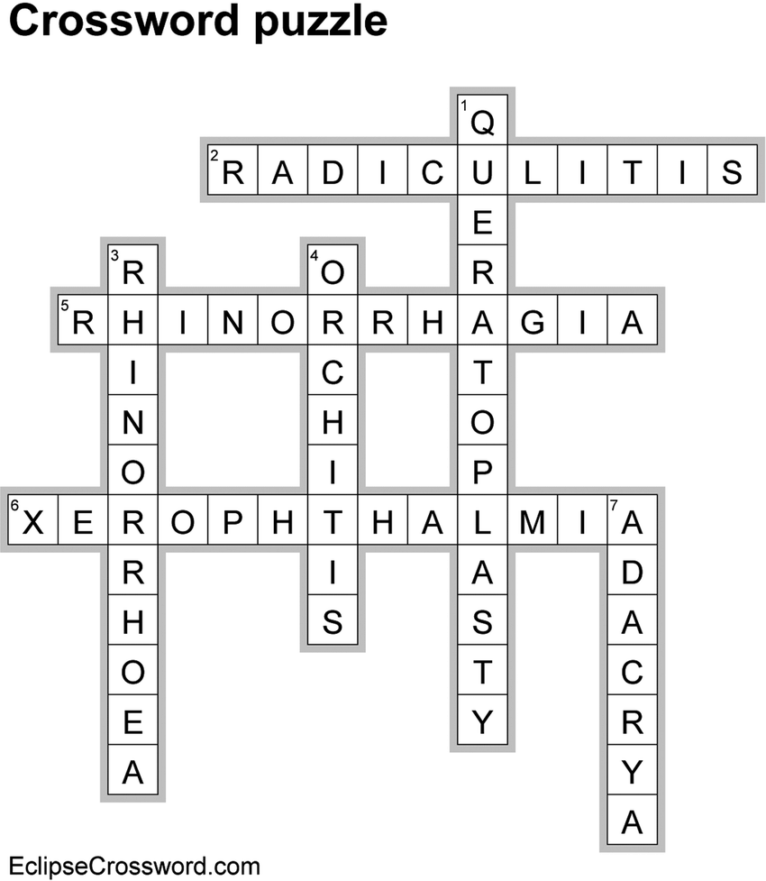
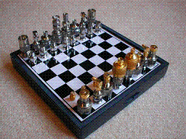


Environment Types Example
Crossword puzzle
Chess
Taxi driving
Part-picking robot
English tutor
Observable
Yes
Yes
No
No
No
Deterministic
Yes
Yes
No
No
No
Episodic
No
No
No
Yes
No
Static
Yes
Yes
No
No
No
Discrete
Yes
Yes
No
No
Yes
Agents
Single
Multi
Multi
Single
Multi

Slide 21
Structure of Agents

Slide 22
Agent design
The environment type largely determines the agent design
Fully/partially observable => agent requires memory (internal state)
Discrete/continuous => agent may not be able to enumerate all states
Stochastic/deterministic => agent may have to prepare for contingencies
Single-agent/multi-agent => agent may need to behave randomly

Slide 23
Skeleton Agent Program
Basic framework for an agent program
function SKELETON-AGENT(percept) returns action
static: memory
memory := UPDATE-MEMORY(memory, percept)
action := CHOOSE-BEST-ACTION(memory)
memory := UPDATE-MEMORY(memory, action)
return action
Agents

Slide 24
Table Agent Program
agent program based on table lookup
function TABLE-DRIVEN-AGENT(percept) returns action
static: percepts // initially empty sequence*
table // indexed by percept sequences
// initially fully specified
append percept to the end of percepts
action := LOOKUP(percepts, table)
return action
* Note: the storage of percepts requires writeable memory
Agents

Slide 25
Structure of Agent
Different ways of achieving the mapping from percepts to actions
Types of agents (increasing in generality and ability to handle complex environments)
Simple reflex agents
Model-based reflex agents
keep track of the world
Goal-based agents
work towards a goal
Utility-based agents
Learning agent

Slide 26
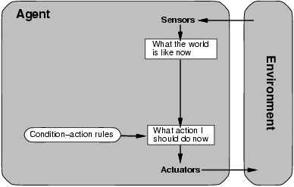
Simple reflex agents
Act only on the basis of the current percept, ignoring the rest of the percept history.
The agent function is based on the condition-action rule: if condition then action.
the vacuum agent is a simple reflex agent, because its decision is based only on the current location and on whether that location contains dirt.
Fully-observable

Slide 27
Simple Reflex Agents
The Simple reflex agents are the simplest agents. These agents take decisions on the basis of the current percepts and ignore the rest of the percept history.
These agents only succeed in the fully observable environment.
The Simple reflex agent works on Condition-action rule, which means it maps the current state to action.
Problems for the simple reflex agent design approach:
They have very limited intelligence
Mostly too big to generate and to store.
Not adaptive to changes in the environment.

Slide 28
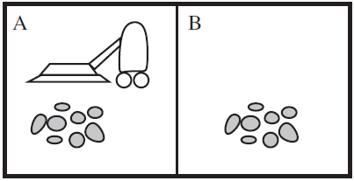
Example: Vacuum Agent
Performance?
1 point for each square cleaned in time T?
#clean squares per time step - #moves per time step?
Environment: vacuum, dirt, multiple areas defined by square regions
Actions: left, right, suck, idle
Sensors: location and contents
[A, dirty]
Rational is not omniscient(all-knowing)
Environment may be partially observable
Rational is not clairvoyant (fore-sighted)
Environment may be stochastic
Thus Rational is not always successful
If status=Dirty then return Suck
else if location=A then return Right
else if location=B then return Left

Slide 29
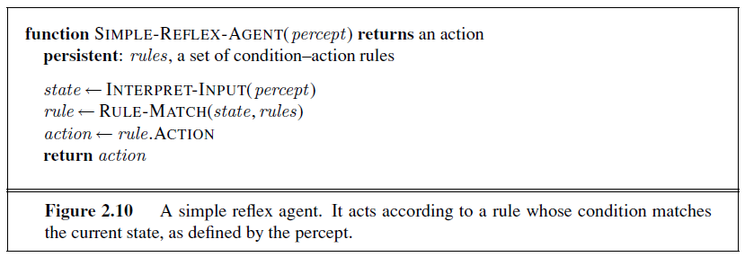
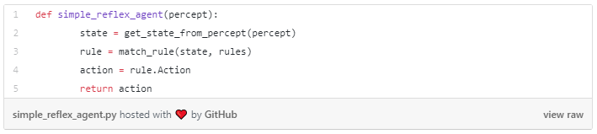
Simple Reflex Agent

Slide 30
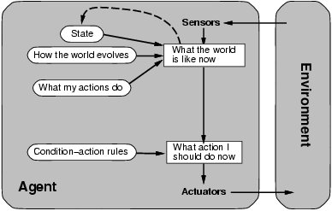
Model-based reflex agents
Keep track of the part of the words it can’t see now.
Its current state is stored inside the agent ---- Internal state
Percept history and impact of action on the environment can be determined by using internal model.
It then chooses an action in the same way as reflex agent.
Partially-observable

Slide 31
Model-Based Reflex Agents
The Model-based agent can work in a partially observable environment, and track the situation.
A model-based agent has two important factors:
Model: It is knowledge about "how things happen in the world," so it is called a Model-based agent.
Internal State: It is a representation of the current state based on percept history.
These agents have the model, "which is knowledge of the world" and based on the model they perform actions.
Updating the agent state requires information about:
How the world evolves
How the agent's action affects the world.

Slide 32
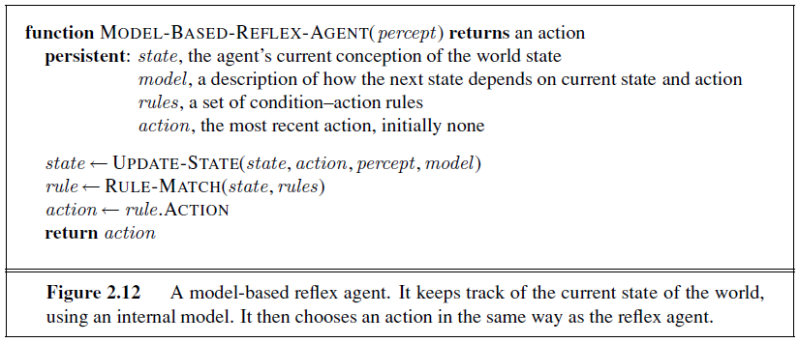
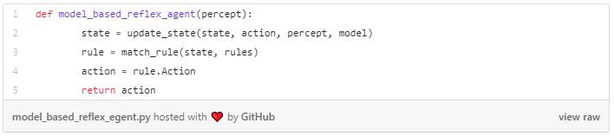
Model-Based Agent

Slide 33
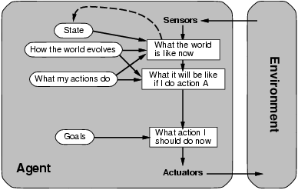
Goal-based agents
Expand on the capabilities of the model-based agents, by using "goal" information.
Goal information describes situations that are desirable.
This allows the agent a way to choose among multiple possibilities, selecting the one which reaches a goal state.
Search and planning

Slide 34
Goal Based Agents
The knowledge of the current state environment is not always sufficient to decide for an agent to what to do.
The agent needs to know its goal which describes desirable situations.
Goal-based agents expand the capabilities of the model-based agent by having the "goal" information.
They choose an action, so that they can achieve the goal.
These agents may have to consider a long sequence of possible actions before deciding whether the goal is achieved or not. Such considerations of different scenario are called searching and planning, which makes an agent proactive.

Slide 35
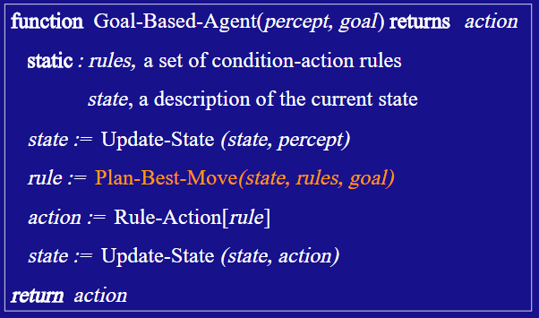

Slide 36
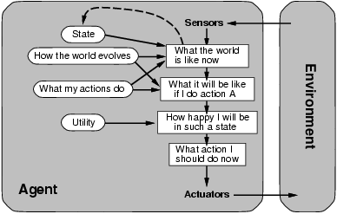
Utility-based agents
We say that if one world state is preferred to another, then it has higher utility for the agent.
Utility is a function that maps a state onto a real number.
state → R
Any rational agent possesses a utility function.
A utility function maps each state after each action to a real number representing how efficiently each action achieves the goal.

Slide 37
Utility Based Agents
These agents are similar to the goal-based agent but provide an extra component of utility measurement which makes them different by providing a measure of success at a given state.
Utility-based agent act based not only goals but also the best way to achieve the goal.
The Utility-based agent is useful when there are multiple possible alternatives, and an agent has to choose in order to perform the best action.
The utility function maps each state to a real number to check how efficiently each action achieves the goals.

Slide 38
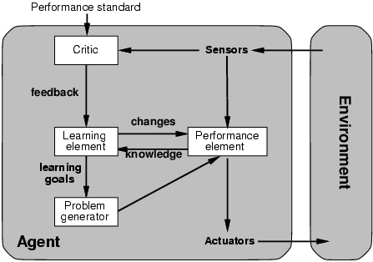
Learning Agents
It allows agents to operate in unknown environments and to become more competent.
learning element
responsible for making improvements
performance element
responsible for selecting actions.
Uses feedback from the critic on how the agent is doing.
problem generator
responsible for suggesting actions that will lead to new experiences suggest (exploratory actions).

Slide 39
Learning Agents
A learning agent in AI is the type of agent which can learn from its past experiences, or it has learning capabilities.
It starts to act with basic knowledge and then able to act and adapt automatically through learning.
A learning agent has mainly four conceptual components, which are:
Learning element: It is responsible for making improvements by learning from environment
Critic: Learning element takes feedback from critic which describes that how well the agent is doing with respect to a fixed performance standard.
Performance element: It is responsible for selecting external action
Problem generator: This component is responsible for suggesting actions that will lead to new and informative experiences.
Hence, learning agents are able to learn, analyze performance, and look for new ways to improve the performance.

Slide 40
Intelligent Agents
Simple reflex agents respond directly to percepts
model-based reflex agents maintain internal state to track aspects of the world that are not evident in the current percept.
Goal-based agents act to achieve their goals,
utility-based agents try to maximize their own expected “happiness.”

