Slide 1
Data Structures And Algorithms

Slide 2
Queues
An abstract data structure that contains a collection of elements.
Unlike stacks, a queue is open at both its ends. One end is always used to insert data (enqueue) and the other is used to remove data (dequeue).
Queue implements the FIFO mechanism.
The element that is inserted at the first is removed out first.
Queue is used when things don’t have to be processed immediately, but have to be processed in First In First Out order.

Slide 3

Real world example
A real-world example of queue can be a single-lane one-way road, where the vehicle enters first, exits first.
More real-world examples can be seen as queues at the ticket windows and bus-stops.

Slide 4
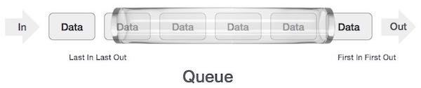
Implementation of queues
As in stacks, a queue can also be implemented using Arrays, Linked-lists.

Slide 5
Application of Queues
Task Scheduling: Queues can be used to schedule tasks based on priority or the order in which they were received.
Resource Allocation: Queues can be used to manage and allocate resources, such as printers or CPU processing time.
Event Handling: Queues can be used to handle events in event-driven systems, such as GUI applications or simulation systems.
Traffic Management: Queues can be used to manage traffic flow in transportation systems, such as airport control systems or road networks.
Operating systems: Operating systems often use queues to manage processes and resources.
Network protocols: Network protocols like TCP and UDP use queues to manage packets that are transmitted over the network. Queues can help to ensure that packets are delivered in the correct order and at the appropriate rate.
Printer queues :In printing systems, queues are used to manage the order in which print jobs are processed. Jobs are added to the queue as they are submitted, and the printer processes them in the order they were received.
Web servers: Web servers use queues to manage incoming requests from clients. Requests are added to the queue as they are received, and they are processed by the server in the order they were received.
Breadth-first search algorithm: The breadth-first search algorithm uses a queue to explore nodes in a graph level-by-level. The algorithm starts at a given node, adds its neighbors to the queue, and then processes each neighbor in turn.

Slide 6
Issues related to queues
Queue overflow: If a queue has a fixed size, it can become full, leading to a queue overflow. This can happen if elements are added to the queue faster than they are removed. To prevent overflow, some implementations use dynamic resizing or circular buffers.
Queue underflow: If a queue is empty and an attempt is made to remove an element, this can lead to a queue underflow. This can happen if elements are removed from the queue faster than they are added. To prevent underflow, some implementations use sentinel values or null pointers to represent an empty queue.
Blocking queues: In some applications, a queue may become blocked if it is full or empty. This can cause delays in processing or deadlock. To address this, some implementations use bounded queues or non-blocking queues.
Priority inversion: In some applications, a higher priority element can get stuck behind a lower priority element in the queue. This can lead to priority inversion and result in reduced performance. To prevent this, some implementations use priority queues or multiple queues with different priorities.
Synchronization issues: In concurrent applications, multiple threads may access the same queue simultaneously. This can lead to synchronization issues like race conditions, deadlocks, and livelocks. To address this, some implementations use locking mechanisms like mutexes or semaphores.
Memory management: In some implementations, a queue may allocate and deallocate memory frequently, leading to memory fragmentation and reduced performance. To address this, some implementations use memory pools or pre-allocated buffers.

Slide 7
Basic Operations
Some of the principle operations in the stack are −
Enqueue( ) // to insert a new item
dequeue( ) // To delete a value or access
Peek( ) // extract front item without removing it
Display( ) //Display stack
isEmpty( )
isFull( )

Slide 8
Enqueue() and Dequeue
In queue, we always dequeue (or access) data, pointed by front pointer
Enqueuing (or storing) data in the queue, we take help of rear pointer.

Slide 9
Enqueue()
Queues maintain two data pointers, front and rear. Therefore, its operations are comparatively difficult to implement than that of stacks.
The following steps should be taken to enqueue (insert) data into a queue −
Step 1 − Check if the queue is full.
Step 2 − If the queue is full, produce overflow error and exit.
Step 3 − If the queue is not full, increment rear pointer to point the next empty space.
Step 4 − Add data element to the queue location, where the rear is pointing.
Step 5 − return success.

Slide 10
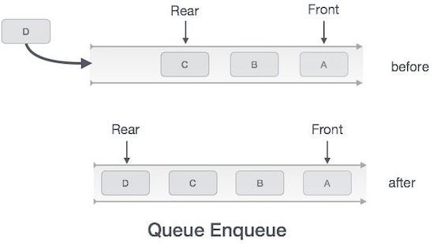
Enqueue()

Slide 11
Insert a new element in Queue
int enqueue(int data)
{
if (isFull())
return 0;
else
{
rear++;
queue[rear] = data;
return 1;
}
}

Slide 12
Check if Queue is full?
bool isFull()
{
if (rear == maxSize - 1)
return true;
else
return false;
}

Slide 13
Dequeue()
Accessing data from the queue is a process of two tasks − access the data where front is pointing and remove the data after access. The following steps are taken to perform dequeue operation −
Step 1 − Check if the queue is empty.
Step 2 − If the queue is empty, produce underflow error and exit.
Step 3 − If the queue is not empty, access the data where front is pointing.
Step 4 − Increment front pointer to point to the next available data element.
Step 5 − Return success.

Slide 14
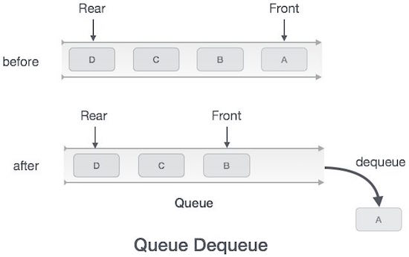
Dequeue()

Slide 15
Delete an element from Queue
int dequeue()
{
if (isEmpty())
return 0;
else
{
int data = queue[front];
front++;
return data;
}
}

Slide 16
Check if queue is Empty or not?
bool isEmpty()
{
if (front < 0 || front > rear)
return true;
else
return false;
}

Slide 17
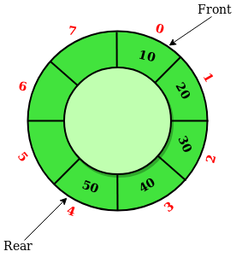
Circular Queue
The circular queue is also a linear data structure in which the last element of the Queue is connected to the first element, thus creating a circle.
Circular Queue works by the process of circular increment i.e. when we try to increment the pointer and we reach the end of the queue, we start from the beginning of the queue.

Slide 18
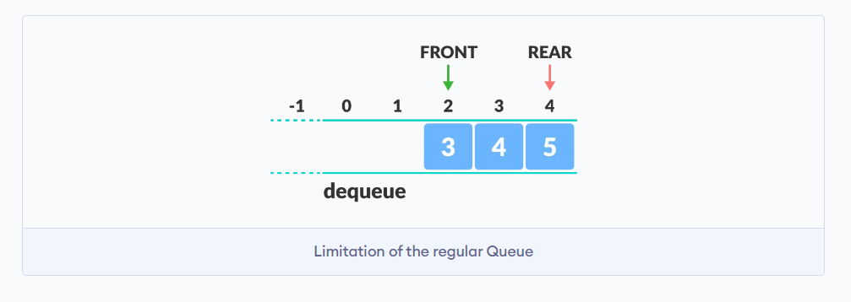
Limitations of Linear Queue
The circular queue solves the major limitation of the normal queue. In a normal queue, after a bit of insertion and deletion, there will be non-usable empty space.

Slide 19
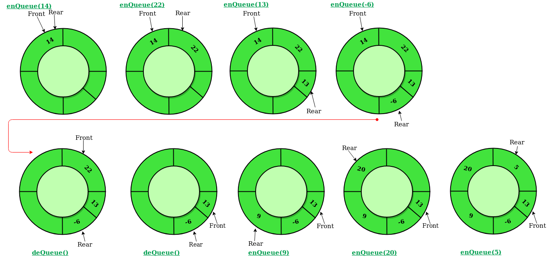
How Circular queue works?

Slide 20
Enqueue() for circular queue
To enqueue an element x into the queue, do the following:
Increment rear by 1.
If rear is equal to n, set rear to 0.
If front is -1, set front to 0.
Set queue[rear] to x.

Slide 21
Dequeue() for circular queue
To dequeue an element from the queue, do the following:
Check if the queue is empty by checking if front is -1.
If it is, return an error message indicating that the queue is empty.
Set x to queue[front].
If front is equal to rear, set front and rear to -1.
Otherwise, increment front by 1 and if front is equal to n, set front to 0.
Return x.

