Slide 1
project with the continuous integration tool jenkins
Author: Vlad Sidyuk

Slide 2
implement in this project
the job that collects a container on a computer, adds the necessary site to it and deploys it to another computer
the job that rolls back to the stable version

Slide 3
USED IN THIS PROJECT
GITHUB
JENKINS
AWS
DOCKER
DOCKER HUB

Slide 4
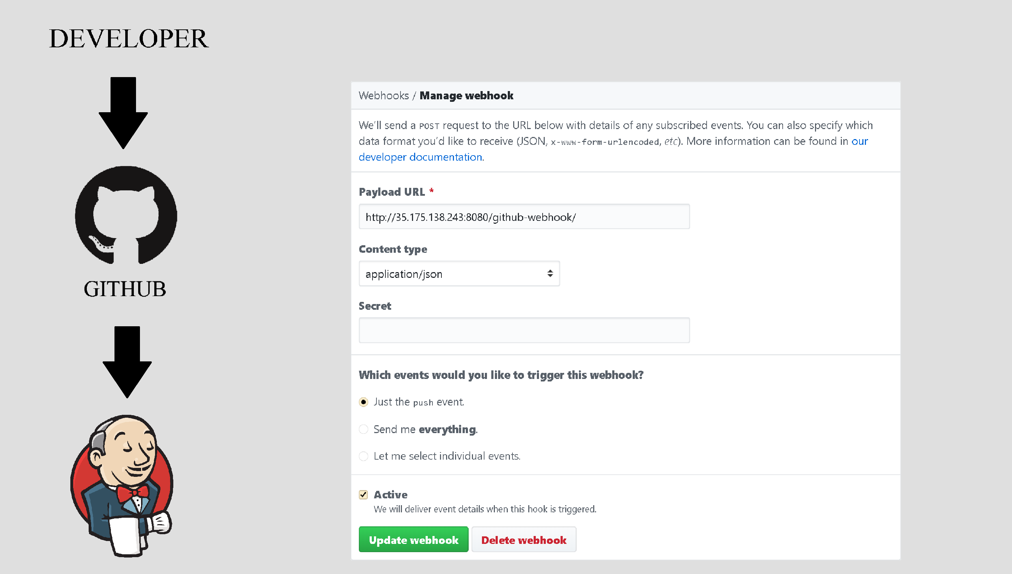
WEBHOOK

Slide 5
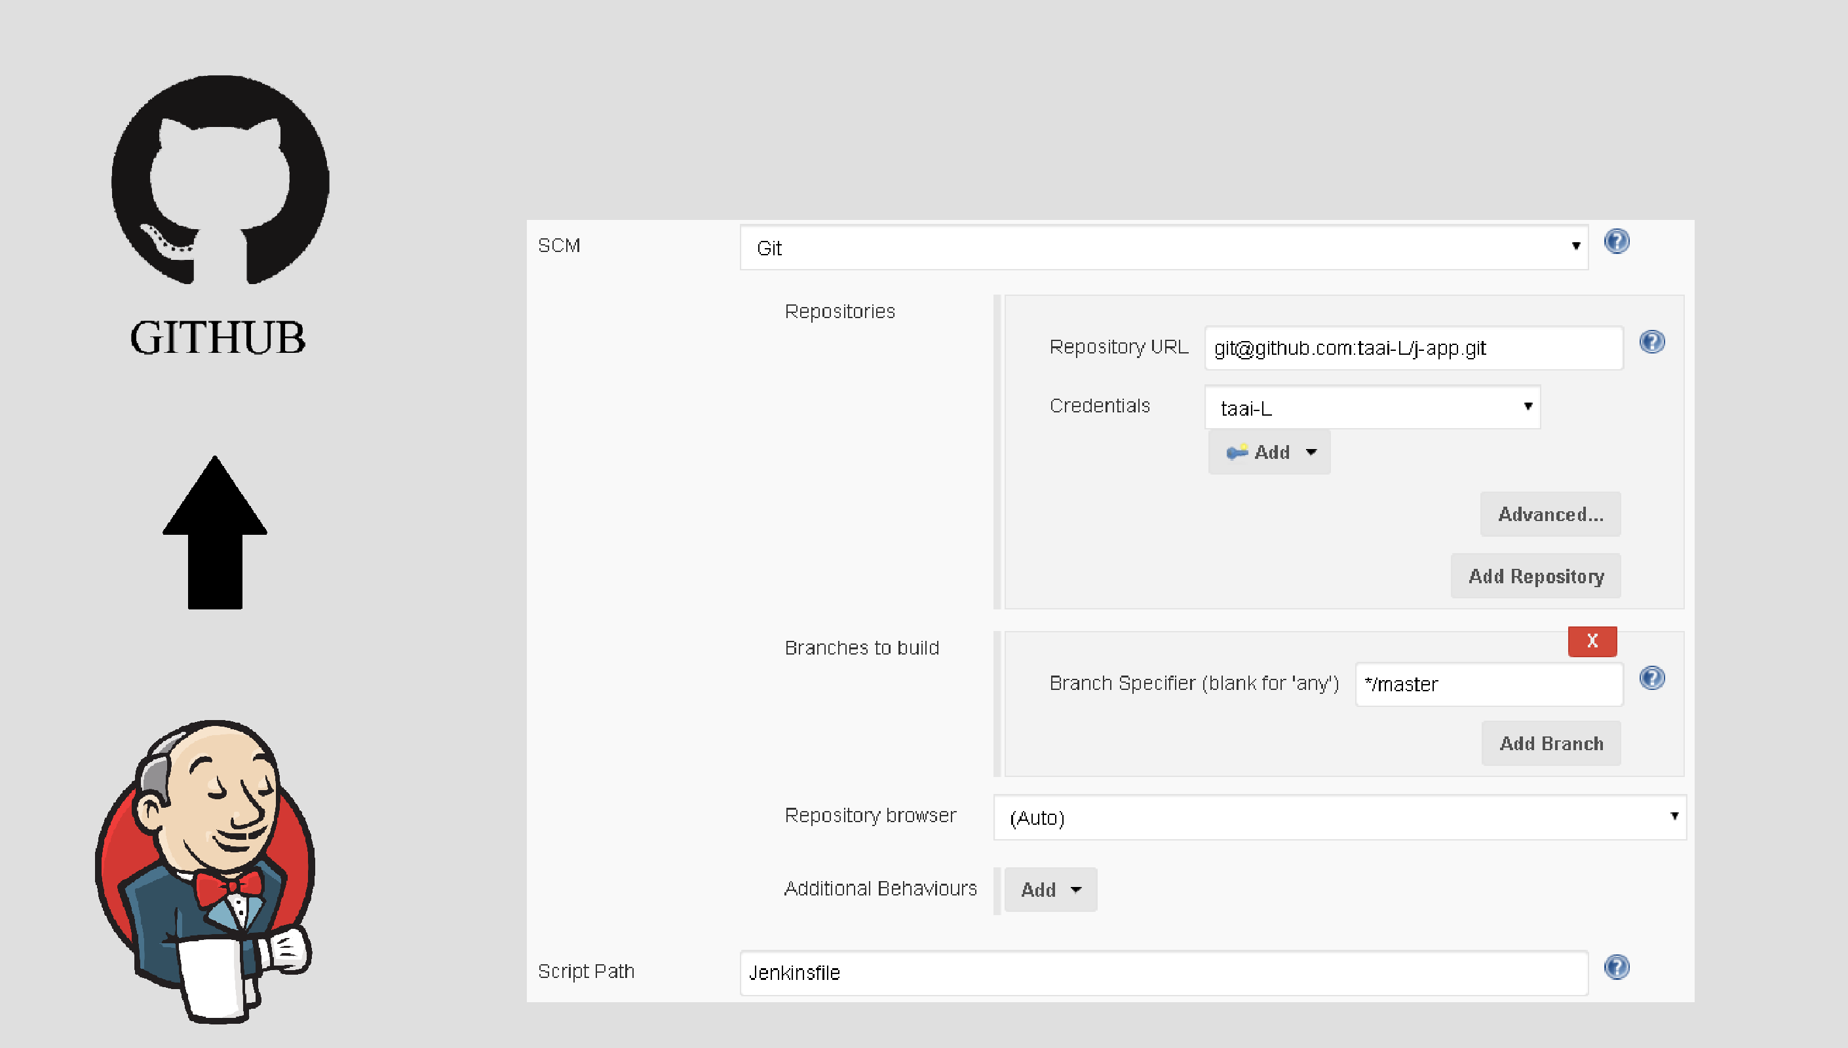
PULL GIT

Slide 6
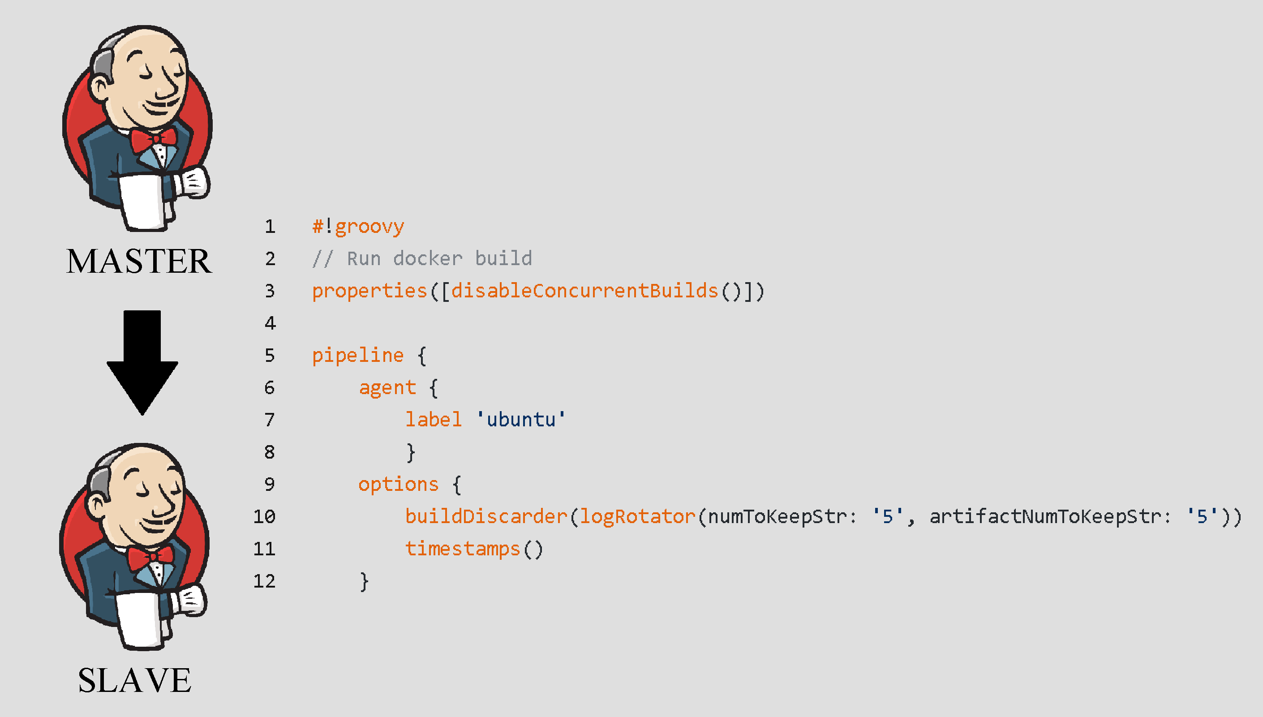
SENDING PROCESSING TO A SLAVE

Slide 7
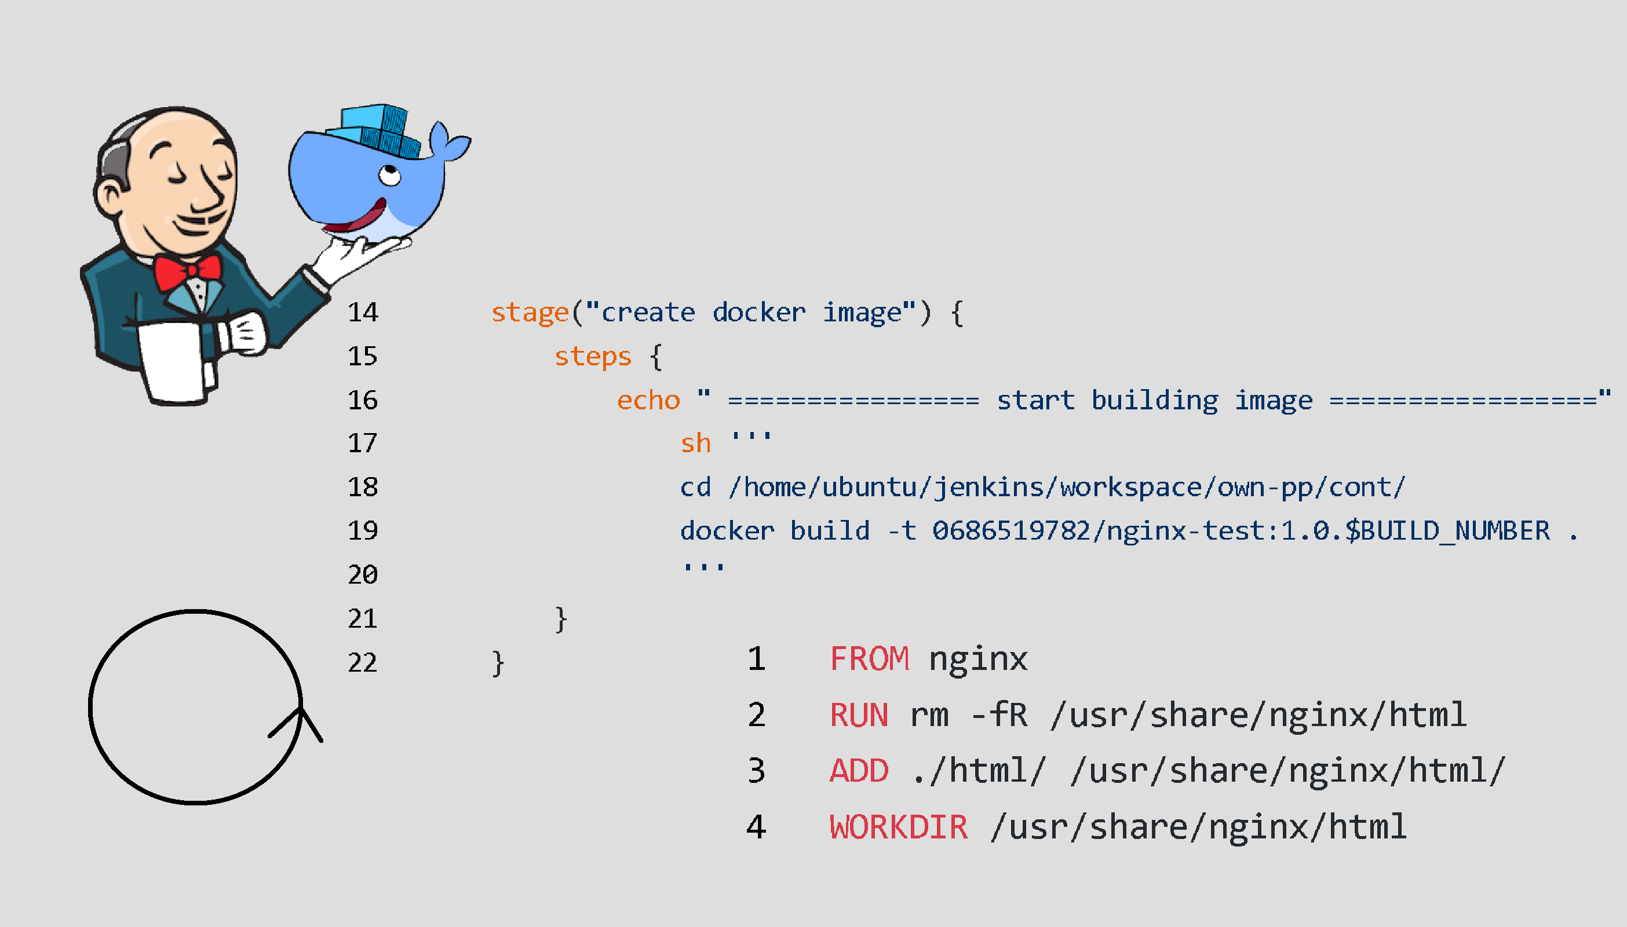
BUILD DOCKER IMAGE

Slide 8
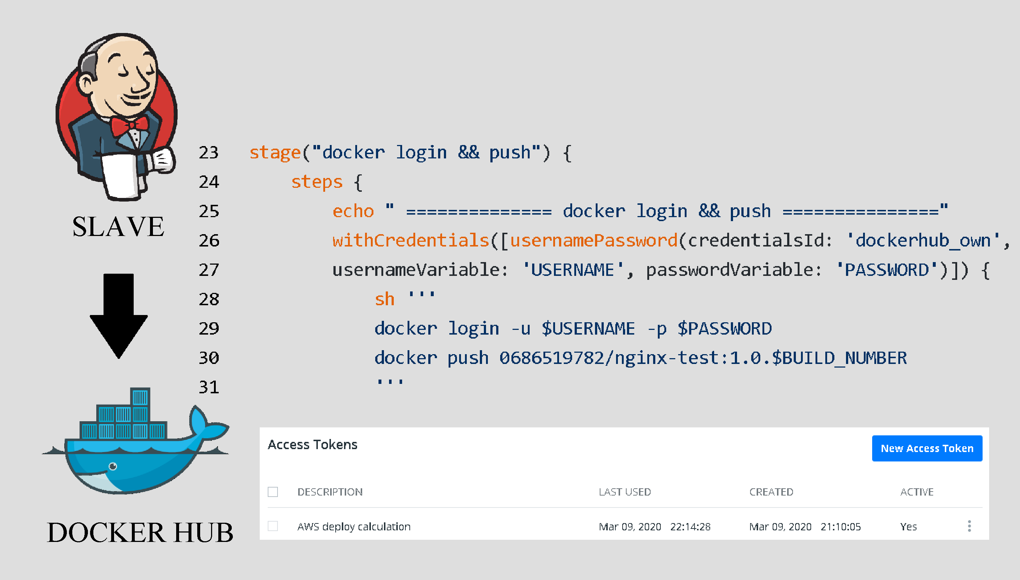
DOCKER HUB LOGIN and push

Slide 9
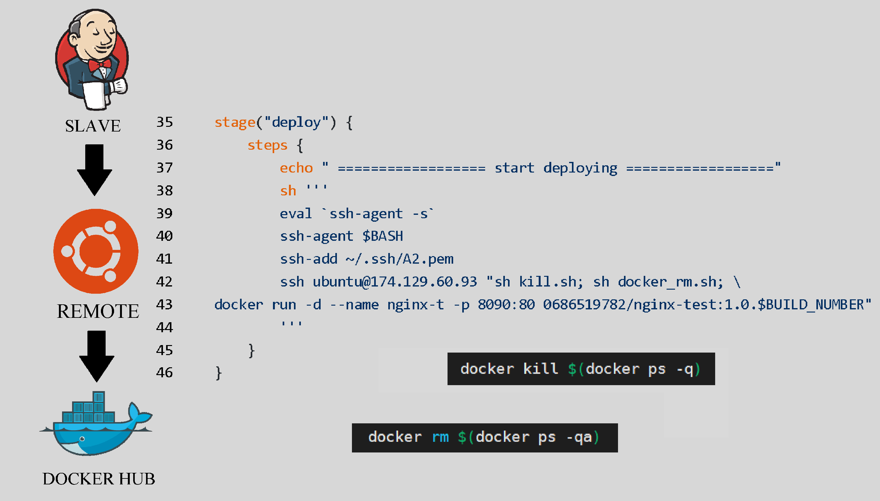
DEPLOY

Slide 10
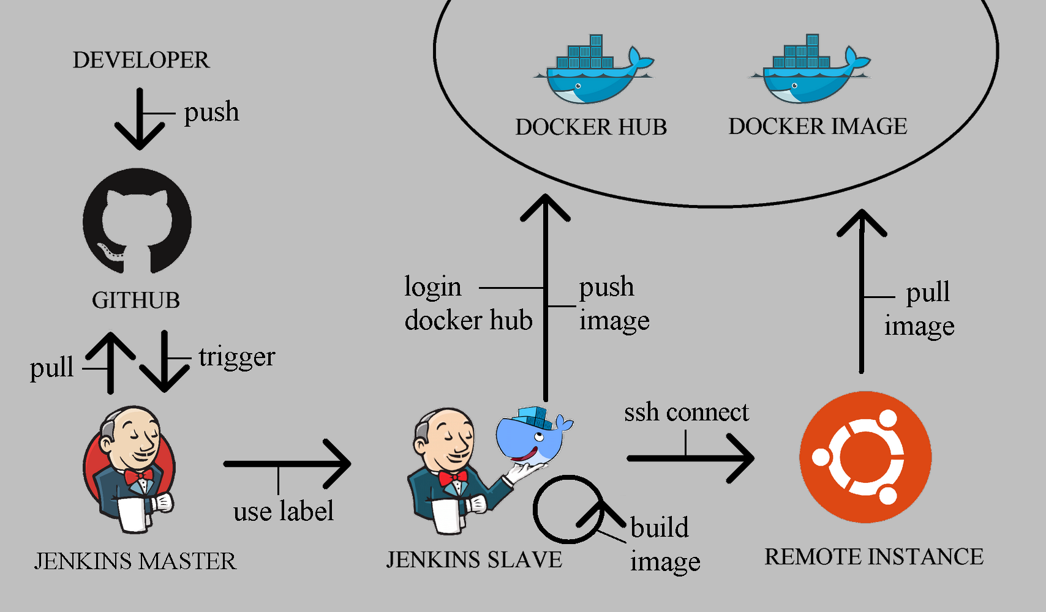

Slide 11
WHAT ARE THE FEATURES
easy to deliver
no additional deployment software required
it is possible to return to the previous version

Slide 12
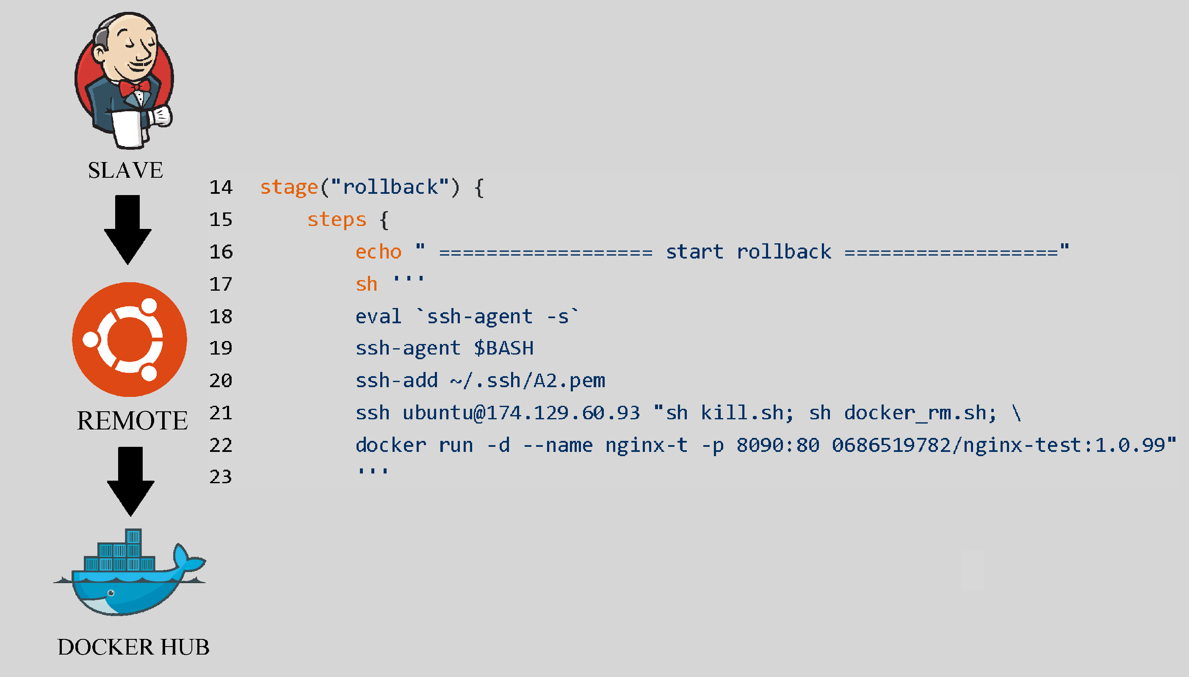
rollback job
if we had a failed build, we can manually return to the stable version with this job

Slide 13
Q&A?
THANKS FOR ATTENTION

