Slide 1
Improving the Contrast of Neutron Interferometry Measurements With Bayesian Markov Chain Monte Carlo Methods
Thomas Alexander

Slide 2
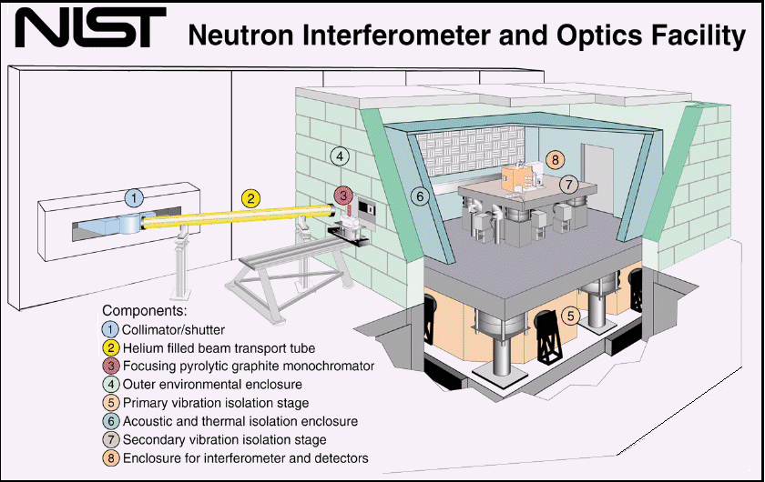
Neutron Interferometry

Slide 3
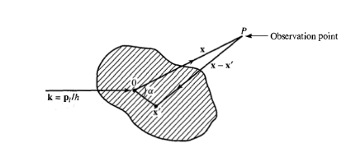
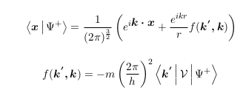



Quantum Scattering
Incident Wave
Outgoing Wave

Slide 4

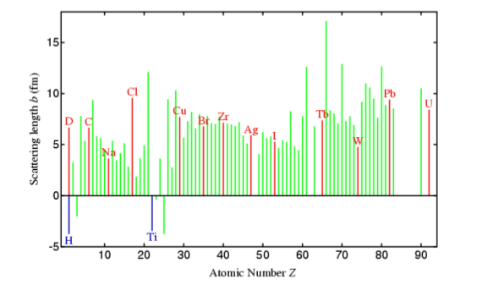




Neutron-Nucleus Scattering

Slide 5
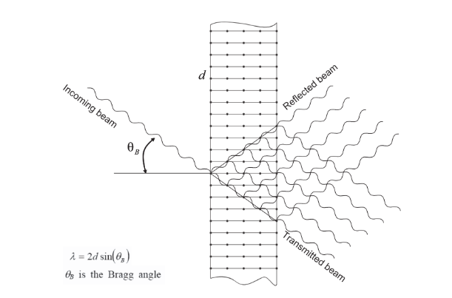

Bragg Scattering

Slide 6


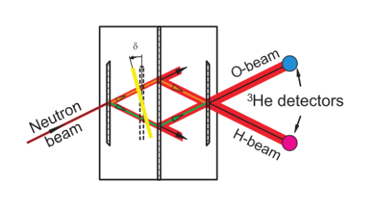







The Neutron Interferometer
Incident Wave
After First Blade
Second Blade
O-Detector
H-Detector

Slide 7






The Phase Flag

Slide 8



Interferometer Contrast

Slide 9
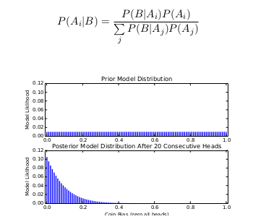
Bayes Thereom

Slide 10




Markov Chain Monte Carlo Methods

Slide 11



Resampling
Particle Weights
Particle Update
Resampling Threshold

Slide 12


Experimental Neutron Interferometry Model
Fittable Model
Water Vapour Phase Dependence

Slide 13





Phase Shift Due to Water Vapour
Antoine Equation
Phase Shift Due
Water Vapour
Final Experimental Model
For Full Phase Control

Slide 14
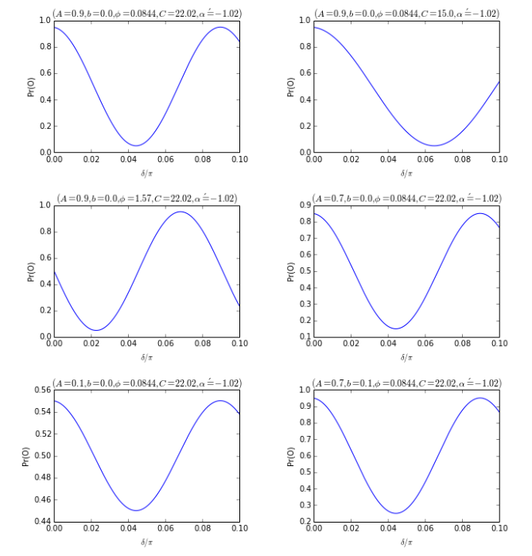
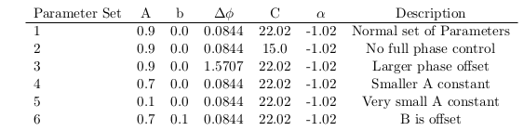
Simulating Experiment – True Parameters

Slide 15
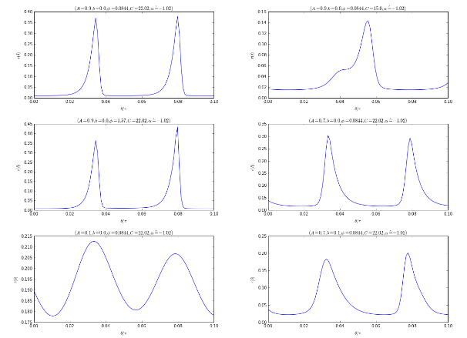
Simulating Experiment – Initial Risk

Slide 16
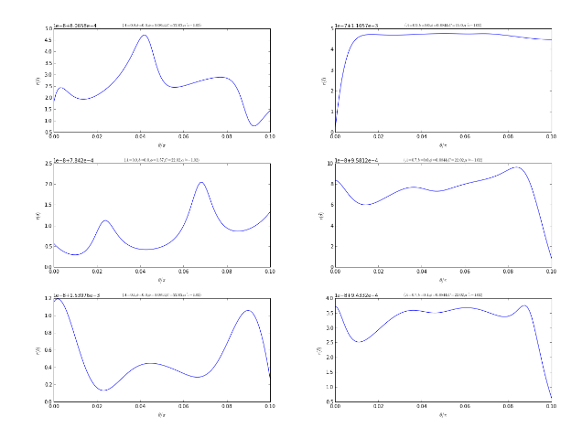
Simulating Experiment – Naive

Slide 17

Simulating Experiment – Naive

Slide 18
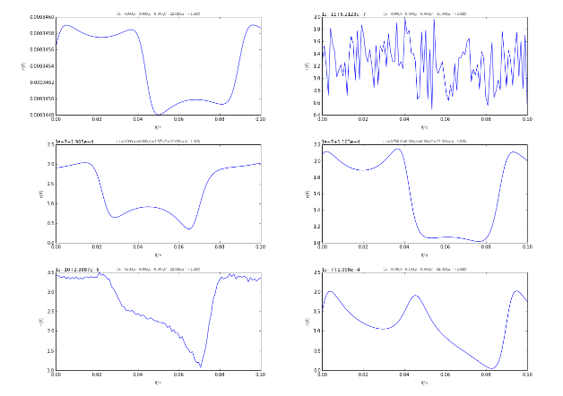
Simulating Experiment - Adaptive

Slide 19

Simulating Experiment - Adaptive

Slide 20
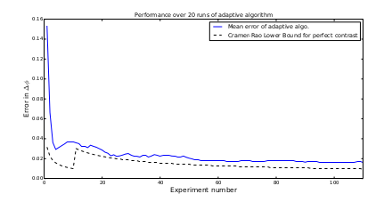
Simulating Experiment – Mean Error

Slide 21
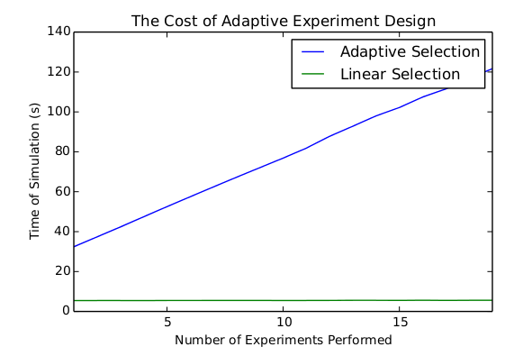
The Cost of Adaptive Experimental Design

Slide 22


Q-Infer - GPU Likelihood Acceleration
Likelihood calls
Where m is number of minimization algorithim iterations, p is the number of experimental parameters and n is the number of Monte Carlo particles.

Slide 23
Ni-Engine – Design Requirements
Communicate with a variety of hardware
Handle all configuration and setup
Measure and Store big datasets
Fast execution and threaded interaction with hardware
Consistent memory use
Stored data should contain all metadata required
Must be modular and extensible
Easy to use
Documentation

Slide 24
Ni-Engine – Why Python?
Python is easy to use and learn
Easy to read code
Lots of libraries
Community
Interface with C
Q-Infer is written in python (biggest reason)

Slide 25
Ni-Engine - Architecture
Object-Oriented Design
Chain of Responsibility
Ni-Engine Object
Hardware Objects
Controller Objects
Sensor Objects
DataHandler
Configuration
Factory objects

Slide 26
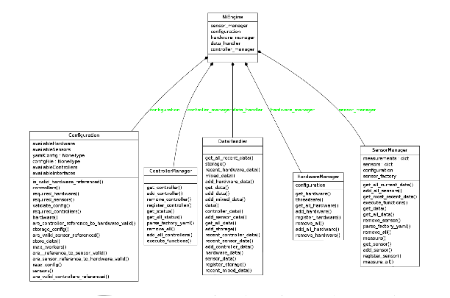
Ni-Engine – Architecture

Slide 27
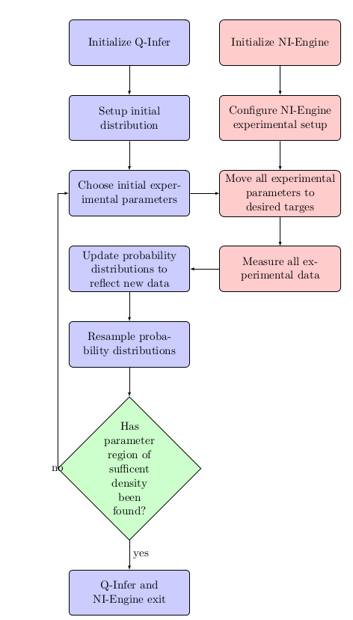
Ni-Engine - Program Flow

Slide 28
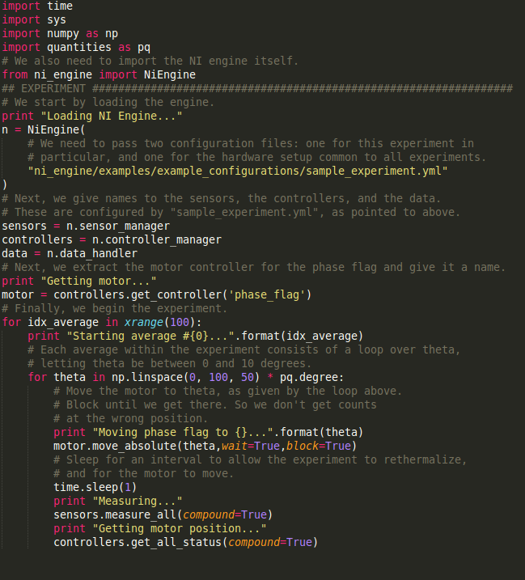
Ni-Engine - Sample Experiment
Experiment initializes all hardware. Then sweeps through a range of phase flag measurements and stores data.

Slide 29
Thank you very much for your time! Questions?

Slide 30




Cramer-Rao Lower Bound

Slide 31




Robust Online Hamiltonian Learning
Information Gain
Quadratic Loss
Bayes' Risk
Bayesian Cramer-Rao Lower Bound

