Slide 1
Continuous Probability Distributions

Slide 2
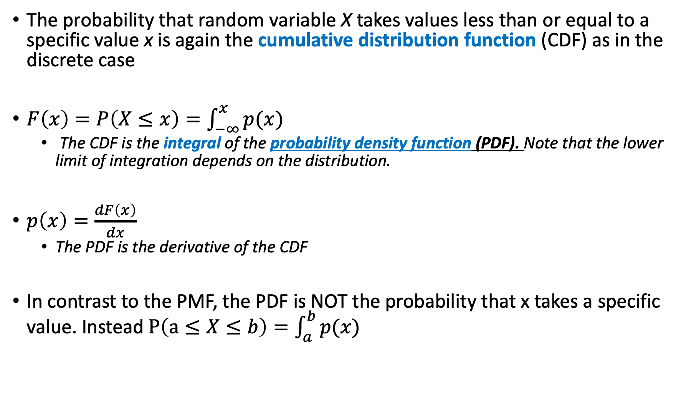
Continuous Distributions
The probability that random variable X takes values less than or equal to a specific value x is again the cumulative distribution function (CDF) as in the discrete case
$F\left(x\right)=P\left(X≤x\right)=\int_{−∞}^{x}{p(x)}$
The CDF is the integral of the probability density function (PDF). Note that the lower limit of integration depends on the distribution.
$p\left(x\right)=\frac{dF\left(x\right)}{dx}$
The PDF is the derivative of the CDF
In contrast to the PMF, the PDF is NOT the probability that x takes a specific value. Instead $P\left(a≤X≤b\right)=\int_{a}^{b}{p(x)}$

Slide 3

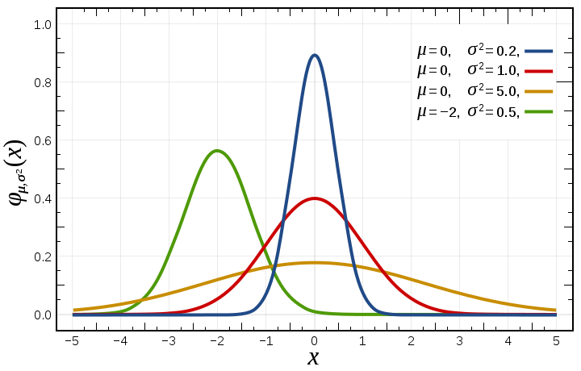
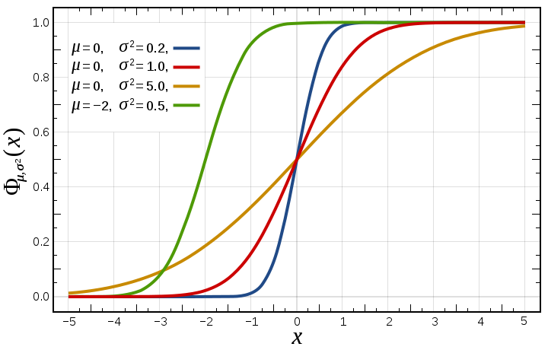
Relationship between PDF and CDF
Recall that the CDF is P[ X ≤ x]
CDF is integral of PDF. PDF is derivative of CDF

Slide 5
Note the inequality. It really matters for discrete distributions

Slide 6
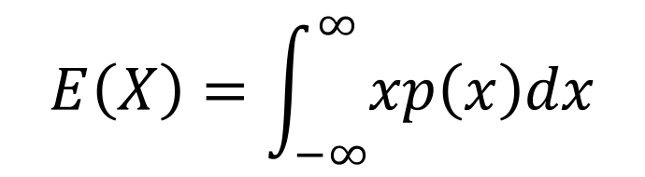
Expected Value
The expected value of a continuous random variable is:
$$E\left(X\right)=\int_{−∞}^{∞}{xp\left(x\right)dx}$$
Just like the discrete case but with an integral instead of summation!

Slide 7
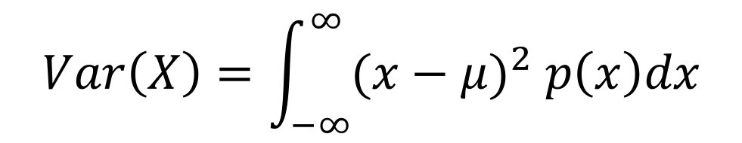
Variance
The variance of a continuous random variable is given by:
Which is the same as E{(X - µ )²}
$$Var\left(X\right)=\int_{−∞}^{∞}{{(x−μ)}^{2} p\left(x\right)dx}$$
Recall our derivation showed that
$$Var\left(X\right)=E\left(X^{2}\right)−{E(X)}^{2}$$

Slide 8
The Normal Distribution aka Gaussian

Slide 9
Introduction
The Normal (or Gaussian) distribution is the most used distribution in statistics.
Normal random variables are continuous (they can take any value on the real line) so the Normal distribution is an example of a continuous probability distribution.

Slide 10
The Normal Distribution-I
Inflection
points
Total area=1
μ-3σ
μ-2σ
μ-σ
μ
μ+σ
μ+2σ
μ+3σ
The graph of the normal distribution
is called the normal (or bell) curve.

Slide 11
The Normal Distribution-II
The mean, median, and mode are the same.
The normal curve is symmetric about its mean.
The total area under the normal curve is one.
The normal curve approaches, but never touches, the x-axis.

Slide 12
The Normal Distribution-III
Notation
We say that the random variable X is normally distributed with mean μ and standard deviation σ
The equation defining the normal curve is:
f (x) is referred to as a probability density function (pdf).

Slide 13
Normal Cumulative Distribution Function -Notice that all CDFs are non-decreasing
Recall that the CDF is P[ X ≤ x]

Slide 14
Relationship between PDF and CDF
Recall that the CDF is P[ X ≤ x]
CDF is integral of PDF. PDF is derivative of CDF

Slide 15
Normal Distributions and Probability-II
Of the total area under the curve about:
68% lies between μ-σ and μ+σ
95% lies between μ-2σ and μ+2σ
99.7% lies between μ-3σ and μ+3σ
Really 1.96 SD, but ~2
68%
34%
95%
2.5%
13.5%
99.7%
2.5%
μ

Slide 16
Example
Group Work
The mean length of a fish of age 5 is 40cm and the standard deviation is 4. What is the approximate probability that the length of a randomly selected fish of age 5 is less than 48cm?
48cm is two standard
deviations above the
mean so the area
to the left of 48cm is
0.5+0.475 = 0.975.

Slide 17

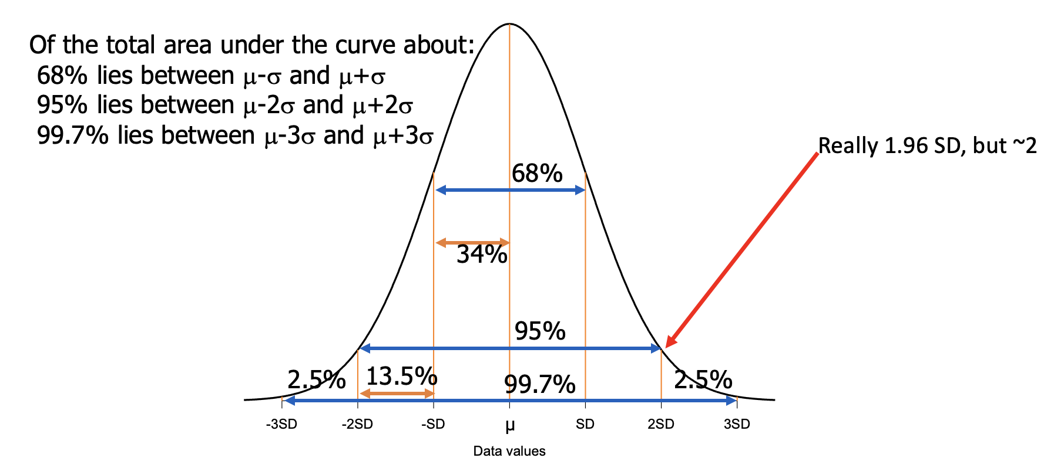
Example
An anchovy net can hold 10 t of anchovy. The mean mass of anchovy school is 8 t with a standard deviation of 2 t. What proportion of schools cannot be fully caught?
Hint: we are interested in the proportion of schools greater than 10t.
ie. 1- P(X ≤ 10) =

Slide 18
The Standard Normal Distribution
The normal distribution with a mean of 0 and a standard deviation of 1 is called the standard normal distribution
We can make a normal RV Y with any mean and variance
Y = μ + σz

Slide 19
Further Examples
Group Work
For standard normally distributed RV X, find the probability that:
X ≤ -0.95
X ≥ 1
0.1 ≤ X ≤ 0.5 OR 1.5 ≤ X ≤ 2

Slide 20
Sampling and Sampling Distributions
Why be Normal?
A sampling distribution is the probability distribution of a sample statistic that is formed when samples of size n are repeatedly taken from a population. If the sample statistic is the sample mean, then the distribution is the sampling distribution of sample means.

Slide 21
Sampling and Sampling Distributions-II (Example)
Consider a population of fish in a lake. The mean and standard deviation of the lengths of these fish are 300 mm and 50 mm respectively.
Take 100 random samples where each sample is of size 10, 20, or 100.
What can we learn about the population mean and how does this depend on the size of our sample?

Slide 22
Sampling and Sampling Distributions-IV (Example)
N=10
N=20
N=100
We know the population we sampled from has mean of 300 and standard deviation of 50

Slide 23
Properties of the Sampling Distribution for the Sample Mean
The mean of the sample means is equal to the population mean:
The standard deviation of the sample means is equal to the population standard deviation divided by the square root of n.
is often called the standard error!

Slide 24
The Central Limit Theorem (Why we use the Normal distribution so much!)
The sum (and therefore mean) of random variables of any distribution tends toward a normal distribution as sample size increases
If samples of size n (where n ≥~30) are drawn from any population with a mean μ and a standard deviation σ, the distribution of the means approximates a normal distribution. The greater the sample size, the better the approximation.
If the population is itself normally distributed, the sampling distribution of the sample means is normally distributed for any sample size.
Compare hist(rgamma(1000,1,1)) with
hist(rgamma(1000,1,1)+rgamma(1000,1,1)+rgamma(1000,1,1)+rgamma(1000,1,1)+rgamma(1000,1,1)+rgamma(1000,1,1)+rgamma(1000,1,1)+rgamma(1000,1,1))

Slide 25
The Central Limit Theorem (Example)

Slide 26
Approximating a Binomial Distribution
It is possible to compute approximate probabilities for the binomial distribution using the normal distribution.
If np ≥ 5 and nq ≥ 5, the binomial random variable X ~B(n,p) is approximately normally distributed:
This approximation can be quite accurate even though the binomial distribution is discrete and the normal distribution is continuous.
These are mean and stdev of a binomial random variable

Slide 27
Approximating a Binomial Distribution-II
BUT we need an interval when defining the probability associated with a discrete value for x using the normal distribution, i.e. P^{B}(X=x) is approximated by P^{N}(x-Δ<X<x+Δ).
We call Δ the correction for continuity and set it to 0.5.

Slide 28
Approximating a Binomial Distribution-III
n=30
p=0.25

Slide 29
Approximating a Poisson Distribution
It is possible to compute approximate probabilities for the Poisson distribution using the normal distribution.
If μ>10, the Poisson random variable X ~P(μ) is approximately normally distributed:
These are mean and stdev of a Poisson random variable
In R, compare
hist(rpois(10000,50))
hist(rnorm(10000,50,sqrt(50)))

Slide 30
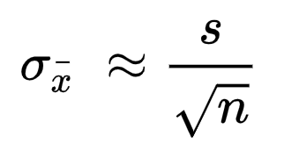
Small Samples and the t-Distribution
The sampling distribution of a test statistic (like a mean or a regression coefficient) is Normal.
Dividing a Normal by its standard deviation (called the standard error) makes a standard Normal, z . This is used in hypothesis testing.
If |z value| > 1.96, then p<0.05.
However, the standard error depends on the sample standard deviation s, which is not precisely known.
When the population standard deviation is unknown and estimated (and n<~30), the sample mean is t-distributed rather than Normally distributed.

Slide 31
Side Note – Stout and Statistics.
The t-distribution is often referred to as “Student’s” t-distribution.
“Student” (W.S. Gossett) was an employee of the Guinness Brewing Company and was prohibited from publishing papers (after someone published trade secrets) so he published under the pseudonym Student for his publications to avoid detection of his publications by his employer

Slide 32
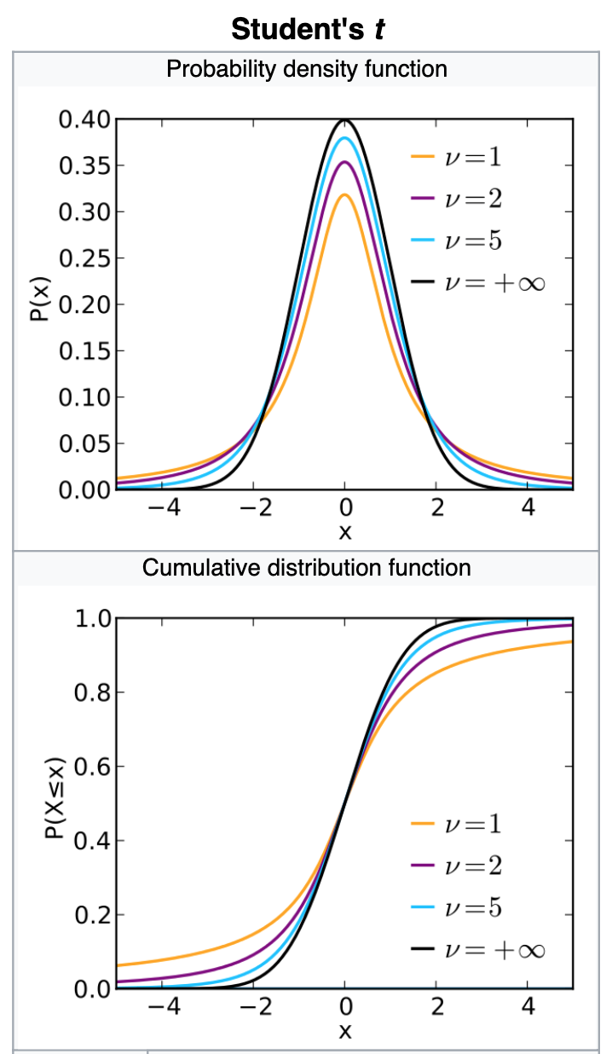
Properties of the t-distribution-I
Bell-shaped and symmetric like Normal
But can have “fattails”, i.e. falls to zero less steeply
The mean, median and mode are equal to 0.
The t-distribution is a family of curves. Each element of the family is determined by a parameter called the degrees of freedom (n-1 for the case of the sample mean)
Smaller samples have more uncertainty about standard deviation and so tails are fatter, but as sample size increases this approaches the standard normal distribution because standard deviation is well estimated.

Slide 33
Properties of the t-distribution-II
Estimate
True Mean. Zero for hypothesis testing
df=5
df=2
Standard error
Notes:
Cue: Taal, open R and show estimate and standard error produce t

Slide 34
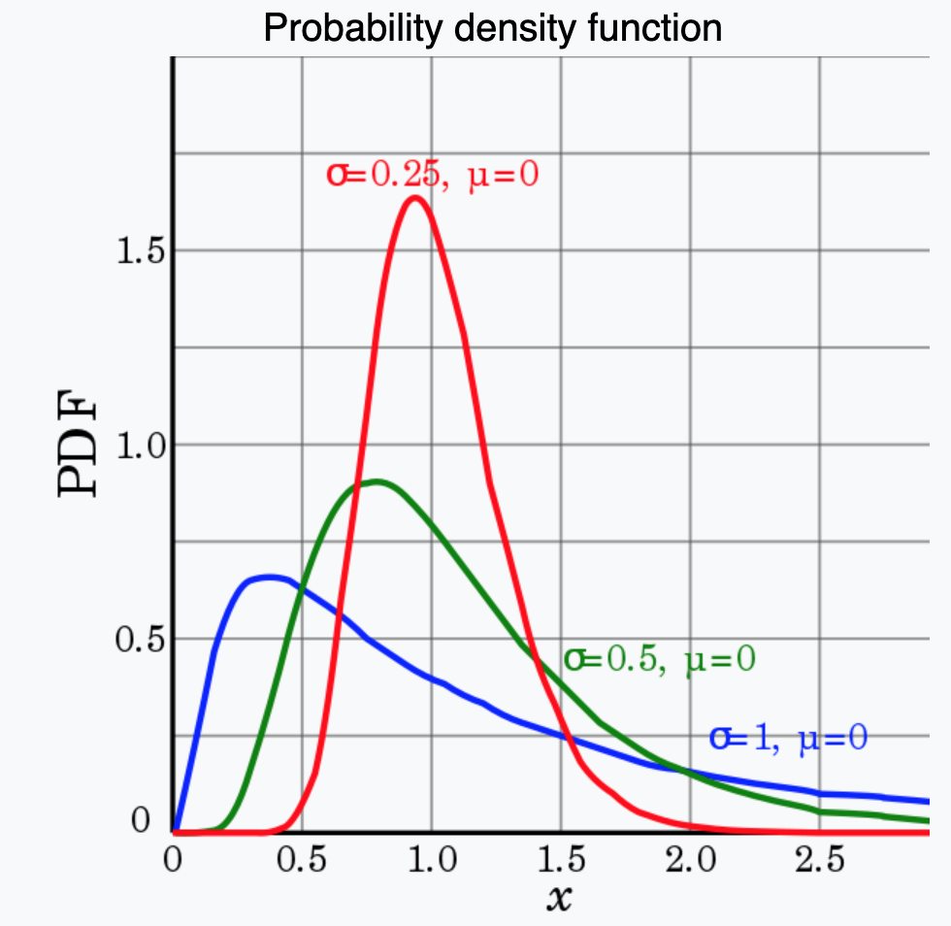
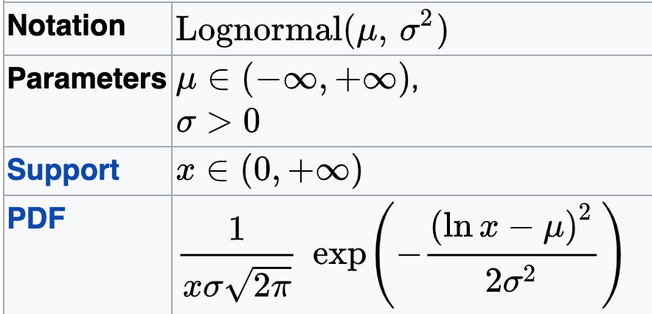
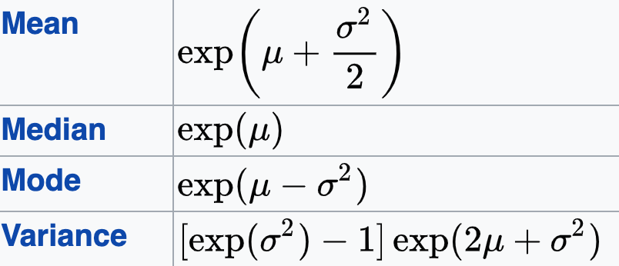
The Lognormal distribution
The log of a lognormal random variable is Normally distributed!
If X~Normal(μ, σ²), then Y=e^{X} ~ lognormal(μ, σ²)

Slide 35
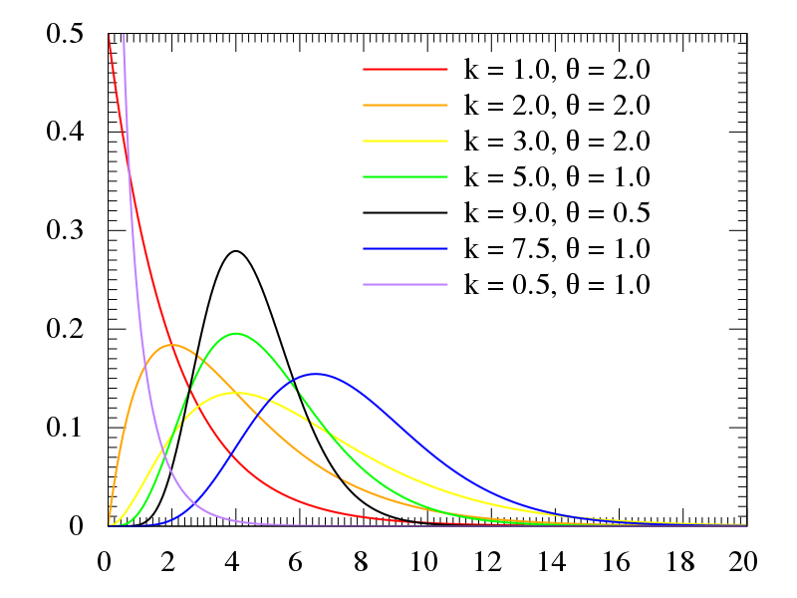
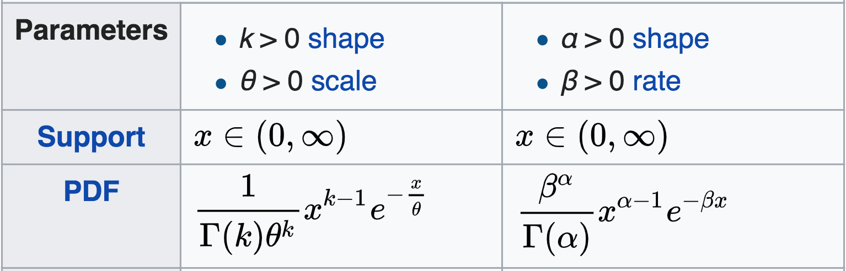


Remember the Gamma distribution
Flexible distribution for positive data. VERY useful in statistical modelling
Standard in R

Slide 36
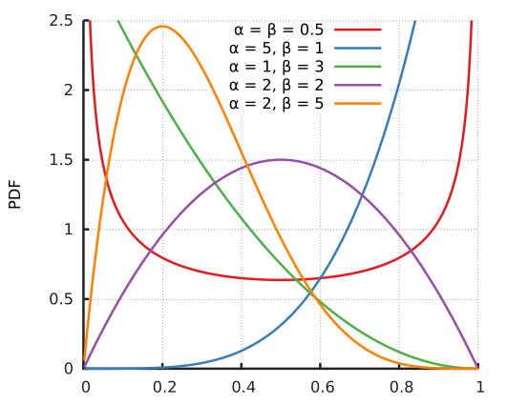
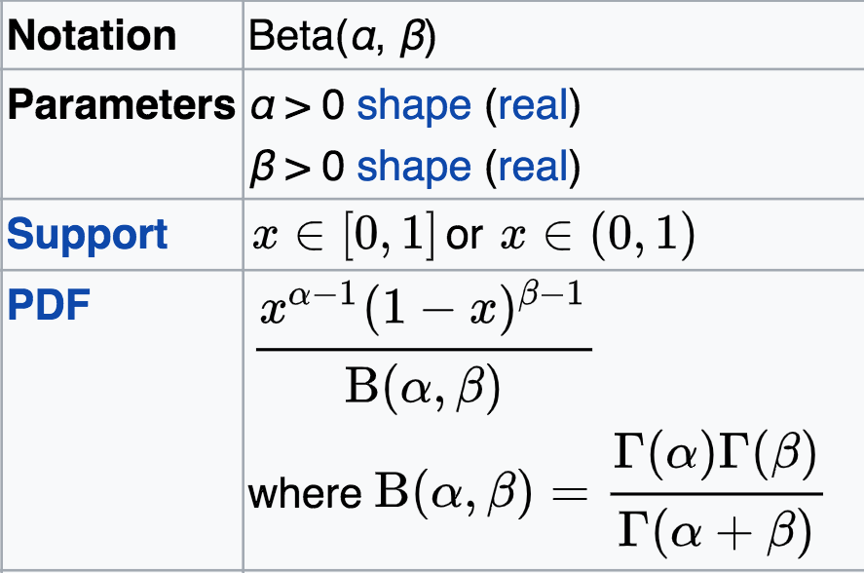
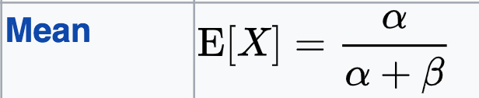
The Beta distribution
Distribution for proportions
What does a Beta(1,1) become?
How might this relate to the binomial distribution?

Slide 37
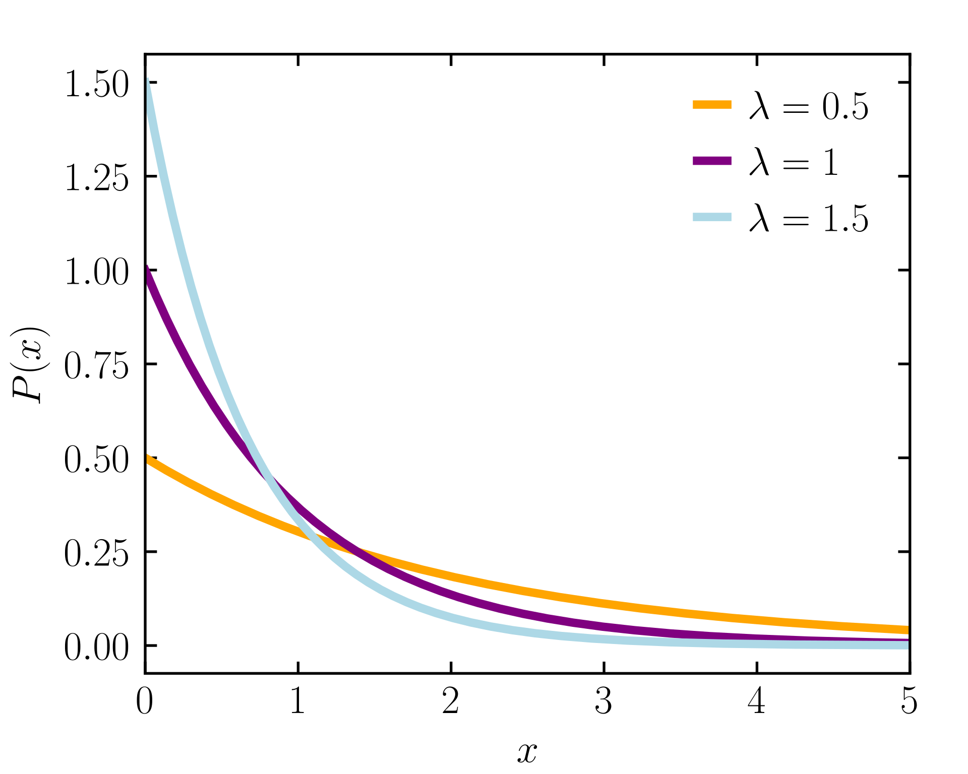
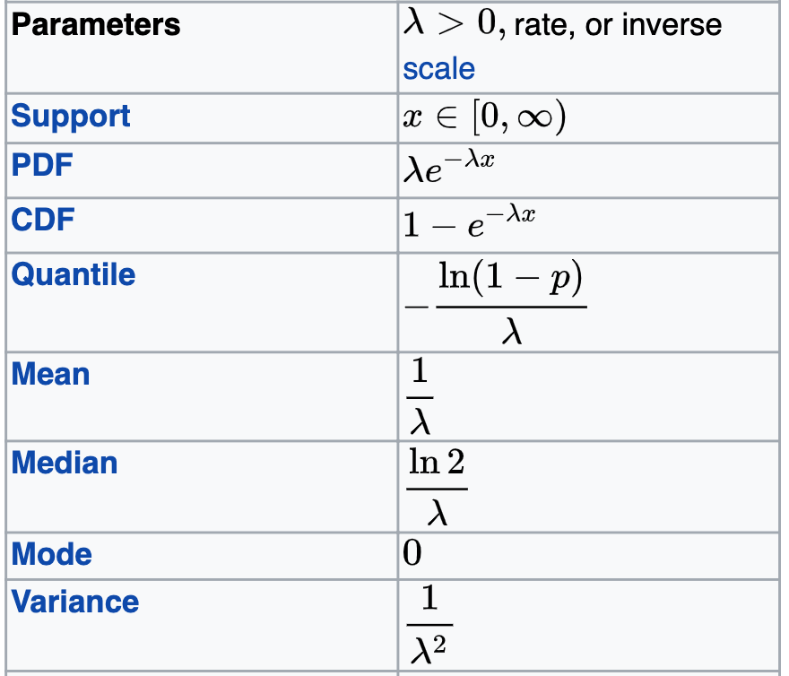
The Exponential Distribution Distribution for time between random events (e.g. survival)

Slide 38
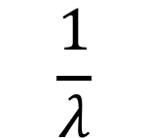
The Exponential Distribution-I
The Poisson distribution arose when counting the number of random events in an interval. The exponential distribution considers the interval of time between random events.
If events are occurring at random with average rate of λ per interval, then the probability density function for the length of time between events is:
$$\frac{1}{λ}$$
SD and Mean =

Slide 39
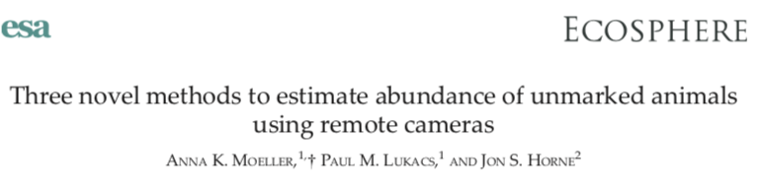



This Poisson – Exponential relationship is basis for animal density estimation from camera trap data
# animals seen by camera
Time between Poisson observations
Density is lambda divided by mean area in camera viewshed

Slide 40
The Exponential Distribution-II (Example-I)
Group Work
If a herring spawns 1.5 times per week on average, what is the probability that it doesn’t spawn for 2 weeks?
Note that this is a continuous probability distribution so we are looking for the area under the curve
Can be done analytically or in R
(wks)

Slide 41

The Exponential Distribution-II (Example-II)
Solution:
P[X>2] = 1-P[X≤2]=0.0498

Slide 42
The Uniform Distribution
This is the simplest possible continuous distribution. It is sometimes used to deal with the situation where all values in some interval (a, b) are equally likely.
Notation:
The probability density function for the uniform distribution is:
Group Work
Can you verify that this is a proper PDF? Use calculus or geometry.

Slide 43
The Uniform Distribution (Example)
Group Work
1
Can you verify that this is a proper PDF? Use calculus or geometry.
2
Suppose the mass of a nominally 500 kg bag of fish is equally likely to lie between 480 and 505 kg. What is the probability that the bag contains at least the advertised mass of fish?

Slide 44
Which distribution and why?
Group Work
The mass of carbon in above ground biomass in square m plot.
The number of seals on a haul-out beach in the gulf of AK.
Presence or absence of an invasive species in forest patches.
The probability that a white male will vote republican in a presidential election.
The number of individuals in four mutually exclusive income categories.
The number of diseased individuals in a sample of 100.
The political party affiliation (democrat, republican, independent) of a voter.

Slide 45
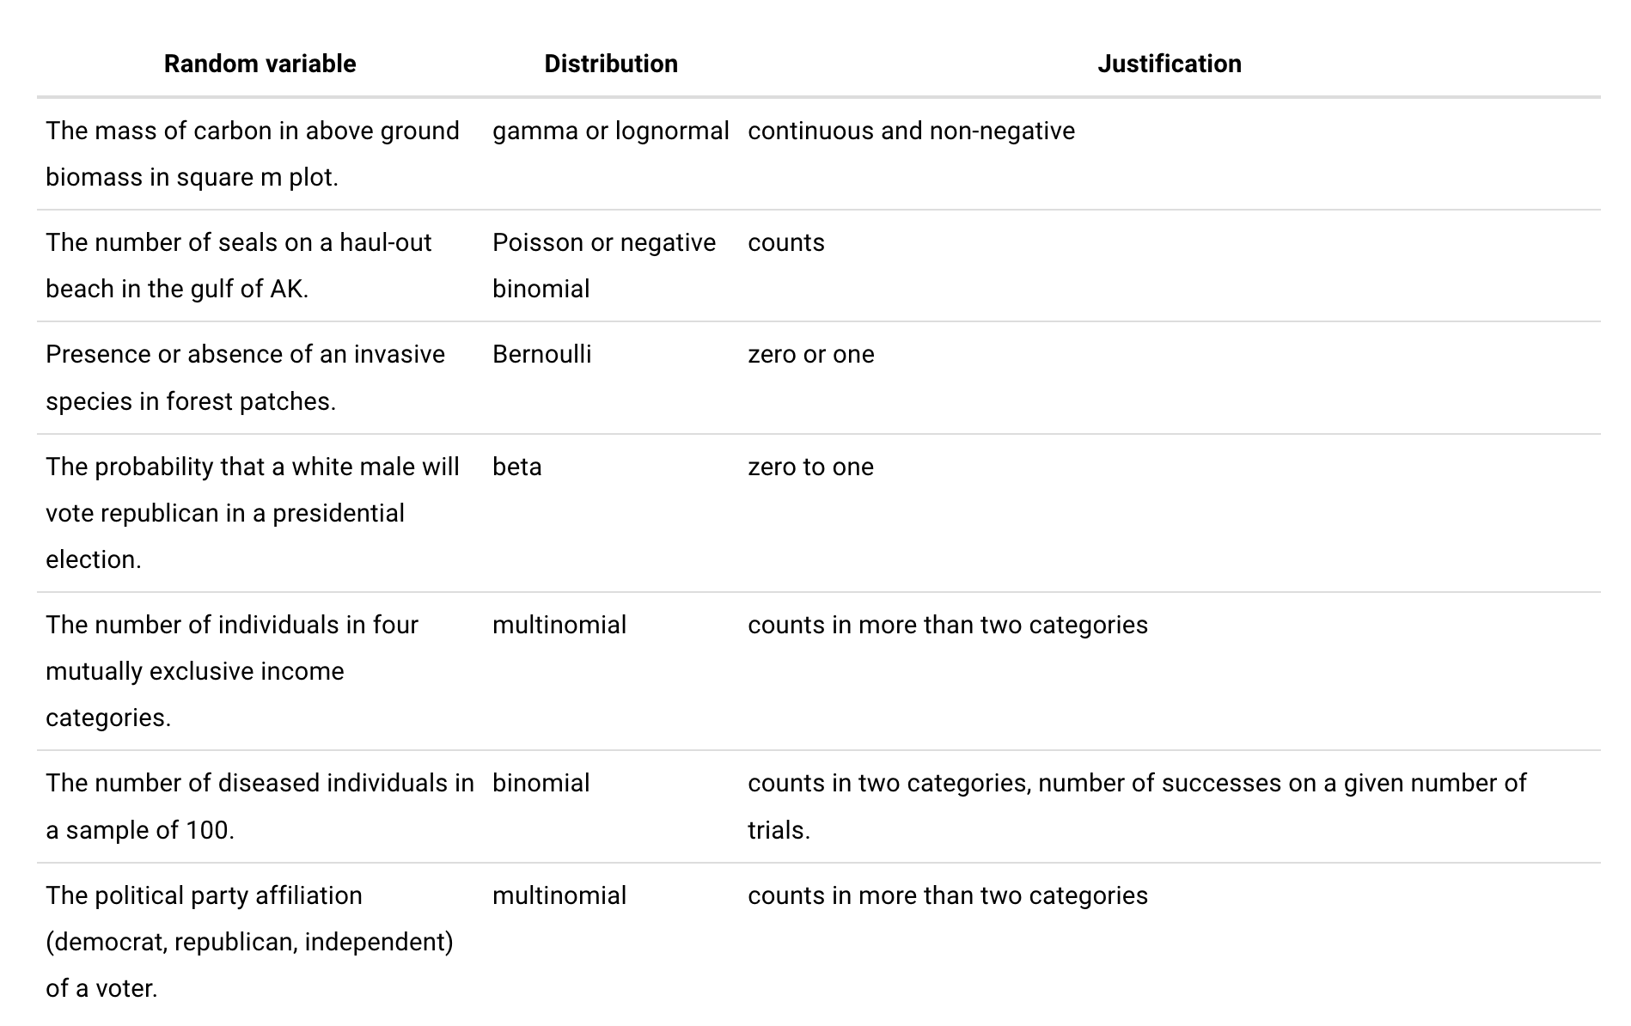

Slide 46
