Slide 1
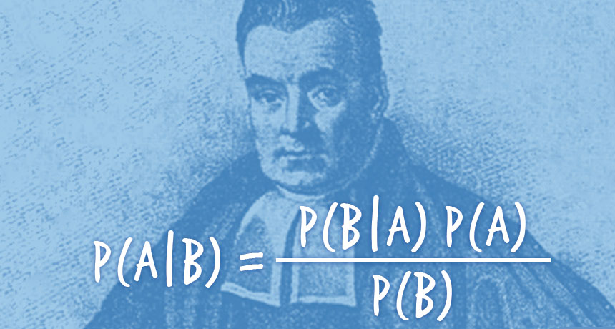
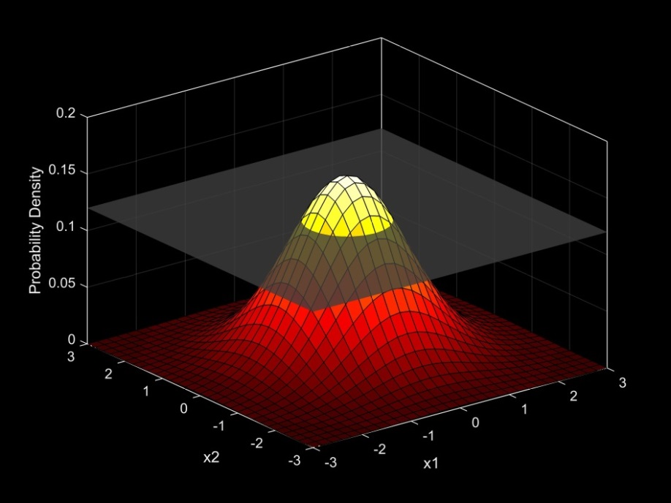
Introduction to Bayesian Analysis Part Deux
Many slides adapted from Matt Falcy ODFW, and SESYNC course by Chris Che-Castaldo, Mary B. Collins, N. Thompson Hobbs (with permission)

Slide 2
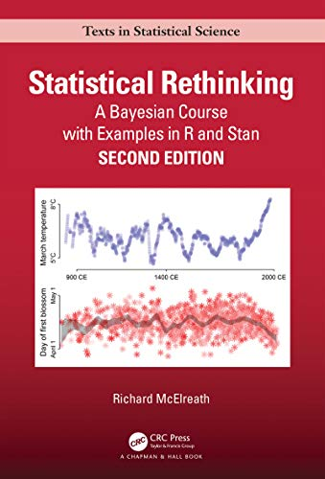
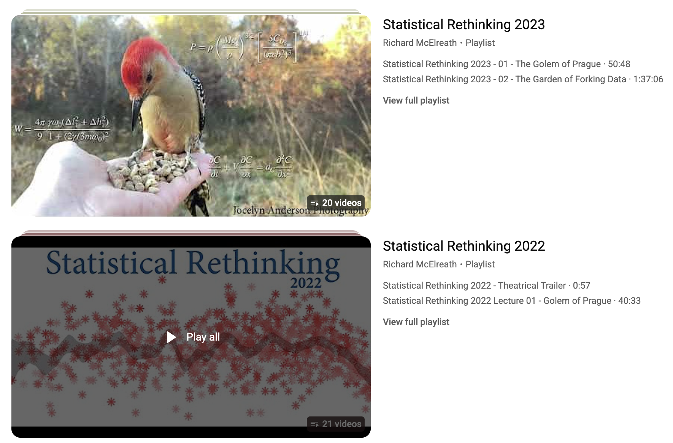
Where to go from here

Slide 3


Where to go from here
If you have strong quantitative skills and want to become a master
Covers a diverse array of topics

Slide 4






This course is just a jumping off point
Train yourself by reading books.
Consider pursuing side project using methods you want to learn
Consider attending weekly math/stats seminars

Slide 6
Unlike with lm() and glm()
this easily extends to nonlinear functional forms
(e.g. Spawner-Recruit Lab)

Slide 7
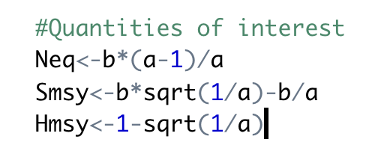
Spawner-Recruit Lab
Another Example with Derived Quantities
Spawner-recruit problem. We want to estimate
equilibrium number of spawners without harvest, Neq
Spawners that maximize sustained yield
The MSY harvest
Beverton-Holt Model
R = (a*S)/(1+a/b*S)
Hmsy
Smsy
Neq
How would you estimate these with uncertainty in frequentist framework?

Slide 8
Wrong→

Slide 10
Priors Lab
Many models have nonlinear transformations such as link functions
We will use a Poisson regression model for ant richness to highlight issues to be aware of

Slide 12
Lizard Occurrence on Islands Labs
Work Through the Lizards Labs
Use the lab page (section B) to guide you through Lizards_Nimble.R.
Use the lab page to guide you through the code
Fit the model in Nimble (lizzard.R is the original JAGS version, for comparison).
The Nimble code for the walkthrough is provided.
Problems 5 and 6 ask you to write your own lizards model.
Visualize and interpret the output

Slide 13
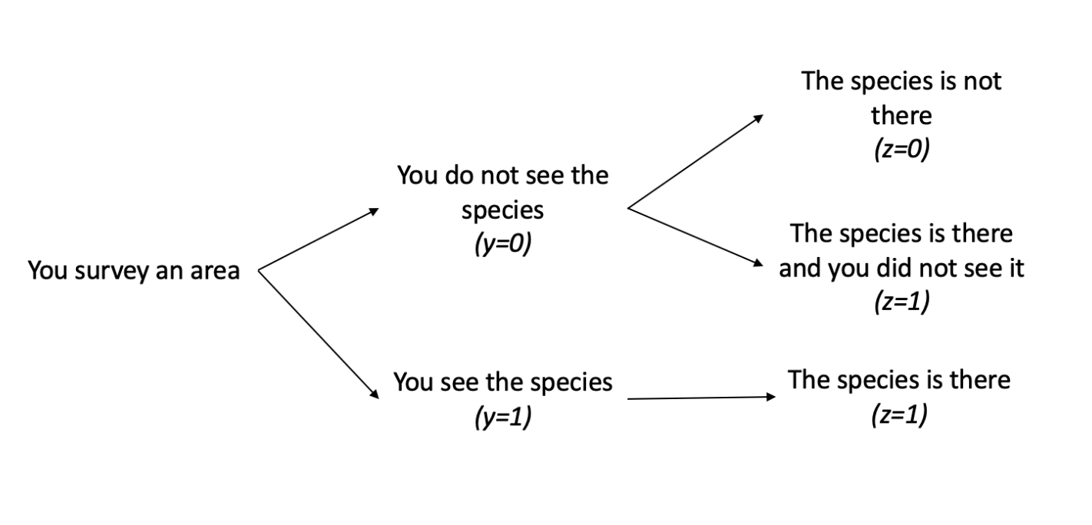
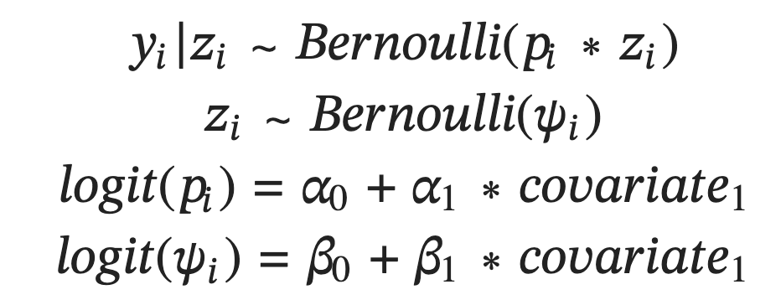
Latent Variable Modeling I - Occupancy
“Latent variable” inferred rather than observed
What should the priors be?

Slide 14
An implied Uniform(0,1) prior for ψ is a Logistic distribution prior for intercept centered at 0 with scale parameter 1
Logistic(μ = 0, σ = 1)

Slide 15
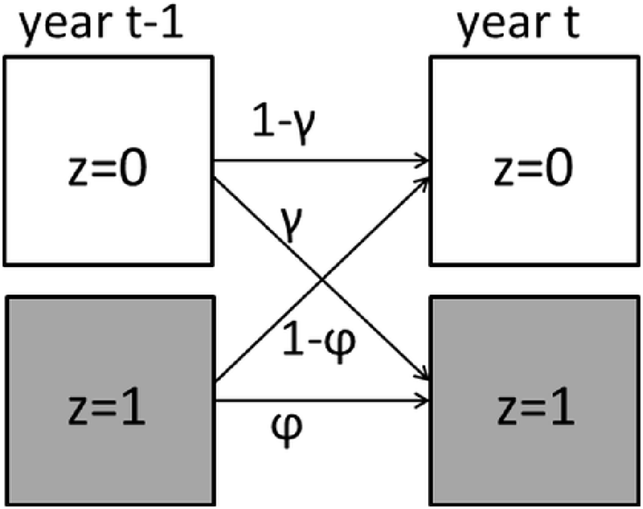
DYNAMIC OCCUPANCY MODELING LAB

Slide 16
Hierarchical Models
From Wikipedia:
Multilevel models (also known as hierarchical linear models, linear mixed-effect model, mixed models, nested data models, random coefficient, random-effects models, random parameter models, or split-plot designs)
Hierarchical models are very natural in a Bayesian framework

Slide 18
#offspring per pair of owls
Model offspring counts with Poisson, but each individual’s rate parameter drawn from a Gamma distribution.
Not just variance in counts, but variance within owl pair and among owl pairs!
Gamma is the conjugate prior and flexible/non-negative. Good choice here
These are called hyperpriors.
What is going on here? Is this possible in glmer()

Slide 19
This model is hierarchical.
Individual fecundity comes from data from that individual and is informed by entire population
Every individual has one of these
But they arise from a common distribution
Gamma is the conjugate prior and flexible/non-negative. Good choice here
These are called hyperpriors.
What is going on here?

Slide 20
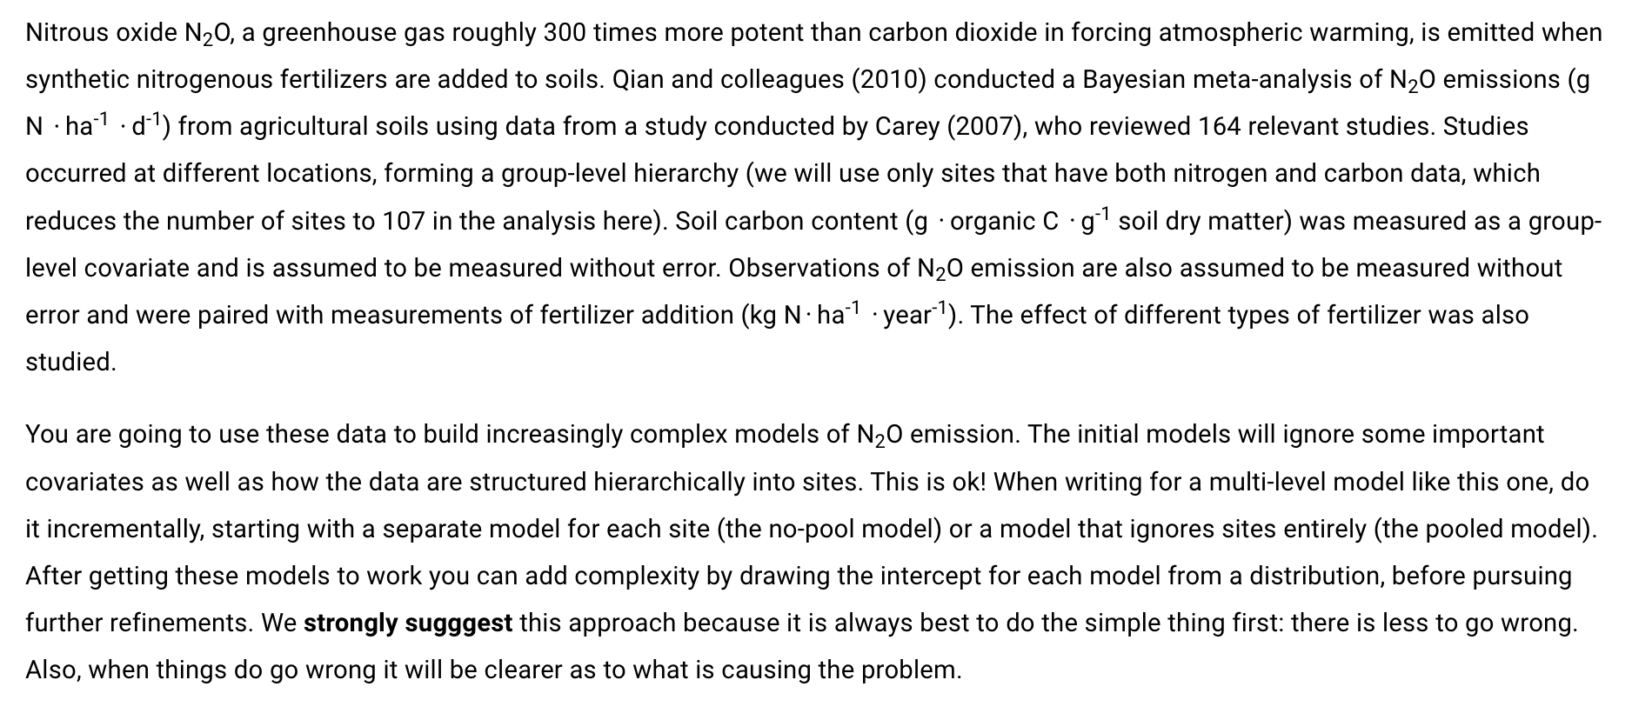
MULTILEVEL MODELING LAB
Multilevel_Nimble.R and lab section C
Sensitivity: changes in parameters of "vague" priors meaningfully changes the posterior when data sets are small or when they have high variance

Slide 21
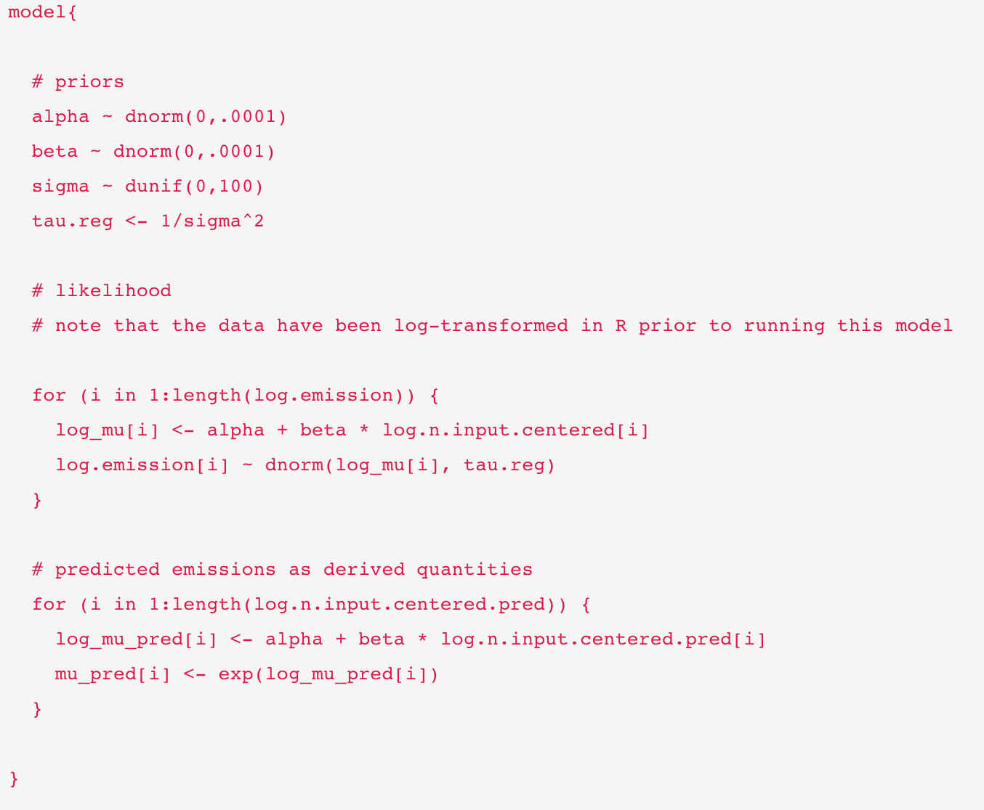
Complete pooling
Only one alpha and beta
Iterate likelihood over the data
Only one alpha and beta

Slide 22
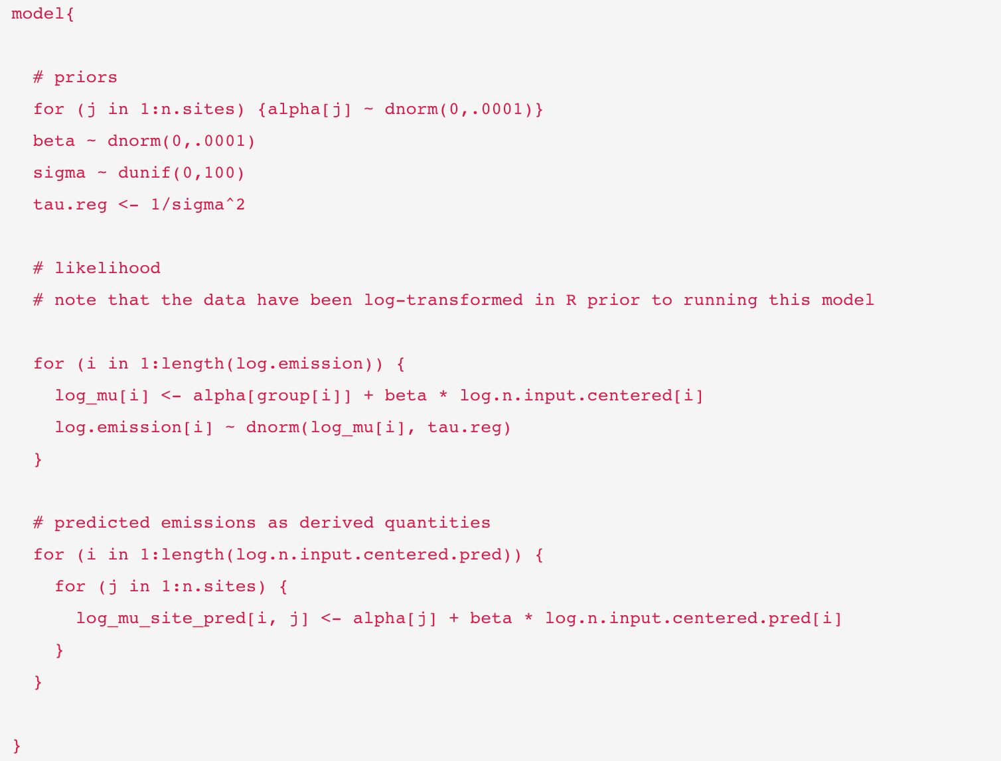
No pooling
Every site gets its own alpha
Every site gets its own alpha
“group” was passed as data

Slide 23
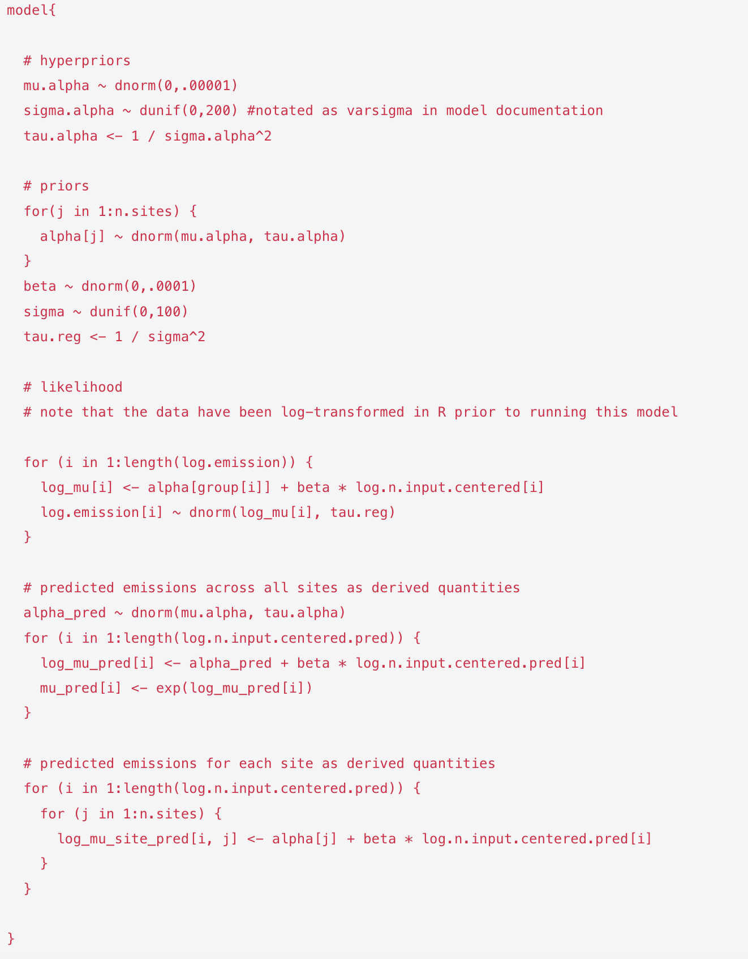
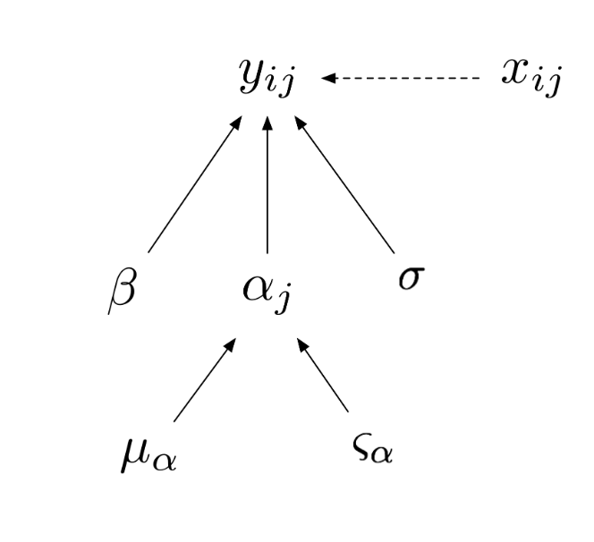
Random intercept
Partial pooling
Alpha varies by site but within shared distribution

Slide 24
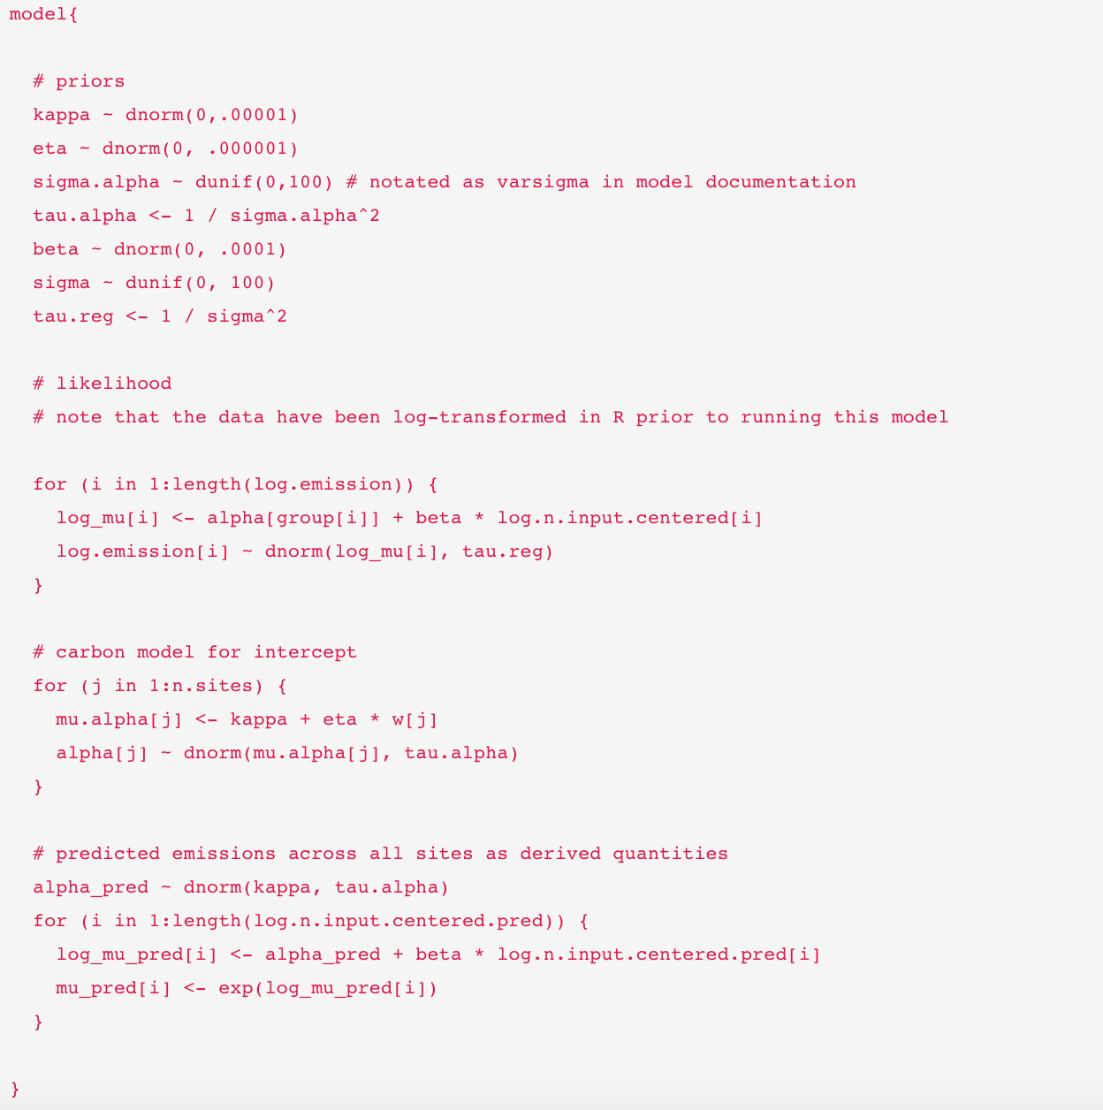
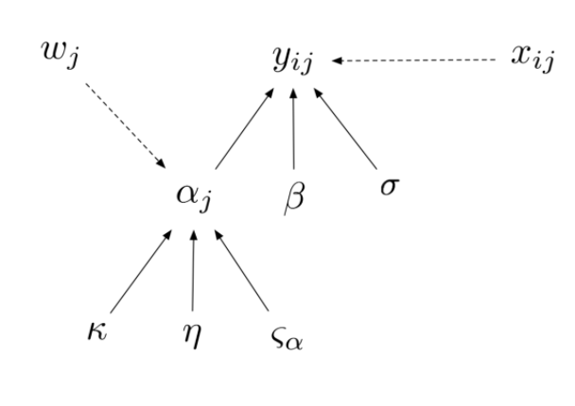
Random intercept
Partial pooling, but also attempt to EXPLAIN site-level differences
In the previous example, we assumed that the variation in the intercept was attributable to spatial variation among sites. We did not try to explain that variation, we simply acknowledged that it exists. Now we are going to “model a parameter” using soil carbon content data at the site-level to explain variation in the intercepts among sites.
Flexibility! Intercepts can depend on soil carbon
Every site gets its own alpha
Alpha varies by site but within shared distribution

Slide 25
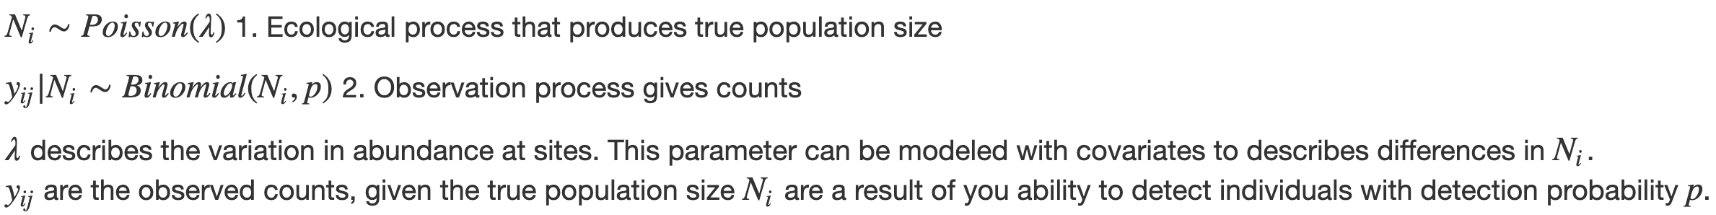
N-mixture Models
Separating Process and Observation Error
Imperfect detection is also a problem when estimating abundance
N-mixture models can account for imperfect detection of individuals within a species
What should the prior distributions be?
How should we link these variables to environmental covariates?

Slide 26
N-MIXTURE MODELING LAB

